Slide 1
Uygulamalı Yapay Zeka Kursu
Ecodation
Staj Raporu
Enes Köroğlu

Slide 2
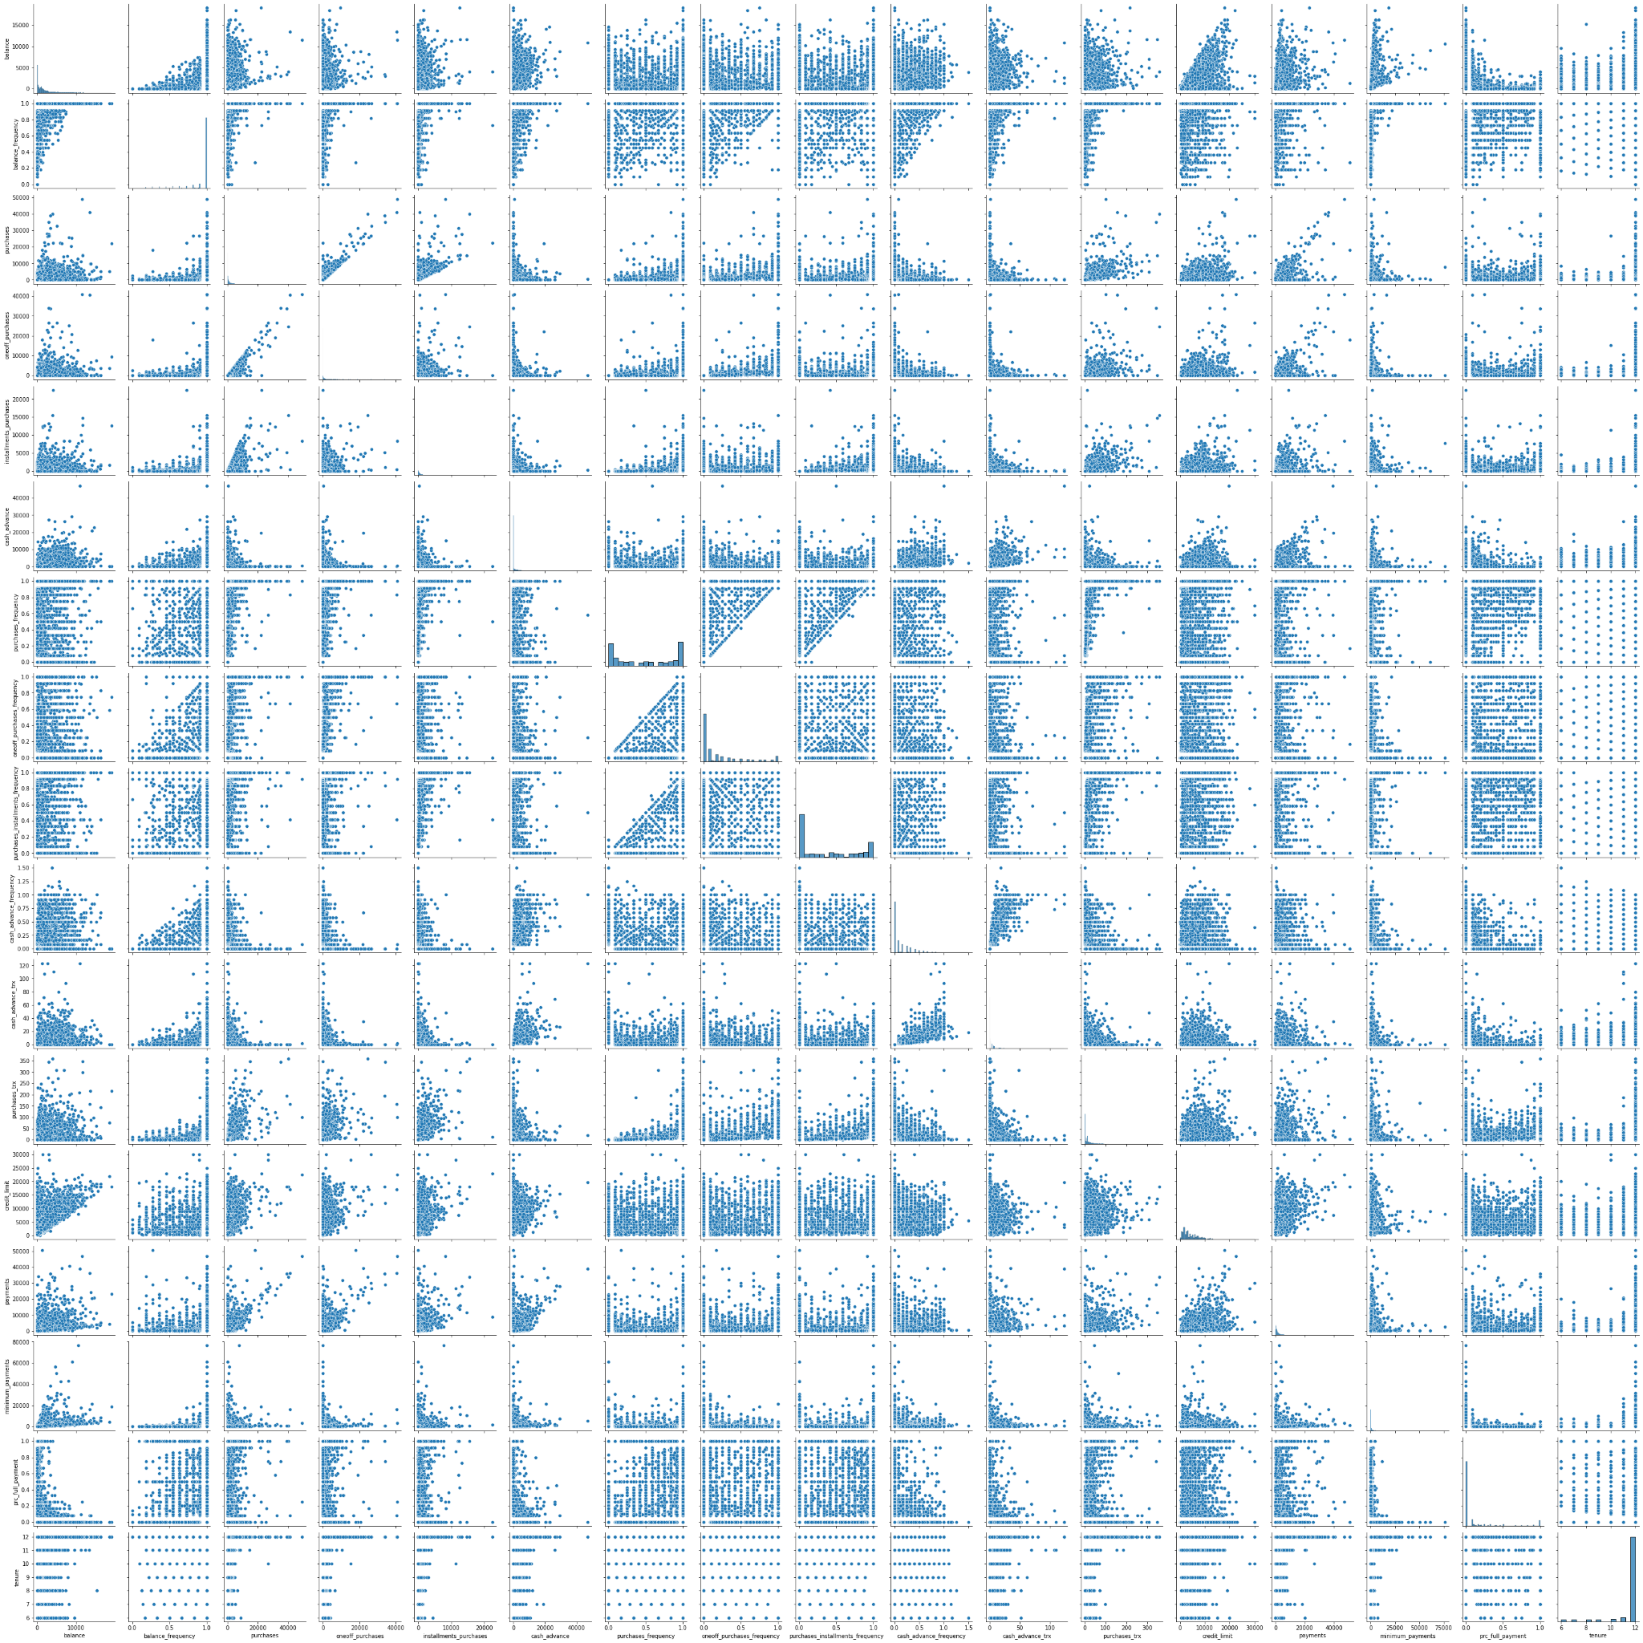

Slide 3
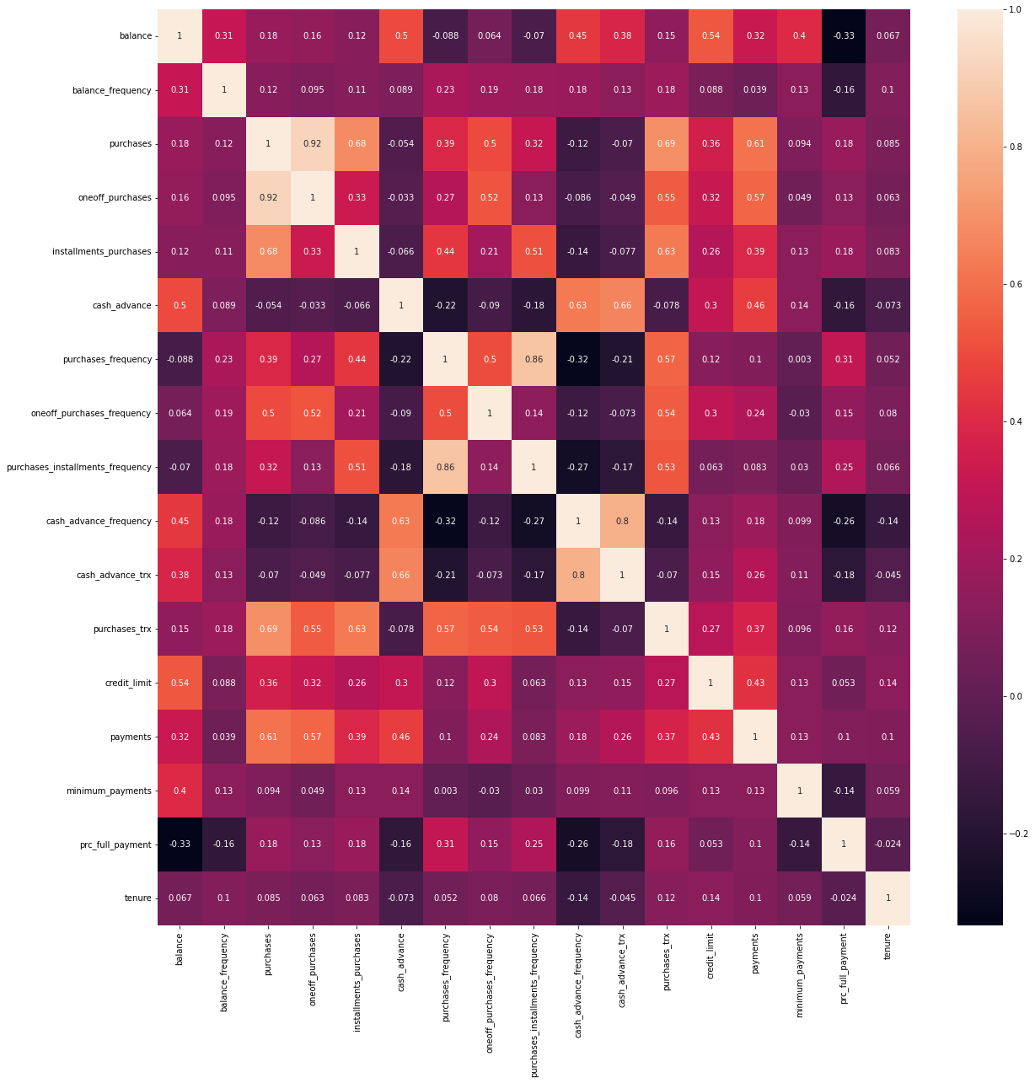

Slide 4
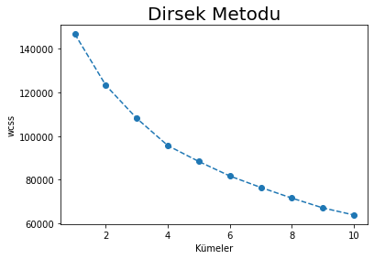

Slide 5
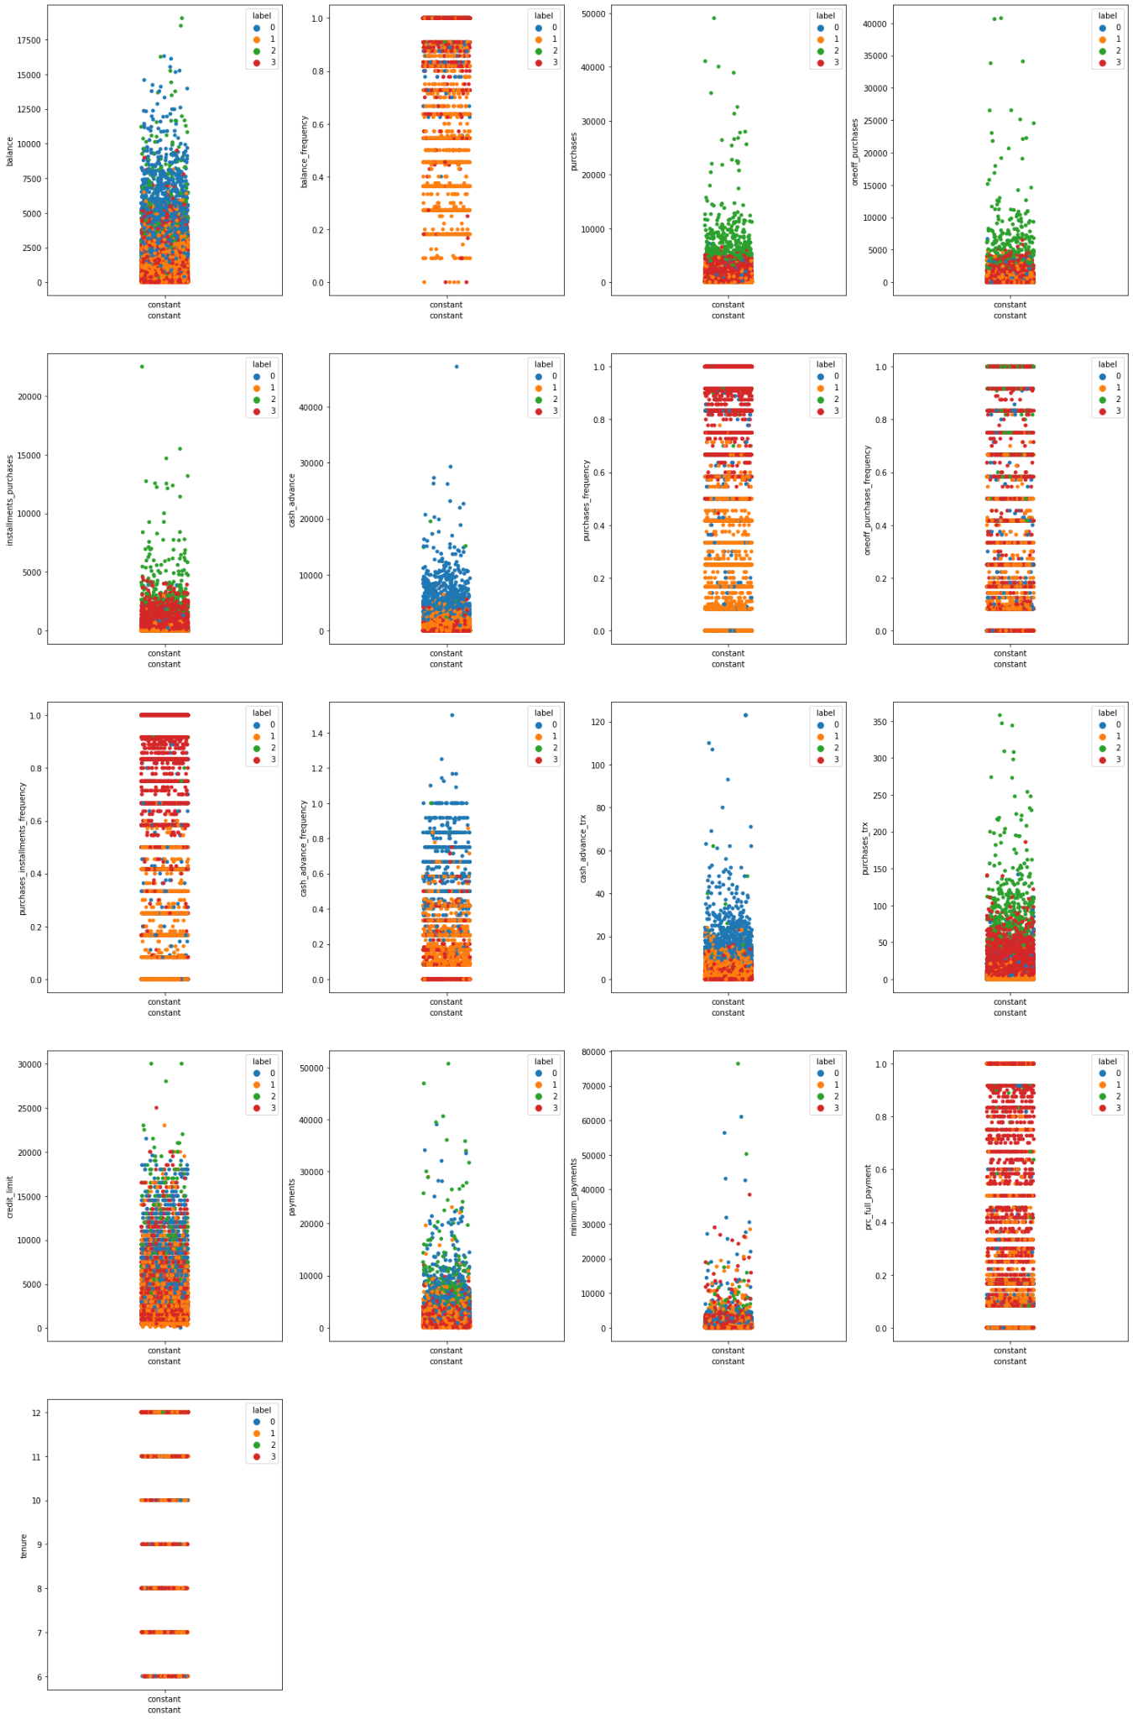

Slide 6
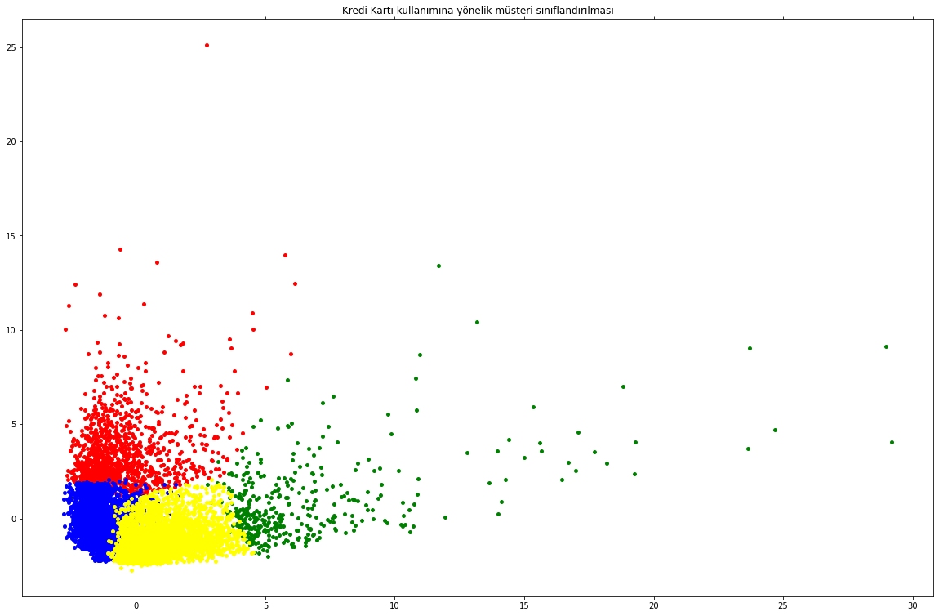

Slide 7
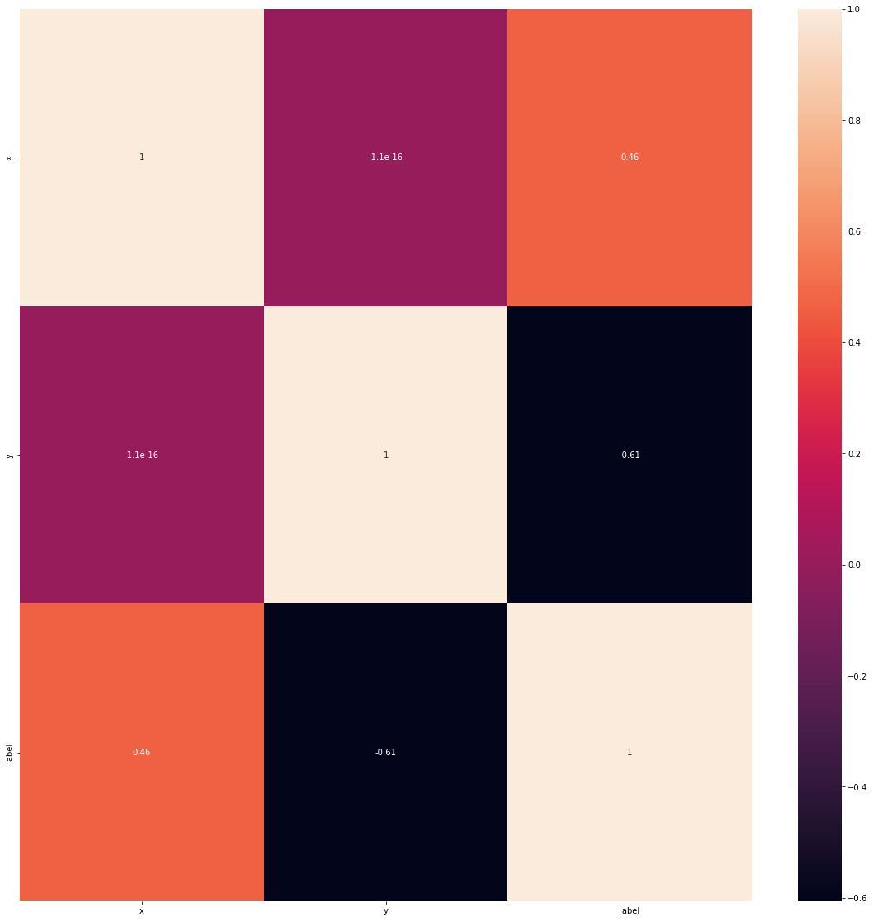

Slide 8
Projenin GitHub linki:
https://github.com/EnsKrgL/ecodation_MLearning

