Slide 1
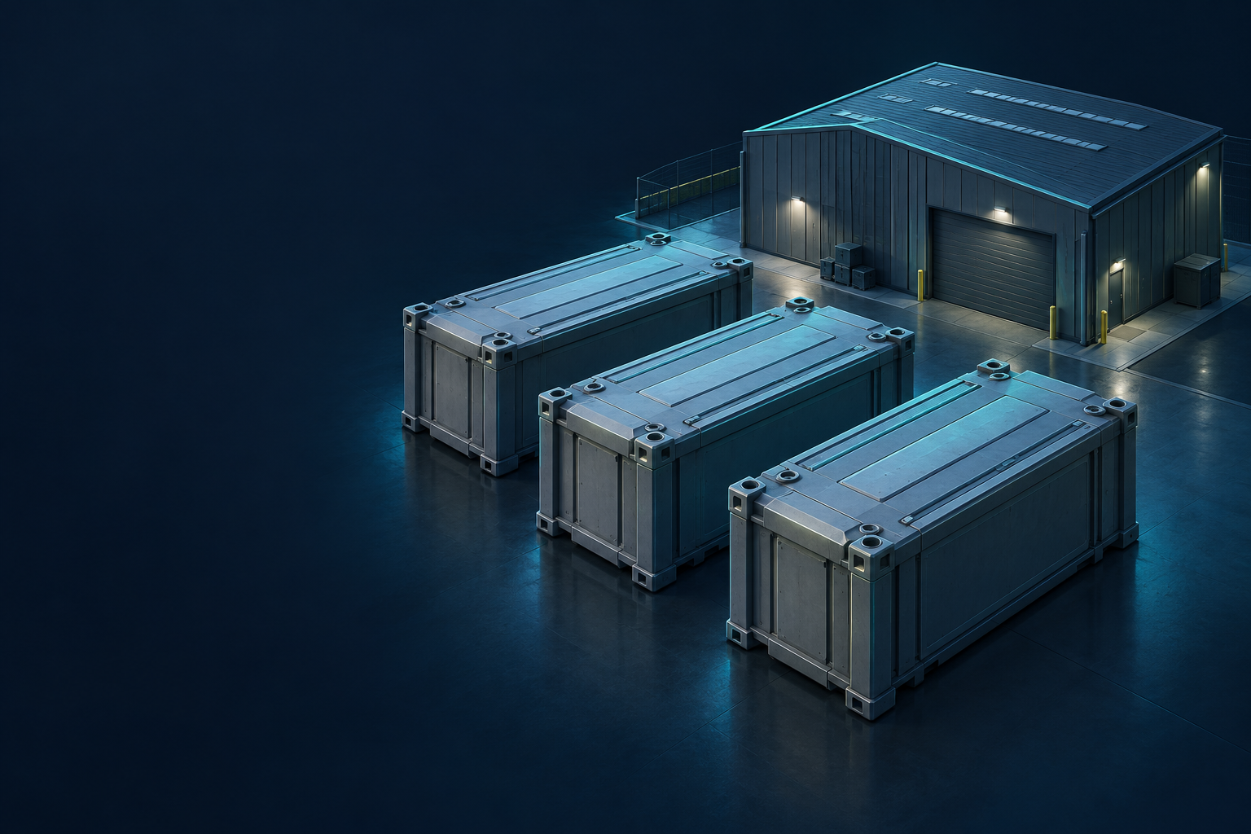
NWTS
Nuclear Waste
Tracking System
Shipment and storage records
for radioactive waste
Product overview
September 2026
Concept illustration
Notes:
NWTS connects shipment information with pre-storage and final-storage workflows. This presentation introduces the current software prototype and a proposed pilot approach. The cover is a conceptual illustration, not a real facility or a container specification.
Illustration: generated with OpenAI ImageGen. Concept art, no real facility. Product basis: NWTS project, 24 September 2026.

Slide 2
Operational information in context
A shipment record becomes more useful when it stays connected to storage work.
Operations
What arrived, what needs receipt, and where is work pending?
Supervision
Which transfers, conditions or stock differences need attention?
Administration
Who can act, which definitions apply, and what changed?
NWTS
02
Notes:
Introduce the operational questions before showing individual features. NWTS brings records from three work areas into one organisation. Employees work in their assigned area, while Supervision and Administrator accounts can review all three. The intended benefit is easier coordination and a clearer view of pending work. No measured time or cost savings are claimed. Ask the audience which of these questions is hardest to answer in their current process.
Project basis: README.md; lib/workspaces.cjs; lib/server/overview.js.

Slide 3
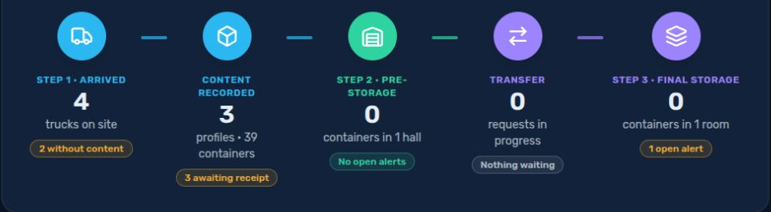
Three connected work areas
01
02
03
Shipments
Pre-storage
Final storage
Arrival and container profiles
Receipt, halls and handover
Transfer requests and receipt
Application screenshots use demonstration data.
Process steps describe the work. User roles define the permitted actions.
NWTS
03
Notes:
Explain the three work areas in order. Step 1 records the truck and its contents. Step 2 receives container quantities into a hall and handles the pre-storage side of transfers. Step 3 requests a transfer and confirms final receipt. A truck departure is a separate event: OUT means that the truck left the unloading zone. It does not prove final disposal. The screenshot illustrates the application’s process overview with demo figures.
Project basis: docs/STEP-WORKSPACES-PLAN.md; lib/workspaces.cjs; lib/shipment-journey.js. Screenshot: local NWTS demo, 24 September 2026.

Slide 4
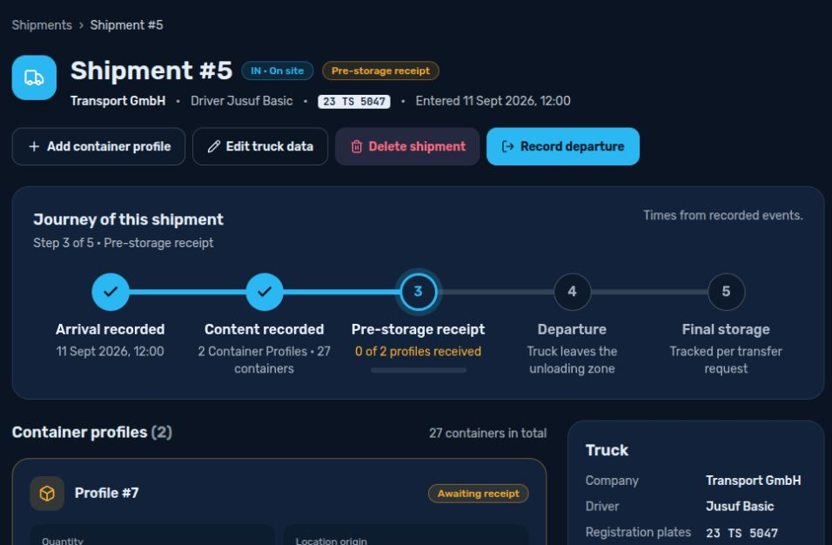
Step 1: Shipment records
Arrival
Company, driver, registration plates and arrival time.
Contents
Quantity, origin, waste profile and container type.
Departure
Recorded departure with controlled corrections.
Example: 15 containers in one profile and 12 in another.
Application screenshots use demonstration data.
NWTS
04
Notes:
Use the sample shipment with 27 containers to make the record tangible. A Shipping employee records arrival and truck information. Supervision or an Administrator prepares the Container Profiles using existing definitions. One profile groups a quantity of containers with shared attributes. It is not an individual serial record for every physical container. After departure, only the Administrator can perform the permitted shipment corrections. Content entry alone does not confirm physical receipt.
Project basis: lib/workspaces.cjs; lib/server/shipment-timeline.js; prisma/schema.prisma. Screenshot: local demonstration shipment #5. Names and specifications are example data.

Slide 5
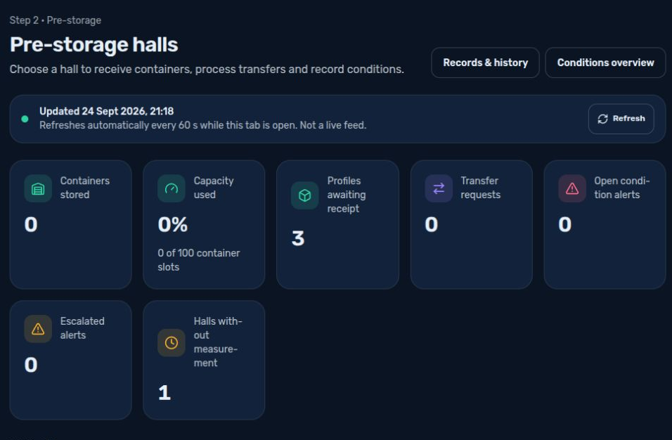
Step 2: Pre-storage
Receipt
Review incoming profiles and record acceptance into a hall.
Storage
See recorded quantities, available space and conditions.
Handover
Process transfer requests using available source quantities.
The assigned employee works in the pre-storage workspace.
Application screenshots use demonstration data.
NWTS
05
Notes:
Show the hall overview and then open a hall. Explain the distinction between recording arrival at the site and accepting containers into storage. Receipt links connect the incoming profile to a hall. Transfer processing uses recorded sources and quantities. Capacity figures use configured floor area and container footprint, so they are planning indicators, not a validated storage layout. Demo counters reflect the current dataset, not the proposed full demonstration scenario.
Project basis: lib/server/storage-balances.js; lib/server/storage-overview.js; prisma/schema.prisma. Screenshot: local NWTS demo.

Slide 6
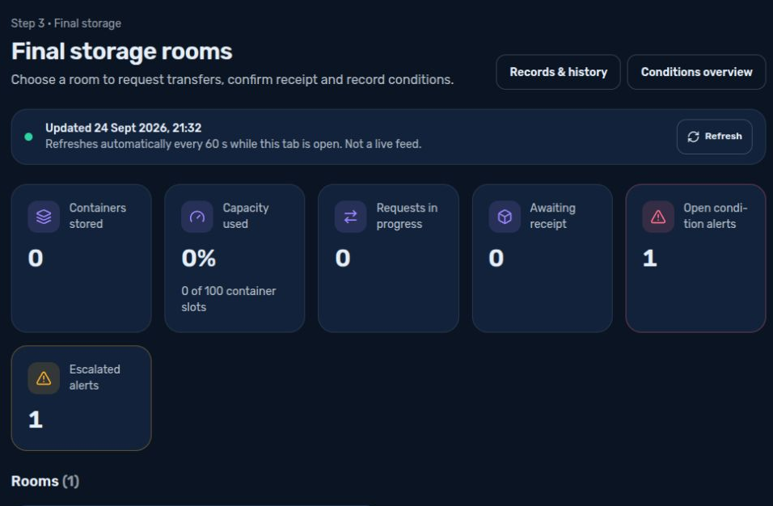
Step 3: Final storage
Request
Select a destination room and request a transfer.
Response
Pre-storage checks the request and prepares the handover.
Receipt
Final storage confirms receipt and updates recorded stock.
The workflow separates the request, handover and receipt.
Application screenshots use demonstration data.
NWTS
06
Notes:
Walk through the direction of the transfer. The final-storage area starts the request, the pre-storage area responds, and final storage confirms receipt. The software checks permitted transitions and recorded quantities. This is the application’s final-storage record workflow. It does not itself certify physical emplacement or compliance with a facility’s acceptance criteria. For a live demonstration, use compatible demo definitions and a small quantity from a linked receipt.
Project basis: lib/workspaces.cjs; app/api/final-storage-setup/final-storage-transver-request/route.js; lib/server/storage-balances.js. Screenshot: local NWTS demo.

Slide 7
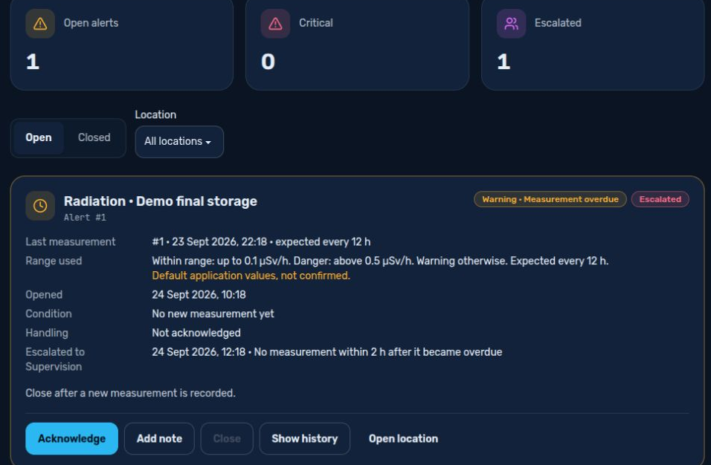
Conditions and follow-up
Measurements
Temperature, radiation, humidity and pressure.
Alerts
Deviations, overdue readings and escalation status.
Actions
Acknowledgement, notes and closure history.
Based on recorded measurements. No live sensor connection.
Application screenshots use demonstration data.
NWTS
07
Notes:
Explain that a user records a measurement and the application compares it with configured ranges. Alerts can track acknowledgement, notes, return to range and closure. Critical alert closure requires a management role and the applicable closure conditions. Rules carry an approval reference. Default demo values do not establish operational limits. Escalation evaluation occurs when the application is used. An always-running background notification service and sensor integration are outside the current implementation.
Project basis: lib/server/monitoring.js; lib/monitoring.js; lib/server/record-measurement.js. Screenshot: local NWTS demo.

Slide 8
Roles and responsibilities
Role | Work area | Main responsibility
Employee | One assigned step | Carry out permitted daily tasks
Supervision | All three steps | Oversee work and create Employee accounts
Administrator | All three steps | Manage accounts, definitions and controlled corrections
Each organisation has its own data. Permissions also depend on the action and record status.
NWTS
08
Notes:
Distinguish role from work area. An Employee belongs to Shipping, Pre-storage or Final storage. Supervision and Administrator accounts can access all three areas, but their editing rights differ. Supervision creates Employee accounts and prepares Container Profiles. The Administrator manages definitions and existing accounts and has additional correction rights. Responsible-employee records attached to a hall or room are operational records and are not automatically the same as login accounts. The appendix contains a more detailed permission summary.
Project basis: lib/workspaces.cjs; lib/server/accounts.cjs; README.md.

Slide 9
Current scope and next development
Available in the prototype
To define with a pilot partner
Three operational workspaces
Tracking each physical container individually
Receipt and transfer records
Sensor and external-system integrations
Recorded measurements and alert handling
Background notifications
Stock verification and correction records
Organisation access and user roles
Site-specific validation and deployment
A pilot should test the agreed workflow with demonstration or approved test data.
NWTS
09
Notes:
Present the software as a functional prototype. The current repository includes stock verification, correction reports, linked receipts, transfer sources and alert events in addition to the older concept document. These records improve visibility, but they do not establish a complete, independently validated audit trail for every historical or physical container. Integrations and site validation require separate scope. Avoid claims of certification, guaranteed safety or production readiness. Agree which gaps matter to the prospective partner.
Project basis: current application routes, prisma/schema.prisma, lib/server/monitoring.js and lib/server/stock-reconciliation.js. Snapshot: 24 September 2026. Pilot items are proposals, not delivery commitments.

Slide 10
A focused pilot
One organisation. One agreed workflow. Clear acceptance criteria.
1
Map the process
Confirm terminology, roles, locations and required records.
2
Run a demonstration
Follow one sample shipment through receipt and transfer.
3
Review the outcome
Check quantities, permissions and exception handling together.
Next step: a working session with an operational owner.
NWTS
10
Notes:
Propose a limited pilot rather than a broad implementation commitment. Ask the partner to nominate an operational owner and describe one representative scenario. Agree success criteria before work begins: whether records can be found, quantities reconcile, the right users can act and exceptions remain visible. Deployment, integrations, pricing and project duration need separate agreement. A technical partner may focus on integration boundaries, while a prospective user may focus on everyday tasks.
Proposed pilot approach. No agreed commercial terms or delivery schedule.

Slide 11
Function overview: operations
Area | Current functions | Result
Shipments | Arrival, search, IN/OUT, departure review | Transport record
Container profiles | Quantity, origin, waste and container definitions | Structured content record
Pre-storage | Incoming queue, receipt and hall records | Recorded location and quantity
Transfers | Request, response, sources and final confirmation | Documented handover
Final storage | Room records, receipts and capacity view | Recorded final-storage stock
History | Shipment events, receipts, transfers and corrections | Review of recorded activity
Appendix / NWTS
11
Notes:
This inventory summarises the current software rather than contractual deliverables. Records may contain multiple containers with shared attributes. Newer receipt and transfer links support source tracking. Older data can lack these links and the application exposes those limitations. The shipment activity view covers selected event types and bounded result lists. It should not be described as a universal immutable audit log. Final acceptance criteria belong in the pilot scope.
Project basis: lib/workspaces.cjs; lib/server/shipment-timeline.js; lib/server/storage-balances.js; prisma/schema.prisma.

Slide 12
Function overview: oversight
Area | Current functions | Important boundary
Conditions | Measurements, rule versions and alerts | User-recorded values
Alert handling | Acknowledge, note, escalate and close | Evaluation during application use
Stock reconciliation | Counts, supported legacy links, correction reports | Corrections require Administrator rights
Overview and statistics | Pending work, capacity and movement summaries | Based on recorded data
Administration | Accounts, roles, areas and shared definitions | Within one organisation
Interface | English/German, dark/light, responsive navigation | Stored record names keep their original text
Appendix / NWTS
12
Notes:
Explain the oversight functions only as far as they relate to the audience. Stock reconciliation compares a recorded count with the system quantity and supports an Administrator correction report. It does not prove the physical count. A supported legacy link records an explicit reconciliation decision, rather than guessing an origin. Statistics describe recorded movements and quantities. Capacity uses configured area and footprint. Interface translation does not translate user-entered names or every historical free-text note.
Project basis: lib/server/monitoring.js; lib/server/stock-reconciliation.js; lib/server/statistics.js; lib/i18n.js.

Slide 13
Permission summary
Action | Employee | Supervision | Administrator
Daily operational tasks | Assigned area | All areas | All areas
Prepare Container Profiles | No | While IN | Yes*
Correct an OUT shipment | No | No | Yes*
Create Employee accounts | No | Yes | Yes
Change accounts / definitions | No | No | Yes
Verify stock / apply correction | No | Verify | Verify + correct
* Subject to the record state and additional checks. This is a summary of current application rules.
Appendix / NWTS
13
Notes:
Use this table to answer detailed access questions after the main presentation. All permissions apply inside the user’s organisation. Access to a work area does not allow every action. Accepted profiles, active transfer states and other record constraints can limit changes. Employees can record measurements in their own area. Critical alert closure is reserved for Supervision or Administrator accounts and still requires the closure checks. The current Employee model assigns one work area, not multiple temporary assignments.
Project basis: lib/workspaces.cjs; lib/server/accounts.cjs; lib/server/monitoring.js; app/api/storage-reconciliation/.

Slide 14
Demonstration: one shipment
Stage | Example action | What the audience sees
Arrival | Record one demonstration truck | A shipment awaiting contents
Contents | Add profiles of 15 and 12 containers | 27 containers in two groups
Receipt | Receive each group into a compatible hall | Stock linked to the receipt
Transfer | Request 5 from the group of 15 | Request and handover status
Confirmation | Confirm receipt of those 5 | 22 in pre-storage, 5 in final storage
Illustrative scenario. Assumes empty starting stock and no other movements.
Appendix / NWTS
14
Notes:
Prepare the demonstration before the meeting. Use dedicated test locations with compatible definitions, sufficient configured capacity and responsible-employee records. Prepare the five demonstration accounts: Administrator, Supervision and one Employee for each step. Create a fresh shipment rather than altering existing examples. Receive all 27 containers, then transfer 5 from the first group. With zero initial stock and no other movements, the final balance is 22 in pre-storage and 5 in final storage. The screenshots show the existing demo dataset and do not assert completion of this scenario.
Illustrative scenario adapted from Nuclear Waste Tracking System - Concept doc.pdf. Arithmetic: 15 + 12 = 27; 27 - 5 = 22. No assertion that the screenshot dataset has completed this sequence.

