Slide 1
Superstore
File created on: 9/18/2019 12:53:41 PM

Slide 2
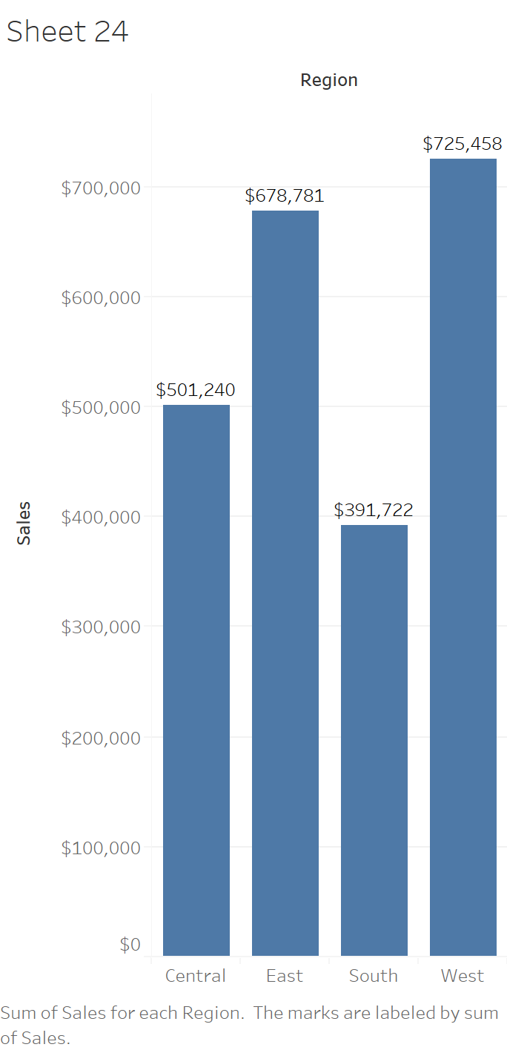

Slide 3
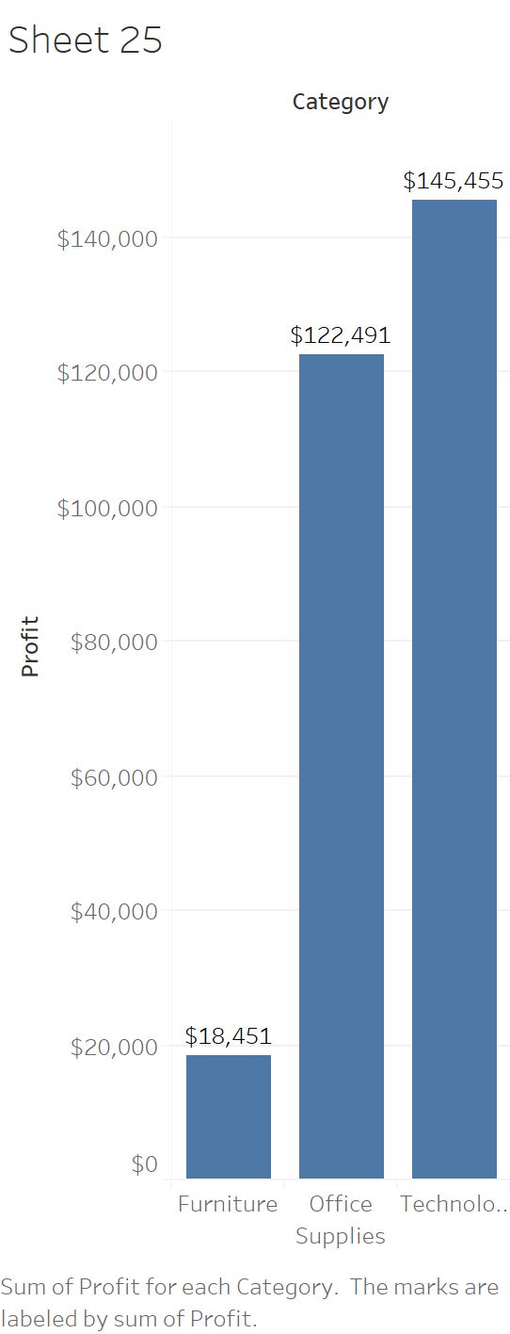

Slide 4
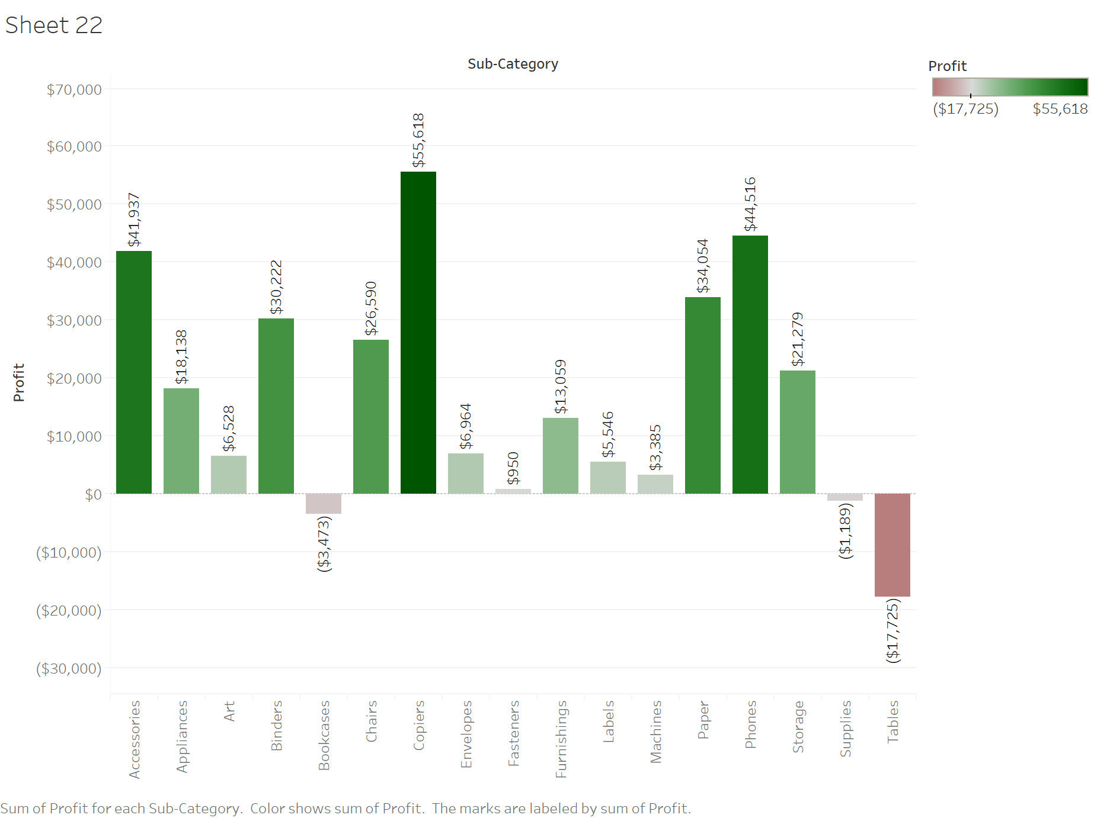

Slide 5
