Slide 1

Ensembl and DAS
Eugene Kulesha
Wellcome Trust Sanger Institute
April 2006
April 2006

Slide 2
DAS and Ensembl
DAS Essentials
Ensembl as DAS server
Adding DAS sources to Ensembl views
DAS configuration in Ensembl
DAS code in Ensembl
Future development

Slide 3
DAS Essentials
Distributed Annotation System (DAS);
  A server system for the sharing of Reference Sequences, and their annotations.
DAS servers:
  Reference server
  Annotation server
DAS requests:
  dns
  entry_points
  dna
  features
Ensembl as DAS server:
http://www.biodas.org/documents/spec.html

Slide 4
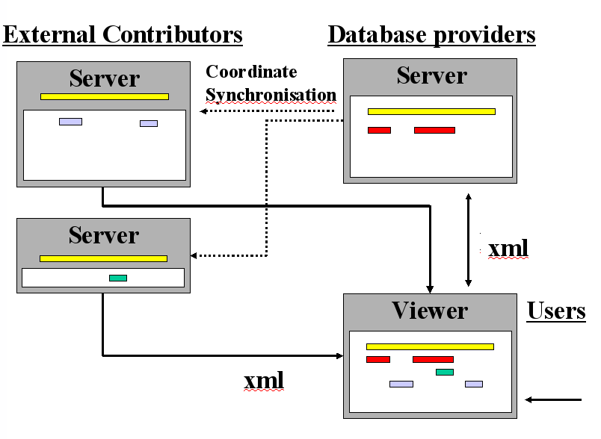
Distributed Annotation System

Slide 5
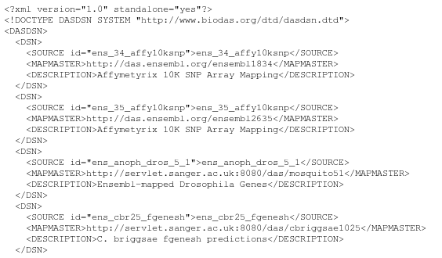
DAS Essentials
`dsn` - Get the list of available sources
http://das.ensembl.org/das/dsn

Slide 6
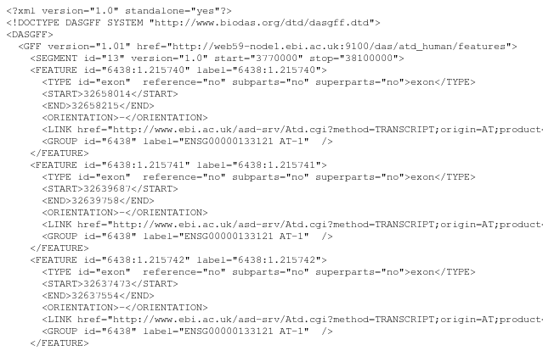
DAS Essentials
`features` - Get the annotations
http://www.ebi.ac.uk/das-srv/asd/das/atd_human/features?segment=13:3770000,38100000

Slide 7
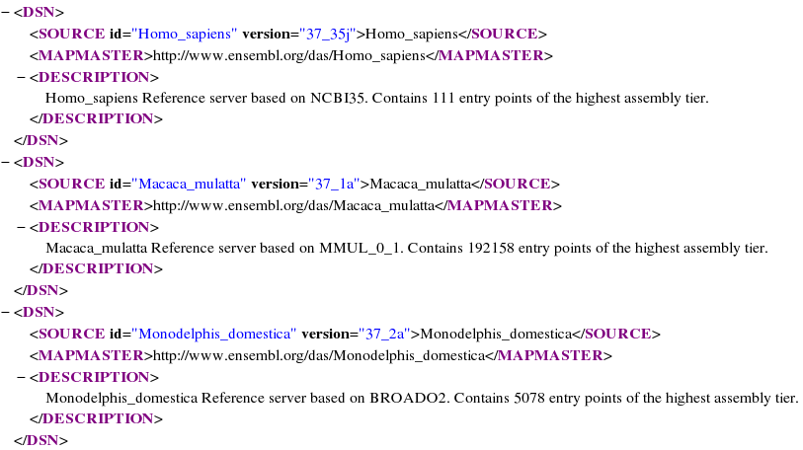
Ensembl as DAS server
list of reference sources
http://www.ensembl.org/das/dsn

Slide 8
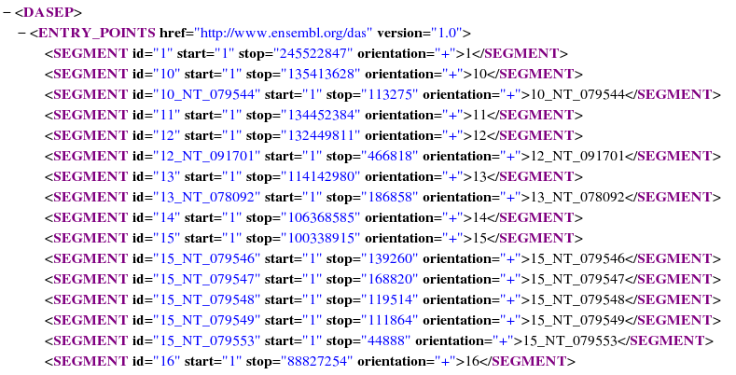
Ensembl as DAS server
list of entry points
http://www.ensembl.org/das/Homo_sapiens.current.reference/entry_points
http://www.ensembl.org/das/Homo_sapiens.NCBI36.reference/entry_points

Slide 9
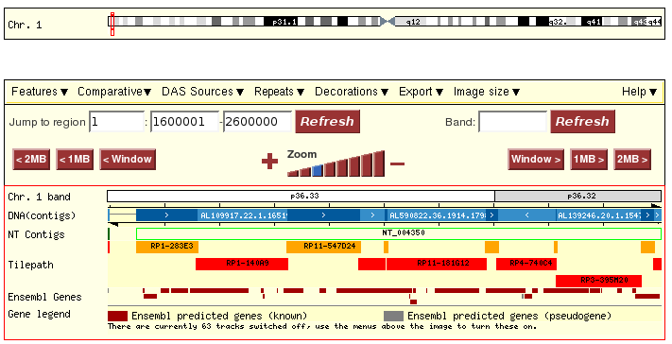
Ensembl as DAS server
Exploring assembly

Slide 10
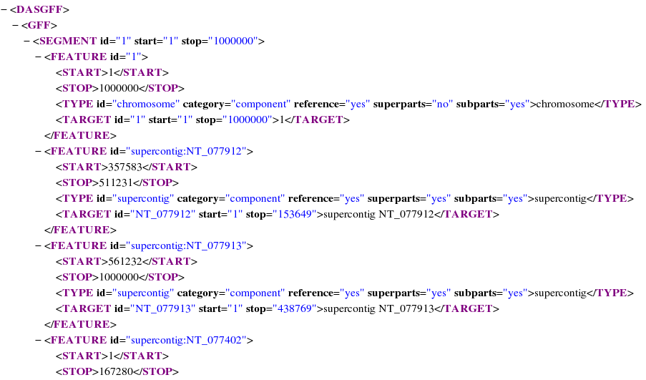
Ensembl as DAS server
Exploring assembly:
http://www.ensembl.org/das/Homo_sapiens.current.reference/features?segment=1:1,1000000

Slide 11
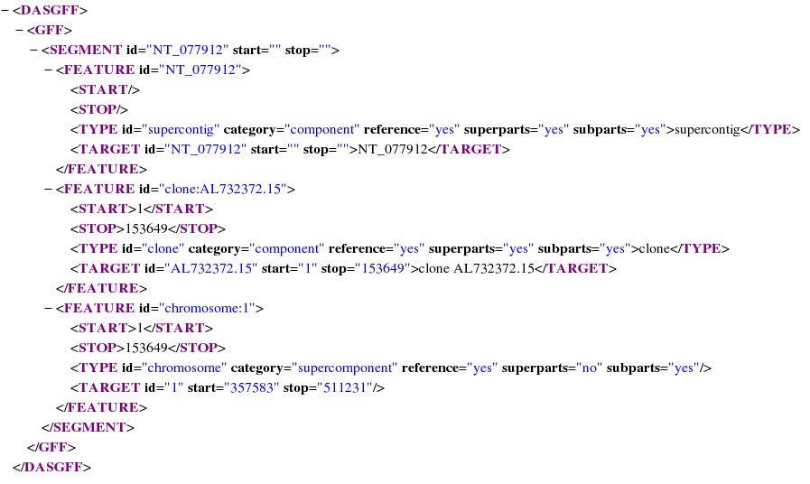
Ensembl as DAS server
Exploring assembly:
http://www.ensembl.org/das/Homo_sapiens.current.reference/features?segment=NT_077912

Slide 12
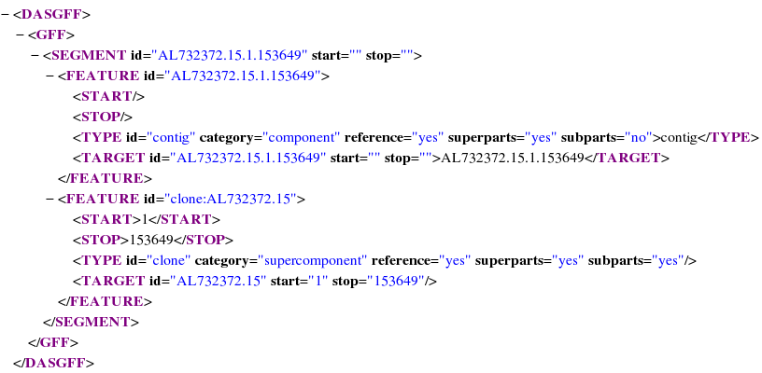
Ensembl as DAS server
Exploring assembly:
http://www.ensembl.org/das/Homo_sapiens.current.reference/features?segment=AL732372.15.1.153649

Slide 13
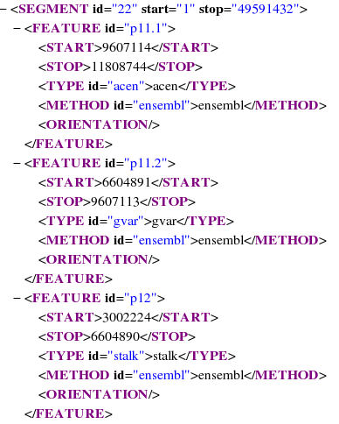
Ensembl as DAS server
Exploring assembly:
http://www.ensembl.org/das/Homo_sapiens.current.karyotype/features?segment=22

Slide 14
Adding DAS source to Ensembl

Slide 15
Adding DAS source to Ensembl
Switch on pre-configured server
Set up your own server
(ProServer, Dazzle, LDAS – see Ensembl docs)
Configure an existing server
Upload your own data
View your data
Send your source to a colleague
Web-based sources (Contigview & Cytoview only)

Slide 16
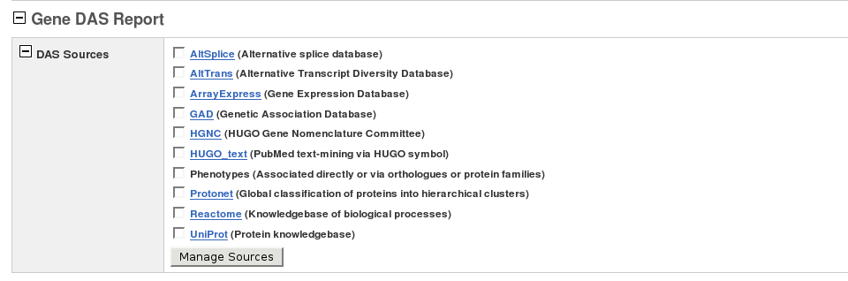
Switch on a pre-configured source in geneview, protview, transview

Slide 17
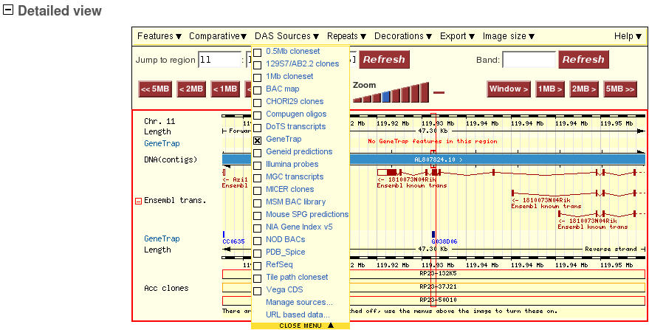
Switch on a pre-configured source in contigview and cytoview

Slide 18
Set up your own DAS source
ProServer
http://www.sanger.ac.uk/Software/analysis/proserver/
Dazzle
http://www.biojava.org/dazzle/
LDAS
http://biodas.org/servers/LDAS.html
and register with DAS Registry !
http://das.sanger.ac.uk/registry

Slide 19
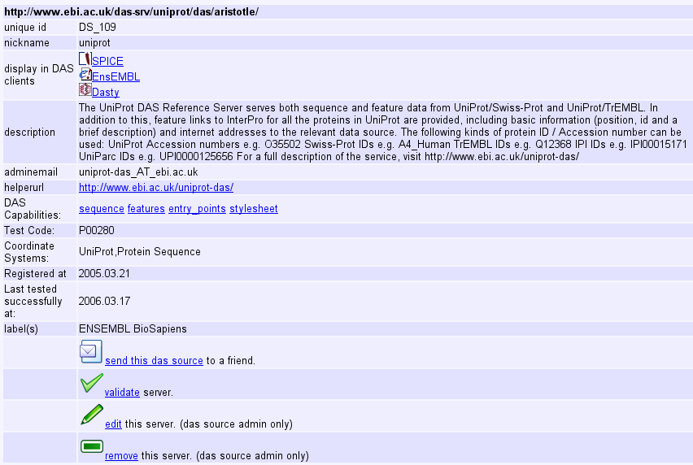
DAS Registry

Slide 20
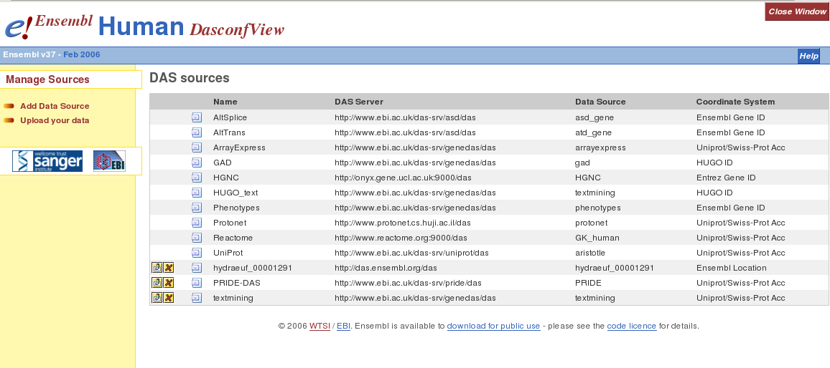
Configure an existing source

Slide 21
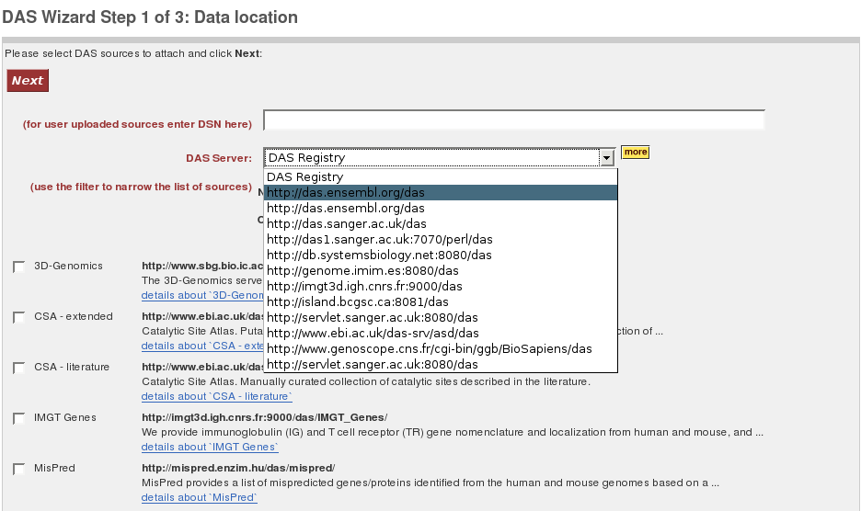
Configure an existing source

Slide 22
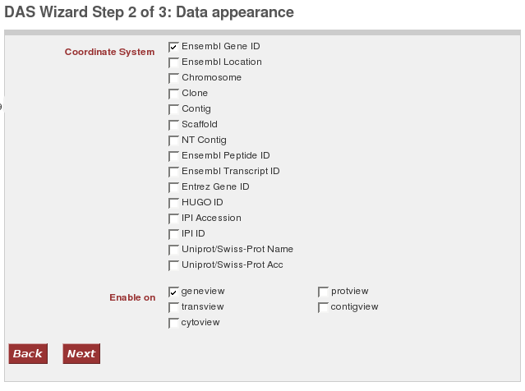
Configure an existing source

Slide 23
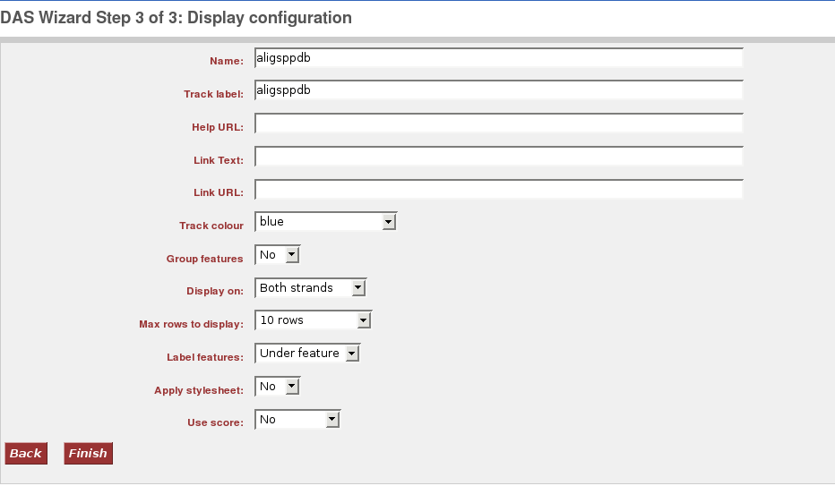
Configure an existing source

Slide 24
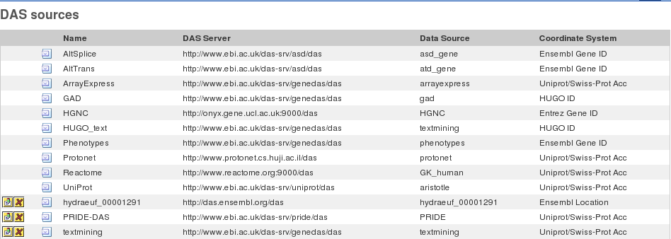
Configure an existing source

Slide 25
Upload your data
File format:
annotation section
http://www.sanger.ac.uk/Software/formats/GFF/
stylesheet section
http://www.ensembl.org/info/data/external_data/das/CSS_support.pdf
Examples: http://www.ensembl.org/info/data/external_data/das/das_upload_v1.euf

Slide 26
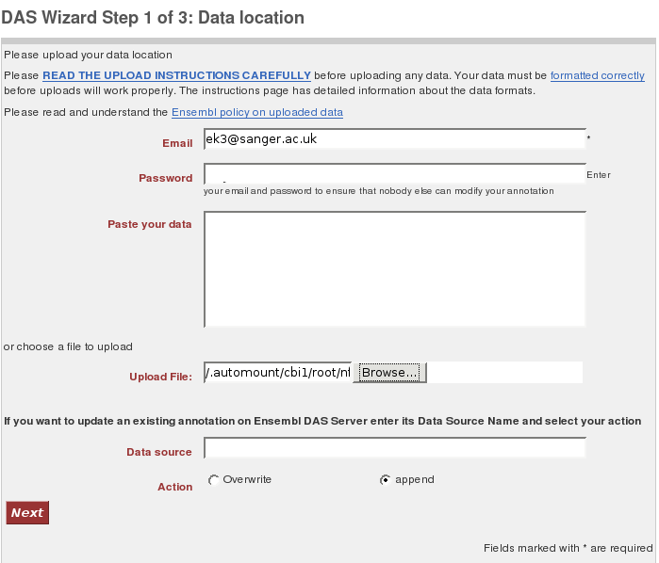
Upload your data

Slide 27
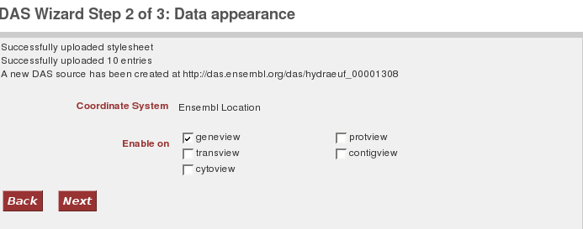
Upload your data

Slide 28
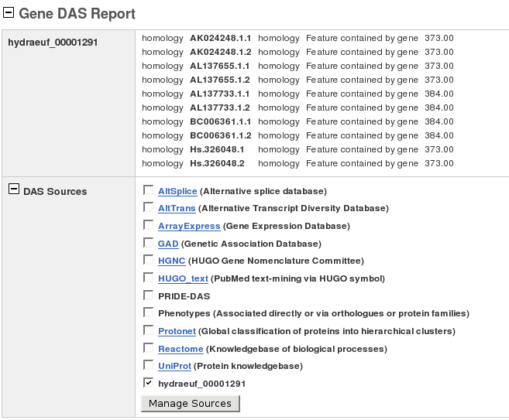
View your data in geneview

Slide 29
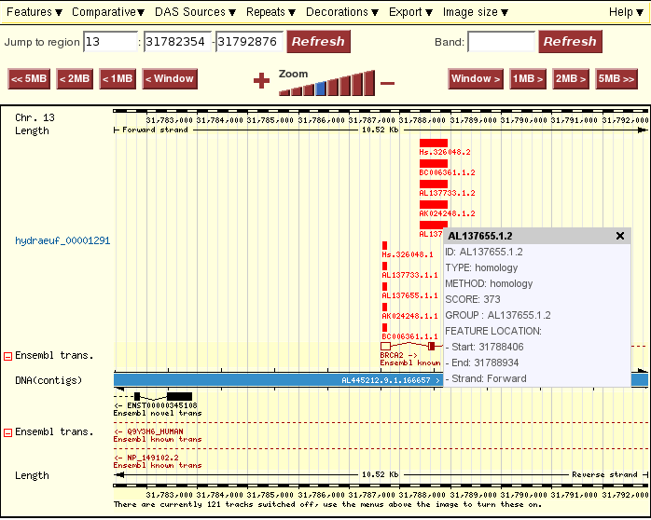
View your data in contigview

Slide 30
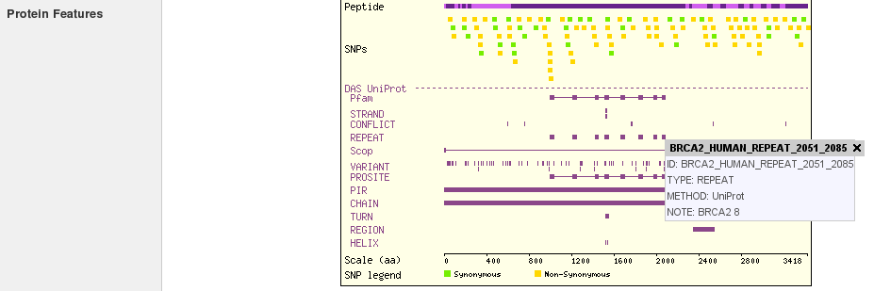
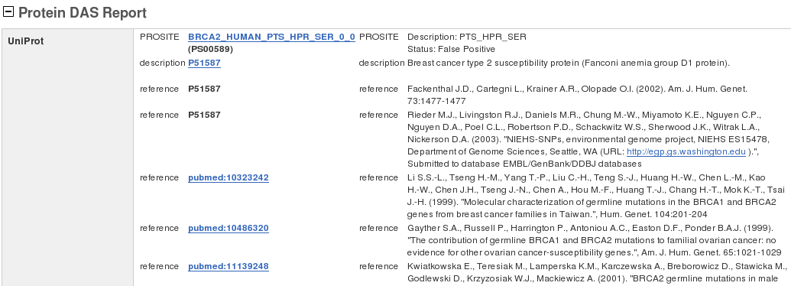
View your data in protview

Slide 31
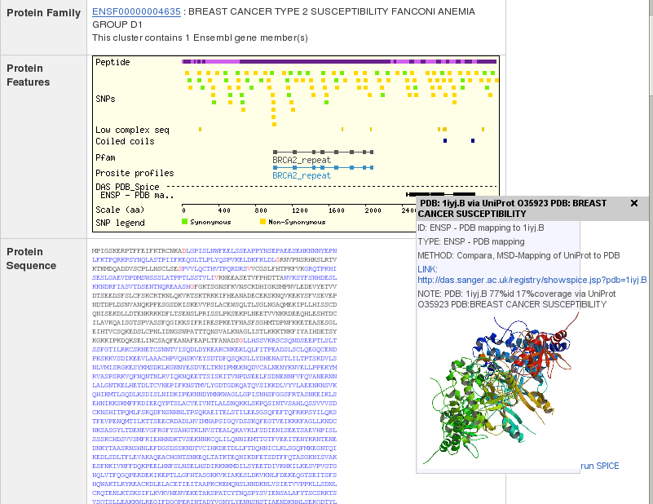
View your data in protview

Slide 32
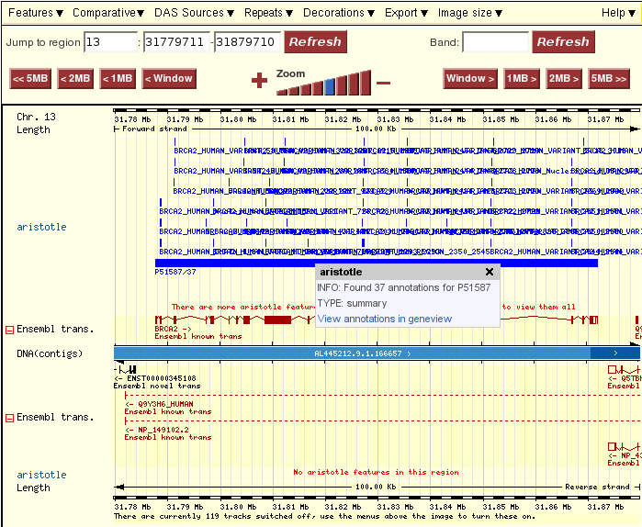
Gene-based annotations in contigview

Slide 33
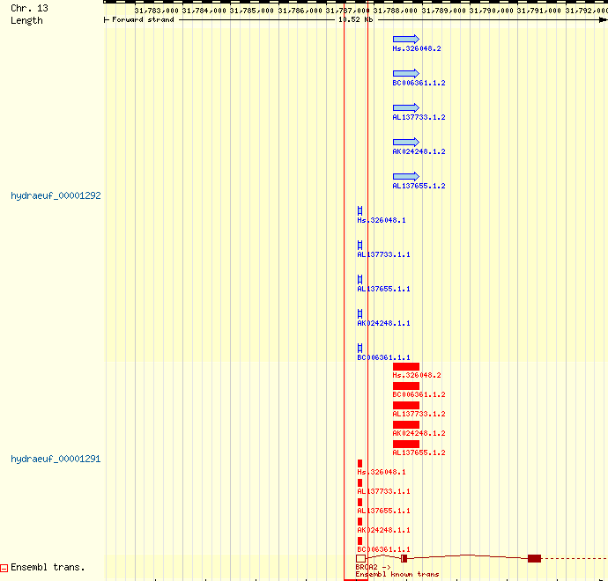
Applying stylesheet
http://www.ensembl.org/info/data/external_data/das/CSS_support.pdf

Slide 34
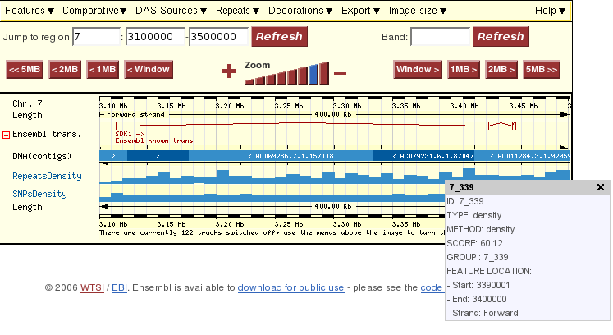
Using score data

Slide 35
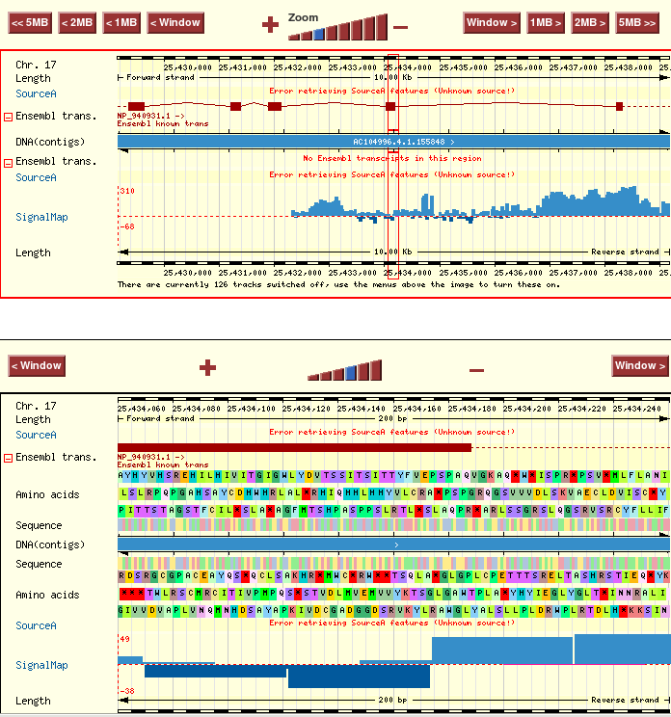
Using score data

Slide 36
Send the source
http://www.ensembl.org/Homo_sapines/contigview?
conf_script=contigview;c=13:31829752.5:1;w=500000;h=;
add_das_source= (name=hydraeuf_00001291+
url=http://das.ensembl.org/das+dsn=hydraeuf_00001291+
type=ensembl_location+color=red+strand=b+labelflag=u+stylesheet=n
+group=n+depth=10+score=n+active=1)

Slide 37
Web-based source
browser position chr19:6900001-7400000
track name=BAC_end_pairs_bed description="BAC end pairs (BED)" useScore=1 color=ffcc66 url=http://www.ensembl.org/human/fastaview?faid=DNA_bacend_1533&id=$$ height=0.1
19 6503520 6641948 CTD-3084A17:AQ144413-AQ186293 1000 - 6503520 6641948 0 2 462,512 0,137917
19 6527567 6695619 RP11-357B22:AZ518790-AQ552859 1000 - 6527567 6695619 0 2 470,525 0,167528
19 6527640 6704480 RP11-134L9:AQ388324-AQ388334 1000 - 6527640 6704480 0 2 307,557 0,176284
http://www.ensembl.org/info/data/external_data/examples/url_bed.txt
http://www.ensembl.org/info/data/external_data/examples/url_pcl.txt
http://www.ensembl.org/info/data/external_data/examples/url_gff.txt

Slide 38
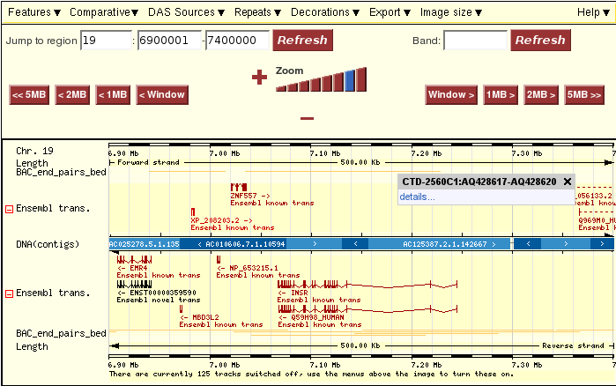
Display of web-based source
http://www.ensembl.org/Homo_sapiens/contigview?data_URL=http://www.ensembl.org/info/data/external_data/examples/url_bed.txt

Slide 39
Exercise I
Create a file for upload :
two features should belong to the group 'Probe A' and
three features should belong to the group 'Probe B'
stylesheet section that renders Probe A features in red and Probe B features in green
Upload the file and view the track in contigview
Attach the same source via auto-attach URL, but with stylesheet switched off and features grouped
File format:
http://www.sanger.ac.uk/Software/formats/GFF/http://www.ensembl.org/info/data/external_data/das/CSS_support.pdf
Examples: http://www.ensembl.org/info/data/external_data/das/das_upload_v1.euf

Slide 40
DAS setup

Slide 41
DAS setup
Resources
DasLite: http://search.cpan.org/~rpettett/Bio-DasLite-0.14
BioDas: http://www.biodas.org/download/Bio::Das
SOAP : http://soaplite.com
Ini-files
DEFAULTS.ini
Preconfigure a source
Data Upload
data journal
ProServer configuration

Slide 42
DAS setup
DEFAULT.ini
;
; Web services (Used for DAS etc)
;
ENSEMBL_WWW_PROXY =
DAS_REGISTRY_URL = http://das.sanger.ac.uk/registry
ENSEMBL_DAS_SERVERS = [das.ensembl.org]
ENSEMBL_DAS_UPLOAD_SERVER = das.mydomain.org
ENSEMBL_DAS_UPLOAD_DB_HOST = das.mydomain.org
ENSEMBL_DAS_UPLOAD_DB_PORT = 3306
ENSEMBL_DAS_UPLOAD_DB_NAME = ens_upload
ENSEMBL_DAS_UPLOAD_DB_USER = root
ENSEMBL_DAS_UPLOAD_DB_PASS =

Slide 43
DAS setup
Preconfigure a source
Homo_sapiens.ini
MULTI.ini
;
; DAS Config
;
[ENSEMBL_INTERNAL_DAS_SOURCES]
SourceA = 1
SourceB = 1
SourceC = 1
[SourceA]
dsn = projectA
url = http://das.ensembl.org/das
on = [ contigview cytoview geneview ]

Slide 44
DAS setup
[SourceA]
dsn = projectA
url = http://das.ensembl.org/das
on = [ contigview cytoview geneview ]
type = ensembl_location
label = Source A probes
caption = Source A probes
col = black
labelflag = U
homepage = http://das.ensembl.org/das/projectA
helplink = http://das.ensembl.org/das/projectA
strand = r
depth = 9999
group = 0
stylesheet = y
score = n
select = [ contigview ]
assembly = NCBIM34
fasta = [ DNA_A_probes ]

Slide 45
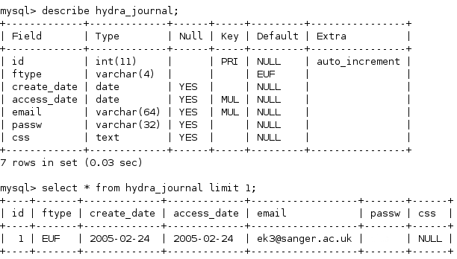
DAS setup
Data upload

Slide 46
DAS setup
Data upload
Configure ProServer (eg/proserver.ini )
[hydraeuf]
state = on
adaptor = upload_euf
hydra = dbi
transport = dbi
basename = euf
dbname = ens_upload
host = das.mydomain.org
port = 3306
username = rw_user
password =

Slide 47
Future development

Slide 48
Future development
User logins
preserving Ensembl DAS configuration
Ensembl as DAS server
serving Ensembl data as DAS sources
DAS for Functional genomics
combining features and real value data
Ensembl Upload Format, version 2
uploading gene and protein based data
`meta` request
configure Ensembl display at the source
Cross-assembly mapping
display sources based on old assemblies on the current Ensembl
DAS2 ?

Slide 49
http://www.ensembl.org/info/data/external_data/das/index.html
http://www.ensembl.org/info/data/external_data/das/DASTalk.ppt
http://www.ensembl.org/info/data/external_data/das/DASTalk.pdf

