Slide 1
Ensembl website refactoring
James Smith
Js5@sanger.ac.uk
Ensembl Web Team Project Leader

Slide 2
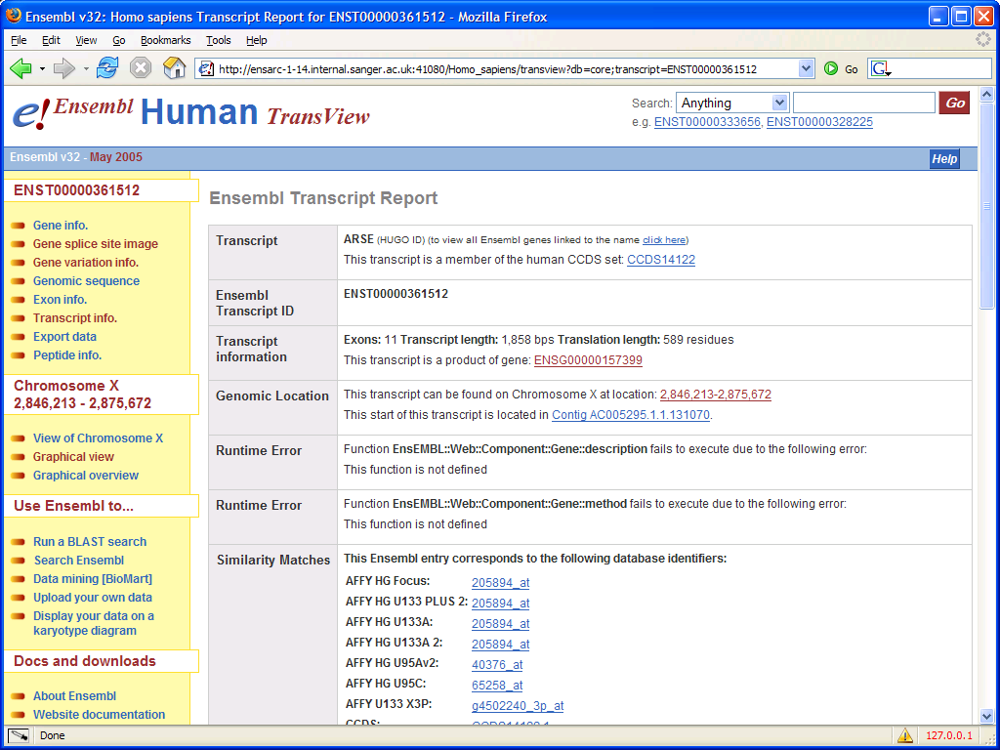
New design
Information about release
Search box on all pages.
Context sensitive links
Dynamic error handling, sending errors to the browser.
How-to style links

Slide 3
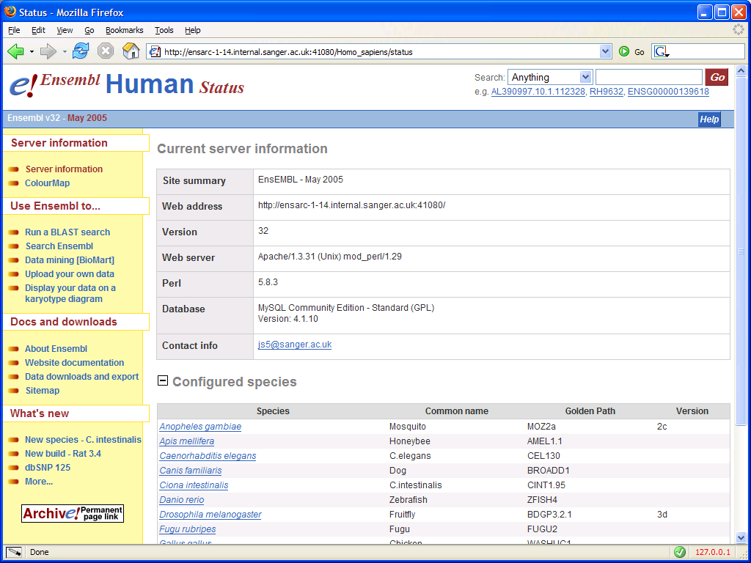
New design
Information style panel
Spreadsheet style panel

Slide 4
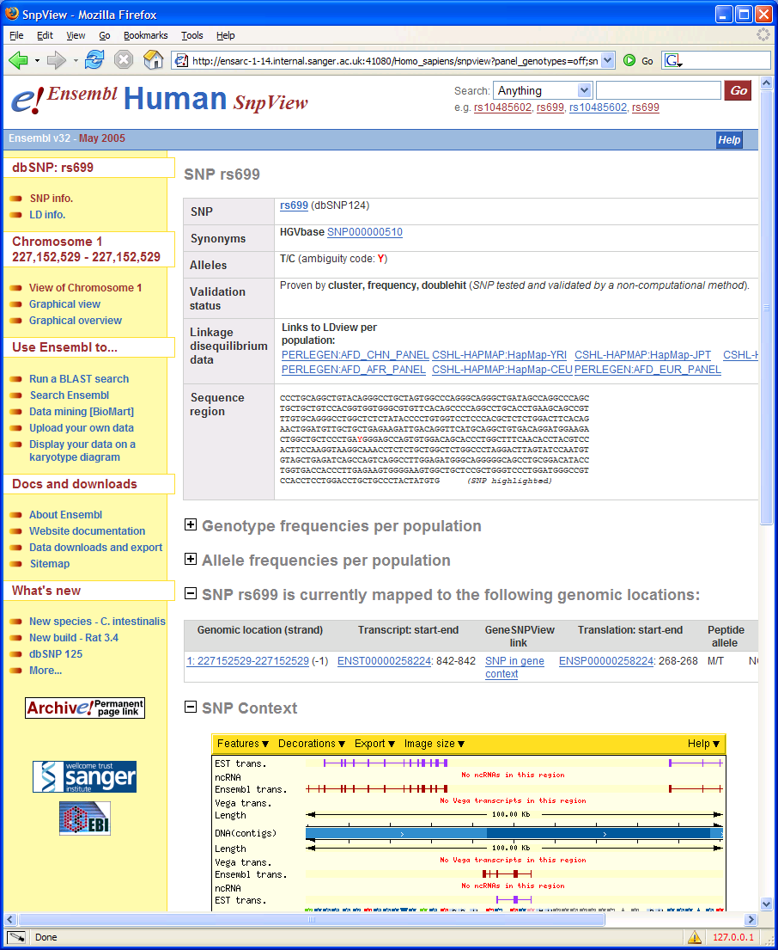
New design
Print previews have been styled so that the output is rendered without a lot of the decoration and navigation of the webpage.

Slide 5
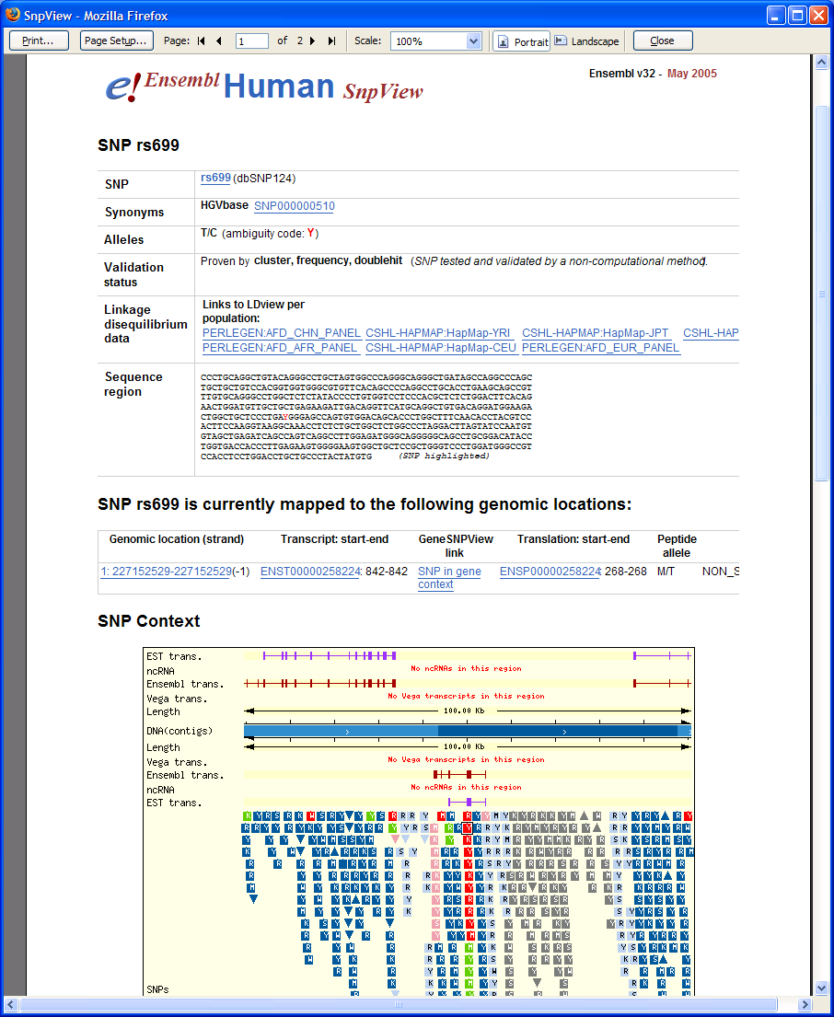
New design
Release information moved to top right
No navigation menu, help link, search.
Collapsed panels
not displayed in
print mode.
+/- boxes and navigation tools hidden

Slide 6
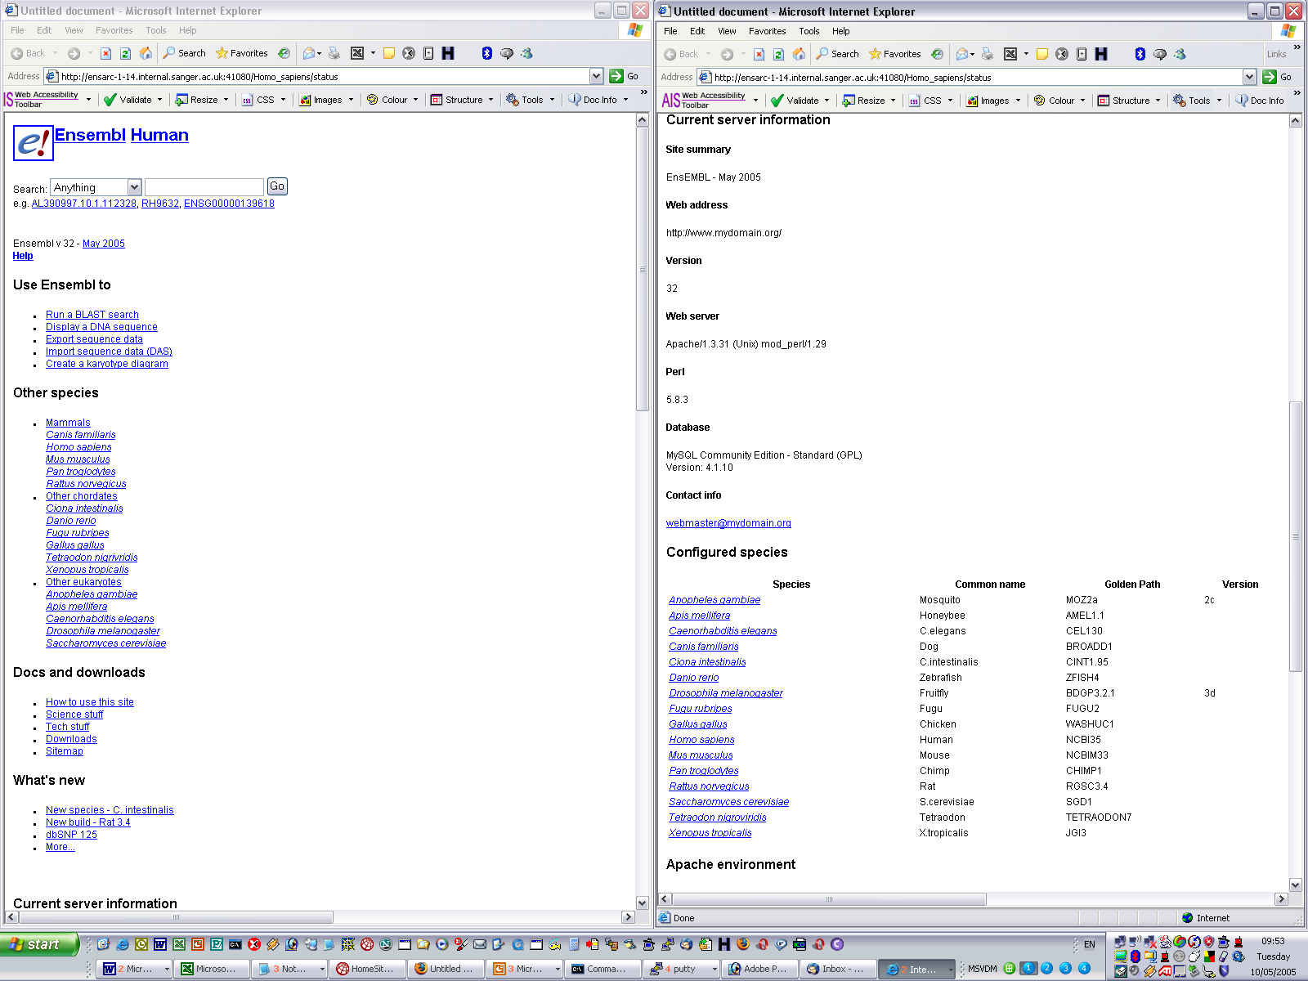
New design – no CSS??
Viewing page with CSS disabled, this is the view a screen reader will see

Slide 7
Plugins
Currently if we wish to have two variants of the website, then we need to have two copies of the whole code – to allow for minor tweaks in a large number of modules. This means:
Whenever the “core” Ensembl webcode is updated, each variant has to work their modifications back into the main branch – risking missing changes and wasting development time.
In the redevelopment we are developing a plugin system, where:
Each “variant” has it’s own set of modules – a Plugin – outside the “core” webcode, which add to, replace or modify the action of the “core” modules.

Slide 8
Plugins – changes requried
Plugins will allow us to:
add additional scripts;
add/modify panels within scripts.
Changes to the code will be extensive (most will need re-writing) but relatively simple:
E::W::Renderer::{ObjectType}::HTML objects split into E::W::Component::{ObjectType} (for rendering) and E::W::Configuration::{ObjectType} (for configuration)
E::W::DataFactory::{ObjectType}Factory modules will be replaced by E::W::Factory::{ObjectType}
E::W::Data::{ObjectType} modules will be replaced by E::W::Object::{ObjectType} modules.

Slide 9
Extending the
Ensembl Website –
Part 1: Writing a new script.
James Smith
Js5@sanger.ac.uk
Ensembl Web Team Project Leader

Slide 10
Writing a new script
To add a new script we need to:
Write a new script in perl/default
And one or more of the following:
new ScriptConfig module;
new Factory module and/or functions;
new Object module and/or functions;
new Configuration module and/or functions;
new Component module and/or functions
We will look at writing a status page

Slide 11
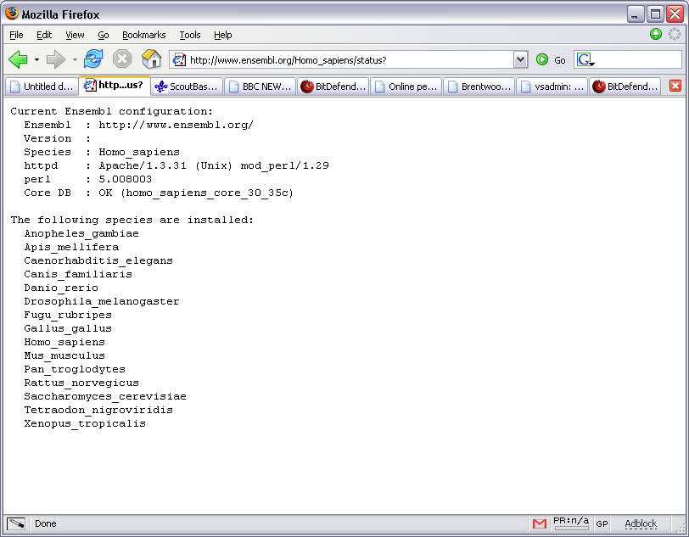
Current status module…
Current status script produces a plain text page:

Slide 12
New status display

Slide 13
The Script
The script needs to:
Handle user input, either directly from the web-page parameters – or through web-page cookies $webpage = new EnsEMBL::Web::Webpage( ... )
Set up any objects required $webpage = new EnsEMBL::Web::Webpage( ... )
Handle errors that are generated $webpage->has_a_problem;
$webpage->render_error_page;
Configure the display $webpage->configure( ... );
Render the display $webpage->render;

Slide 14
Sample webpage script
#!/usr/local/bin/perl
package status;
use strict;
use warnings;
no warnings "uninitialized";
use EnsEMBL::Web::WebPage;
# Initialize the page
# EnsEMBL::Web::WebPage is effectively a webpage factory, which “creates” elements
# the elements of the webpage – including the renderer, factory, objects, etc.
# Parameters
# 'scriptname‘ => [opt] set if want to use alt. scripts input checks
# 'objecttype‘ => [req] type of object to use (B::E::Object::Gene,...
# 'renderer‘ => [opt] defaults to Apache, where to send output
# 'outputtype‘ => [res] in future will may allow rendering in Text, XML, PDF, Excel…
my $webpage= new EnsEMBL::Web::WebPage( 'objecttype' => 'Server‘ );
if( $webpage->has_a_problem ) {
# Handle errors
# Show an error page if there is a problem
$webpage->render_error_page;
} else {
# Configure the page
# Now configure the page, we need to pass configure an object so that it can get information
# and modules from it, the usual approach here is just to loop over all objects (usually only 1!)
# Parameters to configure are a E::W::ProxyObject and a list of function calls to make on
# E::W::Configuration::objecttype
$webpage->configure( $_, qw(status context_menu) ) foreach @{$webpage->dataObjects};
# Finally render the page
$webpage->render();
}

Slide 15
New status display
Configured by
“context_menu”
Configured by “status”

Slide 16
Configuring the display
To configure the display we have to add elements to the webpage:
The main “content” of the webpage is made up one or more panels, which we have to configure at this stage.
The left-hand navigation menu is made up of one or more input blocks.
The configuration functions can create or extend these panels or blocks.
To add a panel… $self->{page}->content->add_panel( ... );
To add a section to a panel… $self->{page}->content->panel( ... )->add_component_first(); etc
To add a menu block… $self->{page}->menu->add_block( ... );
To add a menu entry… $self->{page}->menu->add_entry( ... );

Slide 17
Sample Configuration module
use EnsEMBL::Web::WebPage;
my $webpage= new EnsEMBL::Web::WebPage(
'objecttype' => 'Server‘
);
foreach @{$webpage->dataObjects} {
$webpage->configure( $_, qw(status context_menu) );
}
$webpage->render();
package EnsEMBL::Web::Configuration::Server;
use strict;
use EnsEMBL::Web::Configuration;
our @ISA = qw( EnsEMBL::Web::Configuration );
sub status {
my $self = shift;
my $content = $self->{page}->content;
# First panel, “two-column style” displaying the server information.
if( my $panel1 = $self->new_panel( "Information",
'code' => "info", ## Name this one “info”
'caption' => 'Current server information', ## This is it’s caption
'object' => $self->{object} ## Finally pass it the “Web::Object” object.
) ) {
$panel1->add_components(qw(
name EnsEMBL::Web::Component::Server::name
url EnsEMBL::Web::Component::Server::url
version EnsEMBL::Web::Component::Server::version
webserver EnsEMBL::Web::Component::Server::webserver
perl EnsEMBL::Web::Component::Server::perl
database EnsEMBL::Web::Component::Server::database
contact EnsEMBL::Web::Component::Server::contact
));
$content->add_panel( $panel1 );
}
# Second panel, “spreadsheet table style” displaying the configured species.
if( my $panel2 = $self->new_panel( "SpreadSheet“,
'code' => 'species', ## Name this one “species”
'caption' => 'Configured species', ## And set it’s caption
'object' => $self->{object}, ## Pass it the “Web::Object”
'status' => 'Species‘ ## Make this panel “collapsable”
) ) {
$panel2->add_components( qw(species EnsEMBL::Web::Component::Server::spreadsheet_Species));
$content->add_panel( $panel2 );
}
}
1;
This function creates the two panels used to generate the right hand side of the status, one based on the “two-column” format, and one based on a “spreadsheet” layout.

Slide 18
Sample Configuration module
use EnsEMBL::Web::WebPage;
my $webpage= new EnsEMBL::Web::WebPage(
'objecttype' => 'Server‘
);
foreach @{$webpage->dataObjects} {
$webpage->configure( $_, qw(status context_menu) );
}
$webpage->render();
package EnsEMBL::Web::Configuration::Server;
......
sub context_menu {
my $self = shift;
$self->add_block( 'server', 'bulleted', 'Server information' );
$self->add_entry( ‘server',
'text' => 'Server information',
'href' => "/$ENV{'ENSEMBL_SPECIES'}/status“
);
my $colourmap_URL = "/$ENV{'ENSEMBL_SPECIES'}/colourmap";
my @colourmap_OPT = (
[ 'Sorted by Red, Green' => “$colourmap_URL?sort=rgb” ],
[ 'Sorted by Red, Blue' => “$colourmap_URL?sort=rbg” ],
[ 'Sorted by Green, Red' => “$colourmap_URL?sort=grb” ],
[ 'Sorted by Green, Blue' => “$colourmap_URL?sort=gbr” ],
[ 'Sorted by Blue, Red' => “$colourmap_URL?sort=brg” ],
[ 'Sorted by Blue, Green' => “$colourmap_URL?sort=bgr” ],
[ 'Sorted by Hue, Saturation' => “$colourmap_URL?hls=hsl” ],
[ 'Sorted by Hue, Luminosity' => “$colourmap_URL?hls=hls“ ],
[ 'Sorted by Luminosity, Hue' => “$colourmap_URL?hls=lhs” ],
[ 'Sorted by Luminosity, Saturation' => “$colourmap_URL?hls=lsh” ],
[ 'Sorted by Saturation, Hue' => “$colourmap_URL?hls=shl” ],
[ 'Sorted by Saturation, Luminosity' => “$colourmap_URL?hls=slh” ],
);
$self->add_entry( 'server',
'text' => 'ColourMap',
'href' => $colourmap_URL,
‘options' => [map {{ 'href' => $_->[1], 'text' => $_->[0] }} @colourmap_OPT ]
);
}
1;
This function creates a “left-hand-side” navigation menu block, and adds entries for the status page, and also the colour-map script.
This menu is shared with the colour map script.

Slide 19
Handling persistent user info
There are two types of user configuration stored on the server based on a users cookie. You will already be familiar with the EnsEMBL::Web::UserConfig::… objects for configuring the images on the pages – these will be kept.
We are now adding a second type, EnsEMBL::Web::ScriptConfig::, these hold script specific information. You create a EnsEMBL::Web::ScriptConfig object which is configured by the package EnsEMBL::Web::ScriptConfig::{scriptname}, and/or “plugin” packages.
This package contains a single function “init” which acts on the E::W::SC object when it is created and sets the default values for the ScriptConfig object.
The storage of the cookie is “transparent” to the script – it is embedded in the “new” call for the EnsEMBL::Web::WebPage object, so you don’t have to worry about calling it.

Slide 20
Sample ScriptConfig module
use EnsEMBL::Web::WebPage;
my $webpage= new EnsEMBL::Web::WebPage(
'objecttype' => 'Server‘
);
foreach @{$webpage->dataObjects} {
$webpage->configure( $_, qw(status context_menu) );
}
$webpage->render();
package EnsEMBL::Web::ScriptConfig::status;
use strict;
sub init {
my ($script_config) = @_;
$script_config->_set_defaults(qw(
panel_species on
));
}
1;
ScriptConfig’s are not “objects” they contain just a single function “init” which is called with the ScriptConfig object passed to it as the first parameter, and act upon this ScriptConfig object.
The modules name is based on the name of the script which is being configured.
In this case we are configuring the “species” panel to be collapsible.

Slide 21
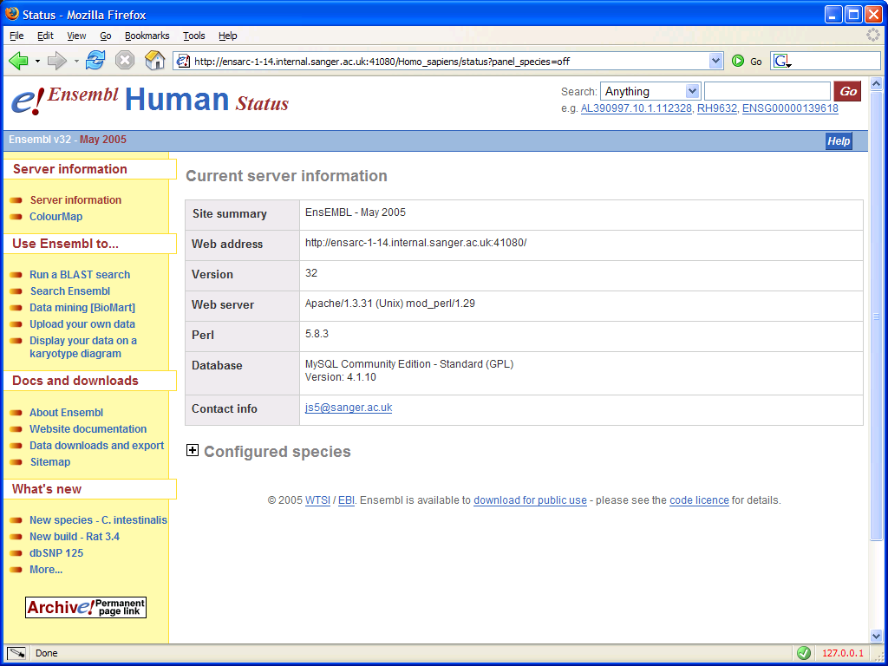
Status display with collapsed panel
Collapsed status stored in the
EnsEMBL::Web::ScriptConfig
in the “flag” – “panel_species”

Slide 22
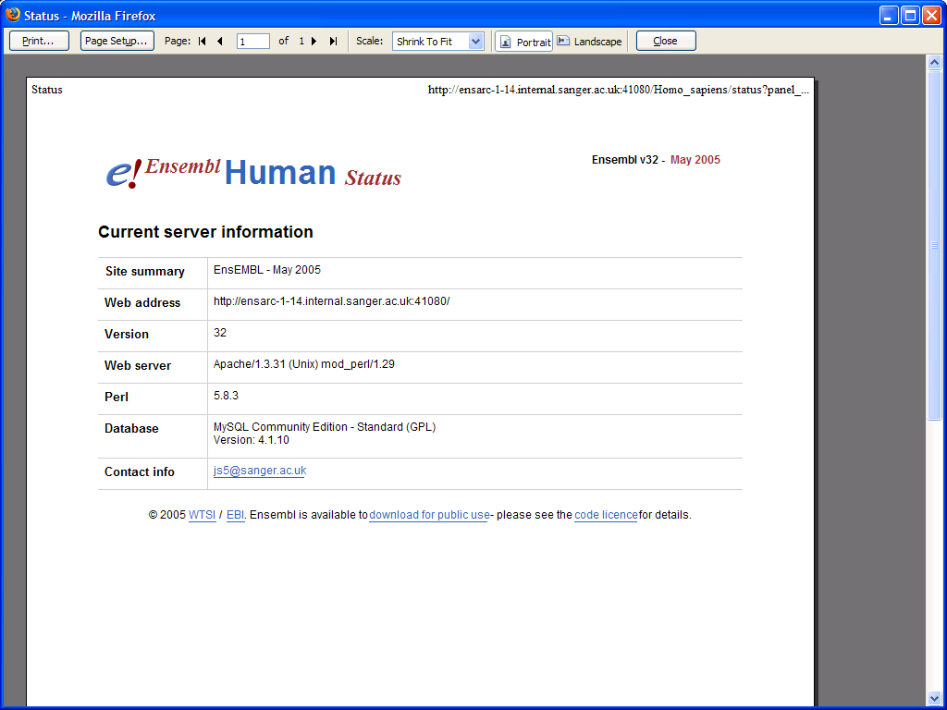
Printing collapsed panels (or not!)
Changed printer layout.
release stripe, search box,
menus all hidden when printing
output;
release information moved to
new location.
Collapsed portion isn’t displayed at all in the printer preview version.

Slide 23
Sample Component module
$panel1->add_rows(qw(
name EnsEMBL::Web::Component::Server::name
url EnsEMBL::Web::Component::Server::url
version EnsEMBL::Web::Component::Server::version
webserver EnsEMBL::Web::Component::Server::webserver
perl EnsEMBL::Web::Component::Server::perl
database EnsEMBL::Web::Component::Server::database
contact EnsEMBL::Web::Component::Server::contact
));
package EnsEMBL::Web::Component::Server;
use strict;
sub name {
my( $panel, $object ) = @_;
(my $DATE = $object->species_defs->ARCHIVE_VERSION ) =~ s/(\d+)/ \1/;
$panel->add_row( 'Site summary',
qq(<p>@{[$object->species_defs->ENSEMBL_SITETYPE]} - $DATE</p>)
);
1;
}
sub url {
my($panel, $object) = @_;
$panel->add_row( 'Web address',
qq(<p>@{[ $object->full_URL( 'species' => '' ) ]}</p>)
);
return 1;
}
sub version {
my($panel, $object) = @_;
$panel->add_row( 'Version',
qq(<p>@{[$object->species_defs->ENSEMBL_VERSION]}</p>)
);
return 1;
}
sub webserver {
my($panel, $object) = @_;
$panel->add_row(
'Web server', qq(<p>$ENV{'SERVER_SOFTWARE'}</p>)
);
return 1;
}

Slide 24
Sample Component module
$panel2->add_component( qw(
EnsEMBL::Web::Component::Server::spreadsheet_Species
));
package EnsEMBL::Web::Component::Server;
use strict;
sub spreadsheet_Species {
my( $panel, $object ) = @_;
$panel->add_columns(
{ 'key' => 'species',
'align' => 'left',
'title' => 'Species',
'format' => sub { return sprintf( qq(<a href="%s"><i>%s</i></a>), $_[1]{'link'}, $_[0] ) } },
{ 'key' => 'common',
'align' => 'left',
'title' => 'Common name' },
{ 'key' => 'gp',
'align' => 'left',
'title' => 'Golden Path' },
{ 'key' => 'version',
'align' => 'left',
'title' => 'Version' }
);
foreach( $object->get_all_species ) {
$panel->add_row( $_ );
}
return 1;
}

Slide 25
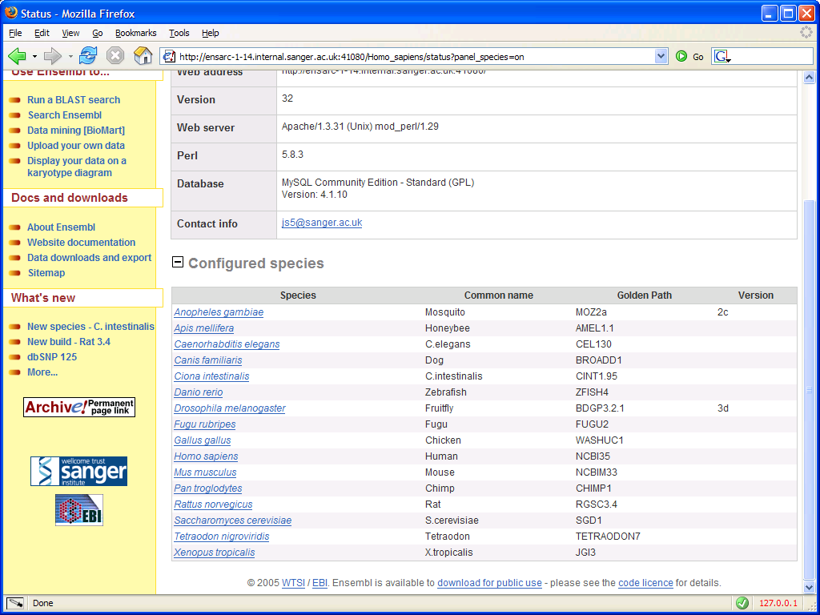
New status display
Columns defined by add_columns call in spreadsheet_Species()
Links generated using the
code reference defined
in the add_columns call

Slide 26
Sample Object module
package EnsEMBL::Web::Component::Server;
sub spreadsheet_Species {
my( $panel, $object ) = @_;
$panel->add_columns( ... );
foreach( $object->get_all_species ) {
$panel->add_row( $_ );
}
return 1;
}
package EnsEMBL::Web::Object::Server;
use strict;
use warnings;
no warnings "uninitialized";
use EnsEMBL::Web::Object;
our @ISA = qw(EnsEMBL::Web::Object);
sub get_all_species {
my $self = shift;
@species = @{ $self->species_defs->ENSEMBL_SPECIES };
my @data = ();
foreach my $species (@species) {
(my $name = $species ) =~ s/_/ /g;
push @data, {
'species‘ => $name,
'common‘ => $self->species_defs->other_species( $species, 'SPECIES_COMMON_NAME' ),
'link‘ => $self->full_URL( 'species'=>$species ),
'gp‘ => $self->species_defs->other_species( $species, 'ENSEMBL_GOLDEN_PATH' ),
'version‘ => $self->species_defs->other_species( $species, 'SPECIES_RELEASE_VERSION' ),
};
}
return @data;
}
1;
This object is very simple as it doesn’t have “ensembl object” attached, as we can get everything we need from the species_defs call…
The columns in the spreadsheet have keys “species”, “common”, “gp” and “version”. The additional hash element “link” is used code reference:
'format' => sub { return sprintf( qq(<a href="%s"><i>%s</i></a>), $_[1]{'link'}, $_[0] ) }
This code reference, reformats the “species” column to be wrapped in an web-link. For the code reference $_[0] is the appropriate element of the row (in this case $row{‘species’}) and $_[1] is the whole row.

Slide 27
Sample Factory module
if( $webpage->has_a_problem ) {
$webpage->render_error_page;
} else {
...
}
package EnsEMBL::Web::Factory::Server;
use strict;
use warnings;
no warnings "uninitialized";
use EnsEMBL::Web::Factory;
use EnsEMBL::Web::ProxyObject;
our @ISA = qw(EnsEMBL::Web::Factory);
sub createObjects {
my $self = shift;
return $self->problem( ‘fatal’, ‘Database error’, ‘Could not connect to core database.’ )
unless $self->database(‘core’);
$self->DataObjects( EnsEMBL::Web::Proxy->new( ‘Server’, ’’, $self->DBConnection, $self->Input );
}
1;
This factory is very simple as it doesn’t have to create any Ensembl objects, usually the second parameter to Proxy is the “Bio::EnsEMBL” object.
The problem object is created to propogate errors back to the web-browser.

Slide 28
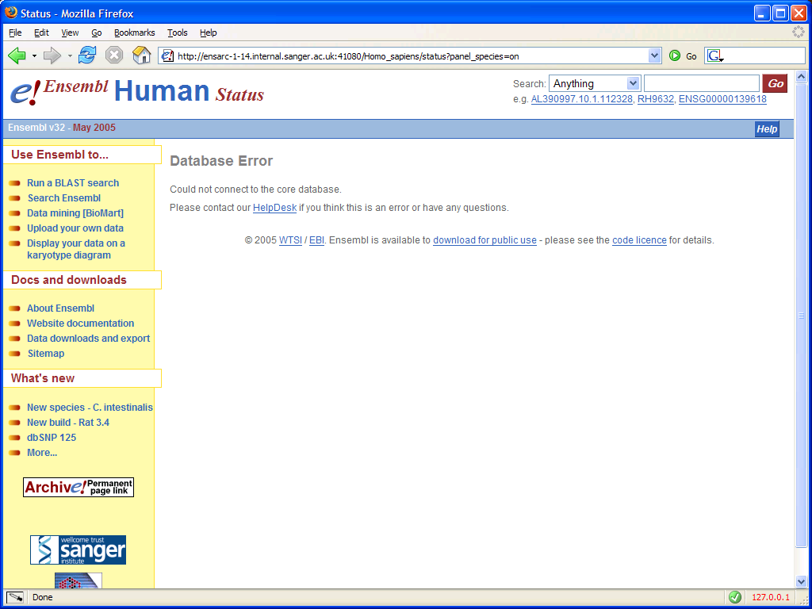
New status display
This is the rendered problem object created by the Factory

Slide 29
Extending the
Ensembl Website –
Part 2: Plugins.
James Smith
Js5@sanger.ac.uk
Ensembl Web Team Project Leader

Slide 30
Plugins – why?
We have implemented plugins for four main reasons:
Makes our lives easier maintaining a number of different Ensembl sites within the web-team… www, dev, pre, archive, vega, personal development environments and the “public” mirror code.
Will make those who create there own local Ensembl installations lives easier – as the can create a personalised “configuration” file which they can copy into any new installation, and it should just work!
Will make those who extend their local installation of Ensembl lives easier – as any “additional” code is stored in their own Plugin space.
Should allow for “external” groups to develop features in Ensembl, which can be incorporated into anyones “Ensembl” mirror without being merged into the main code.

Slide 31
Plugins – using to configure e!
The simplest use of plugins is to store “local” overrides for the configuration.
First: edit the conf/Plugins.pm file to specify where and in what name space your plugin is stored:
## To get standalone scripts to run from anywhere – hard code your server-root here!!
$SiteDefs::ENSEMBL_SERVERROOT = ‘/my_ensembl_install/xtreme';
$SiteDefs::ENSEMBL_PLUGINS = [
## 'MyModule::NameSpace' => 'Directory/root/of/plugin/directory',
'EnsEMBL::MyMirror' => $SiteDefs::ENSEMBL_SERVERROOT.'/mymirror/',
];
Second: create your plugin directory and the conf directory within it, in this case
  /my_ensembl_install/xtreme/mymirror/ and
  /my_ensembl_install/xtreme/mymirror/conf/
Third: create your own SiteDefs.pm, DEFAULTS.ini and any other species “.ini” files in this directory to over-ride the standard settings.

Slide 32
Plugins – SiteDefs.pm
package EnsEMBL::MyMirror::SiteDefs;
use strict;
## update_conf function called by main SiteDefs.pm
sub update_conf {
$SiteDefs::ENSEMBL_PORT = 80;
$SiteDefs::ENSEMBL_USER = ‘my_ensembl_user';
$SiteDefs::ENSEMBL_GROUP = ‘my_ensembl_group';
$SiteDefs::ENSEMBL_SERVERADMIN = ‘me@my_ensembl.mydomain.org';
$SiteDefs::ENSEMBL_SERVERNAME = 'my_ensembl.mydomain.org';
$SiteDefs::ENSEMBL_MAIL_ERRORS = 1;
$SiteDefs::ENSEMBL_ERRORS_TO = ‘me@mydomain.org’;
$SiteDefs::ENSEMBL_DEBUG_FLAGS = 24;
$SiteDefs::ENSEMBL_USERDB_NAME = 'ensembl_web_user_db';
$SiteDefs::ENSEMBL_USERDB_HOST = 'my_mysql.mydomain.org';
$SiteDefs::ENSEMBL_USERDB_PORT = 3306;
$SiteDefs::ENSEMBL_USERDB_USER = ‘my_mysql_user';
$SiteDefs::ENSEMBL_USERDB_PASS = ‘my_mysql_pass';
$SiteDefs::ENSEMBL_LONGPROCESS_MINTIME = 20;
}
1;

Slide 33
Plugins – DEFAULTS.ini
[general]
ENSEMBL_HOST = my_mysql.mydomain.org
ENSEMBL_HOST_PORT = 3306
ENSEMBL_WRITE_USER = my_mysql_user
ENSEMBL_WRITE_PASS = my_mysql_pass
ENSEMBL_DBUSER = my_mysql_ro
ENSEMBL_DBPASS =
ENSEMBL_BINARIES_PATH = /usr/local/bin ; DotterView
ENSEMBL_EMBOSS_PATH = /usr/local/emboss ; AlignView
ENSEMBL_WISE2_PATH = /usr/local/wise2 ; AlignView
ENSEMBL_BLAST_BIN_PATH = /data/bin/wu_blast ; BlastView
ENSEMBL_REPEATMASKER = /data/bin/RepeatMasker ; BlastView
ENSEMBL_BLAST_FILTER = /data/bin/wu_blast/filter ; BlastView
ENSEMBL_BLAST_MATRIX = /data/bin/wu_blast/matrix ; BlastView
ENSEMBL_BLAST_DATA_PATH = /data/blastdb/ensembl ; BlastView
ENSEMBL_SEARCH = textview
etc ...

Slide 34
Plugins – using to configure e!
Here we use a “standard” Sanger plugin, plus local “development” plugins.
## To get standalone scripts to run from anywhere – hard code your server-root here!!
$SiteDefs::ENSEMBL_SERVERROOT = ‘/my_ensembl_install/xtreme';
$SiteDefs::ENSEMBL_PLUGINS = [
## 'MyModule::NameSpace' => 'Directory/root/of/plugin/directory',
'EnsEMBL::MyMirror_js5' => $SiteDefs::ENSEMBL_SERVERROOT.'/mymirror_js5/',
'EnsEMBL::MyMirror' => $SiteDefs::ENSEMBL_SERVERROOT.'/mymirror/',
];
This extra “plugin” conf contains just the following SiteDefs.pm file:
package EnsEMBL::Sanger_js5::SiteDefs;
sub update_conf {
$SiteDefs::ENSEMBL_PORT = 41080;
$SiteDefs::ENSEMBL_USER = 'js5';
$SiteDefs::ENSEMBL_SERVERADMIN = 'js5@mydomain.org';
$SiteDefs::ENSEMBL_SERVERNAME = ‘my_ensembl.mydomain.org';
$SiteDefs::ENSEMBL_ERRORS_TO = 'js5@mydomain.org';
$SiteDefs::ENSEMBL_DEBUG_FLAGS = 24;
$SiteDefs::ENSEMBL_LONGPROCESS_MINTIME = 5;
}
1;

Slide 35
Extending the
Ensembl Website –
Part 3: Extending the script.
James Smith
Js5@sanger.ac.uk
Ensembl Web Team Project Leader

Slide 36
Extending this display
Want to add a “development” plugin which displays the Apache webserver environment information.
Need additional Configuration::Server module to add new panel
Need additional to Object::Server module to collect “environment information”
Need additional Component to configure the additional panel
Required to update Plugins.pm in conf directory to include module.
Additionally the plugin will add a “rudimentary” sitemap for the static content to the top panel.

Slide 37
Plugins module
## To get plugins to work with standalone scripts
## you need to specify the server root here!!
$SiteDefs::ENSEMBL_SERVERROOT = '/ensemblweb/js5/wwwdev/xtreme';
## Add our module, Key is namespace, Value is directory containing plugin.
$SiteDefs::ENSEMBL_PLUGINS = [
'EnsEMBL::Sanger‘ => $ENSEMBL_SERVERROOT.'/sanger-plugins/sanger',
'EnsEMBL::Sanger_js5‘ => $ENSEMBL_SERVERROOT.'/sanger-plugins/js5',
'EnsEMBL::Development‘ => $ENSEMBL_SERVERROOT.'/public-plugins/development',
];
1;

Slide 38
Plugin Configuration module
package EnsEMBL::Development::Configuration::Server;
use strict;
use EnsEMBL::Web::Configuration;
our @ISA = qw( EnsEMBL::Web::Configuration );
use EnsEMBL::Web::Document::Panel::SpreadSheet;
sub status {
my $self = shift;
if( my $panel2 = $sefl->new_panel( 'SpreadSheet',
'code‘ => 'environment',
'caption‘ => 'Apache environment',
'object‘ => $self->{object},
‘status’ => ‘panel_apache’
) ) {
$panel2->add_components(qw(apache EnsEMBL::Development::Component::Server::spreadsheet_Apache));
$content->add_panel_last( $panel2 );
}
if( my $panel_ref = $self->panel( 'info' ) ) {
$panel_ref->add_component_last(qw(tree EnsEMBL::Development::Component::Server::static_tree));
}
}
1;

Slide 39
Plugin ScriptConfig
package EnsEMBL::Development::ScriptConfig::status;
use strict;
sub init {
$_[0]->_set_defaults(qw(
panel_apache on)
);
}
1;

Slide 40
Plugin Component module
package EnsEMBL::Development::Component::Server;
use strict;
sub spreadsheet_Apache {
my( $panel, $object ) = @_;
$panel->add_columns(
{ 'key' => 'key', 'align' => 'left', 'title' => 'Key' },
{ 'key' => 'value', 'align' => 'left', 'title' => 'Value' },
);
foreach (@{$object->get_environment}) {
$panel->add_row( $_ );
}
return 1;
}
sub static_tree {
my($panel,$object) = @_;
$panel->add_row( 'Document tree', _sub_tree( $object, '/', 0) );
return 1;
}
sub _sub_tree {
my( $object, $K, $i ) = @_;
my $HTML = qq(@{['&nbsp;' x ($i*2)]}<a href="$K">@{[$object->species_defs->ENSEMBL_BREADCRUMBS->{$K}[0]]}</a><br />\n);
foreach my $C (@{$object->species_defs->ENSEMBL_CHILDREN->{$K}||[]}) {
$HTML .= _sub_tree( $object, $C, $i+3 );
}
return $HTML;
}
1;

Slide 41
Plugin Object module
package EnsEMBL::Development::Object::Server;
use strict;
use warnings;
no warnings "uninitialized";
use EnsEMBL::Web::Object;
our @ISA = qw(EnsEMBL::Web::Object);
sub get_environment {
my $self = shift;
return [ map { {'key'=>$_,'value'=>$ENV{$_}} } sort keys %ENV ];
}
1;

Slide 42
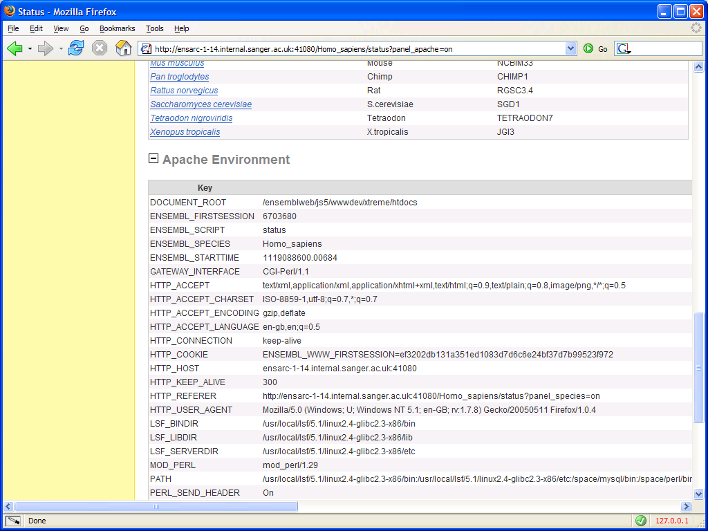
Additional “Development” panel
Extra “SpreadSheet” panel configured by
by the plugin’s Coniguration module

Slide 43
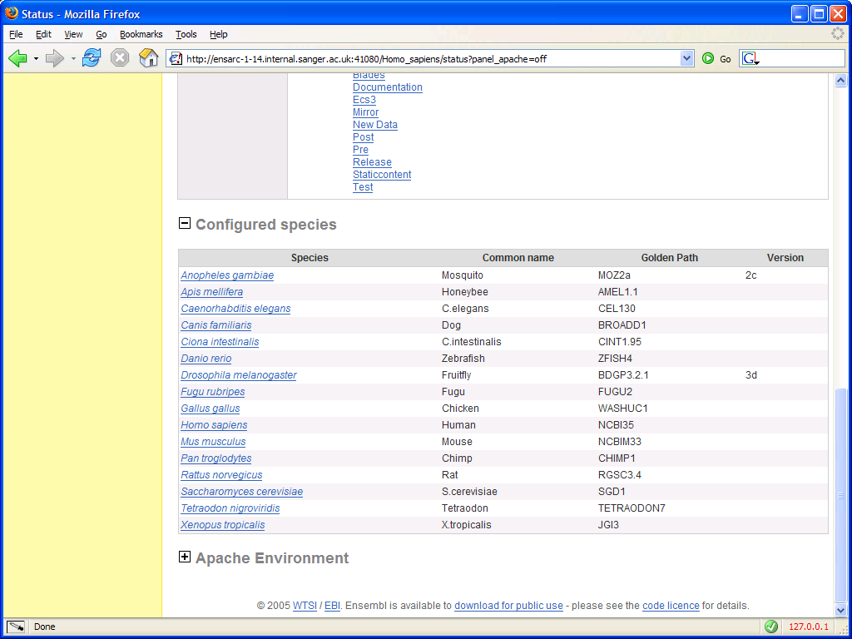
Additional “Development” panel
Panel can be collapsed as we set up the
additional status flag in the plugin’s
ScriptConfig::status module

Slide 44
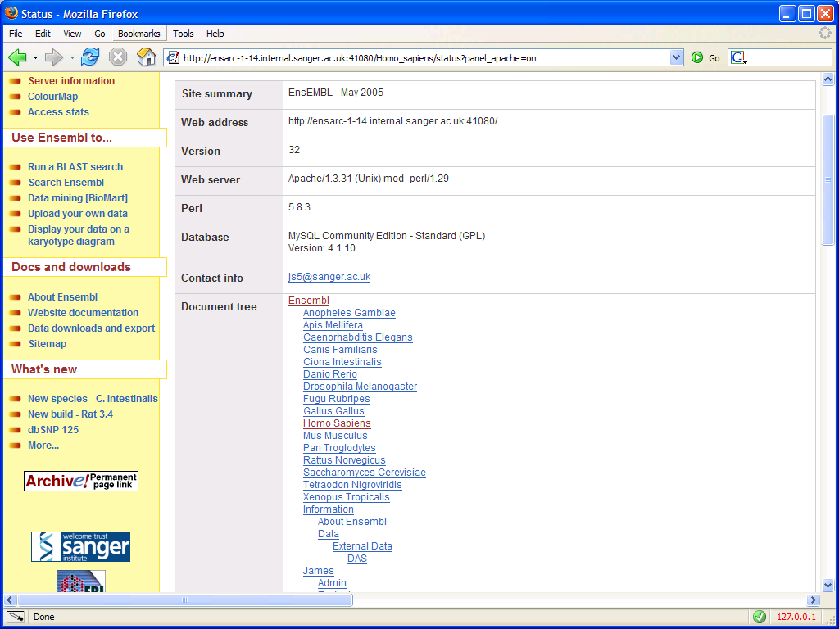
Additional “Development” panel
Additional menu
Item added by
Sanger plugin
Extra component in “Information” Panel added
by the plugin’s Coniguration module

