Slide 1
Ensembl Compara
Perl API
Stephen Fitzgerald
EBI - Wellcome Trust Genome Campus, UK
http://www.ebi.ac.uk/~stephenf/Workshops/EBI_may_2013/

Slide 2
Sequence types and outputs
Pairwise alignments
Multiple alignments
Nucleotide sequence
Syntenic regions
Conservation
Protein trees
Protein sequence
Homologues
Families

Slide 3
Nucleotide sequence analyses
Pairwise Alignments
BLASTZ-net
LASTZ-net
t-BLAT-net
Syntenic regions
Only for species with chromosomal mappings
Multiple alignments
Mercator-Pecan
Enredo-Pecan-Ortheus
Conservation
GERP Cons. Scores
GERP Constr. Elements

Slide 4
Pairwise Alignments in Compara 71
43 tBLAT alignments of distantly related species
Compara 71
65 BlastZ/LastZ alignments of closely related species
26 analyses of species with karyotypes

Slide 5
Multiple Alignments in Compara 71
20-way amniota
veretebrates
Mercator
Pecan
13-way eutherian
mammals
Compara 71
EPO
6-way primate
5-way fish
EPO
2x
3-way birds
36-way eutherian
mammals
8-way fish

Slide 6
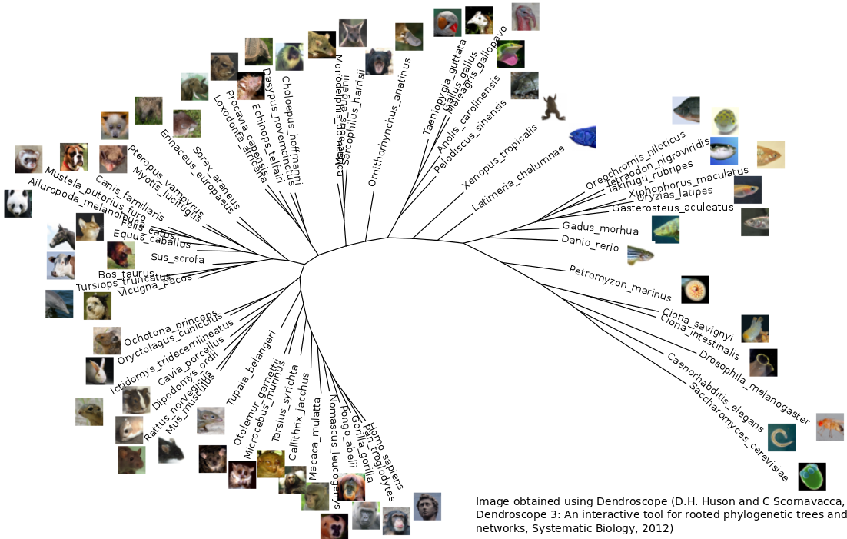
Xenarthra
Marsupials
Birds
Afrotheria
Laurasatheria
Fish
outspecies
Glires
Primates

Slide 7
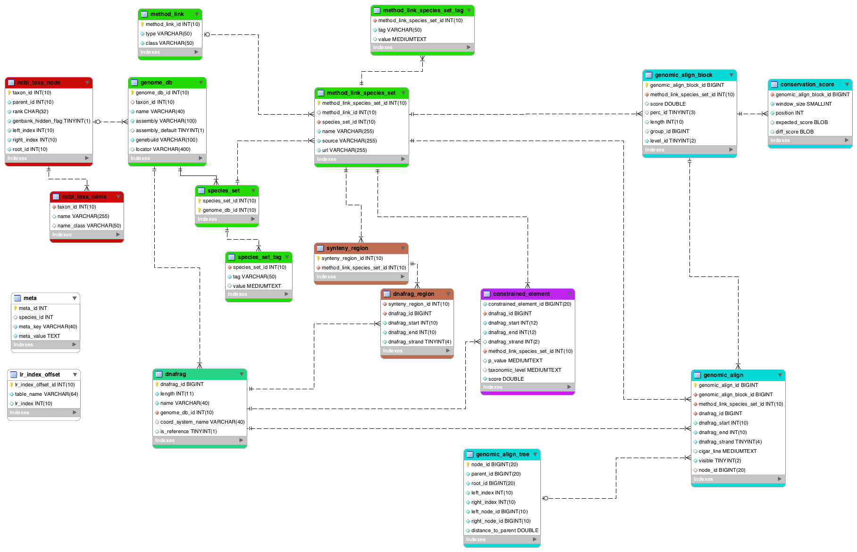
Genomic alignments schema

Slide 8
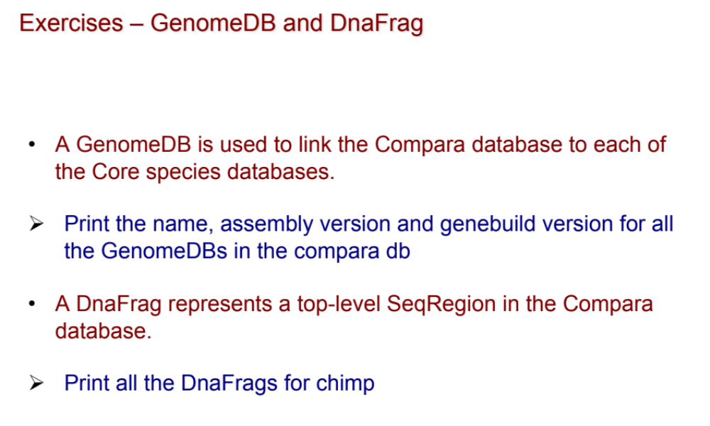

Slide 9
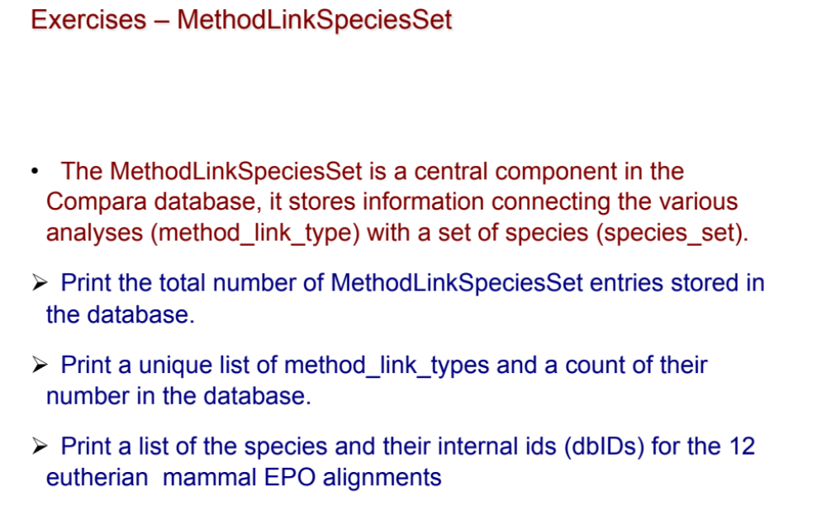

Slide 10
Compara database is coupled to Ensembl core databases
Compara stores relationships between the genomes by loading references or ‘handles’ to external data.
Since there is minimal primary data inside Compara, to gain full access to the data these external links must be re-established
Example: compara_70 must be linked with the Ensembl core_70 databases
Proper REGISTRY configuration is needed

Slide 11
Alignments are stored in the genomic_align and genomic_align_block tables
A small example :
gorilla_gorilla/MT/935-953 gacat-ttaactaaaac-ccc
macaca_mulatta/MT/1469-1488 aacatcttaactaaacg-ccc
pan_troglodytes/MT/934-953 gatac-ttaacttaaaccccc
pongo_pygmaeus/MT/940-958 actac-ctaactaaaac-ccc
homo_sapiens/MT/1516-1534 gacat-ttaactaaaac-ccc
* ***** ** ***
GACATTTAACTAAAACCCC 5MD11MD3M
AACATCTTAACTAAACGCCC 17MD3M
GATACTTAACTTAAACCCCC 5MD15M
ACTACCTAACTAAAACCCC 5MD11MD3M
GACATTTAACTAAAACCCC 5MD11MD3M
5 genomic_align entries
1 genomic_align_block
Sequences from core

Slide 12
Exercises - GenomicAlignBlock
A GenomicAlignBlock represents an alignment between two or more regions of genomic DNA. Within these blocks every region of genomic DNA is represented by a GenomicAlign object.
Print the LASTZ-NET alignments for pig chromosome 15 with cow (using pig coordinates 105734307 and 105739335).
Change the above example so that it prints the 13-way eutherian mammal (EPO) multiple alignments.

Slide 13
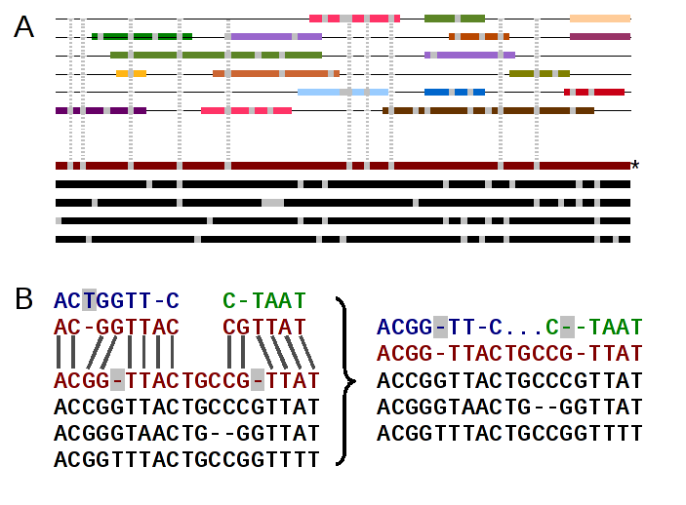
Adding low-coverage (2X) genomes
Low coverage genomes cannot be fully assembled
Resulting assembly is too scattered to be used with Enredo
Run EPO on high-coverage genomes only
Map 2X genomes using pairwise alignments

Slide 14
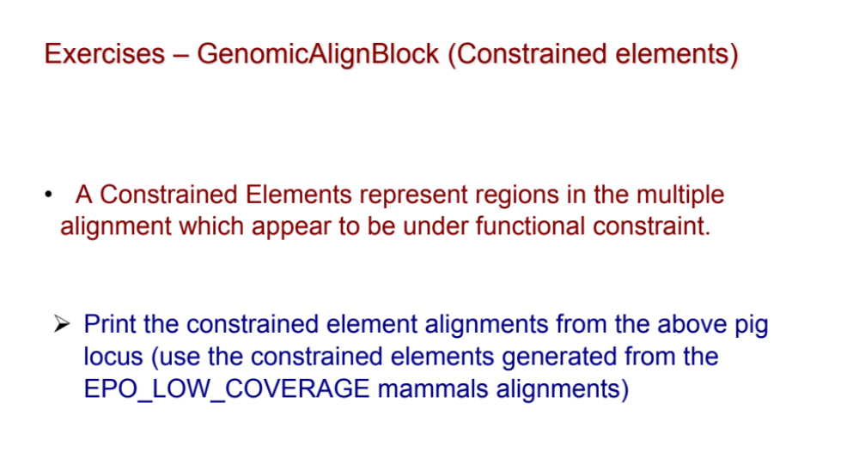

Slide 15
Exercises - Synteny
Synteny blocks are derived from Lastz-net alignments
  group syntenic alignments closer than 200Kb
  link syntenic groups closer than 3Mb
  minimum length of the syntenic block: 100 kb
Print the pig-cow synteny map using pig chromosome 15 as a reference

Slide 16
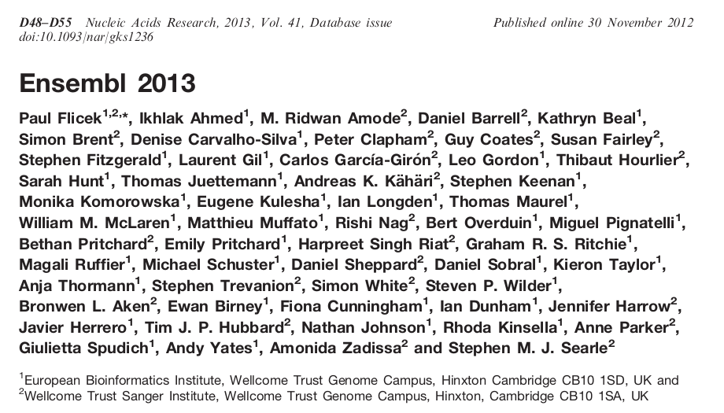














Acknowledgements
Compara Team
Javier
Kathryn
Stephen
Leo
European Commission Framework Programme 7
Matthieu
Miguel

