Slide 1

Ensembl Compara
Perl API
compara
Matthieu Muffato
API workshop - EBI
Nov 2012

Slide 2
Outline of the course
Introduction about Compara
  Resources
  API
Base objects
  Genes, peptides, RNAs
  Multiple / pairwise alignments
Data objects
  Families
  Gene trees
  Homologies

Slide 3
Outline of the course
Introduction about Compara
  Resources
  API
Base objects
  Genes, peptides, RNAs
  Multiple / pairwise alignments
Data objects
  Families
  Gene trees
  Homologies

Slide 4
What is Ensembl Compara?
A single database which contains precalculated comparative genomics data and which is linked to all the Ensembl Species databases.
Access via perl API and mysql
A production system for generating that database
(not in this presentation)‏

Slide 5
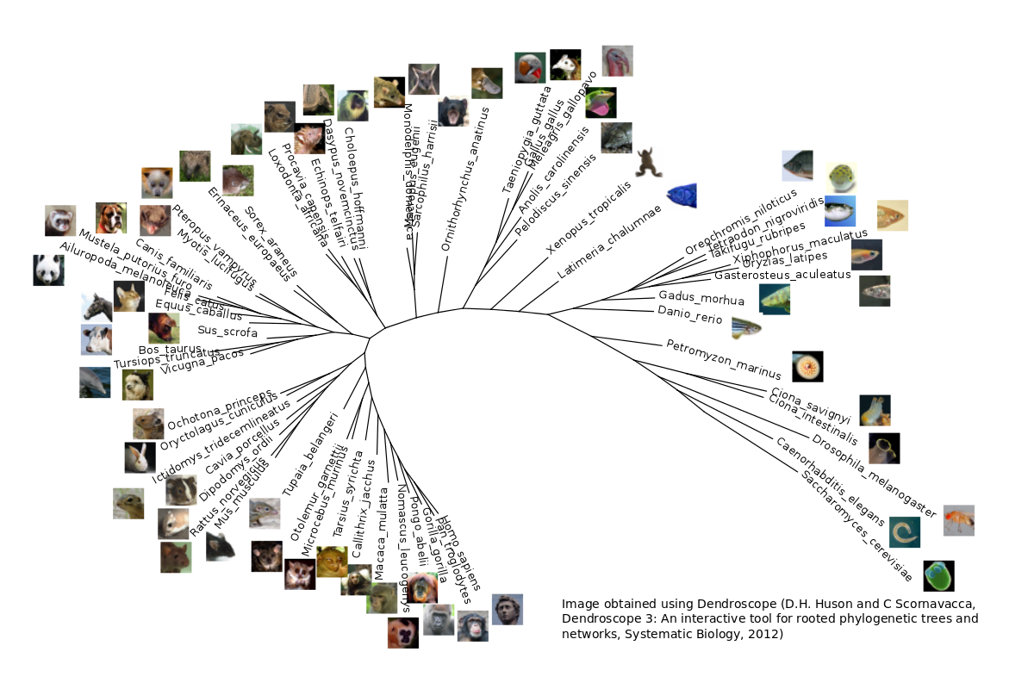
The genomes in Ensembl

Slide 6
Help & Useful documentation
perldoc – Viewer for inline API documentation
  shell> perldoc Bio::EnsEMBL::Compara::GenomeDB
  shell> perldoc Bio::EnsEMBL::Compara::DBSQL::MemberAdaptor
Online documents (website)
  http://www.ensembl.org/info/docs/Doxygen/compara-api/index.html
  http://www.ensembl.org/info/docs/api/compara/index.html
CVS
  ensembl-compara/docs/protein_schema.png
  ensembl-compara/docs/genomic_schema.png
ensembl-dev mailing list:
  dev@ensembl.org
  helpdesk@ensembl.org

Slide 7
Compara data
Genome level (this afternoon)
Whole genome alignments (pairwise and multiple)‏
Syntenic regions (based on pair-wise align.)
Gene level (now !)
Families (clusters of proteins + multiple align.)
Gene trees (proteins, non-coding RNAs)
Gene orthology / paralogy predictions

Slide 8
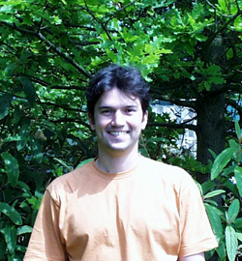
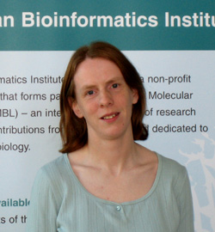
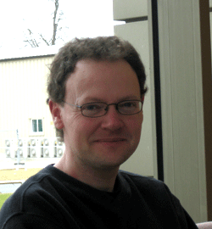
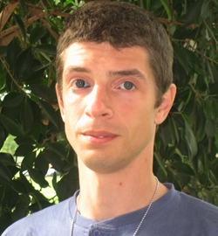
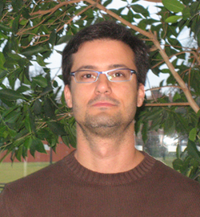
Who is in Ensembl Compara?
Kathryn Beal
Javier Hererro
Stephen Fitzgerald
+ me ! :)
Leo Gordon
Miguel Pignatelli

Slide 9
The Compara Perl API
Written in Object-Oriented Perl
Used to retrieve data from and store data into the Ensembl Compara database
Links species together for Ensembl website
Generalized to extend to non-Ensembl genomic data (Uniprot)‏
Follows same ‘Data Object’ & ‘Object Adaptor’ DBAdaptor design as the other Ensembl APIs

Slide 10
Compara template script
use strict;
use Bio::EnsEMBL::Registry;
my $reg = "Bio::EnsEMBL::Registry";
# Auto-configure the registry
$reg->load_registry_from_db(
-host => "ensembldb.ensembl.org",
-user => "anonymous"
);
# Get the adaptor object for the data type you want
my $xx_adaptor = $reg->get_adaptor("Multi", "compara", "XX");
# Fetch the data objects using the adaptor
my $all_interesting_xx = $xx_adaptor->fetch_all_by_YY();
print "All XX objects from E!Compara :\n";
foreach my $this_xx (@$all_interesting_xx) {
# Do some stuff with the data object
print "\t", $this_xx->stable_id, "\n";
}

Slide 11
Compara object model overview
PRIMARY DATA
NCBITaxon
species
GenomeDB
chromosomes
scaffolds
genes
proteins
transcripts
DnaFrag
Member
AlignedMemberSet
GenomicAlignBlock
ConservationScore
Family
RESULTS
GeneTree
SyntenyRegion
ConstrainedElement
Homology

Slide 12
Outline of the course
Introduction about Compara
  Resources
  API
Base objects
  Genes, peptides, RNAs
  Multiple / pairwise alignments
Data objects
  Families
  Gene trees
  Homologies

Slide 13
Member object / MemberAdaptor
Represents a gene, a transcript, or a protein
    $member_adaptor->fetch_by_source_stable_id(...)
    $member_adaptor->fetch_all_by_source_taxon(...)
Come from Ensembl and Uniprot. The “source” or “source_name” field can be one of:
    ENSEMBLGENE, ENSEMBLPEP, ENSEMBLTRANS,Uniprot/SPTREMBL, Uniprot/SWISSPROT
Attributes | Methods
Stable ID | $member->stable_id()
Coordinates | $member->chr_name() $member->chr_start() …
Sequence | $member->sequence()
Function | $member->description()

Slide 14
Links involving Member objects
Compara
Core
ENSEMBLGENE
get_Gene()
Gene
get_all_peptide_Members()
Transcript
gene_member()
get_Transcript()
Translation
ENSEMBLPEP
ENSEMBLTRANS
get_Translation()
UNIPROT/SPTREMBL
UNIPROT/SWISSPROT

Slide 15
Exercises - Member
Print the sequence of the Member corresponding to SwissProt protein O93279
Find the Member(s) for the human ncRNA gene(s) FAM41C
Find and print the sequence of all the peptide Members corresponding to the human protein-coding gene(s) FRAS1

Slide 16
AlignedMemberSet object
Base object that represents a set of members aligned together, e.g. a multiple alignment of peptides / ncRNAs
“Applied” in gene trees, families, and homologies
No specific adaptor
Attributes | Methods
List of members | $aln->get_all_Members()
Alignment (BioPerl object) | $aln->get_SimpleAlign()
Description (if available) | $aln->description()
Stable ID (if available) | $aln->stable_id()

Slide 17
HOWTO: print a BioPerl alignment
Compara objects return alignments as BioPerl instances
    $aln->get_SimpleAlign()
BioPerl provides an AlignIO object to format the actual output in various formats (fasta, clustalw, phylip … )
use Bio::AlignIO;
# Get the alignIO object from BioPerl
my $alignIO = Bio::AlignIO->newFh(-format => "fasta");
# Print the alignment
print $alignIO $aln;

Slide 18
Outline of the course
Introduction about Compara
  Resources
  API
Base objects
  Genes, peptides, RNAs
  Multiple / pairwise alignments
Data objects
  Families
  Gene trees
  Homologies

Slide 19
Families
Families are clusters of similar peptides
Ensembl
(all transcripts)
Uniprot/SWISSPROT
Uniprot/SPTREMBL
All vs. all BlastP
MCL clustering
Mafft multiple alignment
Mafft
Mafft
Mafft

Slide 20
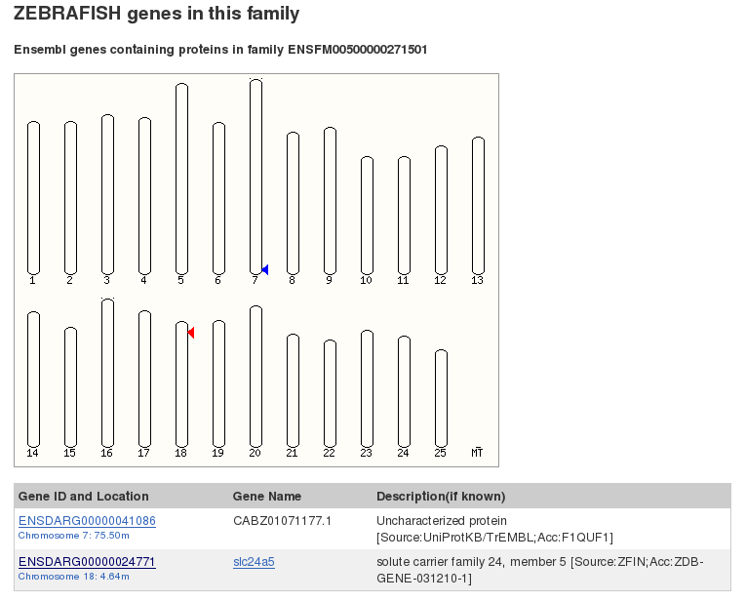
Example on the web: ENSFM00500000271501 in Zebrafish

Slide 21

Family object / FamilyAdaptor
Represents a group of similar peptide members
    $family_adaptor->fetch_all_by_Member(...)
    $family_adaptor->fetch_by_stable_id(...)
Alternative transcripts can belong to different families !
(almost) the same methods as in AlignedMemberSet
Attributes | Methods
Alignment | $family->get_SimpleAlign()
Biological function | $family->description() $family->description_score()
Gene content | $family->get_all_Members()

Slide 22
Exercises - Families
Get the multiple alignment corresponding to the family with the stable id ENSFM00250000006121
Get the families predicted for the human gene ENSG00000139618. What do you notice ?

Slide 23
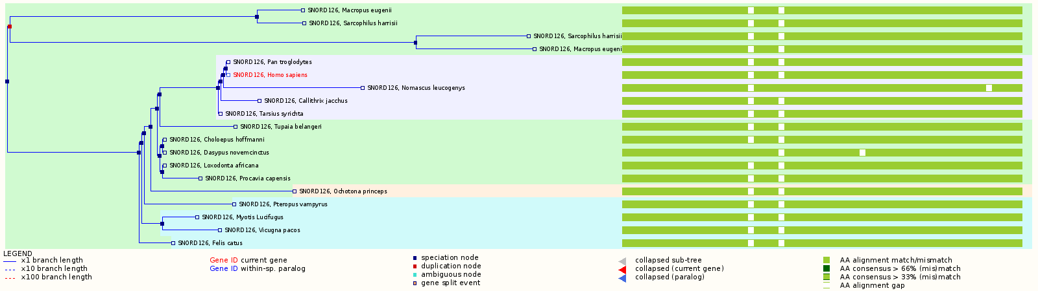
GeneTree example on the website
Tree
Multiple alignment

Slide 24
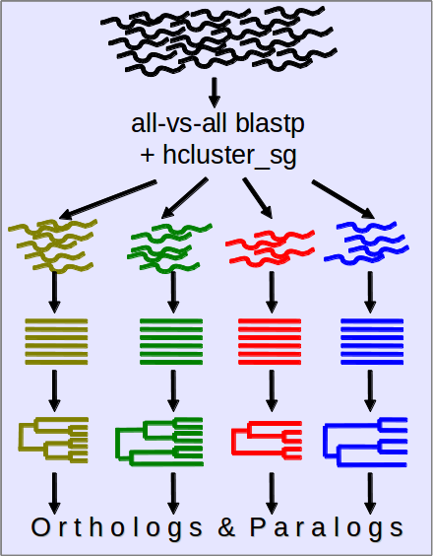
Protein-Tree pipeline overview
All e! genes – canonical prot.
BLAST
hcluster_sg
MCoffee: MSA
TreeBeST: (+ reconciliation)
Ortholog/Paralog inference
Vilella et al., Genome Res. 2009

Slide 25
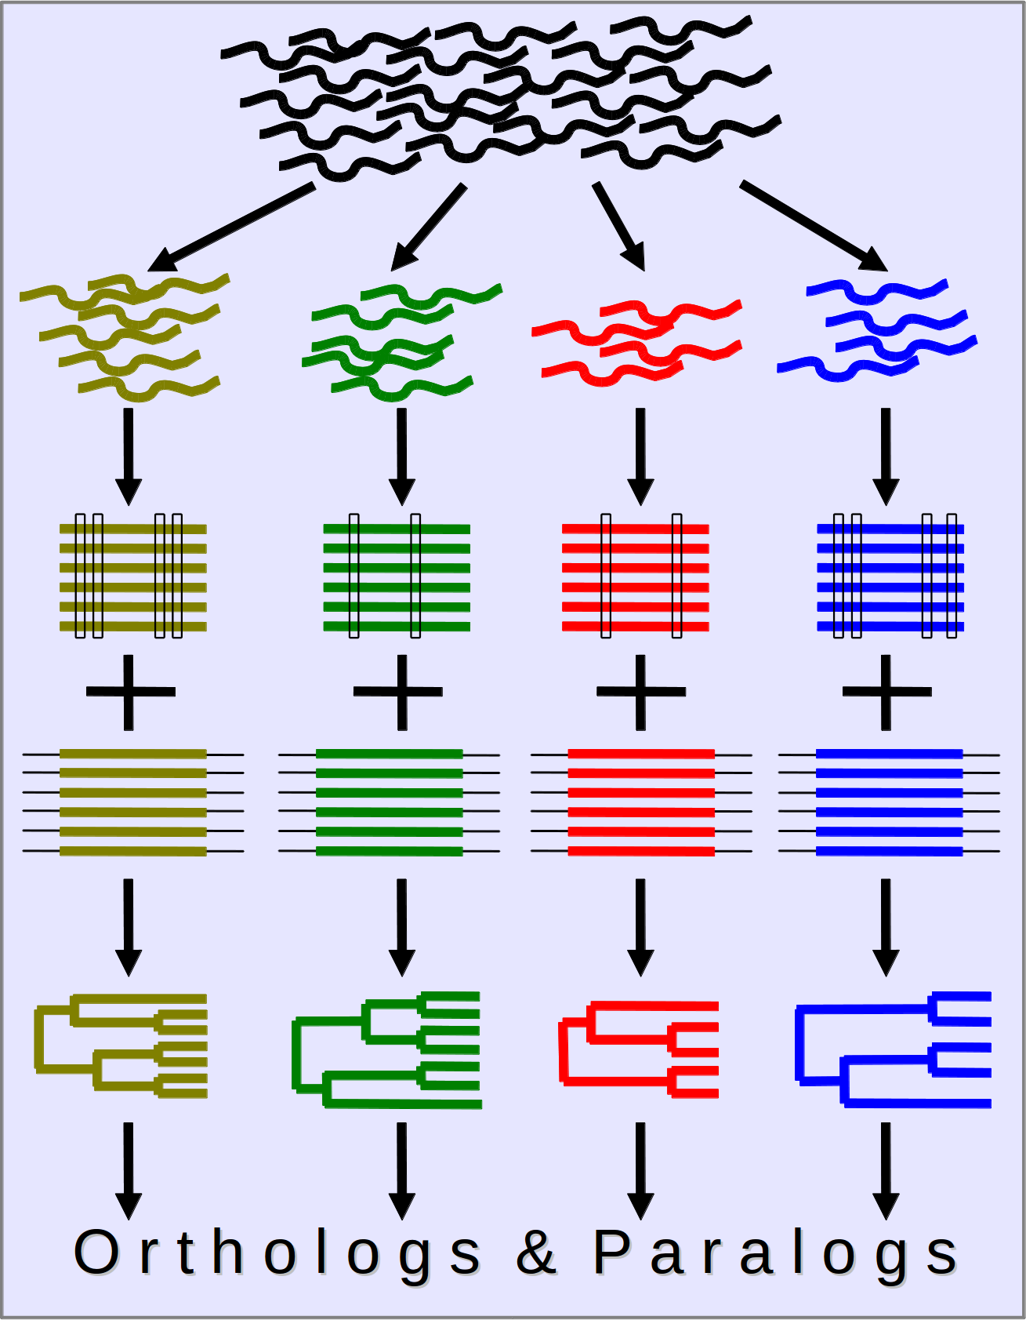
ncRNA-Tree pipeline overview
All e! ncRNA genes
Grouped in Family Models - RFAM
Infernal alignment + RaxML trees
PRANK alignment + NJ/ML trees
TreeBeST (tree reconciliation)
Ortholog/Paralog inference
Pignatelli et al., in preparation

Slide 26
GeneTree object / GeneTreeAdaptor
Represents a set of members, in a phylogenetic tree
    $genetree_adaptor->fetch_by_stable_id(...)
    $genetree_adaptor->fetch_default_for_Member(...)
fetch_all* methods require some more arguments:
    -clusterset_id => 'default'
    -tree_type => 'tree'
    -member_type => 'protein' or 'ncrna'
Attributes | Methods
Alignment | $tree->get_SimpleAlign()
Stable ID | $tree->stable_id()
Tree export | $tree->newick_format('simple') $tree->nhx_format('full') $tree->print_tree()

Slide 27
GeneTreeNode object
The actual tree structure is a hierarchy of GeneTreeNode objects
root node
leaf 1 (node)
int. node
GeneTree
internal node
leaf 2 (node)
leaf 3 (node)

Slide 28
GeneTreeNode object
The actual tree structure is a hierarchy of GeneTreeNode objects
root()
is_leaf() == 0
root node
parent()
children()
is_leaf() == 0
leaf 1 (node)
int. node
GeneTree
parent()
internal node
is_leaf() == 1
children()
leaf 2 (node)
leaf 3 (node)
is_leaf() == 1
is_leaf() == 1
Additional information is stored with “tags”
    $node->get_all_tags()
    $node->get_tagvalue('node_type') or 'taxon_name', 'bootstrap'

Slide 29
Exercises – Protein and ncRNA trees
Print the protein tree with the stable id ENSGT00390000003602
Print all the members of the tree containing the human ncRNA gene ENSG00000238344
Count the number of duplication event in the tree of the zebrafish protein-coding gene ENSDARG00000003399

Slide 30
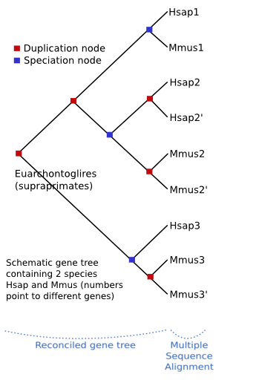
Homology inference
Consists in tagging the pairs of genes of all the trees with a relation type, depending on the tree topology.

Slide 31
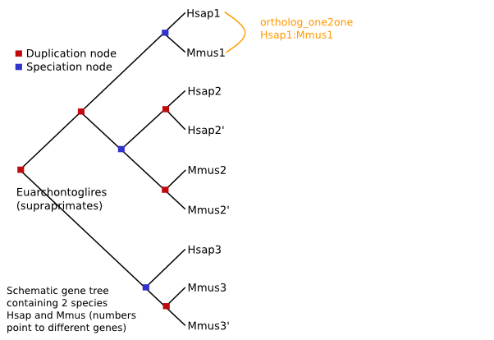
Homology inference

Slide 32
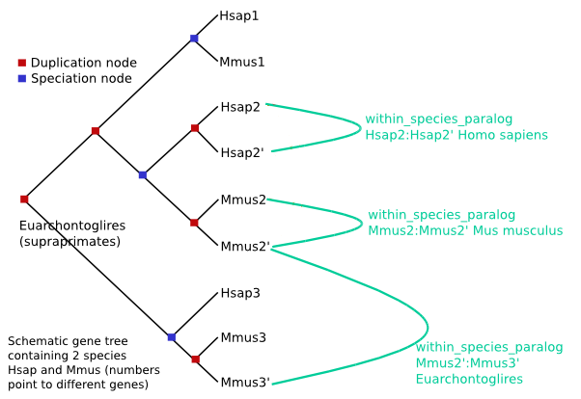
Homology inference

Slide 33
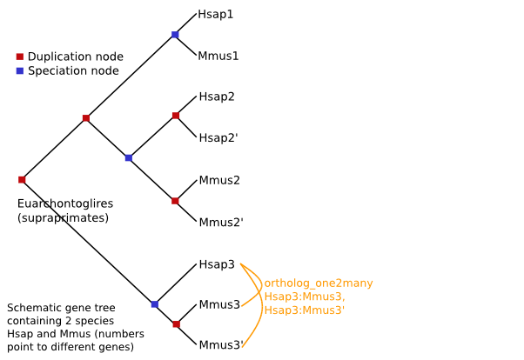
Homology inference

Slide 34
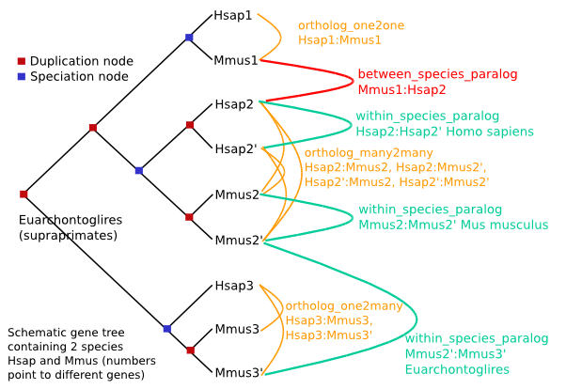
Homology inference

Slide 35
Homology object / HomologyAdaptor
Represents a relationship between two members
    $homology_adaptor->fetch_all_by_Member(...)
    $homology_adaptor->fetch_all_by_MethodLinkSpeciesSet(..)
    $homology_adaptor->fetch_all_by_Member_paired_species(..)
One-to-many relationships are split:
  “H ortholog to M1” and “H ortholog to M2” are different objects
Attributes | Methods
Alignment | $homology->get_SimpleAlign()
Natural selection | $homology->dn() / $homology->ds()
Gene content | $homology->get_all_GeneMembers()
Homology characteristics | $homology->description() $homology->taxonomy_level()
Node in the gene tree | $homology->node_id()

Slide 36
Exercises - Homologies
Get all the homologues for the human gene ENSG00000229314
Count the number of “one2one” homologues between human and mouse
Find the human orthologues of ENSMUSG00000004843 and ENSMUSG00000025746. For each homology, display the alignment and the dn value. Comment on the divergence

