Slide 1
eHive Workshop
part 2: How to create pipelines
(configuration files)
Leo Gordon

Slide 2


Before we begin:
Please make sure you have correct setup from part 1:
  You are running screen -RD on one of farm login nodes
  ensembl (core) and ensembl-hive repositories are installed and up-to-date:
    $ cvs -q update -dP
  $ENSEMBL_CVS_ROOT_DIR points to the directory holding the checkouts
  Slides are here:
  $ENSEMBL_CVS_ROOT_DIR/ensembl-hive/docs/presentations/HiveWorkshop_Sept2013
  $PERL5LIB includes ensembl/modules and ensembl-hive/modules
  $PATH includes ensembl-hive/scripts
  You have a username+password on our training MySQL server
  (set them in $EHIVE_* environment variables for the duration of the course)
Do we need breaks?

Slide 3
Modularity of pipelines. PipeConfigs & Runnables
A Hive pipeline is defined in a PipeConfig file which references one or more Runnable modules.
Many tasks can be solved by using “universal” Runnables provided by the Hive (SystemCmd, SqlCmd, JobFactory, Dummy), but sometimes you have to write your own application-specific Runnables.
We shall learn to use universal Runnables before making our own
(however it may be the opposite of what you do in practice)
Hive’s “universal” Runnables live here:
$ENSEMBL_CVS_ROOT_DIR/ensembl-hive/modules/Bio/EnsEMBL/Hive/RunnableDB/
Hive’s PipeConfig files live here:
$ENSEMBL_CVS_ROOT_DIR/ensembl-hive/modules/Bio/EnsEMBL/Hive/PipeConfig/
They are written in a subset of Perl.

Slide 4

The simplest pipeline : AnyCommands_conf.pm
Open the file - this is the smallest PipeConfig possible:
use base ('Bio::EnsEMBL::Hive::PipeConfig::HiveGeneric_conf'); # or subclass
sub pipeline_analyses {
return [
{ -logic_name => 'perform_cmd',
-module => 'Bio::EnsEMBL::Hive::RunnableDB::SystemCmd',
},
];
}
$ init_pipeline.pl Bio::EnsEMBL::Hive::PipeConfig::AnyCommands_conf
$ generate_graph.pl -url $EHIVE_URL -out any_c_empty.png
or open http://guihive.internal.sanger.ac.uk:8080/ instead

Slide 5


Seeding and running AnyCommands_conf.pm
No jobs - we will have to seed them:
$ seed_pipeline.pl -url $EHIVE_URL -logic_name perform_cmd \
-input_id '{"cmd" => "echo Hello, world"}'
and run:
$ runWorker.pl -url $EHIVE_URL
Practical to a certain extent (analysis_capacity, batch_size, resources)

Slide 6
Analysis-wide parameters and substitution
We can define values for old parameters and create new ones:
sub pipeline_analyses {
return [
{ -logic_name => 'perform_cmd',
-module => 'Bio::EnsEMBL::Hive::RunnableDB::SystemCmd',
-parameters => {
"cmd" => "gzip #filename# ",
},
},
];
}
Exercise:
seed a few jobs and run them ( you can copy some compressible files from ~lg4/work/pdfs )
Automated seeding of jobs?
for filename in `find pdfs/ -name '*.pdf'` ; do
seed_pipeline.pl -url $EHIVE_URL \
-logic_name perform_cmd -input_id "{ 'filename' => '$filename' }";
done
created a new parameter
that can be defined by jobs
“cmd” defined on the analysis level

Slide 7
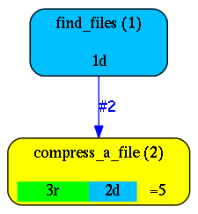
Factories and dataflow : CompressFiles_conf.pm
Dataflow Rules can be used to make Jobs seed other Jobs
Factory is an Analysis whose only aim is to seed other Jobs, create a “fan”, turn time into space
Higher level input
sub pipeline_analyses {
return [
{ -logic_name => 'find_files',
-module => 'Bio::EnsEMBL::Hive::RunnableDB::JobFactory',
-parameters => {
'inputcmd' => 'find #directory# -type f ',
'column_names' => [ 'filename' ],
},
-flow_into => {
2 => [ 'compress_a_file' ],
},
},
{ -logic_name => 'compress_a_file',
-module => 'Bio::EnsEMBL::Hive::RunnableDB::SystemCmd',
-parameters => {
'cmd' => 'gzip #filename#',
},
-analysis_capacity => 4,
},
];
}
created a new
higher level parameter
what to call the output
where the output should go

Slide 8


Dataflow conventions
Each Dataflow Event is a pair (branch_number, hash_of_parameters+).
In our example the 'find_files' job that we seed with
{ 'directory' => 'pdfs' }
generates the following Dataflow Events:
#2, { 'filename' => 'pdfs/first.pdf' }
#2, { 'filename' => 'pdfs/second.pdf' }
. . .
#2, { 'filename' => 'pdfs/last.pdf' }
#1, { 'directory' => 'pdfs' }
“Reserved” branch numbers that have their own meaning:
  1 is almost always present, it is the “continuation” after Job is ‘DONE’
  2 is used by many Factory Runnables to emit the “fan” (of Jobs, etc)
  -1 : “postmortem dataflow after MEMLIMIT” on LSF
  -2 : “postmortem dataflow after RUNLIMIT” on LSF
  3, 4, 5... : unreserved, can be used for anything
Each Runnable has its own set of branch_numbers that it may emit Dataflow Events into.
Check its documentation or code to make sure the dataflow you are wiring is live.
What happens if it’s not?
How to regain the single thread of control?
The “fan”
“autoflow” event,
helps to bind analyses consecutively

Slide 9
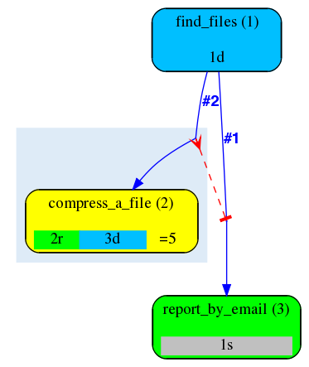
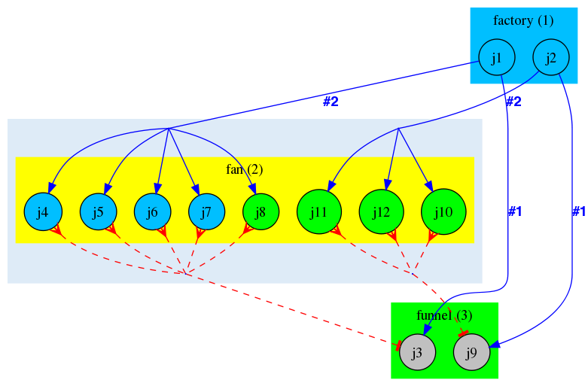
Regaining single thread of control: semaphored dataflow
Built-in mechanism for converging individual threads back together.
Based on semaphores that can block an individual job by a set of prerequisite jobs.

Slide 10
Semaphored dataflow in a PipeConfig
Creating a funnel Analysis : let the pipeline send us a notification:
{ -logic_name => 'report_by_email',
-module => 'Bio::EnsEMBL::Hive::RunnableDB::NotifyByEmail',
-meadow_type => 'LOCAL', # NB: farm nodes may not support sendmail
-parameters => {
'email' => $ENV{'USER'} . '@sanger.ac.uk', # what if it's wrong?
'subject' => 'pipeline has finished',
'text' => 'done compressing files in #directory#',
},
},
Linking two rules together happens in the emitting Analysis:
-flow_into => {
'2->A' => [ 'compress_a_file' ],
'A->1' => [ 'report_by_email' ],
}
Try running.
(solution: CompressFiles2_conf)
A break?
creates a group of jobs that control a semaphore
creates one job that is controlled by the semaphore

Slide 11
Parameters and their implicit propagation
Exercise 1:
How do we set a default directory name for analysis 1?
Exercise 2:
Introduce another parameter 'only_files' to define the wildcard pattern
for filenames we want to compress
What if we wanted to pass something to analysis 2 directly?
Say, if we want the same analysis to act as decompressor:
'cmd' => 'gzip #gzip_flags# #filename#'
First, pass the parameter to the job being seeded, then propagate it
Explicit propagation using templates vs implicit propagation

Slide 12
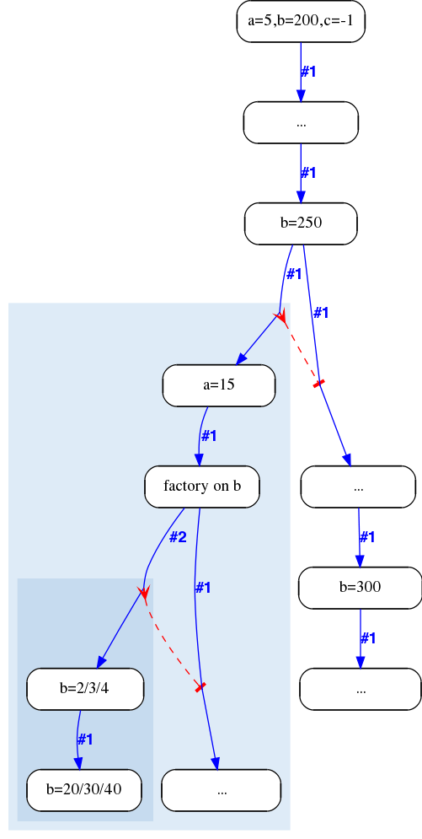
How implicit parameter propagation works
{
my $a=5; my $b=200 ;my $c=-1;
…
$b=250 ;
…
{
my $a=15;
for my $b (2,3,4) {
$b *= 10;
}
…
}
…
$b=300;
}

Slide 13
Using implicit parameter propagation
What if we wanted to pass something to analysis 2 directly?
Say, if we want the same analysis to act as decompressor:
'cmd' => 'gzip #gzip_flags# #filename#'
Implicit parameter propagation mechanism is off by default, switch it on using:
sub hive_meta_table {
my ($self) = @_;
return {
%{$self->SUPER::hive_meta_table},
'hive_use_param_stack' => 1,
};
}
Can you now propagate 'gzip_flags' to analysis 2?
(solution: CompressFiles3_conf)

Slide 14

Capturing data : another role of JobFactory
Both SystemCmd and SqlCmd only run your command,
no output is captured in any structured way.
  So SqlCmd is usually used to INSERT, DELETE, UPDATE, CREATE/ALTER/DROP TABLE, but not with SELECT.
JobFactory is not specifically creating Jobs - it simply transforms streams of “things” into Dataflow Events that may be converted into Jobs, stored in database tables, or accumulated. It is the wiring that defines what happens next.
{ -logic_name => 'pre_compress_size',
-module => 'Bio::EnsEMBL::Hive::RunnableDB::JobFactory',
-parameters => {
'inputcmd' => "wc -c #filename# | sed -e 's/^ *//' ",
'delimiter' => ' ',
'column_names' => [ 'orig_size', 'orig_filename' ],
},
},
Insert and wire it correctly.
  How to check whether we have captured anything?
  How to pass it outside?

Slide 15
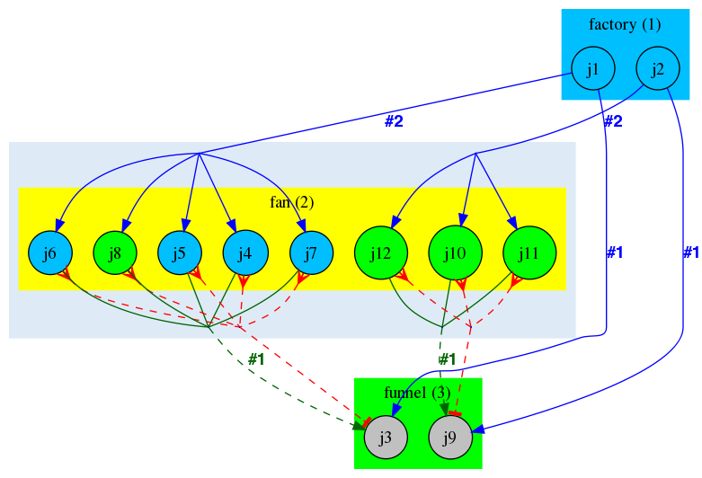
Accumulating data from a semaphore group
How do we pass the data from the box into the funnel?
The data can be passed from any job within the box into the correct funnel Job
Different structures or combinations can be accumulated (hashes, arrays, piles, multisets)
pseudo-Analysis names as targets for Dataflow (with or without templates).
':////accu?hash_name={key_name}'
':////accu?array_name=[index_name]'
':////accu?pile_name=[]'
':////accu?multiset_name={}'
see LongMult_conf for example.
Flow the data into accu (which branch?).

Slide 16

Advanced parameter substitution : expressions
What if we want to compute a value of #alpha#+1 rather than just a string?
'alpha_plus_one' => '#expr( #alpha#+1 )expr#'
Any Perl expression can be evaluated as follows:
  first, #alpha# will be text-substituted with the value of alpha parameter
  then the resulting string will be evaluated
  put a space between dollar and the name ( $ beta ) if you want standard Perl interpretation of the variable
  put curly braces around #alpha# if you want to dereference a reference:
    @{ #array_ref# }
    %{ #hash_ref# }
We can flatten accumulated structures (that are not scalars) into scalars
using #expr()expr# . For example,
'min_comp_size' => '#expr(min values %{#comp_size#})expr#',
'max_comp_size' => '#expr(max values %{#comp_size#})expr#',
'text' => 'compressed sizes between #min_comp_size# and #max_comp_size#',

Slide 17
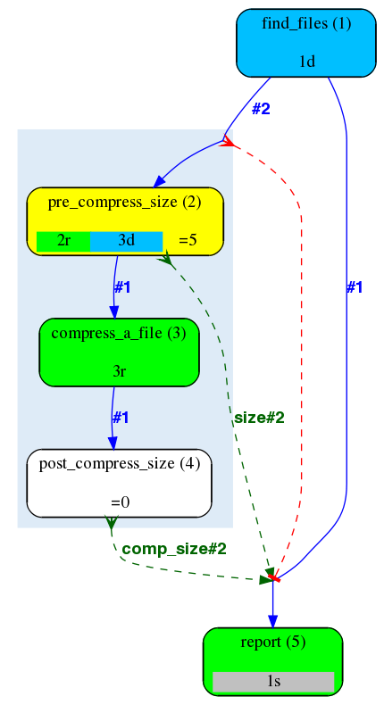
Exercise: accumulation + substitution
Let’s put it all together:
  Factory on a directory to dataflow single filenames
  compute their sizes and accumulate them
  compress the files
  compute the compressed sizes and accumulate
  funnel flattens the accumulated structures and emails you the report
Solution: CompressFiles4_conf

Slide 18
Questions?

Slide 19

Acknowledgements
Matthieu Muffato and Miguel Pignatelli

