Slide 1
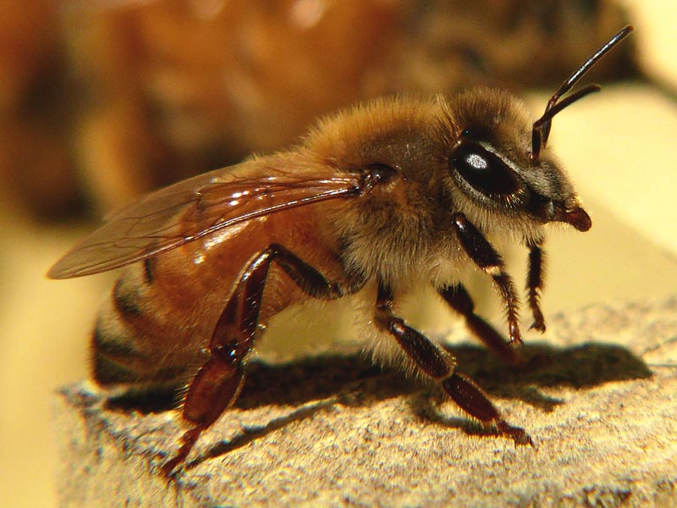
Accumulated dataflow in eHive
Leo Gordon
Notes:
Title page (introduce yourself and what you are doing)

Slide 2
Hive and dataflow
Hive is a DB-based system that simplifies creation of pipelines from configuration files and runs these pipelines on computer farms.
Dataflow is a unified way sending parametrized events in Hive pipelines.
These events are generated by jobs and can be optionally routed:
  to analyses (which produces other jobs) or
  to tables (which stores this data in tables).
Notes:
eHive's definition is deliberately incomplete. Missing are the “distributed autonomous agents”. But this is an implementation-related issue that will be discussed later. One can imagine an eHive with RuleManager kind of job dispatcher that would still do the job
software pipelines are what we build and use on a regular basis, they can be conceptually stratified.
code is the most abstract extremity; it lacks parameters. If it had no parameters or input data, there would be no point in including it into a pipeline. Everything could have been executed once.
job definitions EQUAL to the parameters for the code. There is nothing else.
because jobs are linked together (one job's output is another's input), we need a uniform representation.

Slide 3
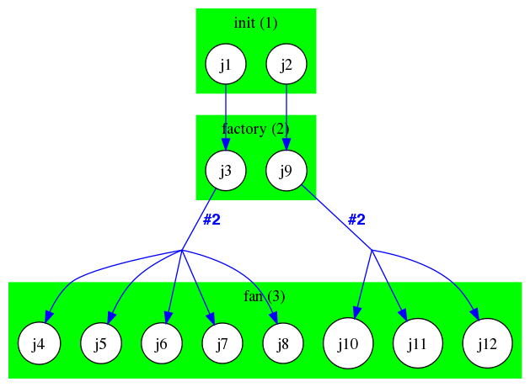
Dataflow into analyses (produces jobs)
The logic of most pipelines follows that of structural programming: there is usually a single backbone/trunk of control that can spawn multiple "threads" whenever things can be done in parallel.
Notes:
eHive's definition is deliberately incomplete. Missing are the “distributed autonomous agents”. But this is an implementation-related issue that will be discussed later. One can imagine an eHive with RuleManager kind of job dispatcher that would still do the job
software pipelines are what we build and use on a regular basis, they can be conceptually stratified.
code is the most abstract extremity; it lacks parameters. If it had no parameters or input data, there would be no point in including it into a pipeline. Everything could have been executed once.
job definitions EQUAL to the parameters for the code. There is nothing else.
because jobs are linked together (one job's output is another's input), we need a uniform representation.

Slide 4
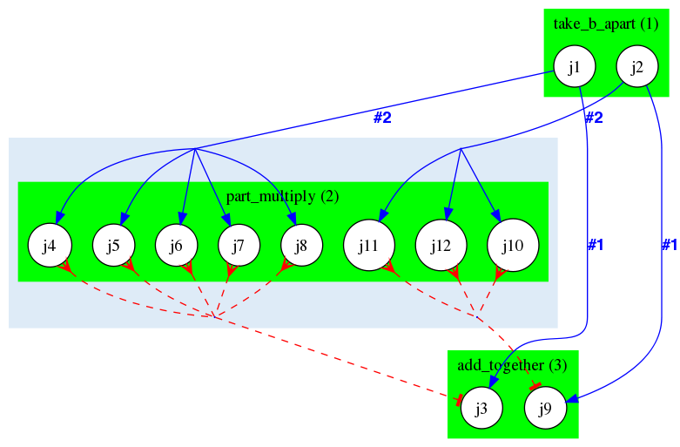
Semaphored dataflow (allows returning control back to trunk)
For gathering these threads back we now employ a trick with semaphores: the gathering point ("funnel job") is a job that is created by the same "factory job" that spawns jobs corresponding to independent threads.
The "funnel job" is then linked to the "fan jobs" by a two-way link which blocks the funnel job from starting until all "fan jobs" are finished.

Slide 5
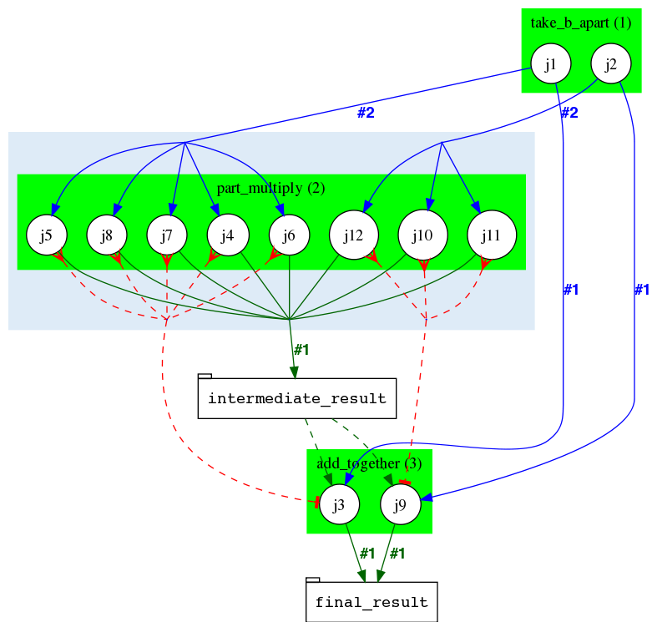
Dataflowing into external tables (old hacky way)
In the old model an external table had to be created and fan jobs were dataflowing their data into it. Then each funnel job had to figure out which rows belonged to it.

Slide 6
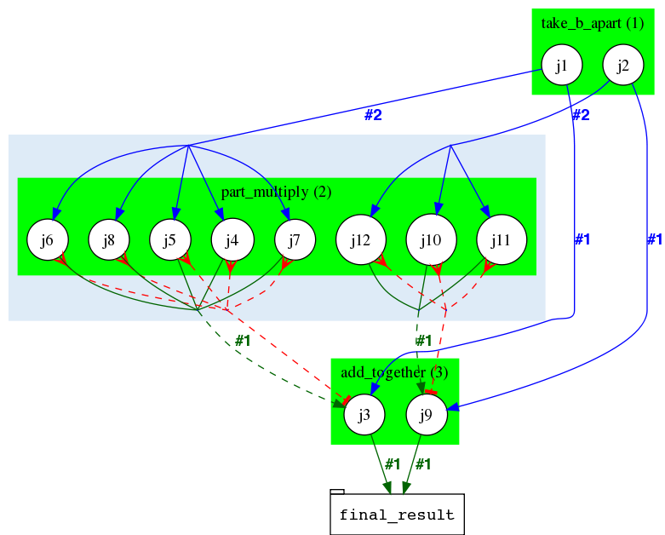
Accumulated dataflow (new proposed way)
This is a new mechanism that allows semaphoring jobs to send data directly to their funnel job.
Same dataflow API is used for sending. Existing param API is used for receiving.
The Hive system makes sure a job only gets data that was intended for it.
Why the name?

Slide 7
Usage example:
dataflow rule from PipeConfig:
  1 => [ ':////accu?partial_product={digit}' ]
Sending code (standard dataflow API call) :
  $self->dataflow_output_id( { # here we are sending only one partial product
  'a_multiplier' => $self->param('a_multiplier'),
  'digit' => $self->param('digit'),
  'partial_product' => $self->param('partial_product')
  }, 1);
  [It ends up in accu table somewhere]
Retrieving code (standard param API call) :
  my $partial_product = $self->param('partial_product'); # an assembled hash

Slide 8
Final remarks
Four signatures correspond to different types of assembled data:
  [foo] indexed/ordered array
  [] pushed/unordered array
  {bar} hash
  {} multiset
Potential storage inefficiency [trade-off]
Untested on large datasets
Available from Sanger-internal git repository, to be included in next CVS release

Slide 9








Acknowledgements
Funding
Current and previous members of Compara team
All users of eHive system for testing, feedback and ideas
Paul Flicek, Steve Searle and the entire Ensembl Team
European Commission Framework Programme 7
Notes:
Updated November 2012

