Slide 1
eHive
–
Ensembl Compara Production system
Javier Herrero
Vertebrate Genomics Team
EMBL-EBI
Wellcome Trust Genome Campus
Hinxton CB10 1SD, UK
Notes:
11

Slide 2
Production System Requiements
Flexible
Fault-tolerant
Minimal supervision
High-throughput

Slide 3
eHive system overview
1 Database with information about
  jobs to be run
  rules about which jobs cannot be run before others
  rules about flowing the output of one job to another job
2 scripts
  runWorker.pl: takes jobs from the eHive DB; runs them; stores and/or flows the output
  beekeeper.pl: monitors the eHive DB and sends workers to the farm using LSF queuing system
BlackBoard
Dataflow graph
Autonomous agent
Central contoller

Slide 4
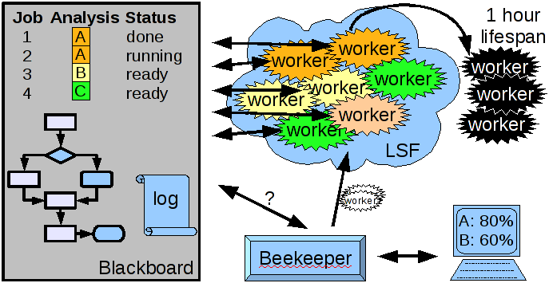
eHive overview

Slide 5
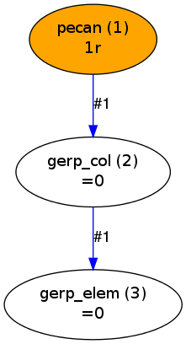
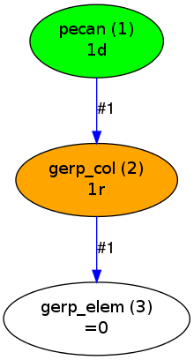
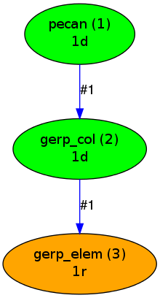
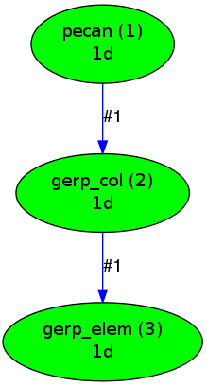
Pipeline design
A pipeline is usually defined a graph, with one job at the top that triggers new jobs when it completes.
time

Slide 6
Configuration module
The graph is defined in a configuration module. The easiest way to create your configuration module is to copy an existing one (ensembl-hive/modules/Bio/EnsEMBL/Hive/PipeConfig/).
It typically requires two sections at least:
  sub default_options { … }: defines defaults for this pipeline
  sub pipeline_analyses { … }: defines the analyses and how they are connected (the graph)

Slide 7
Pecan-GERP mini-pipeline
Let's design a simple pipeline to run:
  Pecan
  gerp_col
  gerp_elem
The output of Pecan will be used as the input for gerp_col and the output of gerp_col will be the input of gerp_elem.

Slide 8
Pecan-GERP mini-pipeline
The default_options section:
sub default_options {
my ($self) = @_;
return {
%{ $self->SUPER::default_options() },
'pipeline_name' => 'mini_pecan_single',
};
}
Returns a hash
Inherits other
defaults from
the base class
The name of the pipeline.
You can be creative
You could also specify other
values that can be used in
the pipeline

Slide 9
Pecan-GERP mini-pipeline
The pipeline_analyses section:
sub pipeline_analyses {
my ($self) = @_;
return [
{ -logic_name => 'pecan',
-module => 'Bio::EnsEMBL::Hive::RunnableDB::SystemCmd',
-parameters => {
'cmd' => 'your command goes here',
},
},
]
}
We need a unique
name for each analysis
The SystemCmd module
allows us to run command lines.
There are other modules and
you can create your owns.
The SystemCmd needs
the parameter cmd which
defines the command line

Slide 10
Pecan-GERP mini-pipeline
Fixed command:
{ -logic_name => 'pecan',
-module => 'Bio::EnsEMBL::Hive::RunnableDB::SystemCmd',
-parameters => {
'cmd' => 'java -cp pecan_v0.8.jar bp.pecan.Pecan
-E "(HUMAN,(MOUSE,RAT));"
-F human.fa mouse.fa rat.fa -G pecan.mfa',
},
},
This is not very convenient as it will
always run exactly the same command

Slide 11
Pecan-GERP mini-pipeline
Parameter substitution:
{ -logic_name => 'pecan',
-module => 'Bio::EnsEMBL::Hive::RunnableDB::SystemCmd',
-parameters => {
'cmd' => 'java -cp pecan_v0.8.jar bp.pecan.Pecan -E
"#tree_string#" -F #input_files# -G #msa_file#',
},
-input_ids => [
{
'tree_string' => '(HUMAN,(MOUSE,RAT));',
'input_files' => 'human.fa mouse.fa rat.fa',
'msa_file' => 'pecan.mfa',
}
],
},
The parameters are the
same for all the jobs of
a given analysis.
Note: Typically, each analysis
gets its input from the previous
one in the pipeline.
Each set of input_ids will be a
job. We can have several ones,
But they need to be unique.

Slide 12
Pecan-GERP mini-pipeline
gerp_col and gerp_elem analyses:
{ -logic_name => 'gerp_col',
-module => 'Bio::EnsEMBL::Hive::RunnableDB::SystemCmd',
-parameters => {
'cmd' => 'gerpcol -t tree.nw -f #msa_file# -a -e HUMAN',
},
},
{ -logic_name => 'gerp_elem',
-module => 'Bio::EnsEMBL::Hive::RunnableDB::SystemCmd',
-parameters => {
'cmd' => 'gerpelem -f #msa_file#.rates -c chr13 -s 32878016 -x .bed',
},
},
Now we have all the analyses,
but we haven't defined how
they are connected
We will use dataflow rules
for connecting the steps.

Slide 13
Pecan-GERP mini-pipeline
Dataflow rules
{ -logic_name => 'pecan',
[[...snip...]]
-flow_into => {
1 => [ 'gerp_col' ],
},
},
{ -logic_name => 'gerp_col',
[[...snip...]]
-flow_into => {
1 => [ 'gerp_elem' ],
},
},
{ -logic_name => 'gerp_elem',
[[...snip...]]
},
Pecan jobs will flow into gerp_col
gerp_col jobs will flow into gerp_elem
See MiniPecanSingle_conf.pm

Slide 14
Running an eHive pipeline
You need to complete four steps:
  Write/Modify your configuration module (this is required only the 1st time)
  Configure your environment (could be saved in your .bashrc file)
    export PATH=$PATH:~/src/ensembl-hive/scripts
    export ENSEMBL_CVS_ROOT_DIR=~/src/
  Initialise your pipeline
    init_pipeline.pl MiniPecanSingle_conf.pm -hive_driver sqlite -password FOO
  Run beekeeper.pl
    beekeeper.pl -url sqlite:///username_mini_pecan_single -loop

Slide 15
Advanced dataflow: input_template
This allows you to rename the parameters between analyses:
{ -logic_name => 'pecan',
[[...snip...]]
-flow_into => {
1 => { 'gerp_col' => {'input_file' => '#msa_file#'} },
},
},
{ -logic_name => 'gerp_col',
-module => 'Bio::EnsEMBL::Hive::RunnableDB::SystemCmd',
-parameters => {
'cmd' => 'gerpcol -t tree.nw -f #input_file# -a -e HUMAN',
},
[[...snip...]]
},
See MiniPecanSingle2_conf.pm

Slide 16
Advanced dataflow: semaphores
Semaphores create control rules at the job level. A given job cannot start until some jobs are done.
This is typically used for fans and funnels, where a job creates several ones and you need a job to collect all the information at the end.
  Imagine you want to find the most similar protein in a large set:
#2 Analysis
- query protein
- target protein 7
#2 Analysis
- query protein
- target protein 6
#2 Analysis
- query protein
- target protein 5
#1 Create BLAST jobs
- query protein
- target set
#2 Analysis
- query protein
- target protein 4
#3 Compile
- query protein
- target set
#2 Analysis
- query protein
- target protein 3
#2 Analysis
- query protein
- target protein 2
#2 BLAST
- query protein
- target protein 1

Slide 17
Simple semaphore
{ -logic_name => 'pecan',
[[...snip...]]
-input_ids => [
{
'tree_string' => '((((HUMAN,(MOUSE,RAT)),COW),OPOSSUM),CHICKEN);',
'input_files' => 'human.fa mouse.fa rat.fa cow.fa opossum.fa chicken.fa',
'msa_file' => "pecan3.mfa",
'chr_name' => "chr13",
'chr_start' => "32878016",
},
],
-flow_into => {
'1->A' => { 'gerp_col' => {'input_file' => '#msa_file#'} },
'A->1' => { 'gerp_elem' => {'input_file' => '#msa_file#.rates',
'chr_name' => '#chr_name#',
'chr_start' => '#chr_start#'}
},
},
},
1->A: jobs flow through branch 1.
These jobs will update the
semaphore 'A' upon completion
A->1: jobs flow through branch 1.
These jobs will wait for the
corresponding gerp_col job.
See MiniPecanSingle3_conf.pm

Slide 18
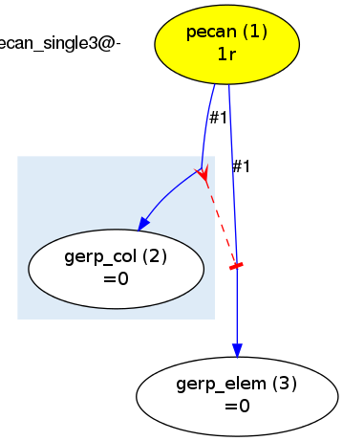
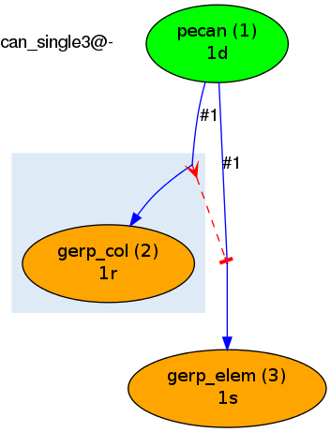
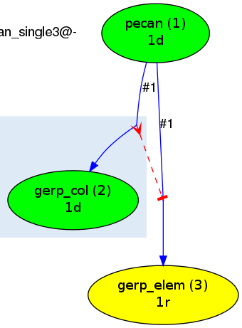
Simple semaphore timeline
The pecan job create both the gerp_col and gerp_elem jobs, however the gerp_elem
job is semaphored (s) and waits for its gerp_col job to finish.
time

Slide 19
A couple of examples of pipelines
used in Ensembl Compara
These graphs represent real pipelines and show how you can build complex pipelines by combining dataflow rules, control rules and semaphores.

Slide 20
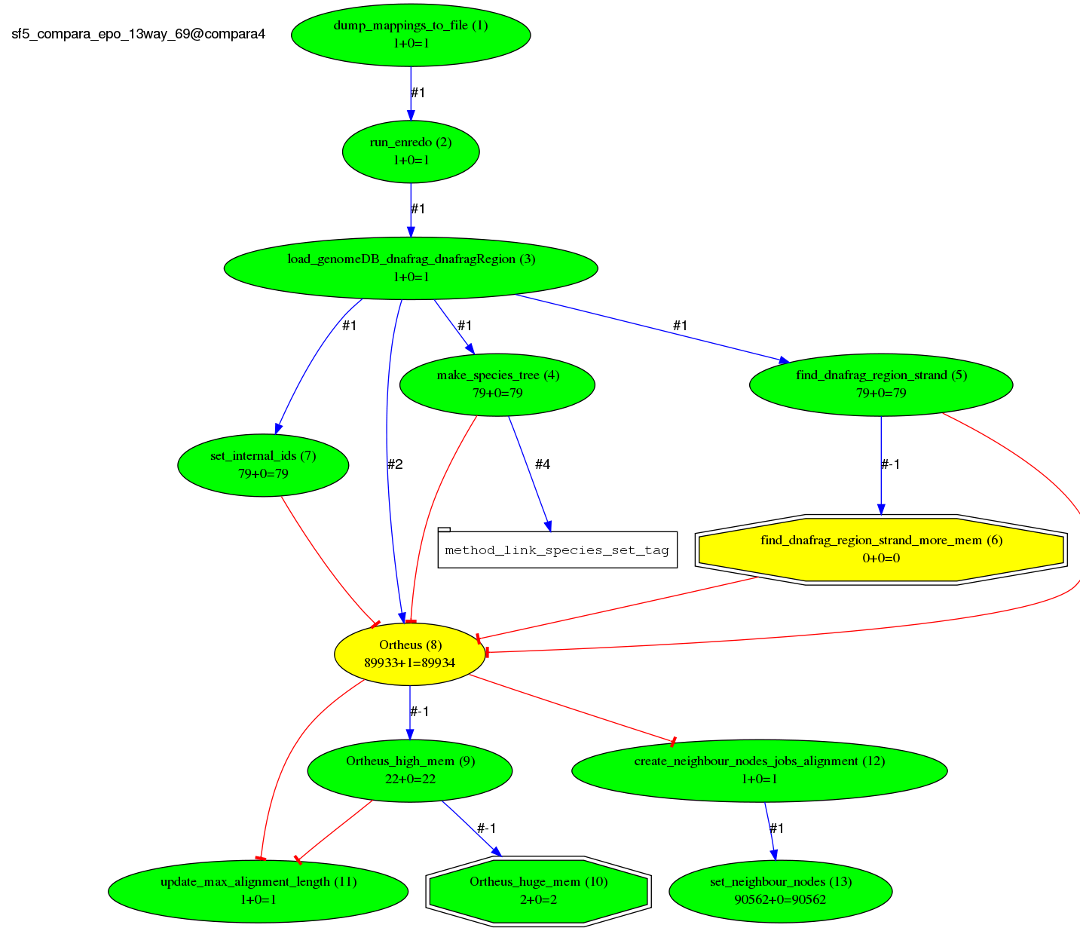
Ensembl EPO pipeline graph

Slide 21
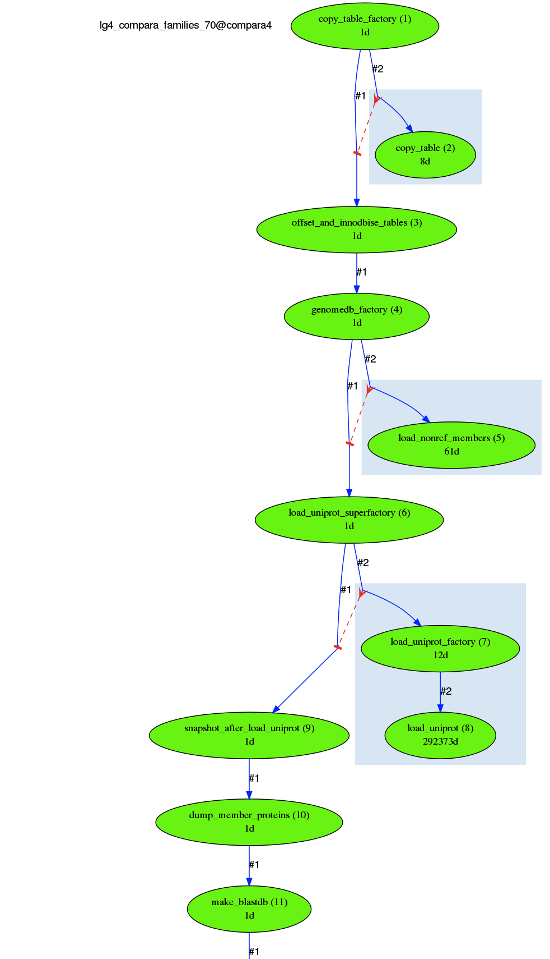
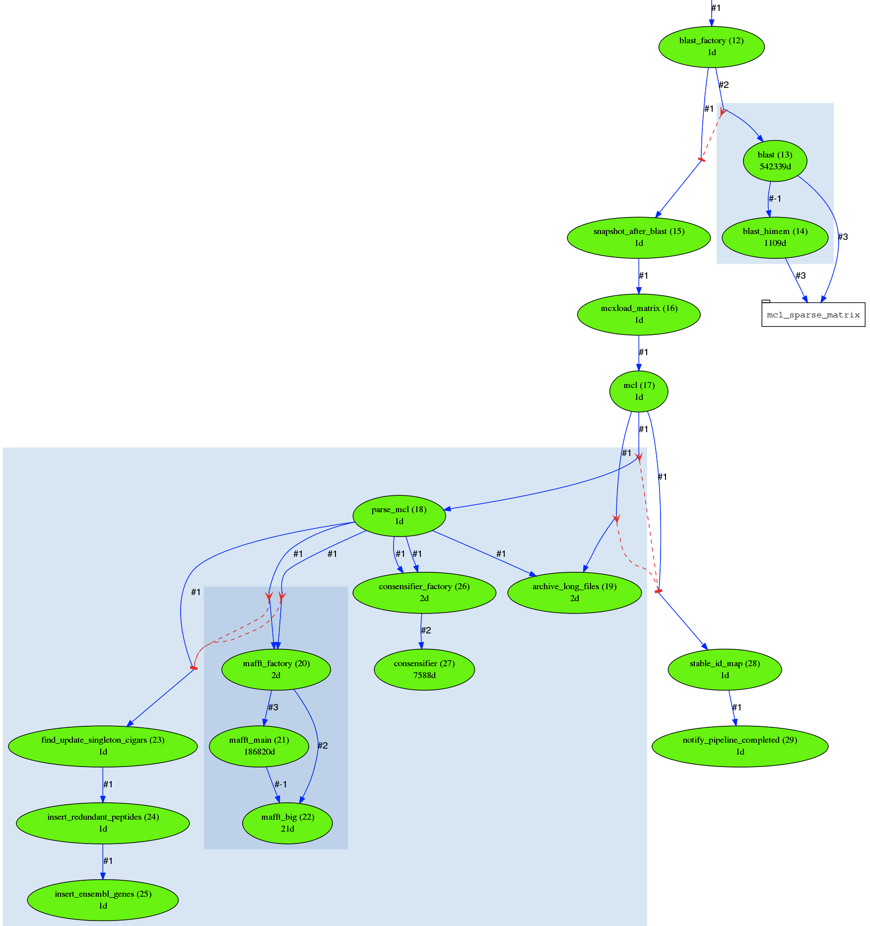
Ensembl Family pipeline graph

