Slide 1
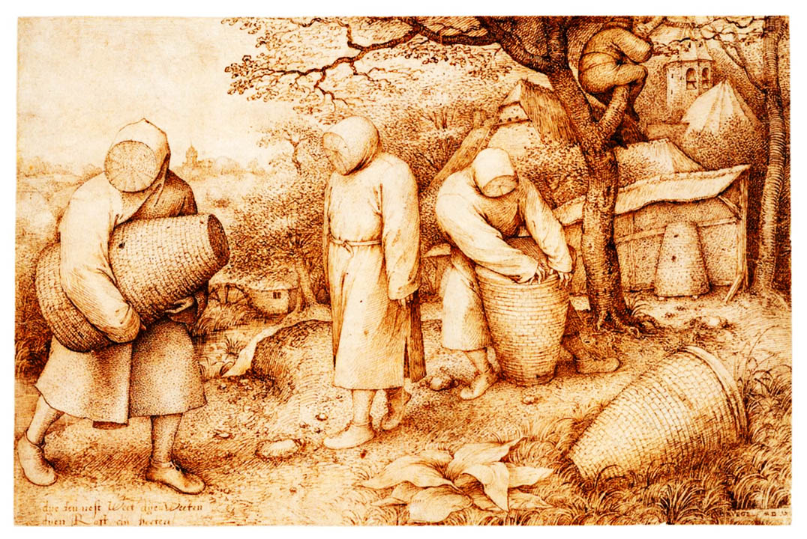
The joys of beekeeping
Leo Gordon
Notes:
Title page (introduce yourself and what you are doing)

Slide 2
Software pipeline (Q)
What makes a software pipeline different from a script/program? (assuming top-down approach)
Notes:
eHive's definition is deliberately incomplete. Missing are the “distributed autonomous agents”. But this is an implementation-related issue that will be discussed later. One can imagine an eHive with RuleManager kind of job dispatcher that would still do the job
software pipelines are what we build and use on a regular basis, they can be conceptually stratified.
code is the most abstract extremity; it lacks parameters. If it had no parameters or input data, there would be no point in including it into a pipeline. Everything could have been executed once.
job definitions EQUAL to the parameters for the code. There is nothing else.
because jobs are linked together (one job's output is another's input), we need a uniform representation.

Slide 3
Software pipeline (A)
Usually a computation that doesn't need interaction
Availability of multiple computers (cluster/farm/grid) to perform the computation
Availability of convenient tools/languages to automate running of this computation
Notes:
eHive's definition is deliberately incomplete. Missing are the “distributed autonomous agents”. But this is an implementation-related issue that will be discussed later. One can imagine an eHive with RuleManager kind of job dispatcher that would still do the job
software pipelines are what we build and use on a regular basis, they can be conceptually stratified.
code is the most abstract extremity; it lacks parameters. If it had no parameters or input data, there would be no point in including it into a pipeline. Everything could have been executed once.
job definitions EQUAL to the parameters for the code. There is nothing else.
because jobs are linked together (one job's output is another's input), we need a uniform representation.

Slide 4
Software pipeline (requirements)
Some code may take too long to compute sequentially
  Transform independent loop iterations into individual “jobs”
    rotate time into space
Some code may crash eventually
  Use checkpointing, restarting only individual jobs that crashed
    rather than restarting the whole computation
  Checkpointing in a non-sequential process means complex states
Some code may be resource-greedy
  Jobs can be given different (estimated) resources - memory, execution time, disk/temp storage space
  Feedback collected on the actual usage of resources

Slide 5
eHive system: analyses, jobs, rules
Database-centric
Individual pipeline instances created from config files and become “pipeline databases” with eHive schema
  possibly extended with pipeline-specific tables
Pipeline database contains a flow diagram with “analyses” as its nodes and “rules” as its edges.
Analyses are abstract classes, jobs are specific instances, units of computation.
Jobs can create other jobs (dataflow rules), block other jobs (semaphores) or whole analyses (control rules)
Notes:
eHive's definition is deliberately incomplete. Missing are the “distributed autonomous agents”. But this is an implementation-related issue that will be discussed later. One can imagine an eHive with RuleManager kind of job dispatcher that would still do the job
software pipelines are what we build and use on a regular basis, they can be conceptually stratified.
code is the most abstract extremity; it lacks parameters. If it had no parameters or input data, there would be no point in including it into a pipeline. Everything could have been executed once.
job definitions EQUAL to the parameters for the code. There is nothing else.
because jobs are linked together (one job's output is another's input), we need a uniform representation.

Slide 6
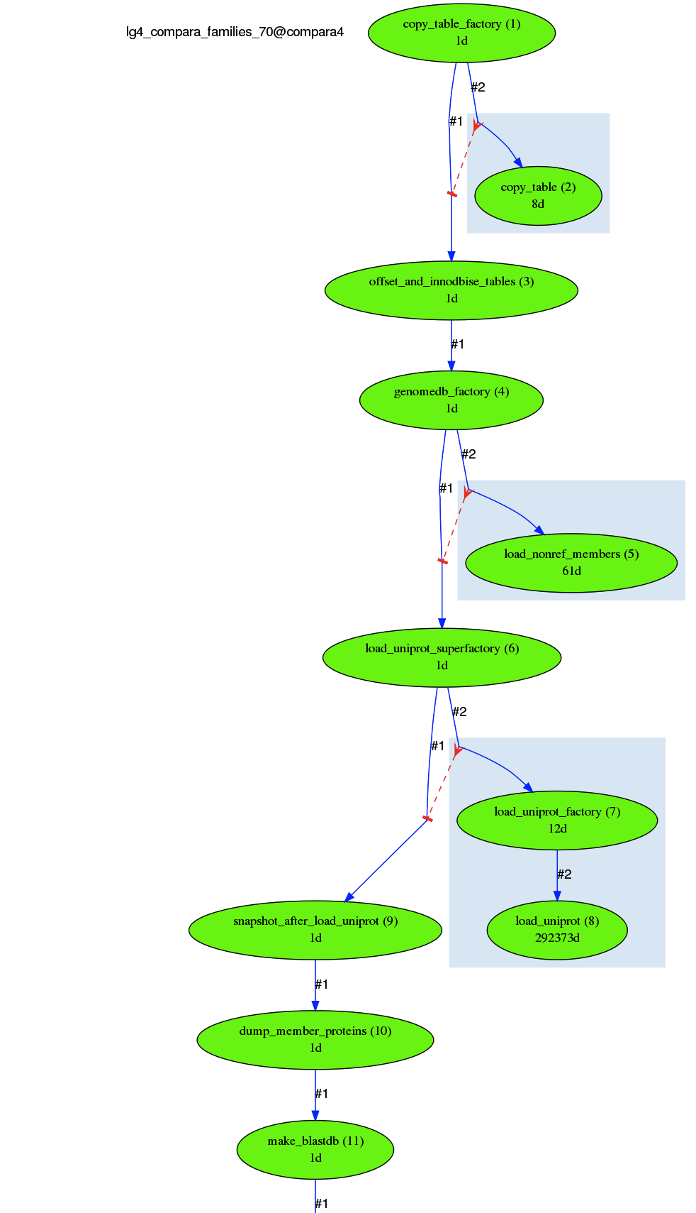
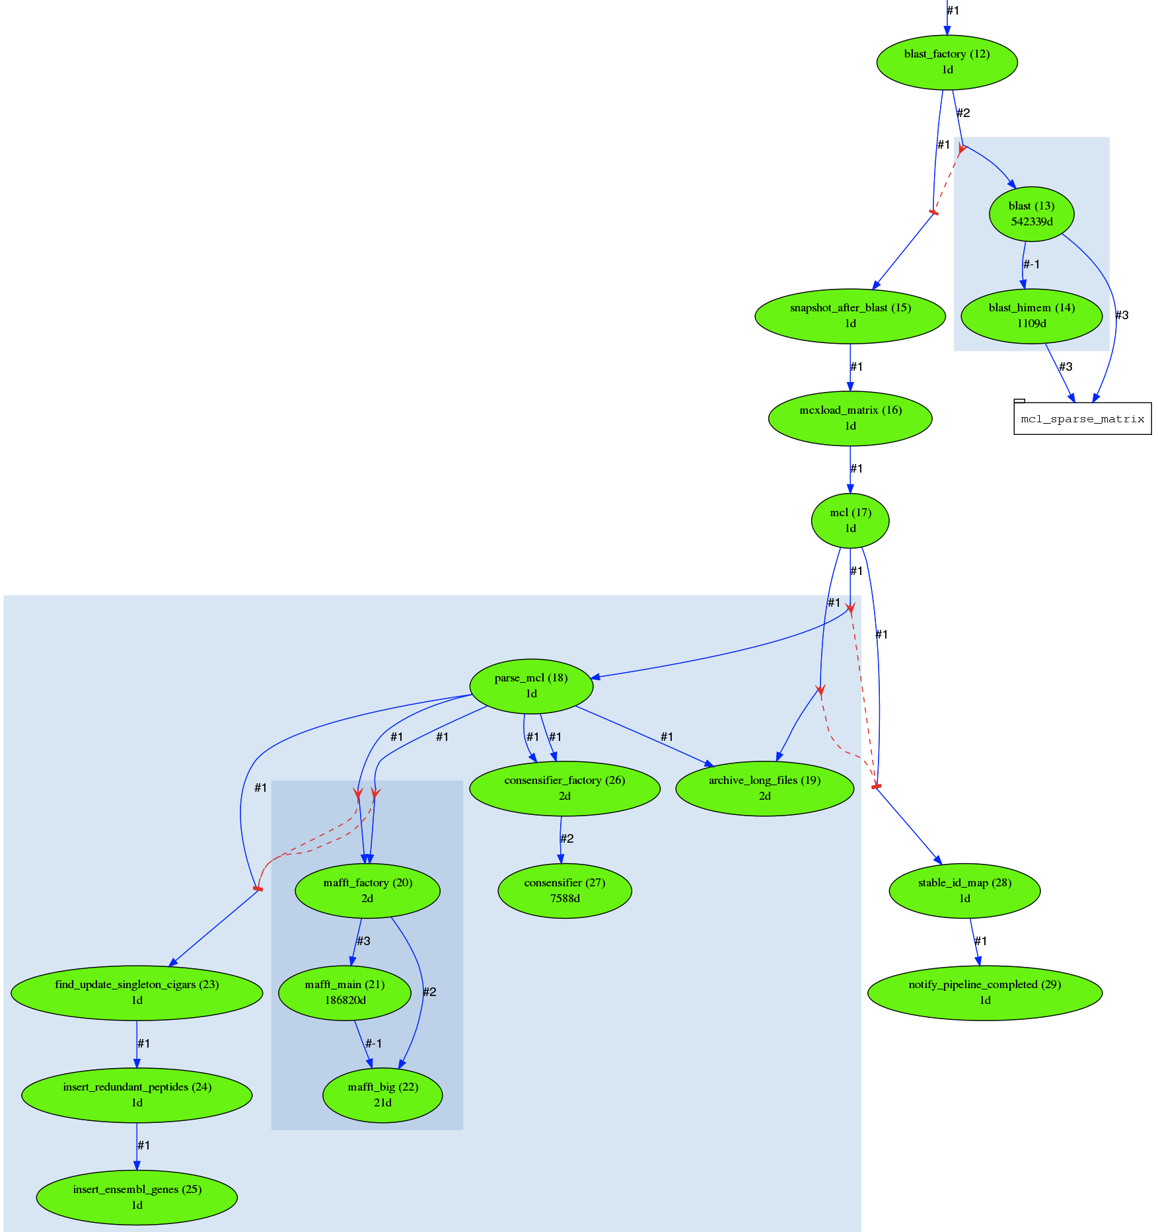
eHive system: a pipeline diagram
Notes:
eHive's definition is deliberately incomplete. Missing are the “distributed autonomous agents”. But this is an implementation-related issue that will be discussed later. One can imagine an eHive with RuleManager kind of job dispatcher that would still do the job
software pipelines are what we build and use on a regular basis, they can be conceptually stratified.
code is the most abstract extremity; it lacks parameters. If it had no parameters or input data, there would be no point in including it into a pipeline. Everything could have been executed once.
job definitions EQUAL to the parameters for the code. There is nothing else.
because jobs are linked together (one job's output is another's input), we need a uniform representation.

Slide 7
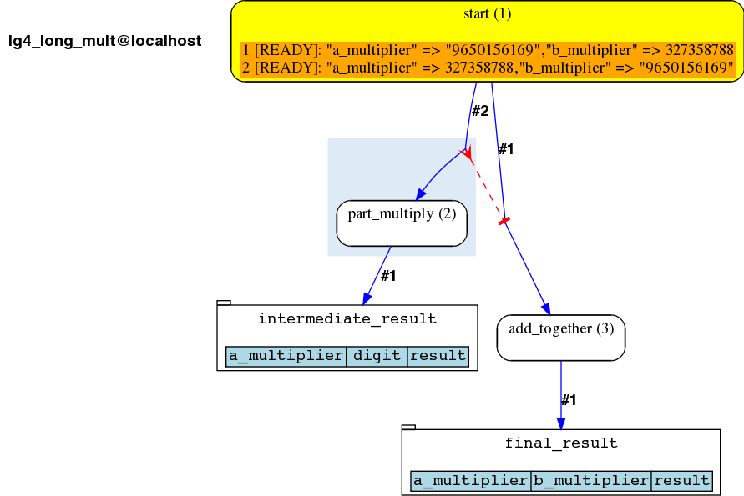
LongMultiplication example pipeline (1)

Slide 8
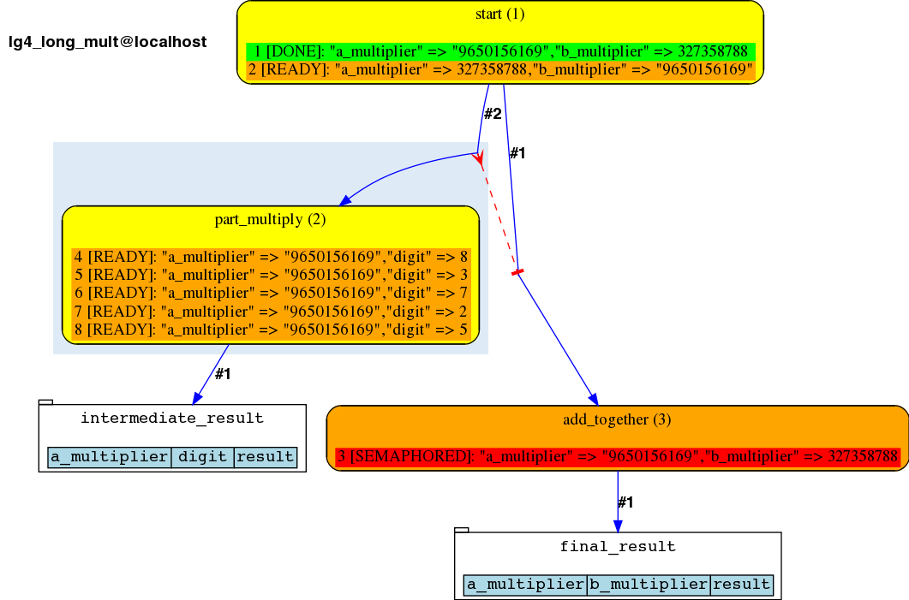
LongMultiplication example pipeline (2)

Slide 9
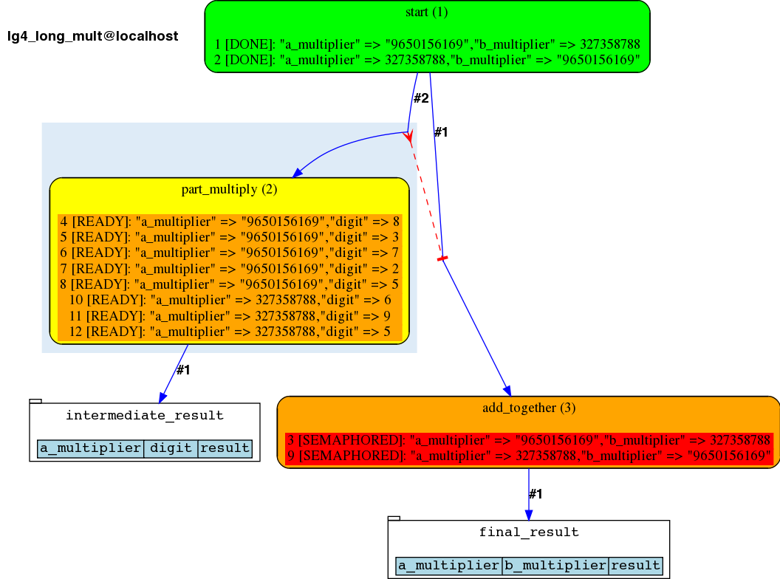
LongMultiplication example pipeline (3)

Slide 10
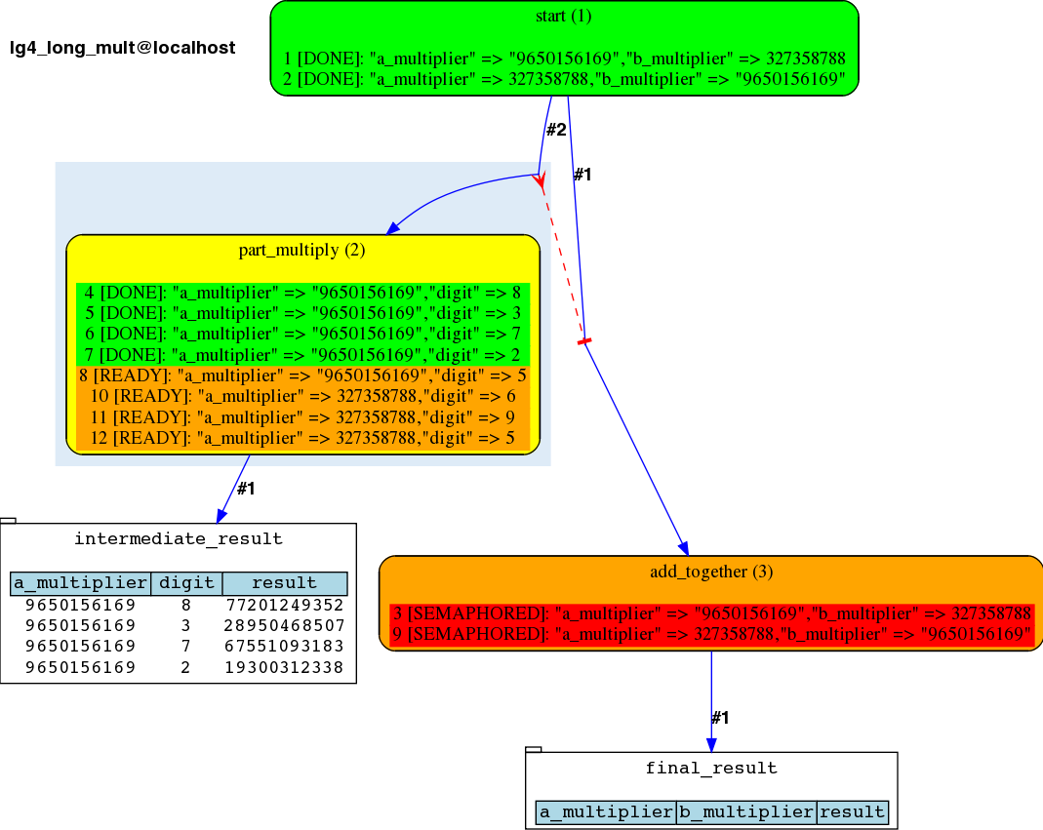
LongMultiplication example pipeline (4)

Slide 11
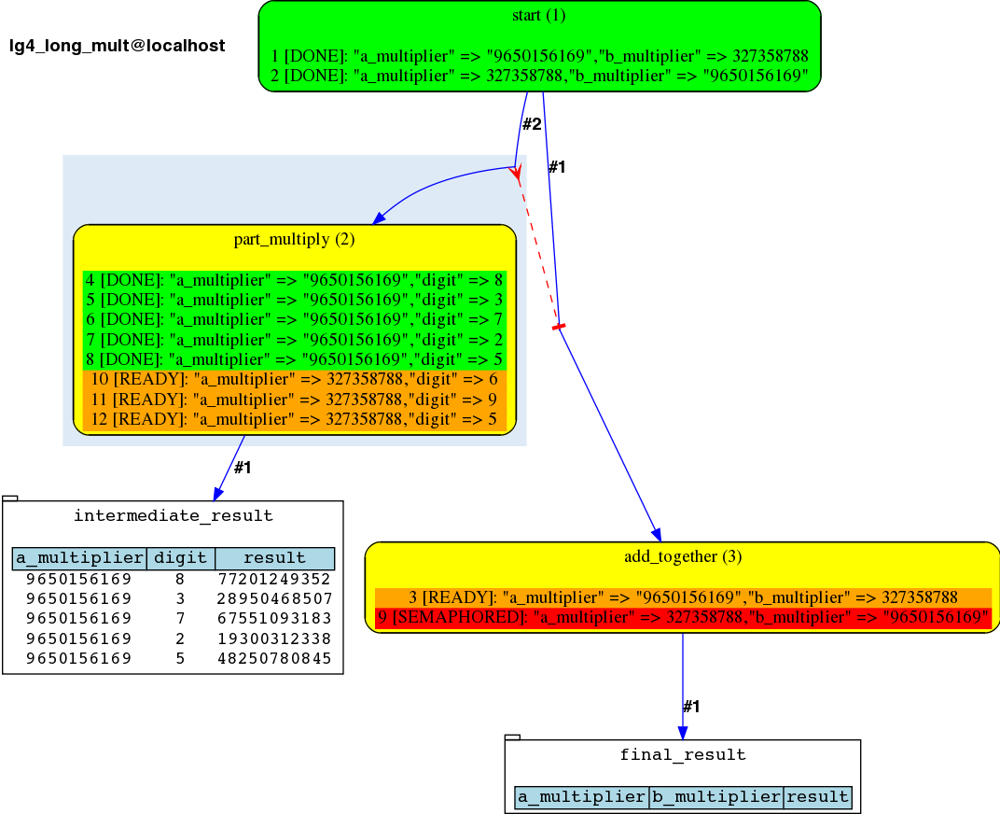
LongMultiplication example pipeline (5)

Slide 12
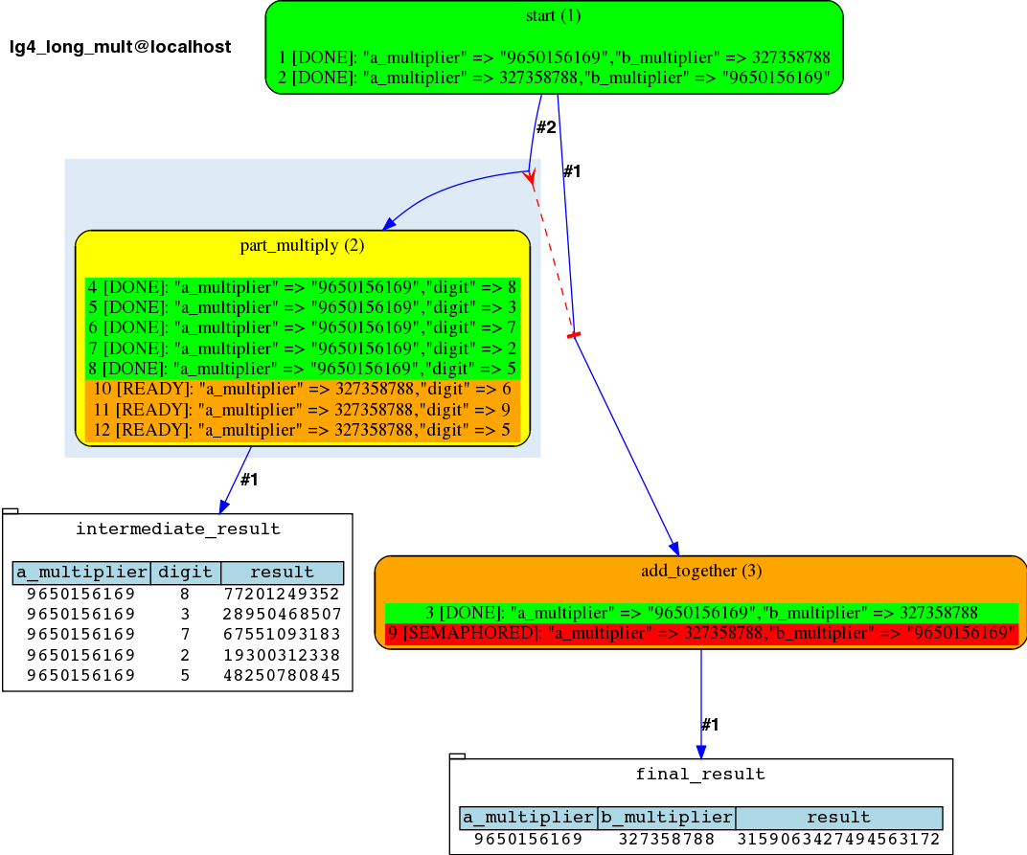
LongMultiplication example pipeline (6)

Slide 13
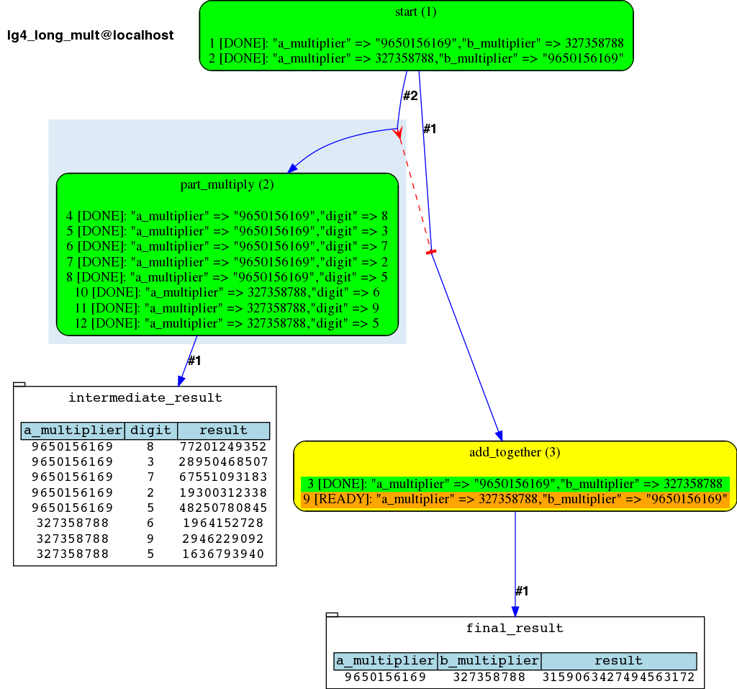
LongMultiplication example pipeline (7)

Slide 14
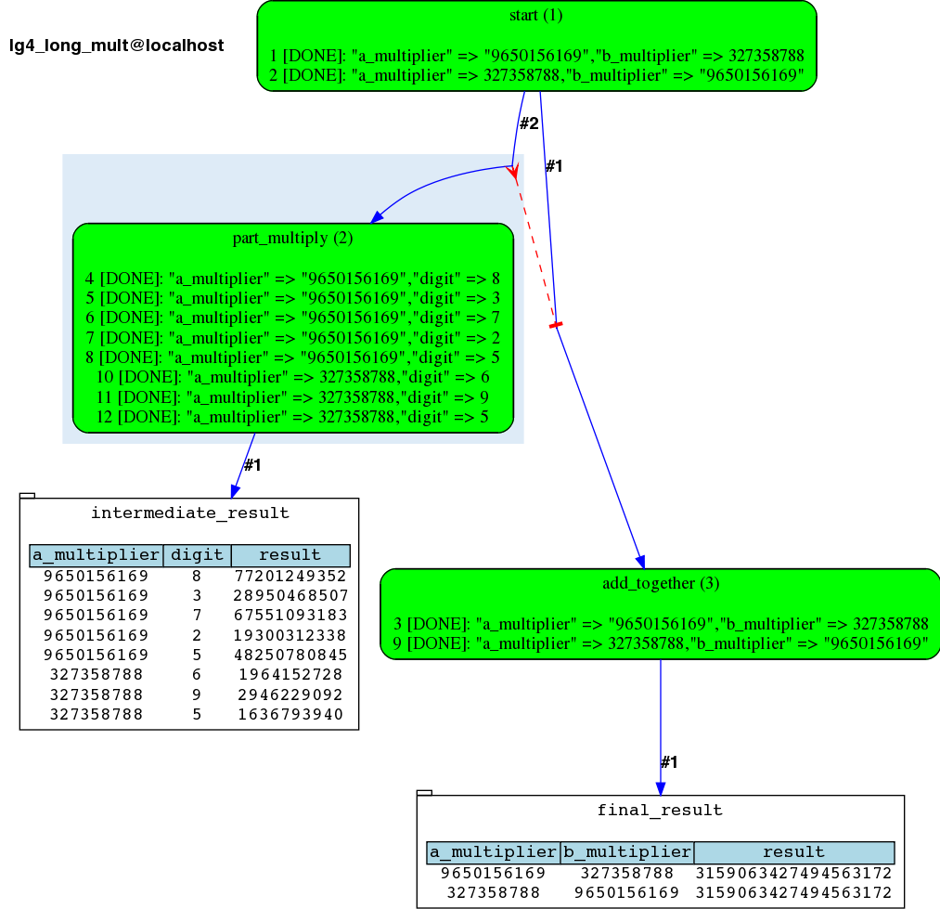
LongMultiplication example pipeline (8)

Slide 15
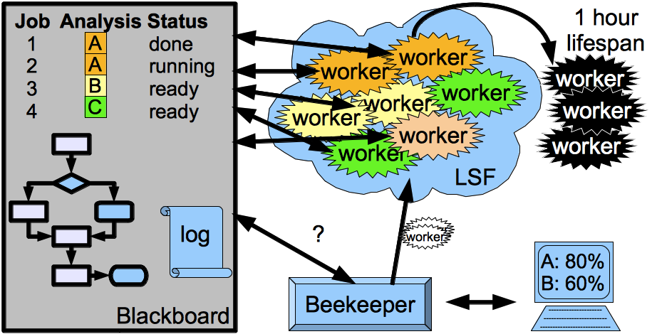
Workers, beekeeper, [re]specialization

Slide 16
Multi-meadow scheduling
The same beekeeper can now submit both farm Workers and local Workers (busy farms, lots of light “linking code” between farm-needing processes)
This preference (as well as desired resources) can be set for each Analysis
Helps to save compute time, esp. combined with re-specialization of Workers

Slide 17
Using Git for development
Development is done in Git (locally)
Regularly pushed to the internal Git server visible to Sanger network users
Less frequent (once per release?) exports to the externally-visible CVS server
Fancy to try?
git clone git.internal:/repos/git/ensembl/compara/ensembl-hive.git
eHive mailing list:
ehive-users@ebi.ac.uk

Slide 18








Acknowledgements
Funding
Current and previous members of Compara team
All users of eHive system for testing, feedback and ideas
Paul Flicek, Steve Searle and the entire Ensembl Team
European Commission Framework Programme 7
Notes:
Updated November 2012

