Slide 1
The IFs of Hive
Leo Gordon
A3-145
ehive-users@ebi.ac.uk

Slide 2
Flow in eHive
eHive is our main tool for building powerful and complex pipelines
We use stratification to minimize the development effort:
  Runnables are simple & generic building blocks;
  they package the code
  PipeConfigs have enough complexity to parametrize and link the above;
  they describe pipeline flow diagrams
In eHive dataflow and control flow tend to converge together, based on a simple messaging protocol:
  Runnables emit messages (send hashes into numbered channels)
  PipeConfigs decide where they should go. It is the only linking mechanism.

Slide 3
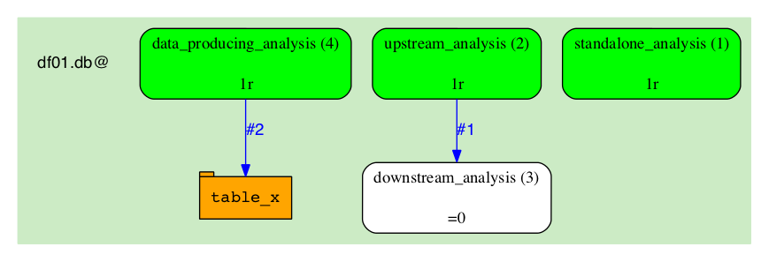
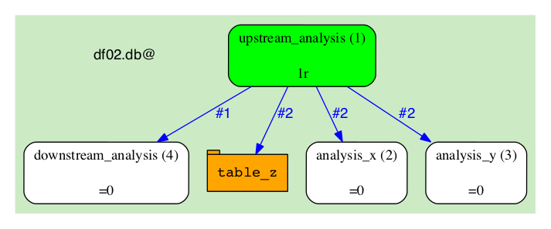
Flow in eHive – simple examples

Slide 4
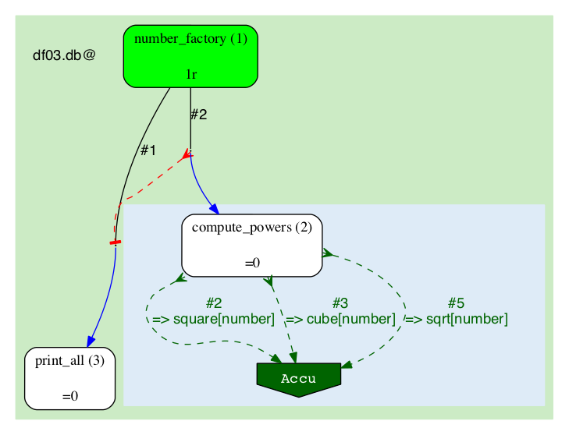
Flow in eHive – Semaphores and Accus
eHive's way to express fanning out, parallel processing and merging back
In semaphore context the concepts of control flow and dataflow converge
An extra type of dataflow targets in semaphore fan context: accumulators

Slide 5
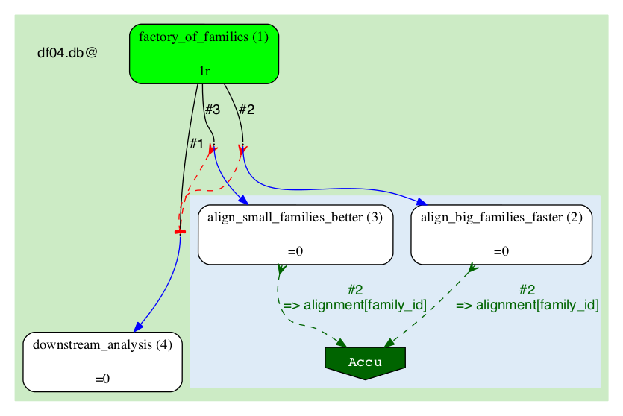
Old way: choice built into Runnables
Solution where Runnable defines the selection criterion is inflexible (even when parametric).
It is also invisible to the pipeline engineer or anyone looking at the diagram.

Slide 6
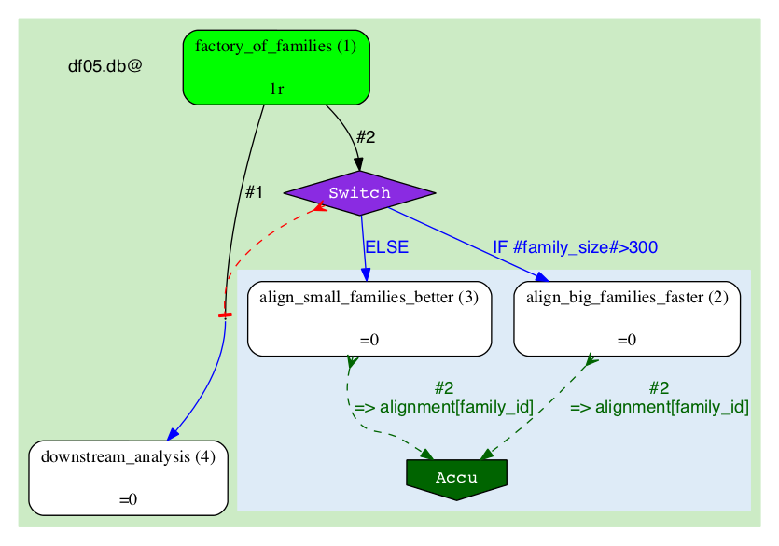
New way: choice on PipeConfig level
We can leave the Runnable alone, treat it as a “black box”.
The condition can be used before any type of target (filter or sort data, create jobs, or both)

Slide 7
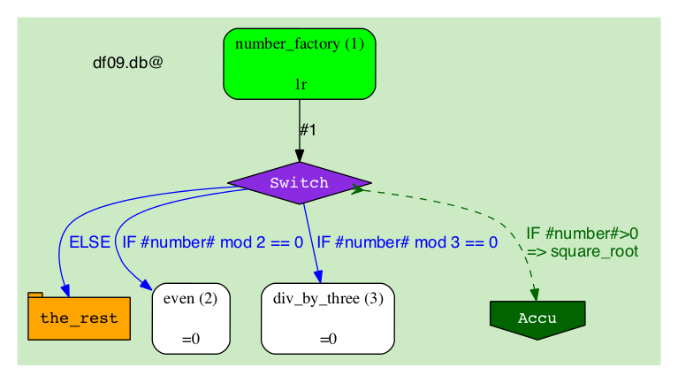
Conditional flow: pros and cons
Pros:
  Conditions are not mutually exclusive and are computed without an order
  (it's a “parallel switch”)
  They share a common “ELSE” branch
  A condition can be used before any type of target:
  filter or sort data, create jobs, accumulators, or any mixture
  Diagrams become more readable
Cons:
  Conditions are not mutually exclusive and are computed without an order
  (they cannot be chained or nested)

Slide 8
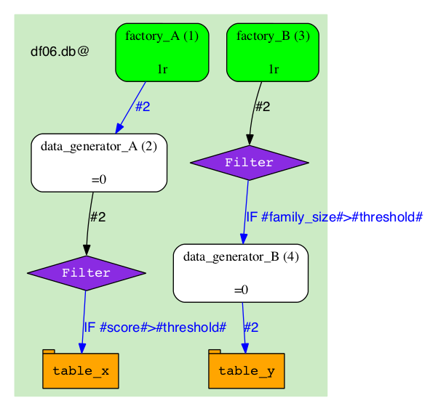
Usage of conditional flow: filtering
Filtering individual items:
  data before storing it in a table
  jobs before creating them in an analysis

Slide 9
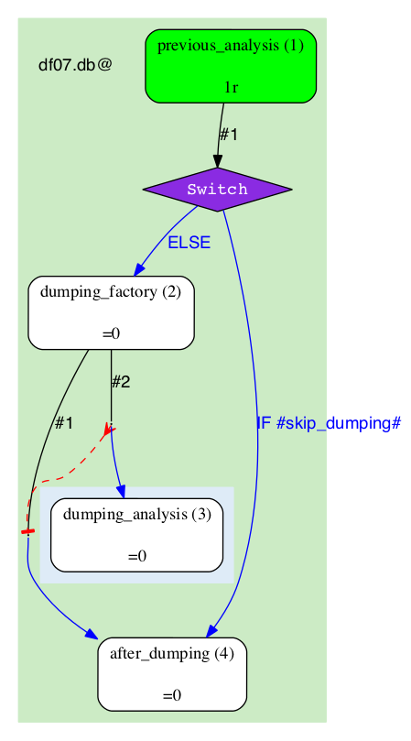
Usage of conditional flow: bypass
Skipping whole parts of the pipeline:
  statically (via pipeline_wide_parameters)
  or dynamically (by passing the parameter in)

Slide 10
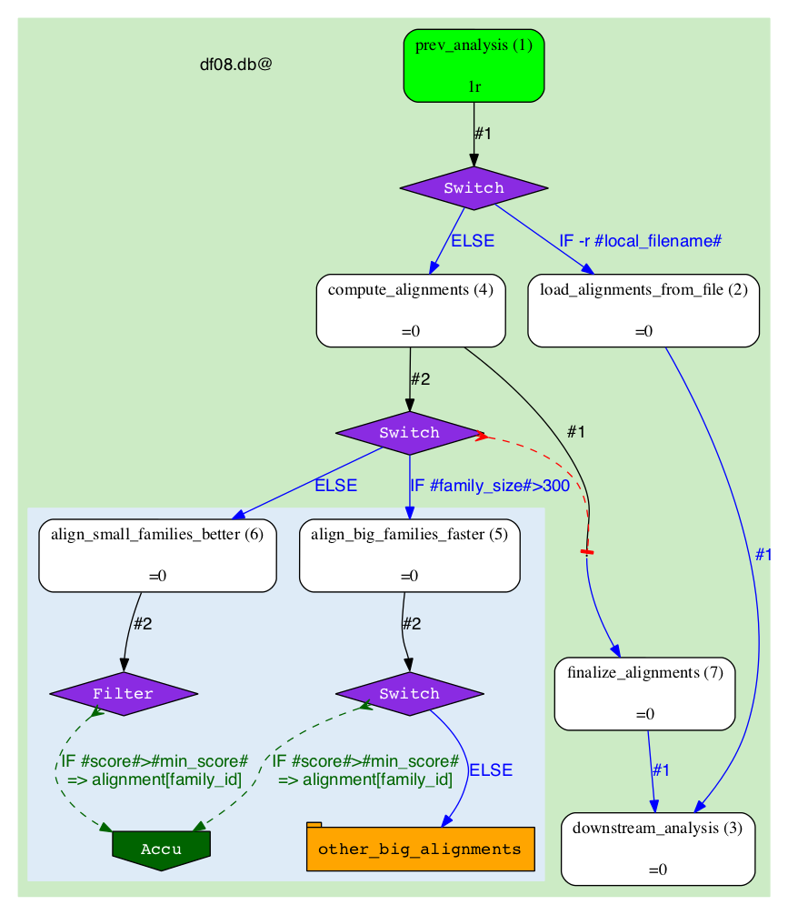

Slide 11
Availability
Questions?
Conditional flow can be tried on master branch
Officially in from version/2.4

Slide 12








Acknowledgements
The Entire Ensembl Team, esp. Matthieu Muffato
Funding
Co-funded by the European Union

