Slide 1
Ensembl API Course: REST API
Magali Ruffier
2nd September 2015
EMBL – European Bioinformatics Institute
Wellcome Trust Genome Campus
Hinxton, Cambridge, CB10 1SD, UK

Slide 2
Outline
Ensembl
Data available
Data access
The REST API
What is it
How to query it
Examples
Retrieve sequence
From region to variation
Write a script

Slide 3
Outline
Introduction to the Ensembl REST APIs on rest.ensembl.org and grch37.rest.ensembl.org
How to make REST requests
How to fetch data with Python, Ruby, Perl or from the UNIX command line
Data available:
sequences and genomic features
genomic alignments or gene trees
convert coordinates between two different assemblies
Fetch variant consequences based on a SNP or a CNV

Slide 4
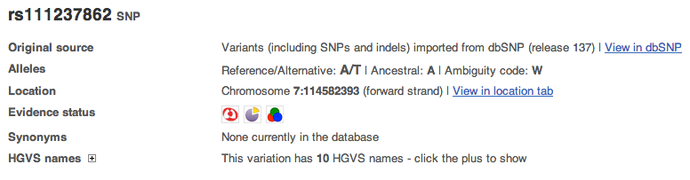
Data in Ensembl
>ENSP00000288602
MAALSGGGGGGAEPGQALFNGDMEPEAGAGAGAAASSAADPAIPEEVWNIKQMIKLTQEH
IEALLDKFGGEHNPPSIYLEAYEEYTSKLDALQQREQQLLESLGNGTDFSVSSSASMDTV
TSSSSSSLSVLPSSLSVFQNPTDVARSNPKSPQKPIVRVFLPNKQRTVVPARCGVTVRDS
LKKALMMRGLIPECCAVYRIQDGEKKPIGWDTDISWLTGEELHVEVLENVPLTTHNFVRK
TFFTLAFCDFCRKLLFQGFRCQTCGYKFHQRCSTEVPLMCVNYDQLDLLFVSKFFEHHPI
PQEEASLAETALTSGSSPSAPASDSIGPQILTSPSPSKSIPIPQPFRPADEDHRNQFGQR
DRSSSAPNVHINTIEPVNIDDLIRDQGFRGDGGSTTGLSATPPASLPGSLTNVKALQKSP
GPQRERKSSSSSEDRNRMKTLGRRDSSDDWEIPDGQITVGQRIGSGSFGTVYKGKWHGDV
AVKMLNVTAPTPQQLQAFKNEVGVLRKTRHVNILLFMGYSTKPQLAIVTQWCEGSSLYHH
LHIIETKFEMIKLIDIARQTAQGMDYLHAKSIIHRDLKSNNIFLHEDLTVKIGDFGLATV
KSRWSGSHQFEQLSGSILWMAPEVIRMQDKNPYSFQSDVYAFGIVLYELMTGQLPYSNIN
NRDQIIFMVGRGYLSPDLSKVRSNCPKAMKRLMAECLKKKRDERPLFPQILASIELLARS
LPKIHRSASEPSLNRAGFQTEDFSLYACASPKTPIQAGGYGAFPVH

Slide 5
Access to data
Ensembl web site
Pre! web site
Archive! web site
GRCh37 web site
BioMart
FTP site
MySQL
Perl API
REST API
GRCh37 REST API
http://www.ensembl.org
http://pre.ensembl.org
http://archive.ensembl.org
http://grch37.ensembl.org
http://www.ensembl.org/biomart/martview
ftp://ftp.ensembl.org
http://www.ensembl.org/info/data/mysql.html
http://www.ensembl.org/info/data/api.html
http://rest.ensembl.org
http://grch37.rest.ensembl.org

Slide 6


What Is A REST API
REpresentational State Transfer
Simple APIs with very few external dependencies
Can use the web (HTTP) to communicate
Can be queried by
Web browsers
Command line tools
Programming languages

Slide 7
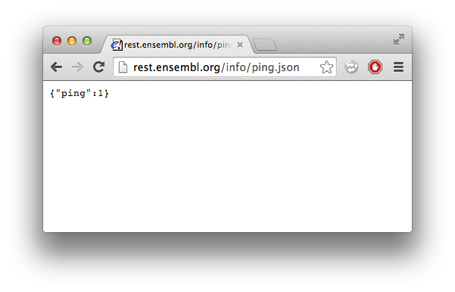
How Do You Query A REST API?
With URLs; the same way you go to any webpage
URL goes here
Output here

Slide 8
How A URL Is Formed
Endpoint
and parameters
Optional
parameters
Server
http://rest.ensembl.org/info/ping?content-type=application/json

Slide 9
How Do You Query?
The web browser can be used as a test client
Plugins are available for most browsers
Firefox – RESTClient
Chrome – REST Console or Postman
All major programming languages can perform HTTP requests

Slide 10
Constructing a URL
Find the endpoint you need
Use find on the main page for more information
Copy an example URL into a text editor
Edit with your variables
Check the options available
Paste back into the address bar and press return
http://rest.ensembl.org/sequence/region/:species/:region.fasta
human
6:2198711..2198900

Slide 11
Example
Using the stable ID ENSG00000157764 (human BRAF)
Retrieve its genomic sequence in plain text
Soft mask this in FASTA format
Retrieve all linked protein sequences in JSON

Slide 12
Example
Using the stable ID ENSG00000157764 (human BRAF)
Retrieve its genomic sequence in plain text
Soft mask this in FASTA format
Retrieve all linked protein sequences in JSON

Slide 13
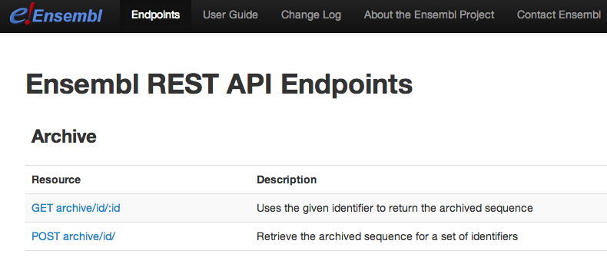
Start from the main page
http://rest.ensembl.org

Slide 14
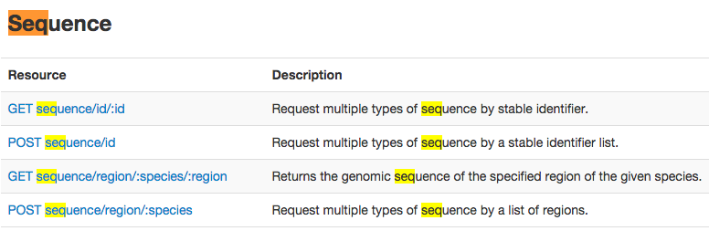

Find the correct endpoint
Find and click sequence/id/:id
⌘ / Ctrl + f = find within page

Slide 15
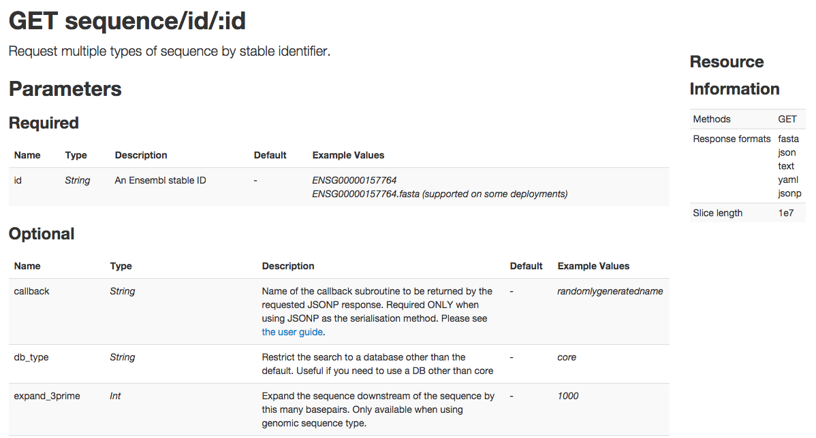
Check the options available
The URL and required parameters
Supported HTTP methods
and output formats
Required parameters
and examples
The optional parameter set

Slide 16
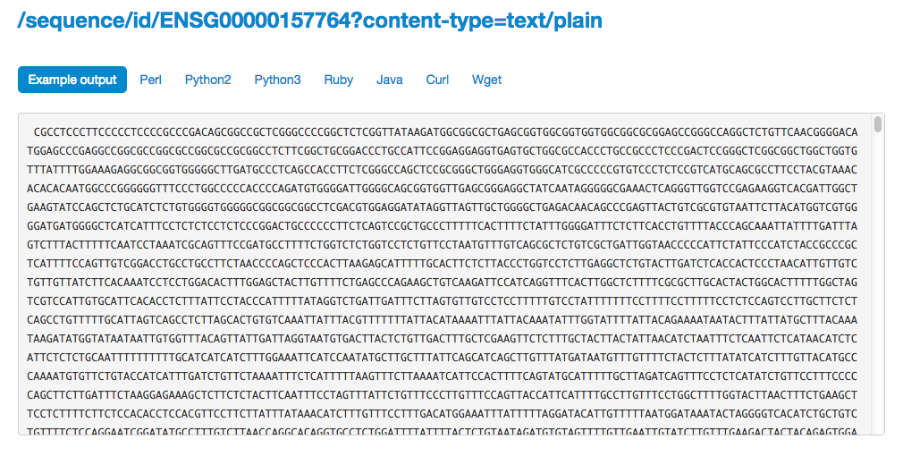
Select an example

Slide 17
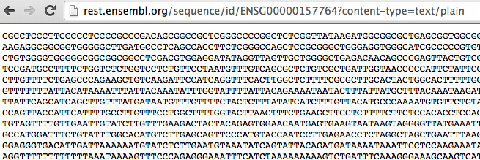
Copy and paste in the navigation bar

Slide 18
Example
Using the stable ID ENSG00000157764 (human BRAF)
Retrieve its genomic sequence in plain text
Soft mask this in FASTA format
Retrieve all linked protein sequences in JSON

Slide 19
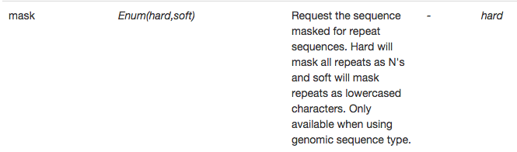
Check the parameters

Slide 20
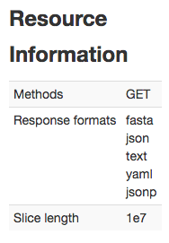
Check the formats available

Slide 21
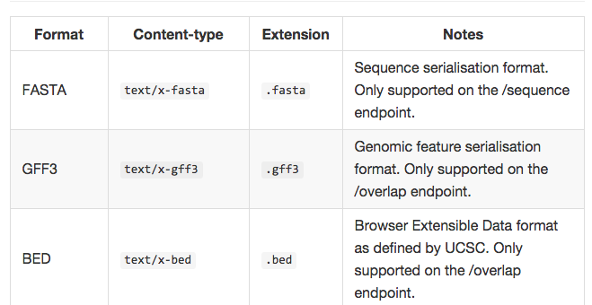
Output formats
https://github.com/Ensembl/ensembl-rest/wiki/Output-formats

Slide 22
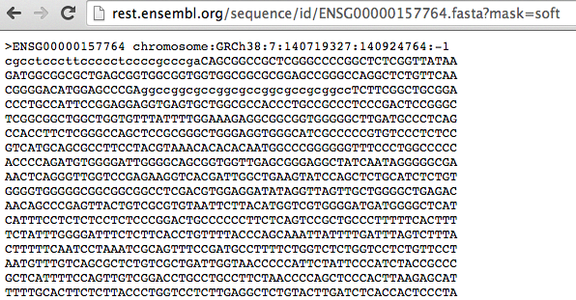
Modify the required parameters

Slide 23
Example
Using the stable ID ENSG00000157764 (human BRAF)
Retrieve its genomic sequence in plain text
Soft mask this in FASTA format
Retrieve all linked protein sequences in JSON

Slide 24

Check the parameters

Slide 25

Modify the required parameters

Slide 26
Check the parameters (again)

Slide 27
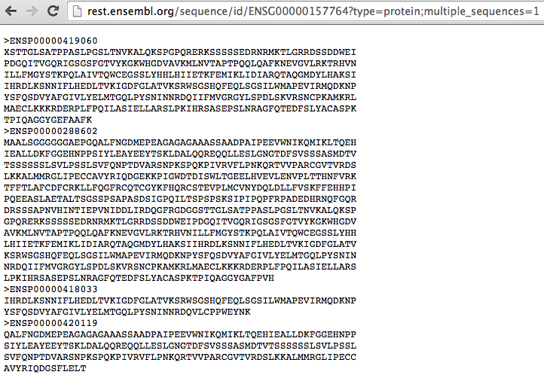
Modify the required parameters

Slide 28
Existing endpoints
Endpoint | Entry point | Output data
/alignment | A region | Whole genome alignments from Compara
/genetree | A gene or tree identifier | The corresponding gene tree
/homology | A gene | Corresponding orthologs and paralogs
/xrefs | An external symbol | Corresponding Ensembl object
/info | Species or nothing | Information about data available
/lookup | A stable identifier | Information related to that feature
/map | A region to convert | Equivalent coordinates in another context
/overlap | A region or feature | All features overlapping that region
/regulatory | A stable identifier | Corresponding regulatory features
/sequence | A stable identifier | The corresponding sequence
/variation | A variation id | Corresponding variation features
/vep | A region or a variation id | Corresponding variant consequences

Slide 29
Example
Starting with a region in GRCh37,
Find the corresponding region in assembly GRCh38
Find genes overlapping this region
Explore the corresponding gene tree
Look for variations

Slide 30
Example
Starting with a region in GRCh37, 17:64216194-64218564:1
Find the corresponding region in assembly GRCh38
Find genes overlapping this region
Explore the corresponding gene tree
Look for variant consequences

Slide 31
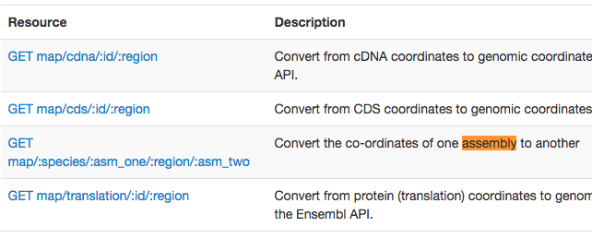
Find the correct endpoint

Slide 32
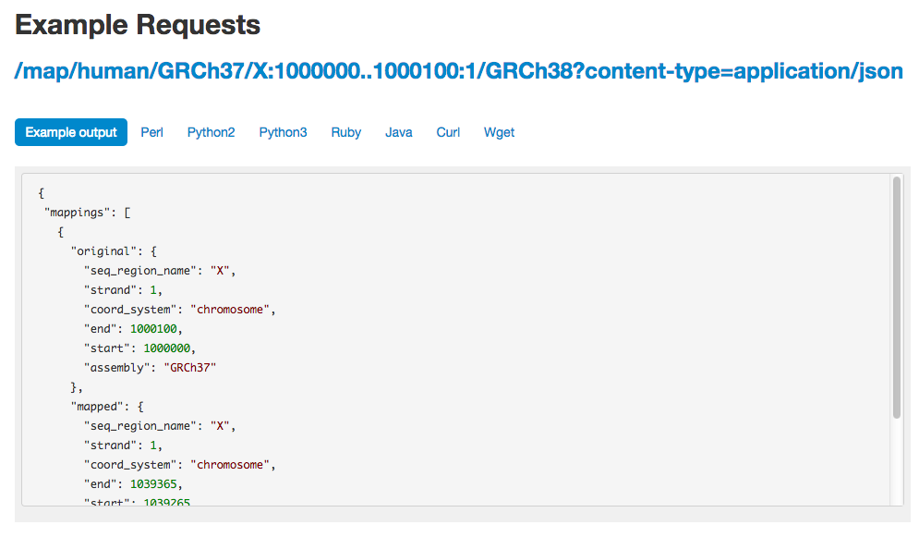
Select an example

Slide 33
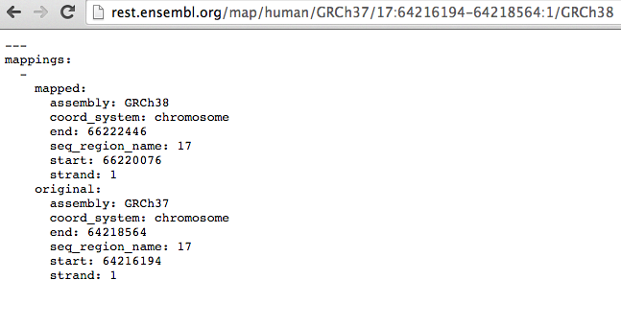
Copy and paste in the navigation bar
GRCh7:17:64216194-64218564:1 maps to GRCh38:17:66220076-66222446:1

Slide 34
Example
Starting with a region in GRCh37, 17:64216194-64218564:1
Find the corresponding region in assembly GRCh38
Find genes overlapping this region
Explore the corresponding gene tree
Look for variant consequences

Slide 35
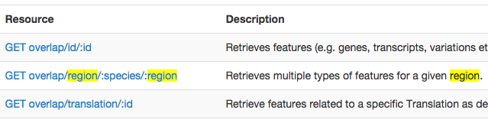
Find the correct endpoint

Slide 36
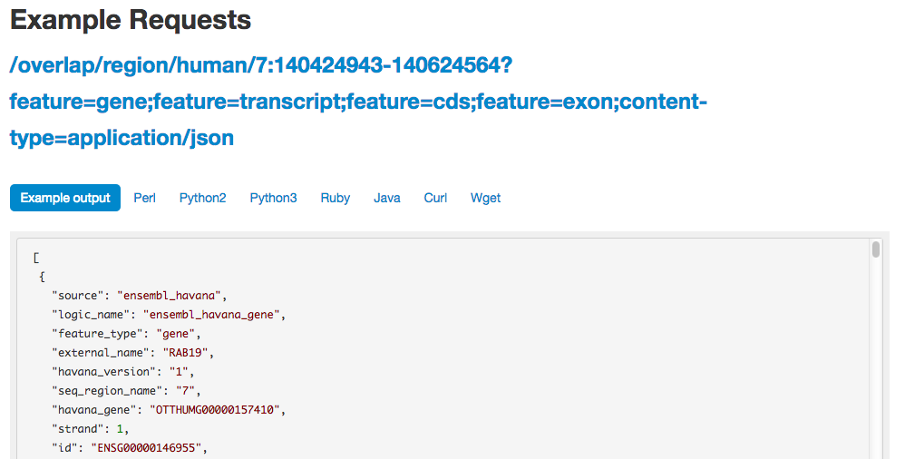
Select an example

Slide 37
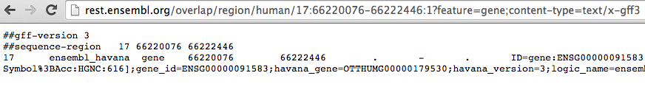
Copy and paste in the navigation bar
Found one gene: ENSG00000091583

Slide 38
Example
Starting with a region in GRCh37, 17:64216194-64218564:1
Find the corresponding region in assembly GRCh38
Find genes overlapping this region
Explore the corresponding gene tree
Look for variant consequences

Slide 39
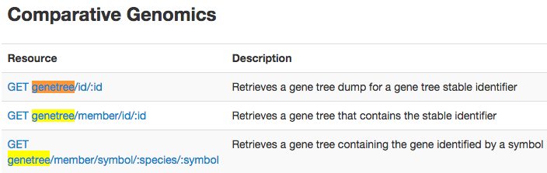
Find the correct endpoint

Slide 40
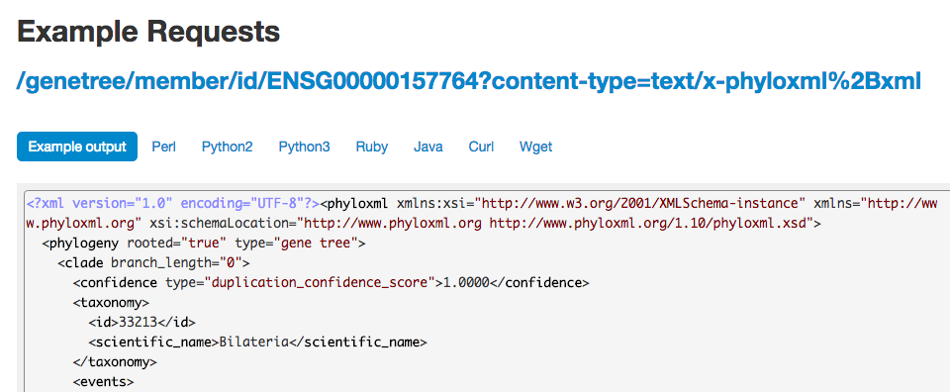
Select an example

Slide 41
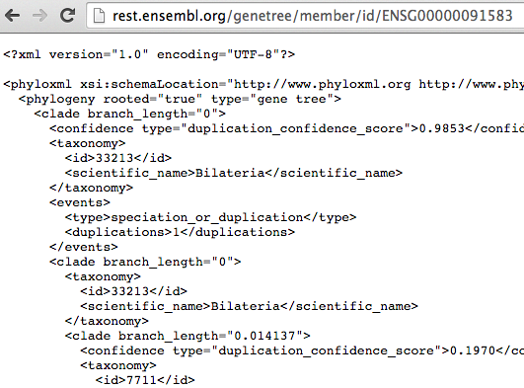
Copy and paste in the navigation bar

Slide 42
Example
Starting with a region in GRCh37, 17:64216194-64218564:1
Find the corresponding region in assembly GRCh38
Find genes overlapping this region
Explore the corresponding gene tree
Look for variant consequences

Slide 43
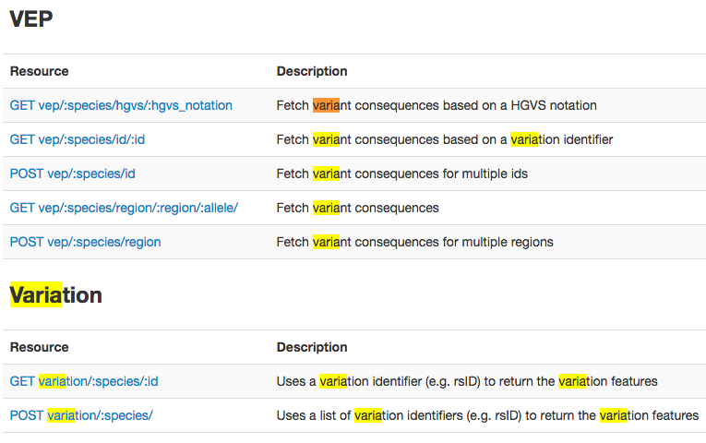
Find the correct endpoint

Slide 44
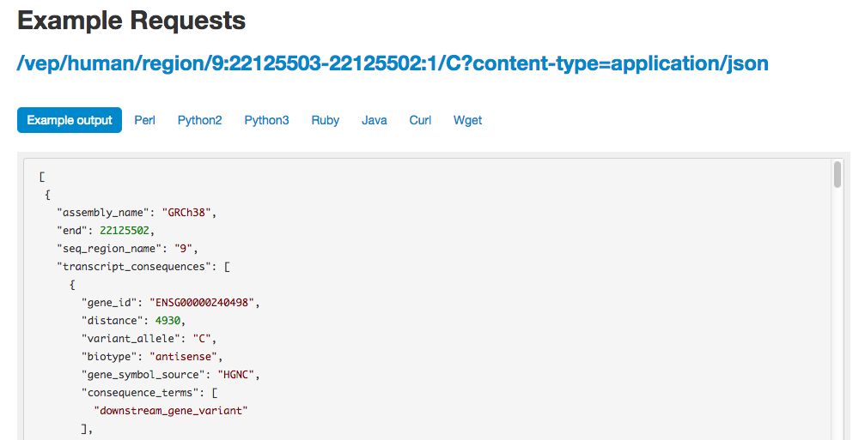
Select an example

Slide 45
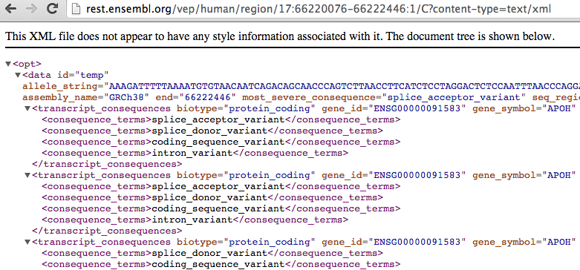
Copy and paste in the navigation bar

Slide 46
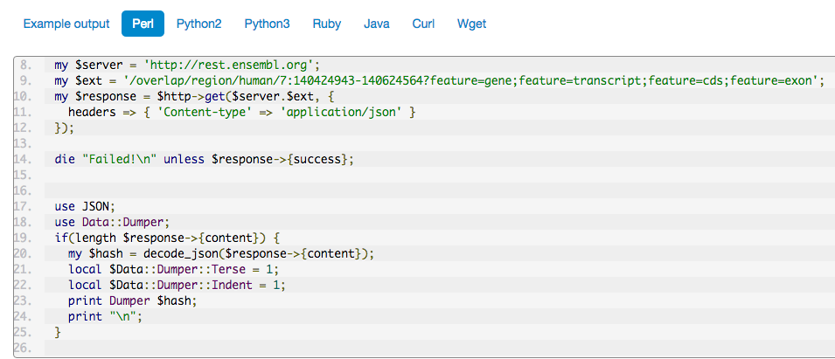
Write a script: documentation
Multiple stub clients designed
to get you working with REST fast
Show more advanced techniques e.g.
providing headers and looking at
server response codes for errors

Slide 47

Modify the example script

Slide 48
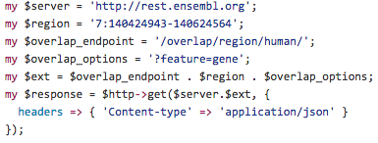
Modify the example script

Slide 49
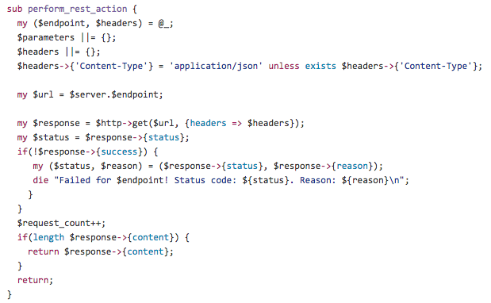
Create re-usable methods

Slide 50
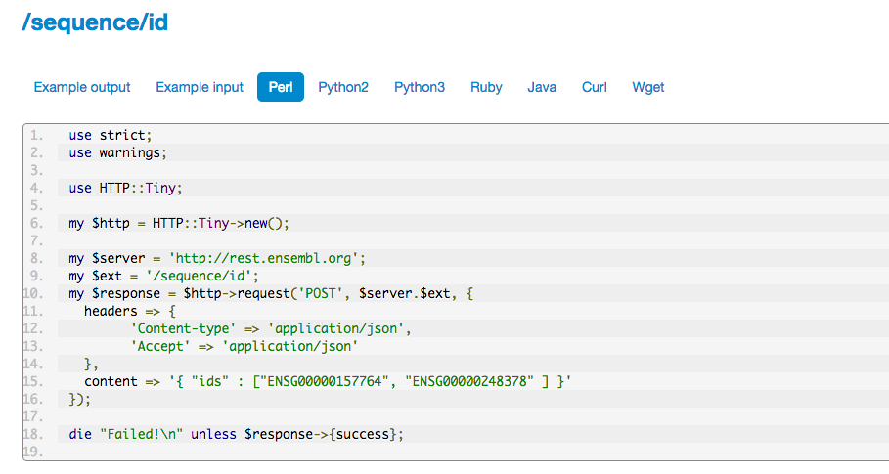
Multiple queries

Slide 51
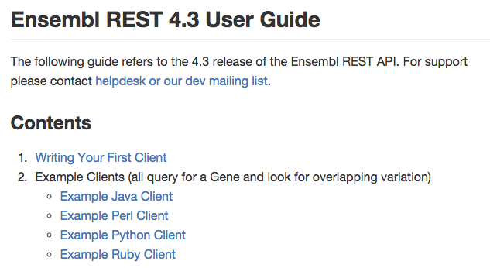
https://github.com/Ensembl/ensembl-rest/wiki

Slide 52
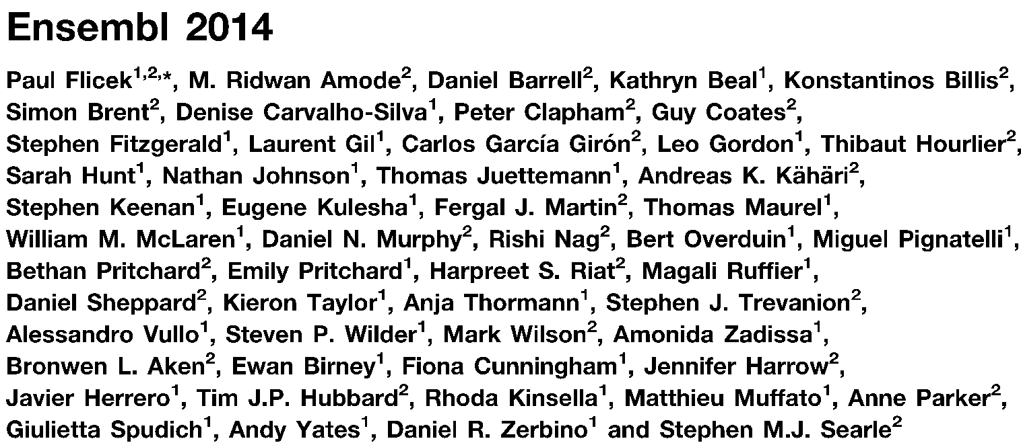








Acknowledgements
Funding
European Commission Framework Programme 7
Notes:
Updated November 2012

Slide 53







Ensembl Acknowledgements
The Entire Ensembl Team
Funding
Co-funded by the European Union

Slide 54
Standard Ensembl REST Parameters
:id – The global ID for that object. Normally a stable ID
ENSG00000157764
ENSGT00390000003602
:species – Species name (any Ensembl alias will do)
human
homo_sapiens
:region – 1 base locations CHR:START-END:STRAND
1:1000-2000
chr1:1000-2000:-1
:symbol – Reserved for Genes. Indicates a name to use
BRAF
BRCA2
Species Required

Slide 55
Specifying Output Formats
File extension
http://rest.ensembl.org/sequence/id/ENST00000288602.json?type=cds
HTTP Parameter
http://rest.ensembl.org/sequence/id/ENST00000288602?content-type=application/json;type=cds
HTTP Header
http://rest.ensembl.org/sequence/id/ENST00000288602?type=cds
Content-Type: application/json

Slide 56
Programming Against REST
Build a URL
Specify the response format
Send HTTP query
Parse the result if successful
If not report the error
Read the response
Respect the rate limit

Slide 57
Rules When Writing a Client
Choose your most convenient language
If you are a Python programmer, use Python
Find a good HTTP and JSON library for your language
Try to limit your requests to 15 per second
We will limit you to ~54,000 per hour
Basic way is to count & sleep for fractions of seconds
Create reusable methods for querying
It will make things easier

Slide 58
Pre-Written REST Clients
All of these are 3rd party contributed
R - https://github.com/acbb/EnsemblRest
Node.js - https://github.com/jermth/EnsemblFetches
Ruby - https://github.com/ALTree/bio-ensembl-rest
Java - https://github.com/heuermh/ensembl-rest-client
Python - https://github.com/pyOpenSci/pyEnsemblRest

Slide 59
REST Terminology
Term | Definition | Example
Endpoint | A URL which will respond to a HTTP request and return data | /sequence/id/ENST00000288602.fasta
HTTP Header | Sent to the server along side the requested URL. | Accepts: application/json Content-type: application/json
HTTP Parameter | Key value pairs separated by an = sign given to an endpoint after all required parameters. | ?type=cds
HTTP Method | Tells the server the kind of operation you want to perform. Are you retrieving data or sending data to the server | GET POST
HTTP Status Code | Indicates to the client what the server did with a request ranging from “OK”, to “Server Error” and “Your Input Was Wrong” | 200 400 404 500
JSON | Common cross-language data structure interchange format | { “key”: [1, “two”]}

Slide 60
Output Formats
Format | Content-Type | Extension | Notes
FASTA | text/x-fasta | .fasta
GFF3 | text/x-gff3 | .gff3
JSON | application/json | .json | Standard serialisation format
JSONP | text/javascript | .jsonp | Used to avoid browser sandbox issues. Use CORS instead
Newick | text/x-nh | .nh | Old tree format. Use PhyloXML instead
SeqXML | text/x-seqxml+xml | .seqxml | FASTA replacement
PhyloXML | text/x-phyloxml+xml | .phyloxml | Phylogenetic format
Text | text/plain | .txt
XML | text/xml | .xml
YAML | text/x-yaml | .yaml

Slide 61
Response Codes - Server Meta Data
Code | Class | Meaning
200 | Success | Everything is groovy!
4xx | Client error | Range specifying some kind of error in the user request.
400 | Client error | User has made a bad request e.g. bad parameters
404 | Client error | Location cannot be found
415 | Client error | Unsupported media type; bad format request made
429 | Client error | Too many requests made. Observe the Retry-After header
5xx | Server error | Anything in the 500 range is a server issue. You cannot fix this
503 | Server error | Server unavailable. Probably down for maintenance.

Slide 62
HTTP Response Headers
Name | Data type | Meaning
Content-type | MIME type | Describes what format the response is. The formats are the same as those used in the content-type request header
Retry-After | Floating point seconds | If found you must wait for this long before retrying the server
X-RateLimit-Limit | Integer | What the total limit of requests is
X-RateLimit-Remaining | Integer | How many requests you have left
X-RateLimit-Reset | Floating point seconds | How long before your tokens reset to the amount given in X-RateLimit-Limit
X-Runtime | Floating point seconds | The amount of time this request took

Slide 63
Documentation and Help
https://github.com/Ensembl/ensembl-rest/wiki
How to write your first client
How to write POST requests
dev@ensembl.org mailing list:
http://www.ensembl.org/info/about/contact/mailing.html
searchable mailing list archive:
http://blog.gmane.org/gmane.science.biology.ensembl.devel
Ensembl helpdesk:
helpdesk@ensembl.org

