Slide 1
Ensembl Compara REST API
Wasiu Akanni
REST workshop

Slide 2
Outline of the course
Introduction about Compara
Resources
REST API
Compara Endpoints
Alignment region
Family
Gene tree
Cafe tree
Homology

Slide 3
Applications of comparative genomics
Understanding of the mechanisms of evolution
Differences between species at the genome level
Species, Chromosomes, Genes
Gene identification and annotation
Identification and understanding of the distribution of highly conserved regions leads to better understanding of the genome.
Drug targets
Human enhancements
Zoology, Agriculture, and Biotechnology

Slide 4
What is Ensembl Compara?
A single database which contains precalculated comparative genomics data and which is linked to all the Ensembl Species (70 in e87) databases.
Access via perl API and mysql and REST
A production system for generating that database
(i.e. pipelines and SOPs, not in this presentation)

Slide 5
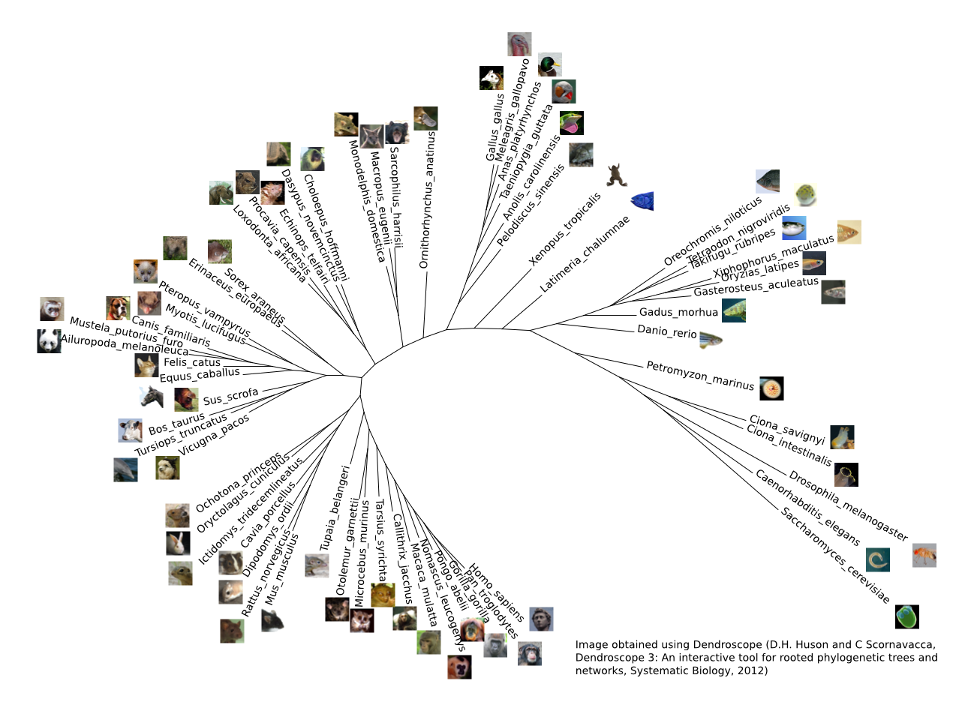
The genomes in Ensembl

Slide 6
Help and useful documentation
Online documents (website)
https://github.com/Ensembl/ensembl-rest/wiki
https://rest.ensembl.org/
Mailing lists:
dev@ensembl.org
helpdesk@ensembl.org

Slide 7
Compara data
Genome level
Whole genome alignments (pairwise and multiple)‏
Constrained elements (based on multiple align.)
Syntenic regions (based on pair-wise align.)
Gene level
Families (clusters of proteins + multiple align.)
Gene trees (proteins, non-coding RNAs)
Cafe tree
Gene orthology / paralogy predictions

Slide 8
Compara data
Genome level
REST endpoints
Whole genome alignments (pairwise and multiple)‏
✔
Constrained elements (based on multiple align.)
✗
Syntenic regions (based on pair-wise align.)
✗
Gene level
Families (clusters of proteins + multiple align.)
✔
Gene trees (proteins, non-coding RNAs)
✔
Cafe tree
✔
Gene orthology / paralogy predictions
✔

Slide 9
Nucleotide sequence analyses in e87
Mercator + Pecan
24-way amniotes
2x
BlastZ
18-way eutherian mammals
134x
LastZ
8-way primates
EPO
5-way fish
4-way birds
Karyotype synteny
56x
40-way eutherian mammals
EPO 2x
11-way fish
with GERP analysis
7-way birds
Progressive Cactus
18-way murinae

Slide 10
Gene analyses
Families
Clusters of similar proteins + multiple alignment
Multiple-species comparisons
Gene Trees
Clusters of similar proteins / ncRNAs + multiple alignment + CAFE: gene history (duplication, losses)
Homologies
Pairs of genes from the same tree + multiple alignment + natural selection analysis (dN, dS)
Pairwise comparisons

Slide 11
The Compara REST API
Provides language agnostic binding to Ensembl’s compara data
Can be accessed from http://rest.ensembl.org
Can be accessed using the following clients
Perl
Java
Ruby
Java with Unirest
Python (Needs the requests module installed for this workshop)

Slide 12
REST template python script
import requests, sys
# rest server address
server = https://rest.ensembl.org
# endpoint path, required parameters and options
ext = ”/path/required_parameters?optional_args1;optional_args2
# specify output format
r = request.get(server+ext, headers={“Content-Type” : “XX”})
if not r.ok:
r.raise_for_status()
sys.exit()
# if you json format decode
decoded = r.json
print repr(decoded)
# else
print r.text

Slide 13
Alignment endpoints
GET alignment/region/:species/:region
Called the alignment region endpoint
Able to retrieve genomic alignments as separate blocks based on a region and species
Requires:
A region : a query region to be given as a string.
A max of 10Mb is allowed to be requested at 1 time
A species name or alias e.g. homo_sapiens or human
Example
ext = "/alignment/region/taeniopygia_guttata/2:106040000-106040050:1? species_set_group=sauropsids"

Slide 14
Alignment endpoints
GET alignment/region/:species/:region
Optional arguments:
method: specify the alignment method you are trying to retrieve.
EPO, EPO_LOW_COVERAGE, PECAN, LASTZ_NET, BLASTZ_NET, CACTUS_HAL.
species_set: The set of species used to define the PW
species_set_group: The species set group name of the MSA.
For a list of available species sets for a particular method /info/compara/species_sets/:method
aligned : default is 1
compara : default is multi if using ensembl
display_species_set : default is all

Slide 15
Alignment endpoints
GET alignment/region/:species/:region
output formats:
Json
e.g. r = requests.get(server+ext, headers={“content-Type” : “application/json”})
Xml + phyloxml

Slide 16
Exercises – Alignment endpoints
Get in json format the LastZ pairwise alignment for taeniopygia_guttata V gallus_gallus for region 2:106041430-106041480:1
Get in json format the aligned human mammal epo alignment for region 2:106040000-106040050:1
Display only the [human, chimp, gorilla] alignment of the mammal epo alignment for region 2:106040000-106040050:1 output in phyloxml.

Slide 17
Families
Families are clusters of similar proteins
Ensembl (all transcripts)
Uniprot/SWISSPROT
Uniprot/SPTREMBL
HMM classification against the TreeFam library
Mafft multiple alignment
Mafft
Mafft
Mafft
Notes:
And panther libraries
At the end annotate the families

Slide 18
Family endpoints
GET family/id/:id
Used to retrieve family information using a family’s stable identifier
Requires
A family’s stable id
E.g. PTHR15573
Example
ext = “/family/id/PTHR15573”
output format : json

Slide 19
Family endpoints
GET family/member/id/:id
Given a gene, transcript, or translation stable identifier, it is used to retrieve the information for all the families where it is a member.
Requires
A stable id for a member of the family
E.g. ENSG00000157764
Example
ext = “/family/member/id/ENSG00000157764”
Output format - json

Slide 20
Family endpoints
GET family/member/symbol/:species/:symbol
Given a symbol that corresponds to a gene, it is used to retrieve the information for all the families where the gene is a member.
Requires
A species name or alias e.g. homo_sapiens/human
The symbol or display name of a gene e.g. BRCA2
Example
ext = “/family/member/symbol/homo_sapiens/BRCA2”
Output format - json

Slide 21
Family endpoints
Optional arguments:
member_source : This allows the user to specify the source of the family members that are returned. Options: all (default), ensembl, or uniprot
object_type : enables filtering of the result based on the feature type of the members e.g. gene or transcript (default)
sequence : enables the user to specify the type of sequence that is returned or if none is wanted. Options: none, cdna, or protein (default)
aligned : default is 1
compara : default is multi if using ensembl

Slide 22
Exercises - Families
Get the information for the family with the stable id PTHR10740_SF4
Get the aligned cdna sequences for only the ensembl members of the family with the stable id PTHR10740_SF4
Get the information for families predicted for the human gene ENSG00000283087. What do you notice ?
Get the information for uniprot members of families predicted for the human gene with the symbol HOXD4-001. show no alignments and no sequences.
Notes:
What we use to print alignments?

Slide 23
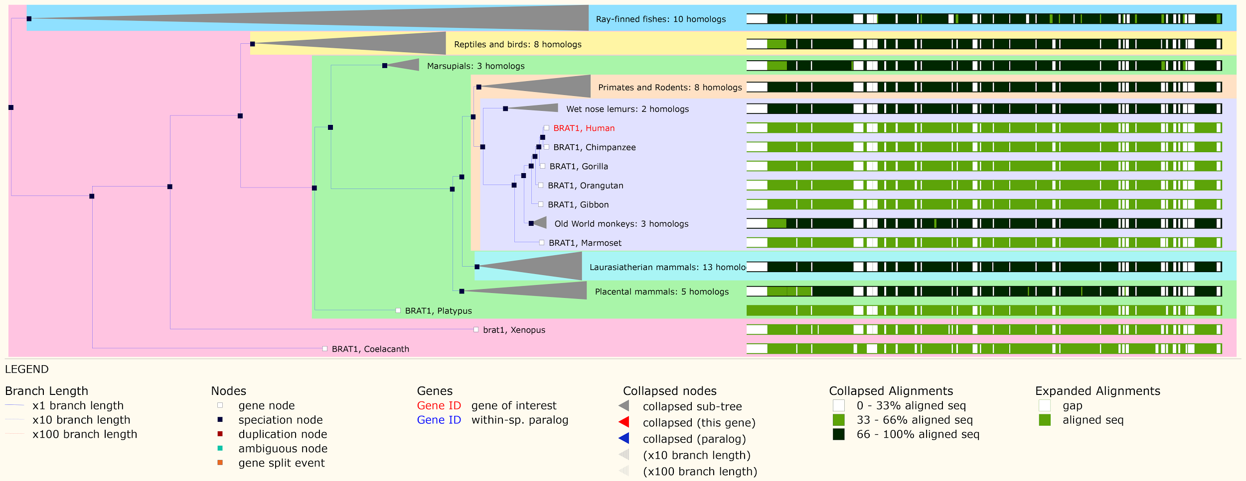
GeneTree example on the website
Tree
Multiple alignment

Slide 24
Protein-Tree pipeline overview
All e! genes – canonical protein
BLAST
hcluster_sg
MCoffee: MSA
TreeBeST: (+ reconciliation)
Orthologue/Paralogue inference
all-vs-all blastp + hcluster_sg
Orthologues and Paralogues
Vilella et al., Genome Res. 2009

Slide 25
ncRNA-Tree pipeline overview
All e! ncRNA genes
Grouped in Family Models - RFAM
Infernal alignment + RaxML trees
PRANK alignment + NJ/ML trees
TreeBeST (tree reconciliation)
Ortholog/Paralog inference
all-vs-all blastp + hcluster_sg
Orthologues and Paralogues
Pignatelli et al., in preparation

Slide 26
GeneTree endpoints
GET genetree/id/:id
Used to retrieve gene tree information using a gene tree stable identifier
Requires
A gene tree’s stable id
E.g. ENSGT00390000003602
Example
ext = “/genetree/id/ENSGT00390000003602”
Output format : json, phyloxml, orthoxml, and nh

Slide 27
GeneTree endpoints
GET genetree/member/id/:id
Given a gene, transcript, or translation stable identifier, it is used to retrieve the information for all the gene trees where it is a member.
Requires
A stable id for a member of the gene trees
E.g. ENSG00000167664
Example
ext = “/genetree/member/id/ENSG00000167664”
Output format : json, phyloxml, orthoxml, and nh

Slide 28
GeneTree endpoints
GET genetree/member/symbol/:species/:symbol
Given a symbol that corresponds to a gene, it is used to retrieve the information for all the gene trees where the gene is a member.
Requires
A species name or alias e.g. homo_sapiens/human
The symbol or display name of a gene e.g. BRCA2
Example
ext = “/genetree/member/symbol/homo_sapiens/BRCA2”
Output format : json, phyloxml, orthoxml, and nh

Slide 29
GeneTree endpoints:
Optional arguments:
prune_species : prune the tree by species/aliases.
prune_taxon : prune the tree using taxon id of the species
sequence : enables the user to specify the type of sequence that is returned or if none is wanted. Options: none, cdna, or protein (default)
aligned : default is 0
nh_format : the format of the nh request. Options: full, display_label_composite, simple, species, species_short_name, ncbi_taxon, ncbi_name, njtree, phylip)

Slide 30
Exercises - GeneTree
Online tree viewer: http://itol.embl.de/upload.cgi
Get the information for the protein genetree with the stable id ENSGT00390000003602. Output should be in the orthoxml format.
Get the ncRNA gene tree with the stable id RF01168. Output in phyloxml format with sequences aligned.
Get the gene tree predicted for the gene ENSG00000189221 in full nh format.
Get the gene tree predicted for the human gene with the symbol HOXD4-001 in simple nh format.

Slide 31
CAFE Trees
We run the CAFE (Computational Analysis of gene Family Evolution) software as part of our genetree pipelines
A tool for the statistical analysis of the evolution of the size of gene families
It uses a stochastic birth and death process to model the evolution of gene family sizes over a phylogeny
Notes:
Consists in tagging the pairs of genes of all the trees with a relation type, depending on the tree topology.

Slide 32
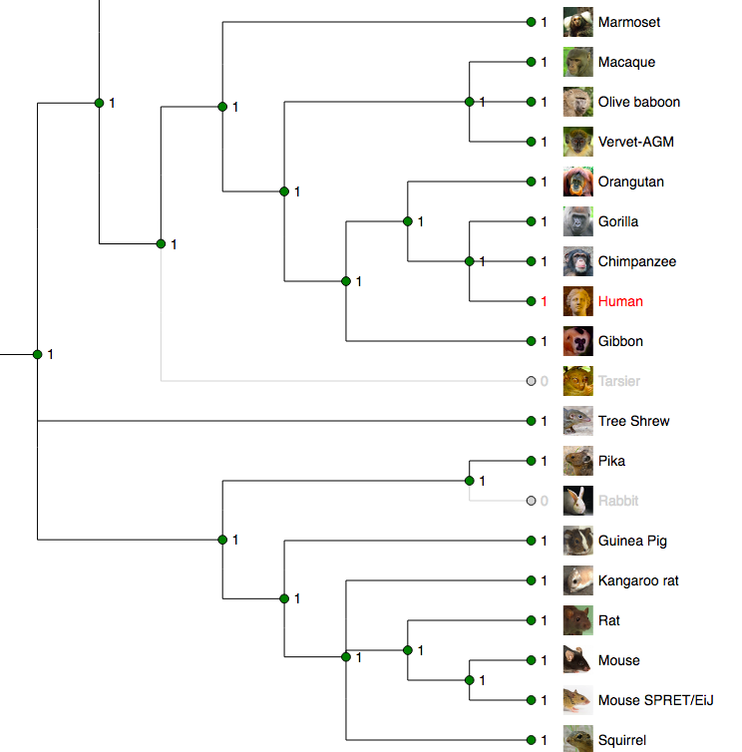
CAFE Trees...
For a specified phylogenetic tree, and given the gene family sizes in the extant species, CAFE can :
estimate the global birth and death rate of gene families
infer the most likely gene family size at all internal nodes
identify gene families that have accelerated rates of gain and loss

Slide 33
Cafe Tree endpoints
GET cafe/genetree/id/:id
Used to retrieve the cafe tree information of a gene tree using a gene tree stable identifier
Requires
A gene tree’s stable id
E.g. ENSGT00390000003602
Example
ext = “cafe/genetree/id/ENSGT00390000003602”
Output format : json and nh

Slide 34
Cafe Tree endpoints
GET cafe/genetree/member/id/:id
Given a gene, transcript, or translation stable identifier, it is used to retrieve the cafe tree information for all the gene trees where it is a member.
Requires
A stable id for a member of the gene trees
E.g. ENSG00000167664
Example
ext = “cafe/genetree/member/id/ENSG00000167664”
Output format : json and nh

Slide 35
Cafe Tree endpoints
GET cafe/genetree/member/symbol/:species/:symbol
Given a symbol that corresponds to a gene, it is used to retrieve the cafe tree information for all the gene trees where the gene is a member.
Requires
A species name or alias e.g. homo_sapiens/human
The symbol or display name of a gene e.g. BRCA2
Example
ext = “cafe/genetree/member/symbol/homo_sapiens/BRCA2”
Output format : json and nh

Slide 36
Exercises – Cafe tree
Get the cafe tree information for the genetree with the stable id ENSGT00390000003602. Output should be in the json format.
Get the cafe tree for gene tree predicted for the gene ENSG00000189221 in nh format. Notice anything?
Get the cafe tree information for the gene tree predicted for the human gene with the symbol HOXD4-001
Notes:
What we use to print alignments?

Slide 37
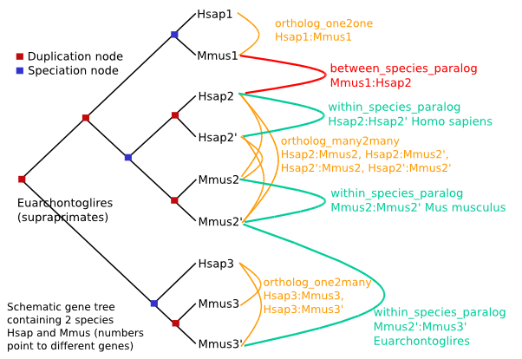
Homology
An Homology object links two genes together
One-to-many relationships are split:
“H orthologue to M1” and “H orthologue to M2” are different objects
Notes:
Consists in tagging the pairs of genes of all the trees with a relation type, depending on the tree topology.

Slide 38
Homology endpoints
GET homology/id/:id
Used to retrieve all the homologous relationships for a given gene using its stable identifier
Requires
An Ensembl gene stable id
E.g. ENSG00000157764
Example
ext = “/homology/id/ENSG00000157764”
Output format : json, xml and orthoxml + xml

Slide 39
Homology endpoints
GET homology/symbol/:species/:symbol
Given a symbol that corresponds to a gene, it is used to retrieve all the information of the homologues of that gene
Requires
A species name or alias e.g. homo_sapiens/human
The symbol or display name of a gene e.g. BRCA2
Example
ext = “homology/symbol/homo_sapiens/BRCA2”
Output format : json, xml and orthoxml + xml

Slide 40
Homology endpoints:
Optional arguments:
target_species : filter homologues by species/aliases.
target_taxon : prune the homologues using taxon id of the species
sequence : enables the user to specify the type of sequence that is returned or if none is wanted. Options: none, cdna, or protein (default)
aligned : default is 1
type : enables users to specify the type of homologues that they want returned i.e. orthologues, paralogues, projections, and all (default)

Slide 41
Exercises – Homologies
Get all the homologues for the human gene ENSG00000229314 in xml format
Return only the aligned chimp and mouse homologues for the gene given in 1 in json format.
Get all the orthologues human gene with the symbol HOXD4-001 in orthoxml format

Slide 42




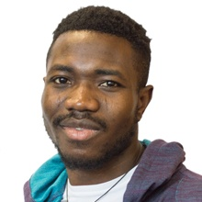

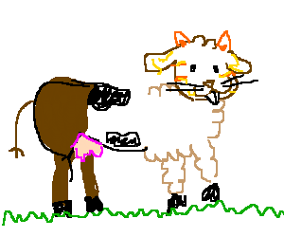
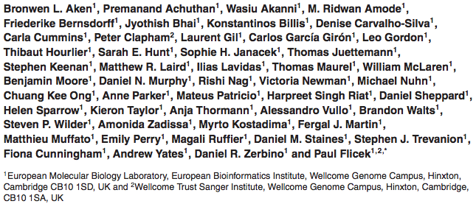








Ensembl Acknowledgements
Leo
Mateus
Matthieu
Carla
AJ
Brandon
Funding
Co-funded by the European Union

