Slide 1

Ensembl Compara REST API
compara
Wasiu Akanni
REST workshop
May 2017
Notes:
Good morning/tzau an ->wu an -> wan shang hau-> wan an
Lin-ho –hello
Lin-ho bo how are you
yin gwan ling->welcome in mandarin
My name is Wasiu Akanni and this is Brandon
Today we are going to introduce you to all the types of data and analyses that the compara team in ensembl produce.

Slide 2
Outline of the course
Introduction about Compara
Resources
REST API
Compara Endpoints
Alignment region
Family
Gene tree
Cafe tree
homology
Notes:
First we will start with some introduction to the motto/objective of compara followed by an introduction to the api that we are going to be using to retrieve the data that we produce.
You will be glad to know that this API is not all that different from the API that you have already been introduced to in the previous workshops.
So we will be focusing more on the actual compara api methods than things like syntax.
Then we will move on to learning/talking about the types of data that we use as inputs for the compara pipelines. From the species that we use to the chromosomes and down to the genes. Whether that be ncRNA or Protein coding genes.
Finally we will discuss the output of these pipelines.

Slide 3
Applications of comparative genomics
Understanding of the mechanisms of evolution
Differences between species at the genome level
Species, Chromosomes, Genes
Gene identification and annotation
Identification and understanding of the distribution of highly conserved regions leads to better understanding of the genome.
Drug targets
Human enhancements
Zoology,Agriculture, and Biotechnology
Notes:
First we will start with some introduction to the motto/objective of compara followed by an introduction to the api that we are going to be using to retrieve the data that we produce.
You will be glad to know that this API is not all that different from the API that you have already been introduced to in the previous workshops.
So we will be focusing more on the actual compara api methods than things like syntax.
Then we will move on to learning/talking about the types of data that we use as inputs for the compara pipelines. From the species that we use to the chromosomes and down to the genes. Whether that be ncRNA or Protein coding genes.
Finally we will discuss the output of these pipelines.

Slide 4
What is Ensembl Compara?
A single database which contains precalculated comparative genomics data and which is linked to all the Ensembl Species (70 in e87) databases.
Access via perl API and mysql and REST
A production system for generating that database (i.e. pipelines and SOPs, not in this presentation)‏
Notes:
The compara resource of ensembl is a single multi species database which contains precalculated genome wide species comparison data at various data level for all of the species that we have in ensembl. This database is actually produced by merging different analyses pipelines databases into one.
This resource can be accessed through the perl API (which is what this workshop will be focussed on) but it can also be accessed by querying the db directly using mysql.
This resource is produced on a production cycle that happen to involves several pipelines and standard operating procedures (SOPs) every 3-4months.

Slide 5
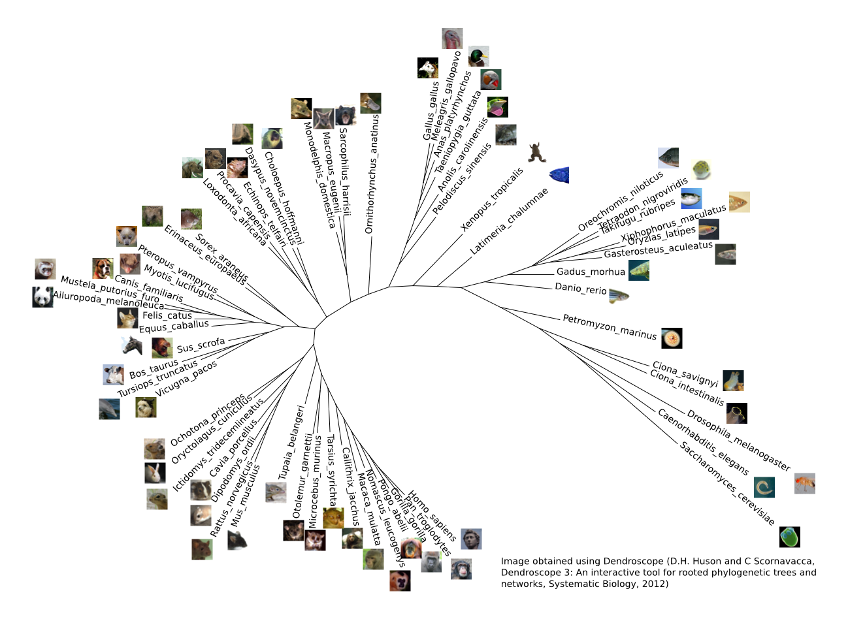
The genomes in Ensembl
Notes:
These is a phylogenetic tree of all the species currently available in ensembl and as you can see not all orders are equally represented. In fact It is heavily biased towards mammals(40) and even within mammals it is biased towards primates (10). This is in part due to a bias by the different consortiums funding ensembl and also by the size of the scientific communities/number of scientist working on these species around the world. We are currently exploring avenues to support species/families/orders that are currently under represented. One such avenue is to allow privately/externally assembled or annotated genomes that we believe are of good quality or at least the best that is currently available and ways to communicate this to the users without affecting the quality of our comparative data i.e. orthologues.

Slide 6
Help & Useful documentation
Online documents (website)
https://github.com/Ensembl/ensembl-rest/wiki
https://rest.ensembl.org/
Mailing lists:
dev@ensembl.org
helpdesk@ensembl.org

Slide 7
Compara data
Genome level
Whole genome alignments (pairwise and multiple)‏
Constrained elements (based on multiple align.)
Syntenic regions (based on pair-wise align.)
Gene level
Families (clusters of proteins + multiple align.)
Gene trees (proteins, non-coding RNAs)
Gene orthology / paralogy predictions
Notes:
The types of data that compara deals with can be divided into 2 categories. We run analyses on whole genome data as well as individual genes.
The types of genome level data that we produce ranges from wga (both pw and multiple) to constrained elements (quick explanation) as well as Syntenic regions.
Gene level data produced by compara include gene family info, gene trees (coding and non coding), gene homology information (i.e. orthologs and paralogs).
We perform analyses at both the genomic and gene levels.
At the genome level we perform WGAs, constraint element, syntenic regions (highly conserved regions At the chromosome level)

Slide 8
Compara data
Genome level
REST endpoints
Whole genome alignments (pairwise and multiple)‏
✔
Constrained elements (based on multiple align.)
✗
Syntenic regions (based on pair-wise align.)
✗
Gene level
Families (clusters of proteins + multiple align.)
✔
Gene trees (proteins, non-coding RNAs)
✔
Gene orthology / paralogy predictions
✔
Notes:
The types of data that compara deals with can be divided into 2 categories. We run analyses on whole genome data as well as individual genes.
The types of genome level data that we produce ranges from wga (both pw and multiple) to constrained elements (quick explanation) as well as Syntenic regions.
Gene level data produced by compara include gene family info, gene trees (coding and non coding), gene homology information (i.e. orthologs and paralogs).
We perform analyses at both the genomic and gene levels.
At the genome level we perform WGAs, constraint element, syntenic regions (highly conserved regions At the chromosome level)

Slide 9
Nucleotide sequence analyses in e!87
Mercator + Pecan
24-way amniotes
2x
BlastZ
18-way eutherian mammals
134x
LastZ
8-way primates
EPO
5-way fish
4-way birds
Karyotype synteny
56x
40-way eutherian mammals
EPO 2x
11-way fish
with GERP analysis
7-way birds
Progressive Cactus
18-way murinae
Notes:
For pairwise alignments at the dna level we use Lastz and its predecessor Blastz. The actual wga are the results of post processing the raw Lastz and BlastZ results. In the first step, the original blocks are chained according to their location in both genomes. We then use a netting process to choose for the reference species the best sub-chain in each region.
**when both species have a chromosome-level assembly, we summarise the lastz-net alignment blocks into syntenic regions by looking for stretches where the alignment blocks are in synteny. The synteny search is run in 2phases. First, syntenic alignment closer than 200kbp are grouped. Then syntenic groups are linked as long as there is not more than 2-non syntenic groups between them and they no more than 3Mbp apart.
Mercator- whole genome homology maps used to identify evolutionary relationships. Then pecan (a global MSA program) is used to build alignments in this homologous regions.
Our whole genome multiple alignment is based on a 3 step pipeline which uses the Enredo, pecan, and ortheus softwares in our EPO pipeline.
Enredo produces the colinear segments from extant genomes (handles rearrangement, deletions, and duplication)
Pecan is used to align these segments
Ortheus is used to generate genome wide ancestral sequence reconstructions.
Because there are problems running Ortheus on low coverage genomes we produce two types whole genome MSA. EPO for high coverage species and EPO 2x for a MSA involving some low coverage genomes.
We are soon going to provide alignments based on a next-generation aligner called progressive cactus which stores alignments in a graph structure and allows genomes to be added incrementally making it scalable to hundreds of genomes.
Currently only partially available on the website. Soon to be fully supported. Not available on thru the api as it requires other programs with multiple dependencies to be installed. Aligment can be in different files and different storage locations.

Slide 10
Gene analyses
Families
Clusters of similar proteins + multiple alignment
Multiple-species comparisons
Gene Trees
Clusters of similar proteins / ncRNAs + multiple alignment + CAFE:
gene history (duplication, losses)
Homologies
Pairs of genes from the same tree
+ multiple alignment
+ natural selection analysis (dN, dS)
Pairwise comparisons
Notes:
Compara also produces produces different gene analysis data for multi species and pw comparison.
For multi species gene analysis we provide family data
Our Families are determined through classification of all Ensembl protein along with metazoan sequences from UniprotKB. This allows our user to explore orthologues and closely related homologs across a wider range of species than we have available in ensembl.
Our family pipeline :
Loads members from ensembl as well as uniprot entries
Run HMM search (using HMM libraries from Treefarm)
Store the families
Align the families with mafft
Annotate the families with a consensus description from it members description
The other type of analysis that we run on peptide seqs is the gene tree pipeline/ we also provide phylogenetic tree data across the whole set of protein coding gene and non-coding genes using two different pipelines. We then use this trees to extract homologoues data. We also analyse gene gain and loss using the café software.
The protein coding trees are reconstructed using a representative protein (currently the longest translation that is annotated by CCDS project) for every gene in Ensembl.
The proteins are clustered using hcluster based on blast e-values (all vs all)
The clusters are aligned using mafft/m-coffee. Mafft when the cluster is too large. Mcoffee – uses multiple aligners and builds a consensus alignment from all the results.
Then we use Treebest to reconstruct the ML gene tree from each MSA while also reconciling it with the species tree to call duplication and speciation events. Able to call complex 1-many and many to many relationships which significantly increases the number of orthologues between distant organisms.
We use codeml programme from PAML to calculate dn/ds values for high coverage closely related pairs of species
The NCRNA tree pipeline is similar to the gene tree pipeline but has been modified to takes advantage of the knowledge that NcRNA genes are well known to form secondary structures where pairs of residues are matched to form loops and other structures.
For the pipeline we get and store families represented in RFAM.
For each family we build several tree using the secondary structure alignment with infernal and genomic alignment with PRANK Using RAxML, Treebest or Fastree/examl for very big family
All the trees and the species tree for each family are then merged into a final tree with Treebest,
Infer orthology and paralogy relationships

Slide 11
The Compara REST API
Provides language agnostic binding to Ensembl’s compara data
Can be accessed from http://rest.ensembl.org
Can be accessed using the following clients
Perl
Java
Ruby
Java with Unirest
Python
*Needs the requests module installed
Notes:
We also make use of BIOPERL.

Slide 12
REST template python script
import requests, sys
# rest server address
server = https://rest.ensembl.org
# endpoint path, requiered parameters and options
ext ”/path/required_parameters?optional_args1;optional_args2
# specify output format
r = request.get(server+ext, headers={“Content-Type” : “XX”})
if not r.ok:
r.raise_for_status()
sys.exit()
# if you json format decode
decoded = r.json
print repr(decoded)
# else
print r.text
Notes:
There are 2 ways to connect to the ensembl compara db
Here is an example of implicitly connecting to the compara db by using the registery module. This can take a global or specific configuration file or auto configure itself as it is doing here.

Slide 13
Alignment endpoints
GET alignment/region/:species/:region
Called the alignment region endpoint
Able to retrieve genomic alignments as separate blocks based on a region and species
Requires
A region : a query region to be given as a string.
A max of 10Mb is allowed to be requested at 1 time
A species name or alias e.g. homo_sapiens or human
Example
ext = "/alignment/region/taeniopygia_guttata/2:106040000-106040050:1?species_set_group=sauropsids"

Slide 14
Alignment endpoints
Optional arguments:
method: specify the alignment method you are trying to retrieve.
EPO, EPO_LOW_COVERAGE, PECAN, LASTZ_NET, BLASTZ_NET, CACTUS_HAL.
species_set: The set of species used to define the PW
species_set_group: the species set group name of the MSA.
For a list of available species sets for a particular method /info/compara/species_sets/:method
aligned : default is 1
compara : default is multi if using ensembl
display_species_set : default is all

Slide 15
Alignment endpoints
output formats:
json
e.g. r = requests.get(server+ext, headers={“content-Type” : “application/json”})
Xml + phyloxml
jsonp

Slide 16
Exercises – Alignment endpoints
1: Get in json format the LastZ pairwise alignment for taeniopygia_guttata V gallus_gallus for region 2:106041430-106041480:1
2a: Get in json format the aligned human mammal epo alignment for region 2:106040000-106040050:1
2b: display only the [human, chimp, gorilla] alignment of the mammal epo alignment for region 140000-141000. output in phyloxml.

Slide 17
Families
Families are clusters of similar proteins
Ensembl (all transcripts)
Uniprot/SWISSPROT
Uniprot/SPTREMBL
HMM classification against the TreeFam library
Mafft multiple alignment
Mafft
Mafft
Mafft
Notes:
And panther libraries
At the end annotate the families

Slide 18
Family endpoints
GET family/id/:id
Used to retrieve family information using a family’s stable identifier
Requires
A family’s stable id
E.g. PTHR15573
Example
ext = “/family/id/PTHR15573”
output format : json

Slide 19
Family endpoints
GET family/member/id/:id
Given a gene, transcript, or translation stable identifier, it is used to retrieve the information for all the families where it is a member.
Requires
A stable id for a member of the family
E.g. ENSG00000157764
Example
ext = “/family/member/id/ENSG00000157764”
Output format - json

Slide 20
Family endpoints
GET family/member/symbol/:species/:symbol
Given a symbol that corresponds to a gene, it is used to retrieve the information for all the families where the gene is a member.
Requires
A species name or alias e.g. homo_spaiens/human
The symbol or display name of a gene e.g. BRAC2
Example
ext = “/family/member/symbol/homo_sapiens/BRCA2”
Output format - json

Slide 21
Family endpoints
Optional arguments:
member_source : This allows the user to specify the source of the family members that are returned.
3 choices: all (default), ensembl, or uniprot
object_type : enables filtering of the result based on the feature type of the members e.g. gene or transcript (default)
sequence : enables the user to specify the type of sequece that is returned or if none is wanted.
none, cdna, or protein (default)
aligned : default is 1
compara : default is multi if using ensembl

Slide 22
Exercises - Families
1a: Get the information for the family with the stable id PTHR10740_SF4
1b: Get the aligned cdna sequences for only the ensembl members of the family with the stable id PTHR10740_SF4
2: Get the information for families predicted for the human gene ENSG00000283087. What do you notice ?
3: Get the information for uniprot members of families predicted for the human gene with the symbol HOXD4-001. show no alignments and no sequences.
Notes:
What we use to print alignments?

Slide 23
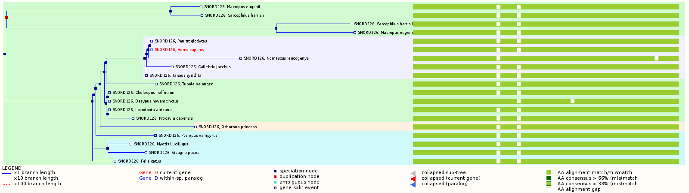
GeneTree example on the website
Tree
Multiple alignment
Notes:
This is what the gene tree page looks like on the website

Slide 24
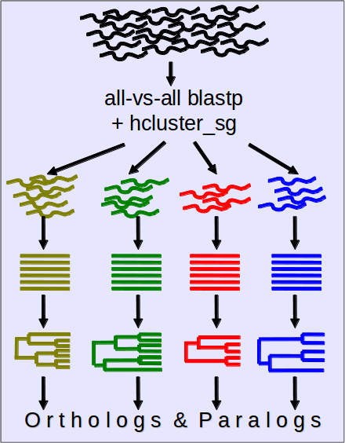
Protein-Tree pipeline overview
All e! genes – canonical prot.
BLAST
hcluster_sg
MCoffee: MSA
TreeBeST: (+ reconciliation)
Ortholog/Paralog inference
Vilella et al., Genome Res. 2009
Notes:
A quick graphical representation of our protein tree pipeline

Slide 25
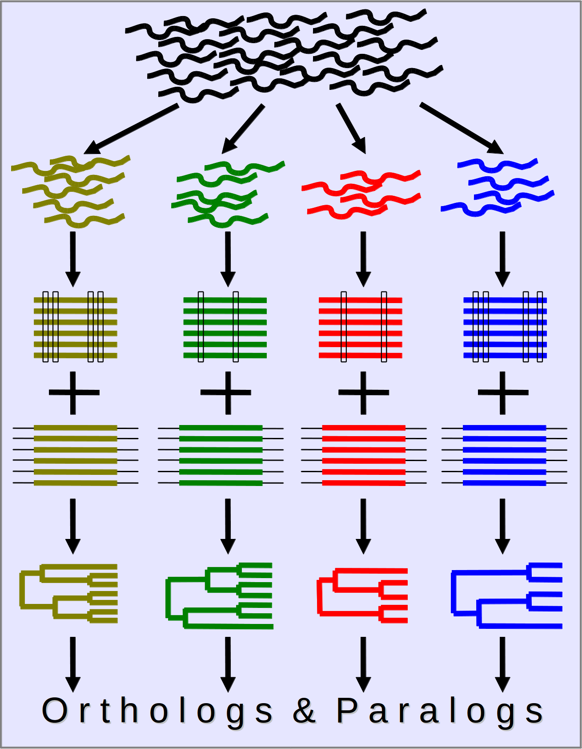
ncRNA-Tree pipeline overview
All e! ncRNA genes
Grouped in Family Models - RFAM
Infernal alignment + RaxML trees
PRANK alignment + NJ/ML trees
TreeBeST (tree reconciliation)
Ortholog/Paralog inference
Pignatelli et al., in preparation
Notes:
Motifs
Conserved regions
Structural alignment

Slide 26
GeneTree endpoints
GET genetree/id/:id
Used to retrieve gene tree information using a gene tree stable identifier
Requires
A gene tree’s stable id
E.g. ENSGT00390000003602
Example
ext = “/genetree/id/ENSGT00390000003602”
Output format : json, phyloxml, orthoxml, and nh

Slide 27
GeneTree endpoints
GET genetree/member/id/:id
Given a gene, transcript, or translation stable identifier, it is used to retrieve the information for all the gene trees where it is a member.
Requires
A stable id for a member of the gene trees
E.g. ENSG00000167664
Example
ext = “/genetree/member/id/ENSG00000167664”
Output format : json, phyloxml, orthoxml, and nh

Slide 28
GeneTree endpoints
GET genetree/member/symbol/:species/:symbol
Given a symbol that corresponds to a gene, it is used to retrieve the information for all the gene trees where the gene is a member.
Requires
A species name or alias e.g. homo_spaiens/human
The symbol or display name of a gene e.g. BRAC2
Example
ext = “/genetree/member/symbol/homo_sapiens/BRCA2”
Output format : json, phyloxml, orthoxml, and nh

Slide 29
GeneTree endpoints:
Optional arguments
prune_species : prune the tree by species/aliases.
prune_taxon : prune the tree using taxon id of the species
sequence : enables the user to specify the type of sequece that is returned or if none is wanted.
none, cdna, or protein (default)
aligned : default is 0
nh_format : the format of the nh request
full, display_label_composite, simple, species, species_short_name, ncbi_taxon, ncbi_name, njtree, phylip)

Slide 30
Exercises – GeneTree
NB: online tree viewer -> http://itol.embl.de/upload.cgi
1a: Get the information for the protein genetree with the stable id ENSGT00390000003602. output should be in the orthoxml format.
1b: Get the NcRNA gene tree with the stable id RF01168. output in phyloxml format with sequences aligned.
2: Get the gene tree predicted for the gene ENSG00000189221 in full nh format.
3: Get the gene tree predicted for the human gene with the symbol HOXD4-001 in simple nh format.
Notes:
What we use to print alignments?

Slide 31
CAFE Trees
We run the CAFE (Computational Analysis of gene Family Evolution) software as part of our genetree pipelines
A tool for the statistical analysis of the evolution of the size of gene families
It uses a stochastic birth and death process to model the evolution of gene family sizes over a phylogeny
For a specified phylogenetic tree, and given the gene family sizes in the extant species, CAFE can :
estimate the global birth and death rate of gene families
infer the most likely gene family size at all internal nodes
identify gene families that have accelerated rates of gain and loss
Notes:
Consists in tagging the pairs of genes of all the trees with a relation type, depending on the tree topology.

Slide 32
Cafe Tree endpoints
GET cafe/genetree/id/:id
Used to retrieve the cafe tree information of a gene tree using a gene tree stable identifier
Requires
A gene tree’s stable id
E.g. ENSGT00390000003602
Example
ext = “cafe/genetree/id/ENSGT00390000003602”
Output format : json and nh

Slide 33
Cafe Tree endpoints
GET cafe/genetree/member/id/:id
Given a gene, transcript, or translation stable identifier, it is used to retrieve the cafe tree information for all the gene trees where it is a member.
Requires
A stable id for a member of the gene trees
E.g. ENSG00000167664
Example
ext = “cafe/genetree/member/id/ENSG00000167664”
Output format : json and nh

Slide 34
Cafe Tree endpoints
GET cafe/genetree/member/symbol/:species/:symbol
Given a symbol that corresponds to a gene, it is used to retrieve the cafe tree information for all the gene trees where the gene is a member.
Requires
A species name or alias e.g. homo_spaiens/human
The symbol or display name of a gene e.g. BRAC2
Example
ext = “cafe/genetree/member/symbol/homo_sapiens/BRCA2”
Output format : json and nh

Slide 35
Exercises – Cafe tree
1: Get the cafe tree information for the genetree with the stable id ENSGT00390000003602. output should be in the json format.
2: Get the cafe tree for gene tree predicted for the gene ENSG00000189221 in nh format. Notice anything?
3: Get the cafe tree information for the gene tree predicted for the human gene with the symbol HOXD4-001
Notes:
What we use to print alignments?

Slide 36

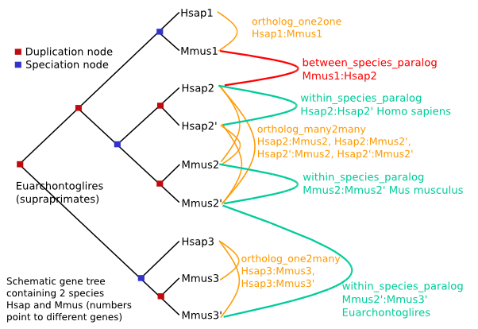
Homology
An Homology object links two genes together
One-to-many relationships are split:
“H ortholog to M1” and “H ortholog to M2” are different objects
Notes:
Consists in tagging the pairs of genes of all the trees with a relation type, depending on the tree topology.

Slide 37
Homology endpoints
GET homology/id/:id
Used to retrieve all the homologous relationships for a given gene using it’s stable identifier
Requires
An ensembl gene stable id
E.g. ENSG00000157764
Example
ext = “/homology/id/ENSG00000157764”
Output format : json, xml and orthoxml + xml

Slide 38
Homology endpoints
GET homology/symbol/:species/:symbol
Given a symbol that corresponds to a gene, it is used to retrieve all the information of the homologs of that gene
Requires
A species name or alias e.g. homo_spaiens/human
The symbol or display name of a gene e.g. BRAC2
Example
ext = “homology/symbol/homo_sapiens/BRCA2”
Output format : json, xml and orthoxml + xml

Slide 39
Homology endpoints:
Optional arguments
target_species : filter homologs by species/aliases.
target_taxon : prune the homologs using taxon id of the species
sequence : enables the user to specify the type of sequece that is returned or if none is wanted.
none, cdna, or protein (default)
aligned : default is 1
type : enables users to specify the type of homologs that they want returned i.e. orthologues,paralogues, projections, and all(default)

Slide 40
Exercises – Homologies
1a: Get all the homologues for the human gene ENSG00000229314 in xml format
1b: Return only the aligned chimp and mouse homologs for the gene given in 1a in json format.
2: Get all the orthologs human gene with the symbol HOXD4-001 in orthoxml format

Slide 41




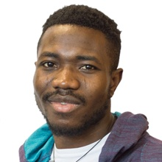

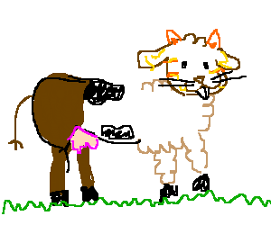
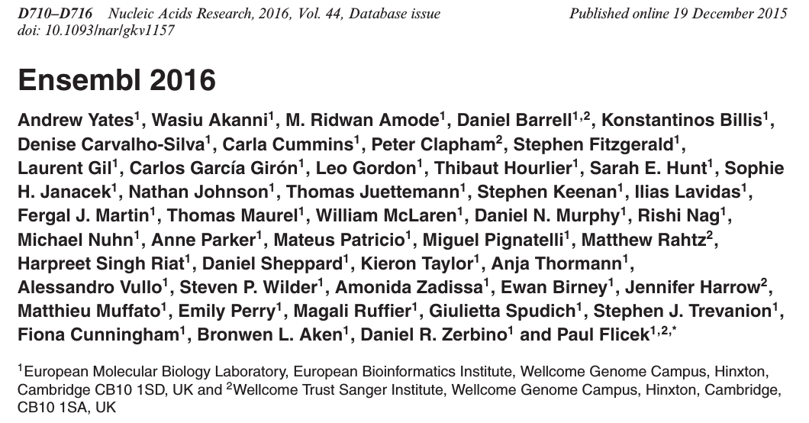



Acknowledgements
Leo
Mateus
Matthieu
Carla
Aj
Brandon
Funding
Co-funded by the European Union

