Slide 1
Genome-wide statistics
Michael Nuhn

Slide 2
Why compute statistics across genomic datasets?
Collapse multiple tracks into a single summary
Assess the quality of experimental data sets
Process signal (normalisation etc)
Discover regions of interest
Compare samples

Slide 3
WiggleTools
Fast C code
Runs on little memory (i.e. common hardware)
Reads common genomics file formats
BigWig, BigBed, VCF
Can read many files simultaneously
Provides a wide set of functionalities

Slide 4
WiggleTools

Slide 5
WiggleTools operators
Basic arithmetics:
+, -, *, /, log, ln, exp, abs etc.
Statistics: mean, standard deviation…
Dataset comparisons: Pearson correlation, Student t-test, Wilcoxon rank sum test…
Compute statistics by region of interest

Slide 6
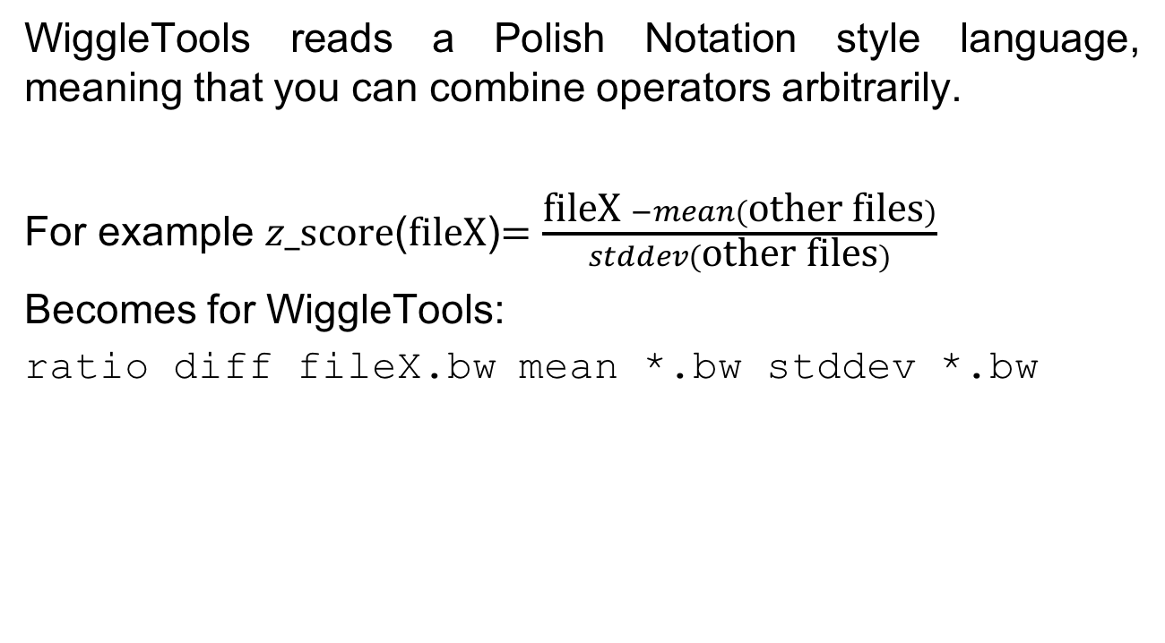
The WiggleTools “language”
WiggleTools reads a Polish Notation style language, meaning that you can combine operators arbitrarily.
For example $z\text{_}\text{score}$($\text{fileX}$)$=\frac{\text{fileX} −mean(\text{other} \text{files})}{stddev(\text{other} \text{files})}$
Becomes for WiggleTools:
ratio diff fileX.bw mean *.bw stddev *.bw

