Slide 1
TrackHub Registry
Code Review
07/05/2015
EMBL – European Bioinformatics Institute
Wellcome Trust Genome Campus
Hinxton, Cambridge, CB10 1SD, UK

Slide 2
Where we are
JSON schema
REST API
Web front-end

Slide 3
JSON Schema (1)
Draft03
  Pros: complete JSON model of UCSC specs
    proper data types
    component relations easier to understand
  Cons: big & complex
    TH providers might be initially discouraged to adopt

Slide 4
JSON Schema (2)
v1.0
  e! web TH parsing code
    properties mapped to string key/value pairs
  TrackDb metadata
    Hub/Species/Assembly
    Track metadata: key/value strings
  TrackDb configuration (not indexed by ES)
    key/value strings + “members” object for container track
    do not distinguish between hierarchical container types

Slide 5
The Model
A track hub is a collection of trackDBs, grouped by assembly
A trackDB is a collection of related tracks
A document in ES represents a trackDB
  No explicit hub type
  Hub redundantly repeated for all trackDBs belonging to the same Hub

Slide 6
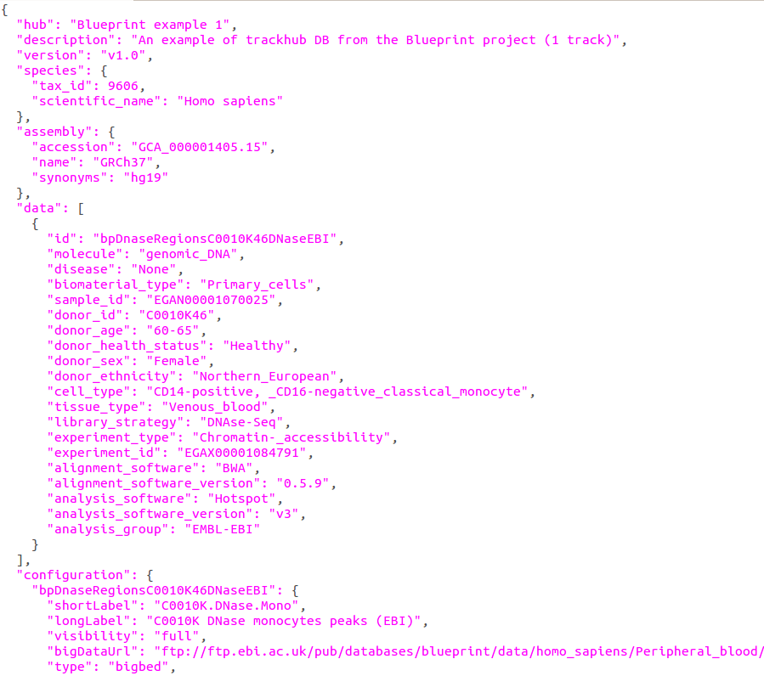

Slide 7
moving to an object, e.g.
hub => {
name => …
shortLabel => …
longLabel => ...
}
array of track metadata,
otherwise ES won't index
!nested types
verbose copy from e! parser,
not indexed

Slide 8
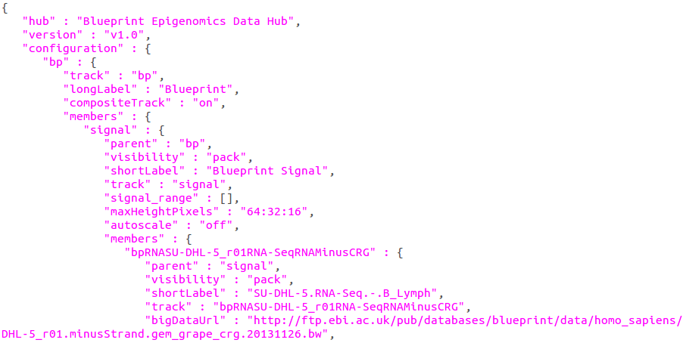
a composite track,
members can be simple
tracks or views
a view, contains
simple tracks
a simple track

Slide 9
The REST API
trackDBs programmatic CRUD for track hub providers
7 endpoints (GET/PUT/POST/DELETE)
Token-based authentication, only after online registration

Slide 10
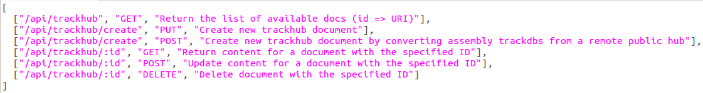
CRUD
GET /api
  Return the list of available endpoints

Slide 11
CRUD (2)
GET /api/trackhub
  return the list of available docs for a user
  doc ID mapped to the URI of the resource which represents the doc
GET /api/trackhub/:id
  return doc for a trackDB with the given ID

Slide 12
CRUD
PUT /api/trackhub/create
  User submits a new trackDB
  Argument (optional): JSON schema version (default: v1.0)
  Body:
    Content-type: application/json
    The trackDB doc in a particular schema version

Slide 13
CRUD (2)
POST /api/trackhub/create
  User creates trackDB(s) as translations from a remote hub (UCSC)
  Argument: same as before
  Body: remote hub URL/assembly
    Content-type: application/json
    { url => '…', assembly => '<UCSC synonym>' }
    Unless assembly, translate/submit all

Slide 14
UCSC Hub Translation
Dispatch mechanism for handling different versions
  1 callback ATMO (v1.0)
  call rewrite of e! web trackhub parser
One big manually curated map from UCSC assembly to NCBI assembly set accessions
  from https://genome.ucsc.edu/FAQ/FAQreleases.html, error correction + other entries found in UCSC public hubs
  die if mapping not found
  query the Genome Assembly DB to fill in species/assembly metadata

Slide 15
CRUD (3)
Validation
  occurs when a doc is submitted/updated
  call python script using Draft4Validator from jsonschema library
    Perl alternative validates everything!
  If error
    dump all to STDOUT
    calling module intercepts and raise exception
    any error prevent subsequent actions
    REST API returns bad request with error

Slide 16
CRUD
POST /api/trackhub/:id
  update content for a doc with the given id
  user re-submits the whole doc
Updates in ElasticSearch
“Partial updates can be done through the API, which accepts a partial document.
However, this just gets merged with the existing document, so the only way to actually update a doc is to retrieve it, change it, and then reindex the whole doc.”

Slide 17
CRUD
DELETE /api/trackhub/:id
  deletes a doc with the specified ID
Delete in ES
“Deleting a doc doesn't immediately remove it from the disk – it just marks it as deleted. ES will clean up deleted docs in the background as you continue to index more data.”

Slide 18
API: TODO
Should be extended to external clients
  search for genome browsers
  no auth, a separate Catalyst controller
TrackHub parser from e! io?!
Complete exception handling for all endpoints

Slide 19
Known Issues
GC DB can be accessed only within EBI
  DBI:Oracle:host=ora-vm5-003.ebi.ac.uk;sid=ETAPRO;port=1571
Some translation tests fail (metadata)
  e! parser does not correctly parse metadata enclosed in double quotes
Some public hubs do not validate
  Empty fields, relax schema?
Memory intensive validation
  Some hubs are very big and do not validate. Validator dumps to STDOUT and consumes a lot of CPU as well
Recently discovered!
  ES wouldn't index all documents in certain circumstances;
  e.g. during testing of the interface, submit a selection of public hubs;
  not all of them are available for search and display to the owner dashboard.

Slide 20
Web front-end
A trackhub aware, intuitive interface for search
A simple dashboard for registered track hub providers
Trackhub submission instructions and REST API documentation

Slide 21
Git Repo
https://github.com/Ensembl/trackhub-registry
3 branches
  master
  angularjs-bootstrap-frontend
  jquery-bootstrap-frontend

Slide 22


master
Catalyst application
  REST API
  front-end with slightly customised bootstrap theme
    initial attempt
    old bootstrap version
    lots of things to do/refine, development stopped

Slide 23
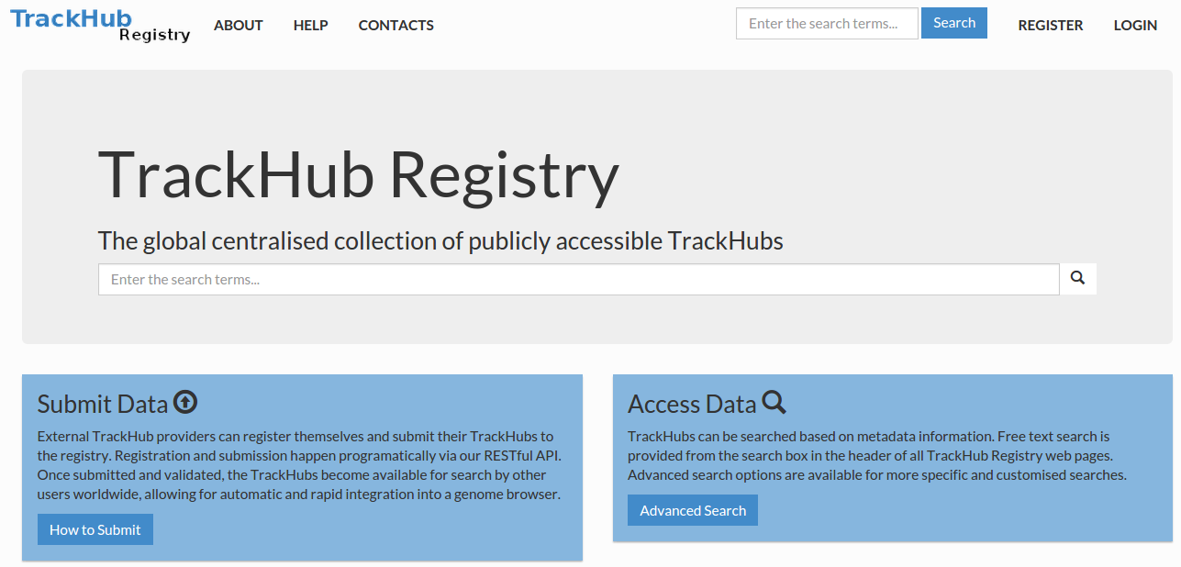

Slide 24

  angularjs-bootstrap-frontend
Catalyst app for REST API
Front-end as SPA
  AngularJS
  UI Bootstrap
  Elasticui
Taking inspiration from elasticsearch-gui
Dev stalled
  do not know enough AngularJS
  steep learning curve
  v2.x coming out soon, complete rewrite

Slide 25

jquery-bootstrap-frontend
where the action is taking place
Catalyst App
  REST API
  Web front-end
    default bootstrap theme (minimalistic CSS)
    jQuery to interact with bootstrap components, plus some effects for search

Slide 26
