Slide 1
TrackHub Registry
In Production
03/02/2016
EMBL – European Bioinformatics Institute
Wellcome Trust Genome Campus
Hinxton, Cambridge, CB10 1SD, UK

Slide 2
Update
https://beta.trackhubregistry.org
4 registered providers
799 submitted track hubs
  >700 plants
  16 human
  5 mouse
  5 zebrafish

Slide 3
Track Submission
Non plant track hubs
  submitted wo author consent, contact and transfer ownership!
  list from e! public page http://www.ensembl.org/info/website/public_trackhubs.html
  some were not possible

Slide 4
E! public hubs
21 hubs, 14 submitted, 7 had problems
Not found
  Deutsches Epigenome Programm (DEEP)
  UMassMed H3K4me3 ChIP-seq data
503: service temporarily unavailable
  CREST IHEC Epigenome Project Hub
504: gateway time out
  DNA Methylation Hundreds of analyzed methylomes from bisulfite sequencing data
Timed out
  Sense/antisense gene/exon expression using Affymetrix exon array from South Dakota State University
Error: chars not mapping to Unicode
  EDACC hosted Roadmap Epigenomics Hub
Error: parent track miRNA_expression is missing
  Broad Improved Canine Annotation v1

Slide 5


HAProxy
Production
Staging
beta.trackhubregistry.org
test.trackhubregistry.org?
Web Node 0
Web Node 1
Web Node
ES
Cluster
ES
Cluster

Slide 6
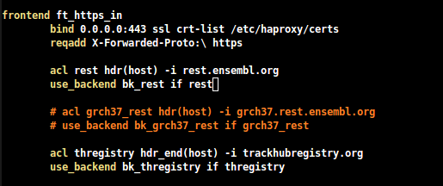

HAProxy
A single shared https based frontend
  use crt-list option to configure multiple certs
/etc/haproxy/haproxy.cfg
/etc/haproxy/certs

Slide 7
The Backend (Prod)
2 s1.large instances
  RAM 8GB, 4 VCPU, Disk 60GB
  thregistry_web_0|1: 192.168.0.89|93
  Access key: trackhub.pem
  Ubuntu 14.04 (kernel 3.13.0-48 SMP)
Each one runs the web site and REST API
  Starman on port 5000
  5 workers

Slide 8
Backend code
TrackHub registry (Catalyst)
  /home/ubuntu/src/trackhub-registry/src/Registry (${REGISTRY_HOME}
Dependencies in /home/ubuntu/src
  various ensembl repos
  includes ensemblgenomes-api

Slide 9
Backend operations
System monitoring
  Installed Sysstat
  $ sar -f /var/log/sysstat/saXX
Various perl scripts in:
  ${REGISTRY_HOME}/scripts/production
Access/Error logs:
  ${HOME}/perl5/registry.(access|error).log
No kibana/logstash at the moment

Slide 10
Production scripts
(in $REGISTRY_HOME/scripts/production)
Start|Stop the server
  (start|stop)_server.sh
  config in $REGISTRY_HOME/conf/production/registry.conf
Reset the cluster (danger!)
  init_cluster.pl
  option controls which cluster (prod|staging)
  read .initrc by default on the same directory

Slide 11
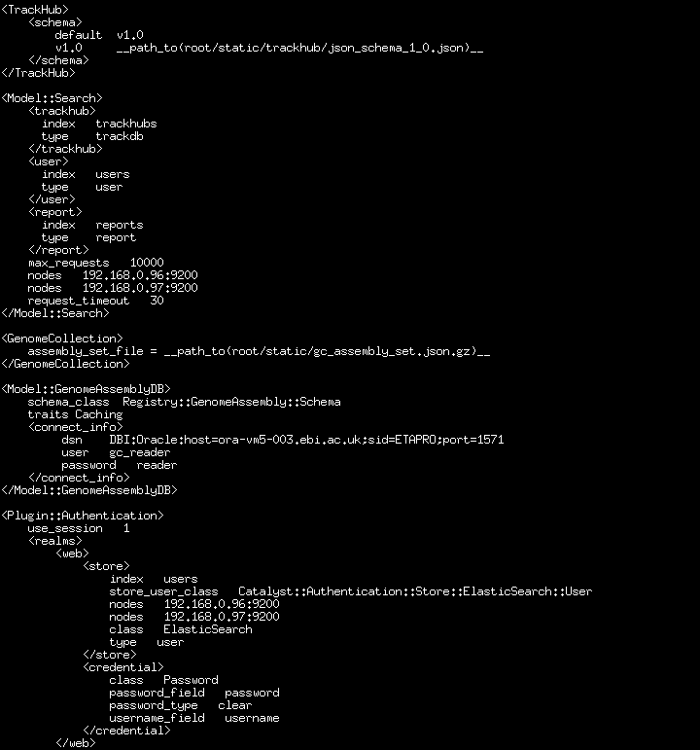
registry.conf

Slide 12
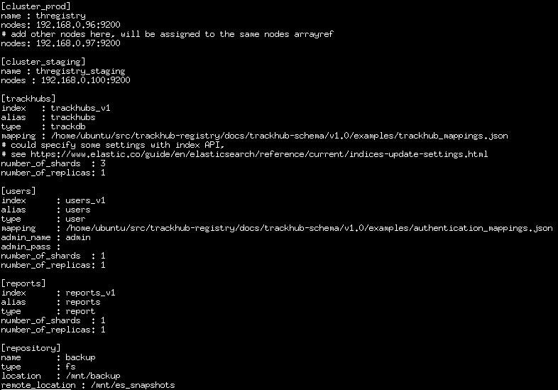

Slide 13
Production scripts (2)
JSONise Genome Assembly DB table
  dump_genome_assembly_set.pl
  run periodically
Monitor registered hubs
  update_trackdb_status.pl
  should run as cron job but not until mail can be sent

Slide 14
ES Cluster (Prod)
2 m1.EBI-Ensembl16 instances
  RAM 16GB, 4 VCPUs, Disk 120GB
  thregistry_cluster_0|1: 192.168.0.96|97
  Access key: trackhub.pem
  Ubuntu 14.04 (kernel 3.13.0-48 SMP)
Cluster: thregistry, no elected master
Run elasticsearch 1.7.3 (from deb)

Slide 15
ES node configuration
Files:
  /etc/elasticsearch/elasticsearch.yml (not a lot there, just cluster name, path.repo and memory options)
  /etc/default/elasticsearch (configure ES init service, i.e. HEAP size 8GB, max open files 65535, locked memory)
  /usr/lib/systemd/system/elasticsearch.service (override memory options elsewhere)
Logs written to /var/log/elasticsearch
Index written to /var/lib/elasticsearch
  120GB with two RAID0 disks (/dev/vdb1, /dev/vdc1)
  pros: high R/W throughput
  cons: no redundancy/fault tolerance, might be tricky adding new disk
  /etc/mdadm/mdadm.conf
Remotely mount staging server /mnt/backup under /mnt/es_snapshots

Slide 16
Indices et al.
Index | Alias | Type | Shards | Replicas
trackhubs_v1 | trackhubs | trackdb | 3 | 1
users_v1 | users | user | 1 | 1
reports_v1 | reports | report | 1 | 1

Slide 17
ES node operations
System monitoring
  $ sar -f /var/log/sysstat/saXX
Start/Stop/Restart ES
  $ sudo elasticsearch start|stop|restart
TODO: cluster monitoring
  use some plugins, e.g. Marvel (free in dev)

Slide 18
Staging server
Purpose
  prepare new data (re-index)
  test new developments of the interface
  test recovery from snapshots
1 s1.small instance
  RAM 2GB, 2 VCPUs, Disk 20GB
  thregistry_staging_backup: 192.168.0.100
  Access key: trackhub.pem
  Ubuntu 14.04 (kernel 3.13.0-48 SMP)

Slide 19
Backend operations
System monitoring
  Installed Sysstat
  $ sar -f /var/log/sysstat/saXX
Various perl scripts in:
  ${REGISTRY_HOME}/scripts/production
Access/Error logs:
  ${HOME}/perl5/registry.(access|error).log

Slide 20
ES node configuration
Cluster: thregistry_staging
  elasticsearch 1.7.3 (from deb)
Files:
  /etc/elasticsearch/elasticsearch.yml
  /etc/default/elasticsearch (HEAP size 1G)
  /usr/lib/systemd/system/elasticsearch.service
Logs written to /var/log/elasticsearch
Index written to /var/lib/elasticsearch
  120GB with two RAID0 disks (/dev/vdb1, /dev/vdc1)
  /etc/mdadm/mdadm.conf
Mount 120GB disk /mnt/backup (/dev/vdd1) to store snapshots

Slide 21
HAProxy
Production
Staging
beta.trackhubregistry.org
test.trackhubregistry.org?
Web Node 0
Web Node 1
Web Node
thregistry_staging
ES
Cluster
ES
Cluster
thregistry
/mnt/backup

Slide 22
Recovery
shards have replicas, but you never know …
  takes regular snapshots of the data
  tests recovery from the latest
  sends alert (sending emails?)
Script still to test/complete, will be at
  ${REGISTRY_HOME}/scripts/production/

Slide 23
New data/development
Scenario:
  implement a change in the interface
  might require re-indexing of the data
How to re-create the index and test it's working before deploying to the prod cluster?

