Slide 1
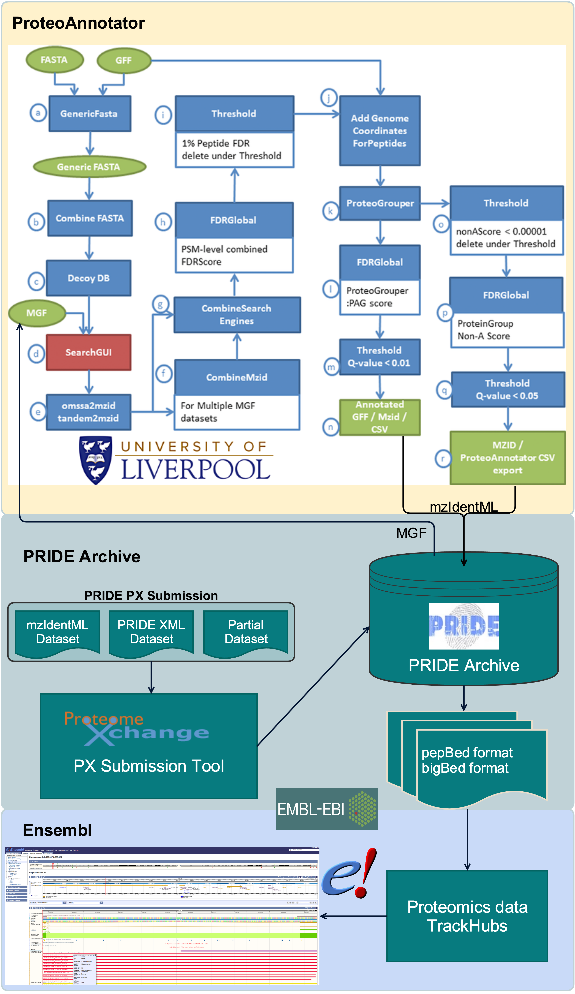





Dynamic linking of public proteomics data in Ensembl using TrackHubs
Juan A. Vizcaíno¹, Tobias Ternent¹, Fawaz Ghali², Alessandro Vullo¹, Paul Flicek¹, Andy Yates¹, Andrew R. Jones², Henning Hermjakob¹
European Molecular Biology Laboratory, European Bioinformatics Institute (EMBL-EBI), Wellcome Genome Campus, Hinxton, Cambridge CB10 1SD, UK.
Institute of Integrative Biology, Biosciences Building, University of Liverpool, Crown Street, Liverpool L69 7ZB, UK.
Objective
We aim to provide dynamic integration between the public-domain proteomics data available in the PRIDE (PRoteomics IDEntifications) database (http://www.ebi.ac.uk/pride) and the genome information available through the Ensembl genome browser (http://www.ensembl.org).
ProteoAnnotator
ProteoAnnotator (http://www.proteoannotator.org/) [1] is a completely automated software pipeline for integration of MS based proteomic evidence into genome databases. The goal is to use MS data for confirming that predicted gene models are translated into protein, and to verify the correctness of the existing gene models.
ProteoAnnotator uses several search engines via SearchGUI [2], combines the results and provides an output in the PSI standard format mzIdentML.
PRIDE / ProteomeXchange
The PRIDE Archive database at EMBL-EBI is one of the main public repositories for MS-based proteomics data. PRIDE is a core member of the ProteomeXchange consortium [3] (http://www.proteomexchange.org/), which provides a standard framework for the submission and dissemination of proteomics data.
The output coming from the datasets reprocessed using ProteoAnnotator (in mzIdentML format) is converted to the pepBed format (which is based on the original BED format), and then converted to an indexed binary bigBed file.
Ensembl Genome Browser
Ensembl is an EMBL-EBI resource that provides a genome browser that acts as a single point of access to annotated genomes for mainly vertebrate species.
Ensembl now provides support for TrackHubs (also known as datahubs), which are an alternative to DAS (Distributed Annotation System) for sharing large quantities of annotation over the internet.
Different proteomics data TrackHubs (in bigBed format) coming from this pipeline will soon be available via the Ensembl web interface.
References:
1.Ghali F, et al. (2014). Proteomics 14:2731-2741.
2. Vaudel M, et al. (2011). Proteomics 11:996-999.
3. Vizcaíno JA, et al. (2014). Nat. Biotechnol. 32:223-226.
Acknowledgements:
BBSRC “ProteoGenomics” [BB/L024225/1].

