Slide 1
Acedb and other things….
Ed Griffiths & Rob Clack

Slide 2
Main projects
Support Wormbase
Support Havana
Support other Sanger users
Do new stuff…

Slide 3
Wormbase
Acedb is used as:
the central repository for worm data
the tool for “putting it all together”
one of the main annotation tools

Slide 4
Wormbase
CSHL
schema
FMap
STL
Keith,
Dan
GMap
CAL
Wormbase
SANG
EMBL

Slide 5
Havana
blixem
Otter
Local
ace
FMap
dotter
Otter/lace

Slide 6
Other users…
“I’ve run out of memory…”
“Can you just make SMap do this…”
“If would be nice if FMap could….”
Acedb, start smoking today !

Slide 7
New Stuff…
Annotation, annotation, annotation…
FMap is:
Perhaps most used component of acedb
Main annotation tool for many groups
Integrated with blixem/dotter/genefinder and of course the underlying database
But is tied to Acedb…

Slide 8
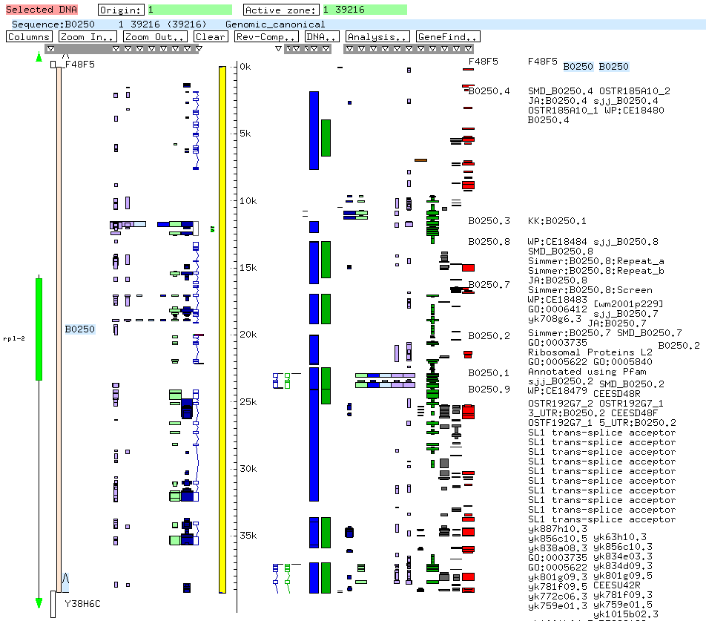
FMap

Slide 9
FMap to ZMap
ZMap aims to:
Provide a client/server version of FMap
Provide an annotation client that is not tied to Acedb
Use a generally supported data format such as DAS 2, Otter or…..
Maintain the good bits of FMap but junk some of the irritating ones

Slide 10
ZMap client, like a Web Browser ?
Interruptible
Multiple independent windows
Contacting arbitrary numbers of servers
Blah, blah, blah
Suggests threads ?

Slide 11
Why use threads ?
Reasons for using threads:
Performance – multiple cpu’s
Performance – overlapping I/O
Asynchronous events
Architecture/Encapsulation
GUI interactivity

Slide 12
ZMap overview
ZMap
window
connection
Appl
Manager
connection
connection
connection
ZMap
window
connection
connection
connection
connection

Slide 13
Factors for ZMap
GUI must be responsive
Servers may take some time to send data, data will take some time to read/convert for drawing
Xlib is not threaded
Calls/subroutines for contacting servers are thread safe, e.g. system socket calls, Libcurl, expat, glib and other libs.
Suggests a natural split into “GUI” vs. “server handling” code.

Slide 14
ZMap and Threads
ZMap
window
connection
Appl
Manager
connection
connection
connection
ZMap
window
connection
connection
connection
connection

Slide 15
In more detail
Zmap
Control
code
Window code
Slave
thread
Some
server

Slide 16
In even more detail…
ZMap
control
5) Draw
Xlib event
Loop..
window
1) register
4) Data
Check
threads
3) Check threads
condvar
Slave thread
2) poll

Slide 17
Things to remember…
Compile your program with –pthreads so you get the thread safe versions of the system libraries
Compile the non-standard libraries you want to use with –pthreads (like my own acedb server connection package…sigh)
Watch out for glib…..
Then stand back and light the blue touch paper…

Slide 18
What we have now…
Multi-threaded ZMap
Each window has an arbitrary number of threads associated with it, i.e. can contact an arbitrary number of servers
Each window has the usual “stop”/”reload” buttons
Prototype runs against multiple acedb servers, soon to include DAS 2 server.
And Rob is working on the drawing but that’s another talk……

