Slide 1
ZMap and DAS2
(a few good days in Cape Town)

Slide 2
Who, where ?
I was at SANBI, University of the Western Cape, Cape Town.
http://www.sanbi.ac.za
Institute is run by Winston Hide
Lincoln Stein of CSHL is on sabbatical there…lucky for me as it was -15C at CSHL
I went to work on DAS 2 with Lincoln because I want to use it for ZMap project

Slide 3
Fmap to ZMap
FMap is the sequence viewer/annotation window of acedb
Displays arbitrary sequence with features
Interfaces to other parts of acedb to allow gene-finding, alignment display, annotation
Is used by lots of annotators here and elsewhere

Slide 4
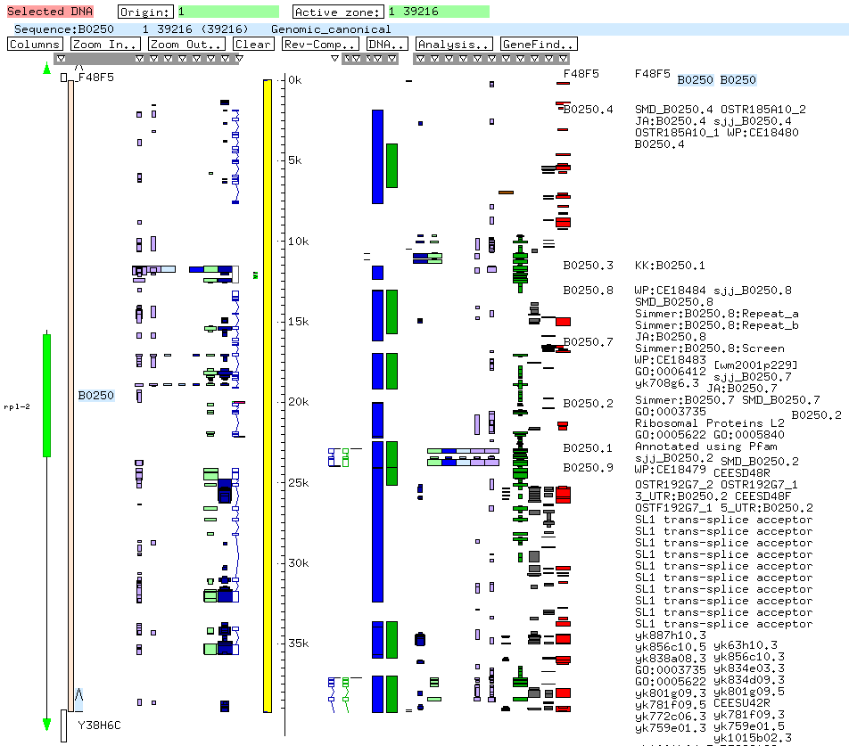
FMap

Slide 5
FMap to ZMap
More and more projects are using relational databases
FMap only works against acedb DBs
Lots of annotators are used to FMap
…so why not split off the FMap…….

Slide 6
ZMap so far…
Zmap App
Zmap
Control
Zmap thread
Server
Zmap thread
Server
Zmap thread
Server
Zmap
Control
Zmap thread
Server
Zmap thread
Server
Zmap thread
Server

Slide 7
ZMap and servers…
?
ZMap
server
What should be the protocol ?
currently a plethora of data formats
experience suggests binary protocols are not well supported
need to interface to C/C++, Java, perl based servers
XML type datastreams are popular + plenty of software
DAS used widely but has some drawbacks, DAS2 could solve these and provide a good solution.

Slide 8
DAS 2
DAS 2.0 is designed to address the short comings of DAS 1.0, including:
an updating protocol to allow the protocol to be used for annotation rather than just viewing.
better support for hierachical structures (e.g. transcript + exons)
alternative formats for payloads

Slide 9
DAS 2 overview
http protocol
GET, PUT, POST, DELETE form basis for updating
Urls act as declarative commands to access database
Makes use of XML “Base” and “XLink” to form unique/consistent Url requests
Initial implementation provides both XML and GFF3 formatted data

Slide 10
http commands
The 4 basic http commands naturally fit:
GET – gets data from the database
PUT – add new data, modify existing data
POST – augment existing data
DELETE – deletes existing data

Slide 11
URLs
Format:
http://server/das/request/
server – server that supports DAS2
das – keyword causing http server to call DAS2 routines
request - DAS 2 request in URL format

Slide 12
DAS 2 URL in more detail
/das/source/version/namespace/
Some examples (all use http GET):
/das/ list all sources (e.g. genomes)
/das/mouse/ list all versions of a source
/das/mouse/43/ list meta-info/namespaces for version
/das/mouse/43/feature list all everything in a namespace
/das/mouse/43/feature/gene/ list all “gene”s
/das/mouse/43/feature/gene/g0034
return gene g0034

Slide 13
Namespaces
Currently there are the following namespaces:
typelist – all feature types
stylesheet – detailed description of all feature types
feature – genomic features
sequence – and and protein sequences
region – genomic features by position

Slide 14
Some examples…
/das/wormbase/1/typelist/
<TYPES
xmlns="http://www.biodas.org/ns/das/2.00"
xmlns:xlink="http://www.w3.org/1999/xlink"
xml:base="http://localhost/das/wormbase/1/stylesheet/"
method_ontology="http://song.sourceforge.net/ontologies/sofa">
<TYPE id="Sequence:tRNAscan-SE-1.11" method="Sequence" source="tRNAscan-SE-1.11">TRNAscan-SE-1.11 Sequences</TYPE>
<TYPE id="gene:curated" method="gene" source="curated">Curated genes</TYPE>
<TYPE id="gene:RNA" method="gene" source="RNA">RNA genes</TYPE>
<TYPE id="gene:framework" method="gene" source="framework">Framework genes</TYPE>
<TYPE id="transcript:curated" method="transcript" source="curated">Curated transcripts</TYPE>
<TYPE id="transcript:RNA" method="transcript" source="RNA">RNA transcripts</TYPE>
<TYPE id="coding_test:curated" method="coding_test" source="curated">Curated coding_tests</TYPE>
<TYPE id="transcript:NDB_CDSl" method="transcript" source="NDB_CDSl">NDB_CDSl transcripts</TYPE>
<TYPE id="alignment:WABA_briggsae_cosmid" method="alignment" source="WABA_briggsae_cosmid">WABA_briggsae_cosmid alignments</TYPE>
<TYPE id="alignment:BLAT_EST_BEST" method="alignment" source="BLAT_EST_BEST">BLAT_EST_BEST alignments</TYPE>
<TYPE id="alignment:BLAT_EST_OTHER" method="alignment" source="BLAT_EST_OTHER">BLAT_EST_OTHER alignments</TYPE>
<TYPE id="alignment:BLAT_mRNA_BEST" method="alignment" source="BLAT_mRNA_BEST">BLAT_mRNA_BEST alignments</TYPE>
<TYPE id="alignment:BLAT_mRNA_OTHER" method="alignment" source="BLAT_mRNA_OTHER">BLAT_mRNA_OTHER alignments</TYPE>
<TYPE id="experimental:RNAi" method="experimental" source="RNAi">RNAi experimentals</TYPE>
<TYPE id="Expression:Expr_profile" method="Expression" source="Expr_profile">Expr_profile Expressions</TYPE>
...
</TYPES>

Slide 15
And more….
/das/wormbase/1/stylesheet/Sequence:tRNAscan-SE-1.11
<STYLESHEET
xmlns="http://www.biodas.org/ns/das/2.00"
xmlns:xlink="http://www.w3.org/1999/xlink"
xml:base="http://localhost/das/wormbase/1/stylesheet/">
<TYPE id="Sequence:tRNAscan-SE-1.11" xml:base="http://localhost/das/wormbase/1/stylesheet/Sequence:tRNAscan-SE-1.11/">
<ATTRIBUTE id="bgcolor" value="white" />
<ATTRIBUTE id="height" value="3" />
<ATTRIBUTE id="fgcolor" value="black" />
<ATTRIBUTE id="key" value="tRNAs" />
<ATTRIBUTE id="citation" value="These are tRNA predictions made using Sean Eddy&#39;s tRNAscan program." />
<ATTRIBUTE id="fontcolor" value="slateblue" />
</TYPE>
</STYLESHEET>

Slide 16
Different formats…
/das/wormbase/1/feature/transcript:curated/M7.1
<FEATURELIST
xmlns="http://www.biodas.org/ns/das/2.00"
xmlns:xlink="http://www.w3.org/1999/xlink"
xml:base=http://localhost/das/wormbase/1/feature/
format="DAS2XML"> we could have put format=“GFF3” here for GFF format data
<FEATURE id="transcript:curated/Sequence:M7.1">
<LOCATION id="../sequence/IV" start="11093983" end="11093354" strand="-1" />
<TYPE id="../stylesheet/transcript:curated" source="curated" method="transcript" />
<DISPLAY_NAME>M7.1</DISPLAY_NAME>
<NOTE>ubiquitin-conjugating enzyme E2-17 KD</NOTE>
<NOTE>let-70</NOTE>
<NOTE>ubc-2</NOTE>
<SUBPARTS xml:base="http://localhost/das/wormbase/1/stylesheet/">
<SUBPART id="CDS:curated/Sequence:M7.1" type="CDS:curated" />
<SUBPART id="CDS:curated/Sequence:M7.1" type="CDS:curated" />
<SUBPART id="CDS:curated/Sequence:M7.1" type="CDS:curated" />
<SUBPART id="CDS:curated/Sequence:M7.1" type="CDS:curated" />
<SUBPART id="CDS:curated/Sequence:M7.1" type="CDS:curated" />
</SUBPARTS>
</FEATURE>
Etc. etc.

Slide 17
GFF format…
/das/wormbase/I/region/III/500/2000?format=GFF3
<FEATURELIST
xmlns="http://www.biodas.org/ns/das/2.00"
xmlns:xlink="http://www.w3.org/1999/xlink"
xml:base="http://localhost/das/wormbase/I/feature/"
format="GFF3">
III Genomic_canonical clone . . . + . ID=Sequence:CTEL54X
III curated coding_test 1271 2917 . - ID=Sequence:cTel54X.1
III curated CDS 1558 2167 . - 1 Parent=Sequence:cTel54X.1
III curated CDS 1271 1507 . - 0 Parent=Sequence:cTel54X.1
III curated transcript 1271 2917 . - ID=Sequence:cTel54X.1
III curated CDS 1558 2167 . - 1 Parent=Sequence:cTel54X.1
III curated CDS 1271 1507 . - 0 Parent=Sequence:cTel54X.1
III Link Sequence 1 13855177 . + . ID=Sequence:III
III GenePair_STS structural 1090 2736 . + . ID=PCR_product:mv_cTel54X.1
III GenePair_STS structural 1753 2948 . + . ID=PCR_product:sjj_cTel54X.1
</FEATURELIST>

Slide 18
Use of XML “Base”
After an href like this:
<a href="/das/mouse/43/region/seq0043/5000/20000">My favourite seq</a>
to get back to a gene would require:
<a href="../../gene/g0043/">Painful hrefs"</a>
but its also possible to use the html "Base" instruction to do this:
<Base href="http://yourserver/das/mouse/43">
then you can simply put:
<a name="gene/g0043">

Slide 19
Updating…
Adding a new exon:
PUT /das/mouse/build4/CDS/cds12345 (n.b. exon must have an id)
put-data <feature>
<location start= end= seqid=/>
<parent="../../mRNA/t00043">
<etc>
</feature>
Remove an exon from mRNA t00043:
DELETE /das/mouse/build4/CDS/cds12345

Slide 20
DAS 2 client…
http protocol + XML = good existing libs ?
http: libcurl, v. portable, easy to use, includes compression
XML: SAX or DOM ?
libxml2: bizarre SAX interface does not implement
streaming
libexpat: seems perfect, is basis of perl xml module
and also Mozilla.
= working client that queries/outputs results from server

Slide 21
DAS 2 summary:
http command usage defined
URL format defined
Update commands - work in progress
Sample server working
Sample client working

Slide 22
Getting DAS 2…
Biodas docs/sample server:
:ext:pub.open-bio.org:/home/repository/biodas/das2
Prototype server at:
http://dev.wormbase.org/das

