Slide 1
The otterlace / Zmap annotation system
James Gilbert
jgrg@sanger.ac.uk
Ed Griffiths
edgrif@sanger.ac.uk

Slide 2
components of otterlace system
perl – Ensembl database of manual gene annotations from the HAVANA group (otter)
perl/Tk – control and editing
C – acedb local database storage (lace)
C/Gtk – Zmap feature display

Slide 3
Data flow
acedb
GUI
Remote
DAS
sources
Zmap
acedb
server
Ensembl
pipeline
Xatoms
http / convert
apache
scripts
otterlace
Ensembl
otter
http

Slide 4
otterlace ⇔ Zmap
client (perl) xml request
ZMap
(property notify)
X11::XRemote
response (xml)
X-atoms
client (zmap) xml request
Tk
(property notify)
response (xml)

Slide 5
flexible / extensible
Two way communication via X server atoms
Extensible xml format language
  Session commands
    initialisation / termination
  Interactive commands
    highlighting features, cut / paste of feature data
  Data commands
    add, modify, delete features

Slide 6
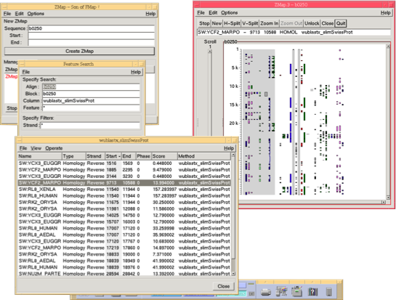
Zmap – Finding Stuff
Clone
selector
Clone
display
Search
window
Search
results
with
selected
Item
Highlighted
item

Slide 7
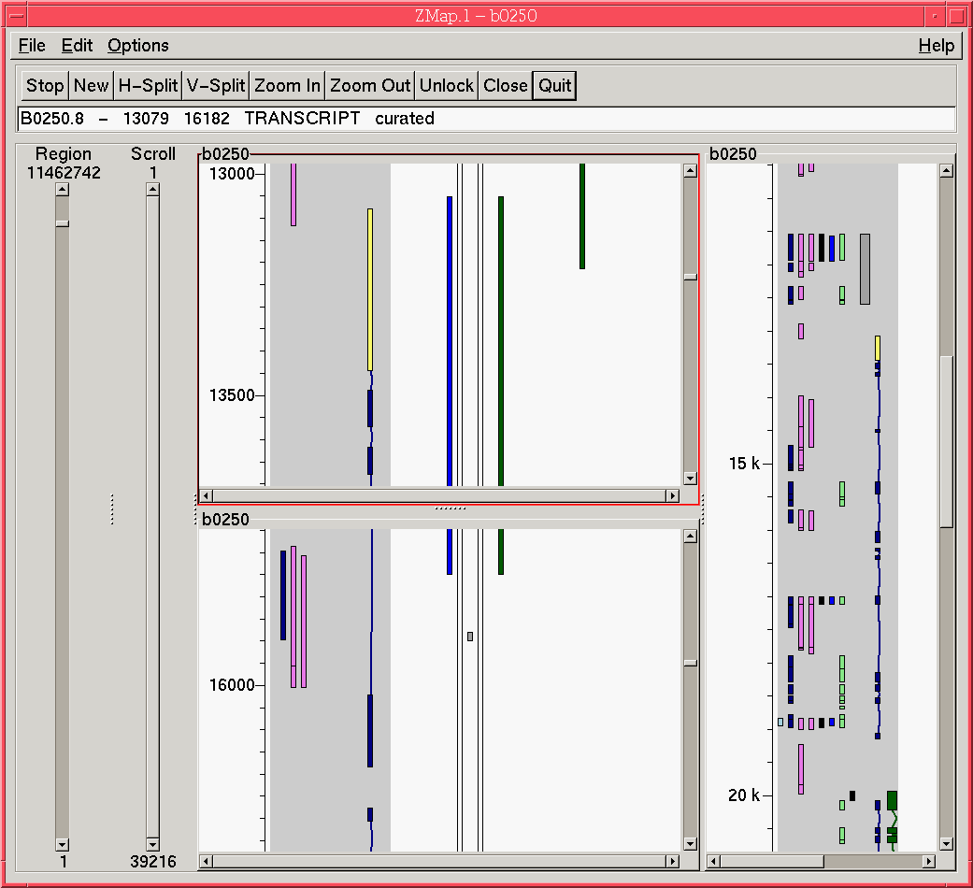
Zmap – Multiple windows
top
Whole
transcript
bottom

Slide 8
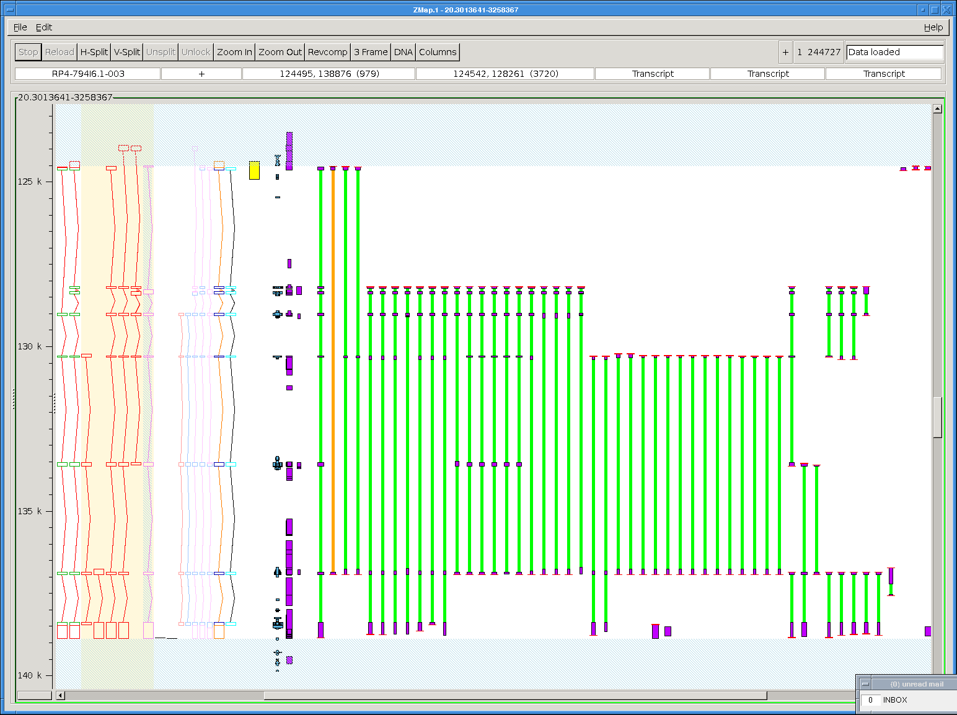
Zmap – Displaying Matches

Slide 9
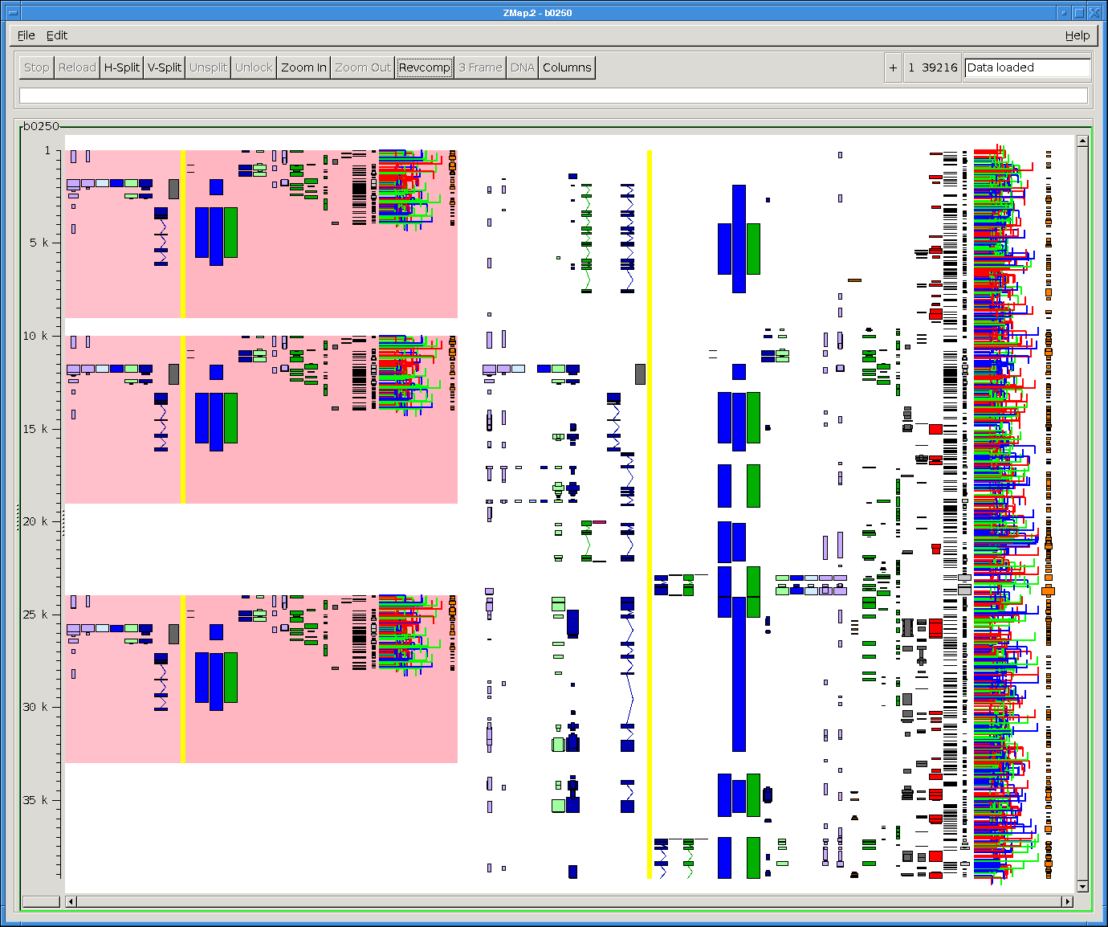
Zmap – Syntenic Regions

Slide 10
Data concerns
Genome assembly versions
  Re-map between assemblies using Ensembl projection API
  Cannot interrogate DAS sources for assembly version
There is too much data to present to the annotator
  Clone based analysis pipeline has disadvantages
  Do not have smart filtering method (retained introns win)
Dynamic loading of subsets of the data

Slide 11
Software Concerns
Perl/Tk moribund?
  used by otterlace, replacing would be costly
Gtk Canvas choices
  Zmap uses Foocanvas
  Gtk will (eventually) choose a generic canvas
    MVC model
    Will not need to deal with 32k viewport
  will be an expensive replacement too

Slide 12
demo here?

