Slide 1
Multiple Syntenic Alignments
More is better......???

Slide 2
Issues with Syntenic Annotation
Navigation and Viewing
  Selecting species/haplotypes/knockouts and sections to work on
  Multiple blocks
  Finding features
  Viewing features
Data
  Alignment format ?
  Dealing with all that data

Slide 3
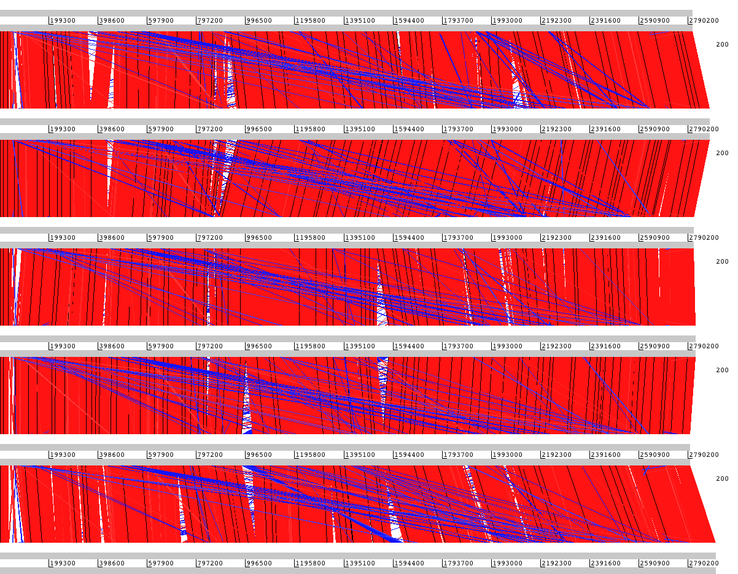
We want to go from this...

Slide 4
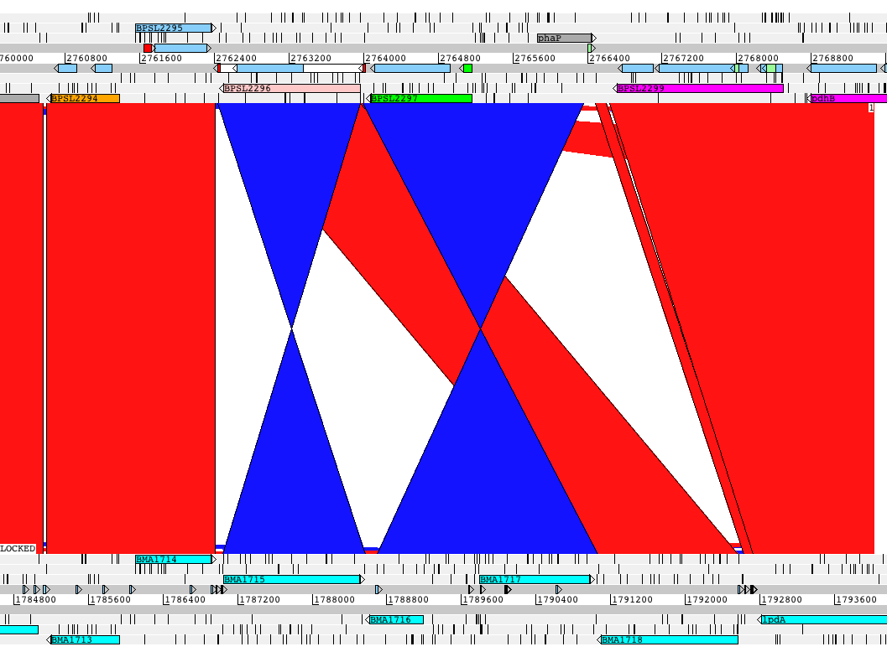
to this...

Slide 5
to maybe this...

Slide 6
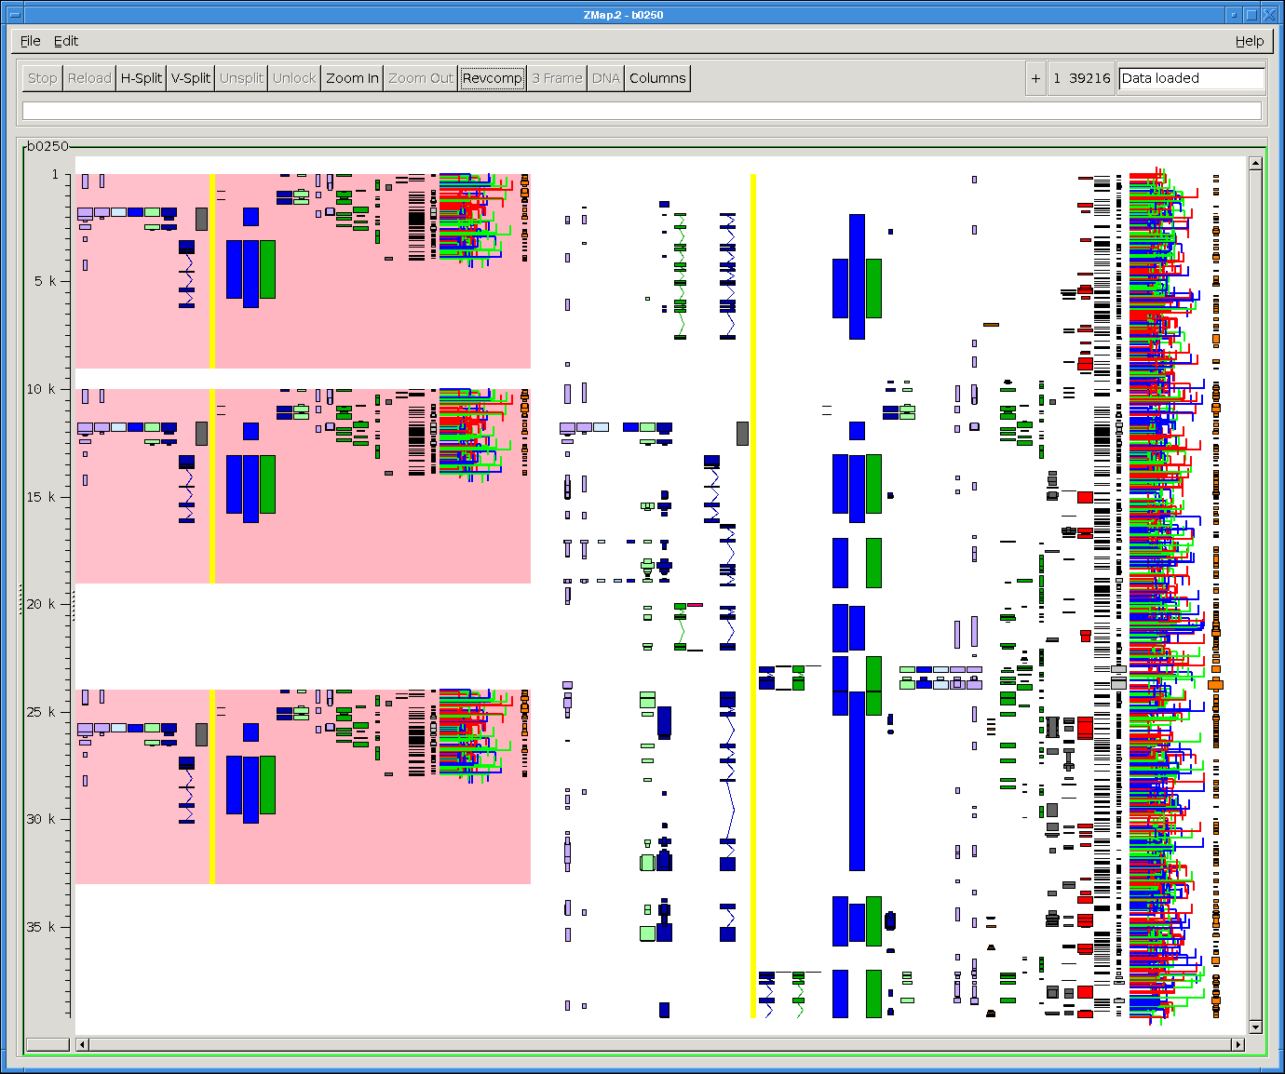
or this...

Slide 7
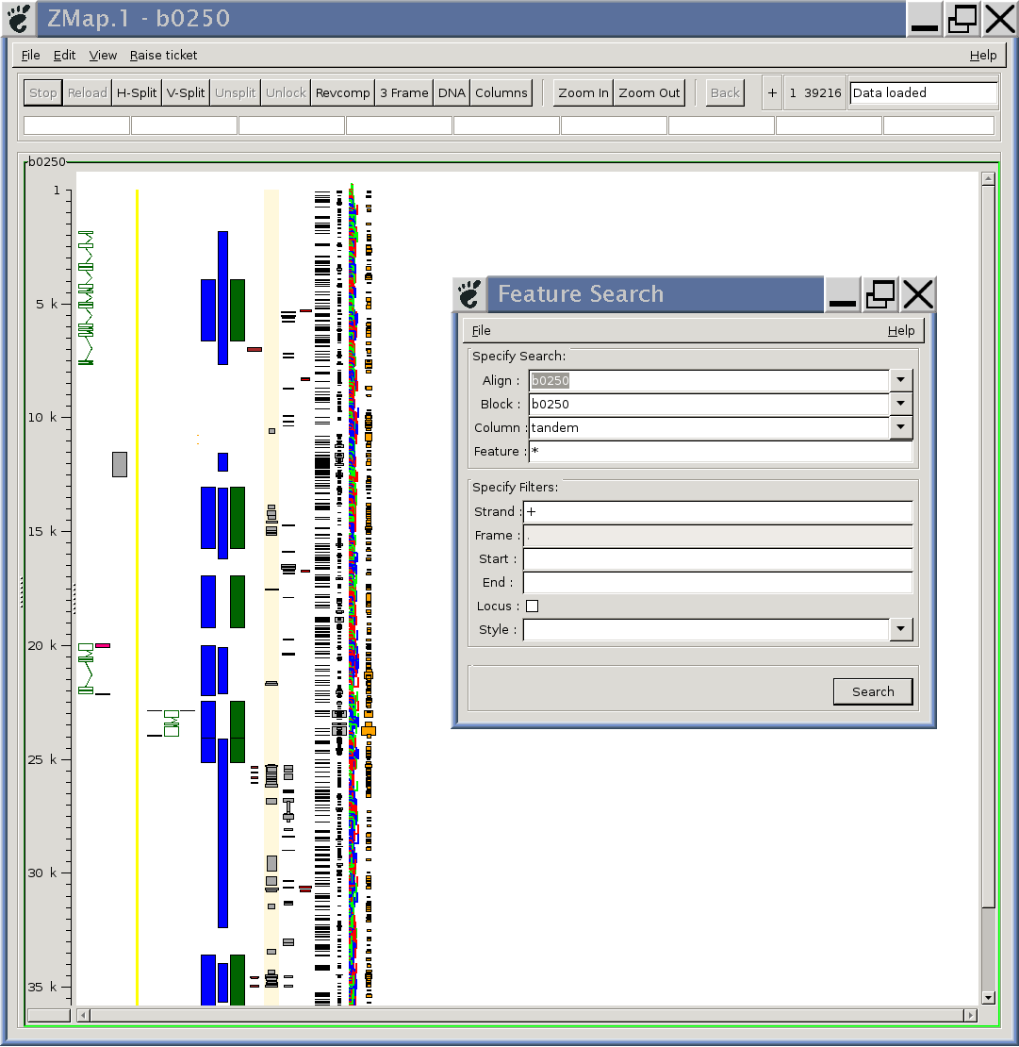
Searching Multiple Regions

Slide 8
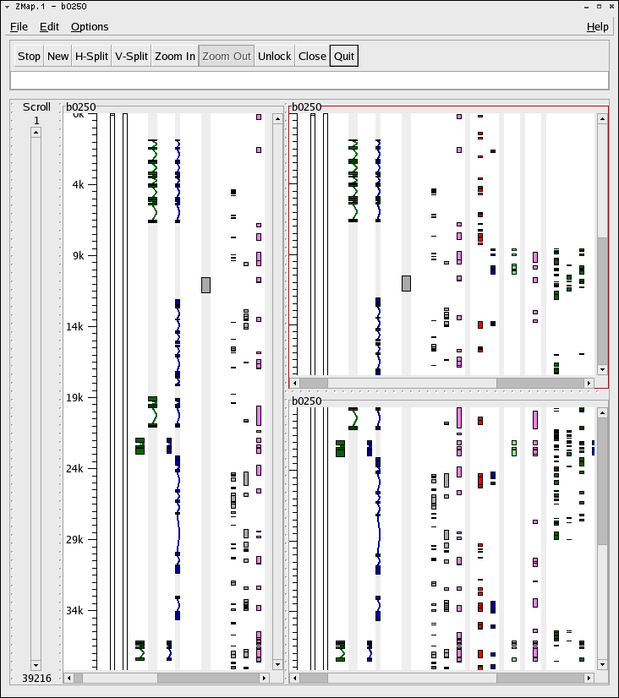
Multiple Windows

Slide 9
Data...
Format:
  Chaining/Netting of Blastz results is some kind of current de facto standard
Volume of data:
  Move from “loading everything” to loading the minimum...
  Allow user to choose areas of interest and load data within that area ?

