Slide 1
Curation Tools
  Gary Williams
  Sanger Institute

Slide 2
Gene curation – prediction software
Gene prediction software is good, but not perfect.
Our current gene prediction combiner Jigsaw is about 80% accurate.

Slide 3
Gene curation – sources of data
We have traditionally relied heavily on EST transcription data to correct predictions.
Now we have many extra data sources
  Protein homology
  Mass-spec peptides
  Chip-based expression data
  Comparative species synteny/homology
  Other data coming (ENCODE etc.)

Slide 4
Confirming the correct structure
Evidence for a correct structure:
  Protein homology, transcript data, ab initio predictions, mass-spec peptides, tiling array, trans-spliced leader sequence, strong splice sites, etc.
Evidence against a correct structure
  Unmatched instances of the above
  Frameshifts in protein alignment
  Overlapping exons
  Genes overlapping repeat regions

Slide 5
Anomalous regions database
Have a database of problem regions.
Anomaly = conflicts with the curated data
Assumption: problem areas that need the most curation will have more anomalies than other places.
Anomalies
Problem areas

Slide 6
Anomaly database
Anomalies that have been seen can be flagged to be ignored in future.
All anomalies in a region are presented for inspection en masse.
We can track what has been seen and measure progress.

Slide 7
Simple anomalies
Protein homology unmatched by curated CDS
Unmatched conserved coding regions
Unmatched predicted exons (twinscan, jigsaw)
Short exons (< 30 bases)
CDS exons overlapping repeat region
Overlapping CDS exons

Slide 8
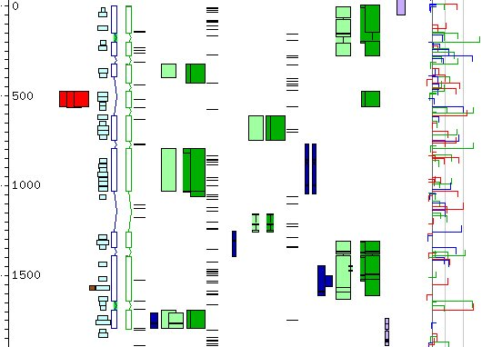
Unmatched anomalies
Twinscan
Splice sites
CDS
Anomalies
Expression
Protein hits

Slide 9
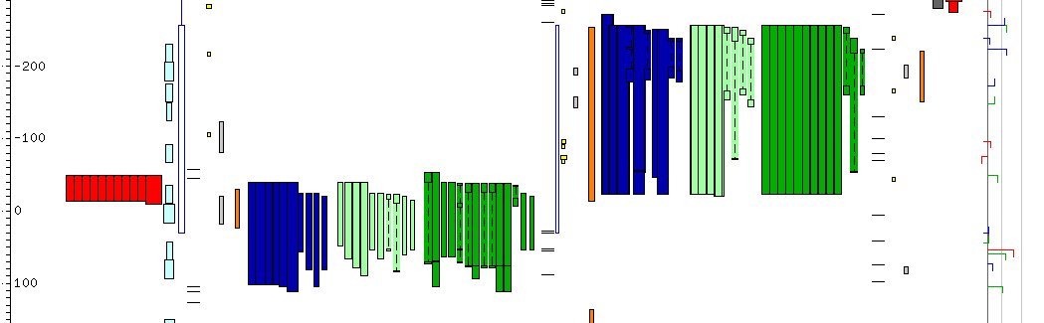
Frameshift in exon
CDS exon
Frame 1
Frame 2
Frame 3
Expression
Anomalies
Protein hits

Slide 10
Find Anomalies
GENOMIC GFF FILES
GFF ANOMALIES FILE
FIND ANOMALIES
MySQL DATABASE
Anomaly Curation Tool
ACeDB FMAP

Slide 11
Anomaly database
Store anomalies in each 10 Kb region
Sort windows by sum of anomaly scores
Curator selects next 10 Kb window
Curator selects anomaly to curate
Acedb editor displays region

Slide 12
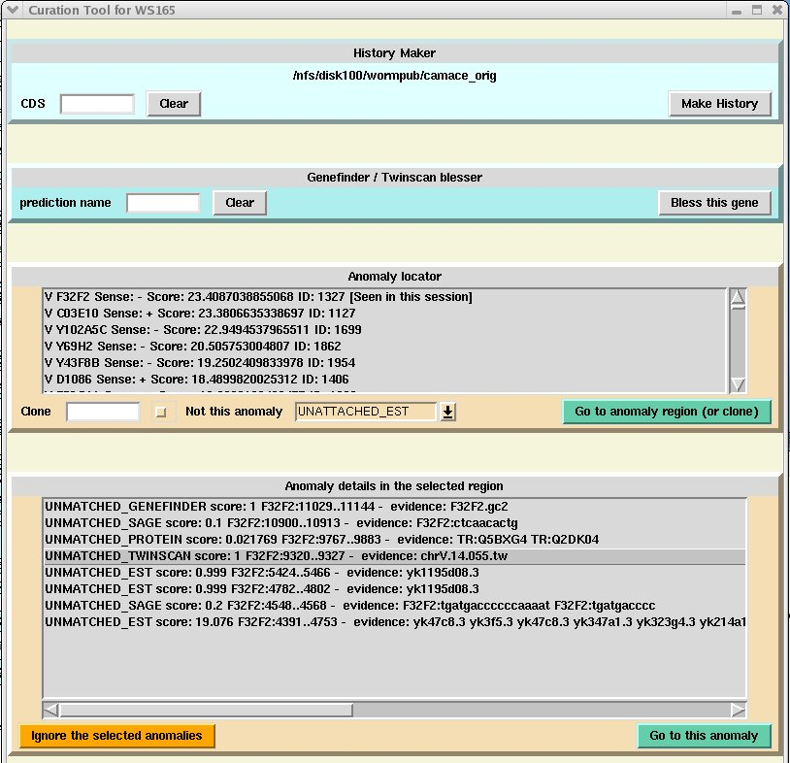
Anomaly curation tool
List of 10Kb windows sorted by anomaly score.

Slide 13
Select region
Select a region
List of
anomalies
in region

Slide 14
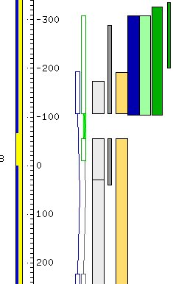
Select anomaly
Select an anomaly
Display of the anomaly
(Unmatched twinscan)

Slide 15
Efficiency
Standard set of anomalies for curators to work on.
Anomalies are not missed.
Can quickly accept or reject regions to curate after a cursory glance.
Makes finding problem areas easy
  concentrate efforts on problem regions
  no unnecessary repeat visits to a region.
Complex problem areas can still take a long time to solve.

Slide 16
Other anomalies
Work is continuing to add new types of anomaly.
  Tiling array expressed regions
  Missing/extra exons compared to other genes in homologs
Adding a new anomaly type requires no changes to the database or curation tool and it is amalgamated with the existing anomalies.
Any new data can easily be added.

Slide 17
Anyone can see them!
The anomalies are publicly displayed in the GBrowse genome display.

Slide 18
Small protein display tool (ilk)
Enter ID
Displays target protein and (blastp) similar nematode proteins
  Highlights blastp HSP similar regions
  Exon boundaries
  SignalP region
  Mass-spec hits
  Domains

Slide 19
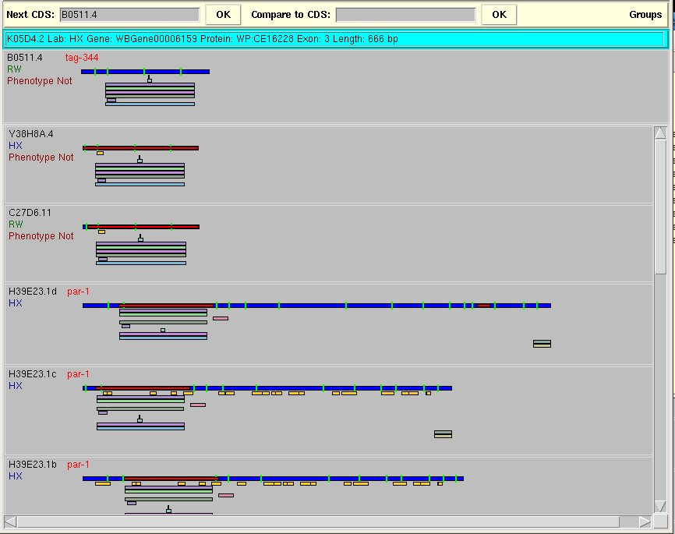
Protein display tool
Target protein
Exon boundaries
ID, Lab and
Phenotype
Region of similarity
Domains
Mass-spec peptide hits

Slide 20
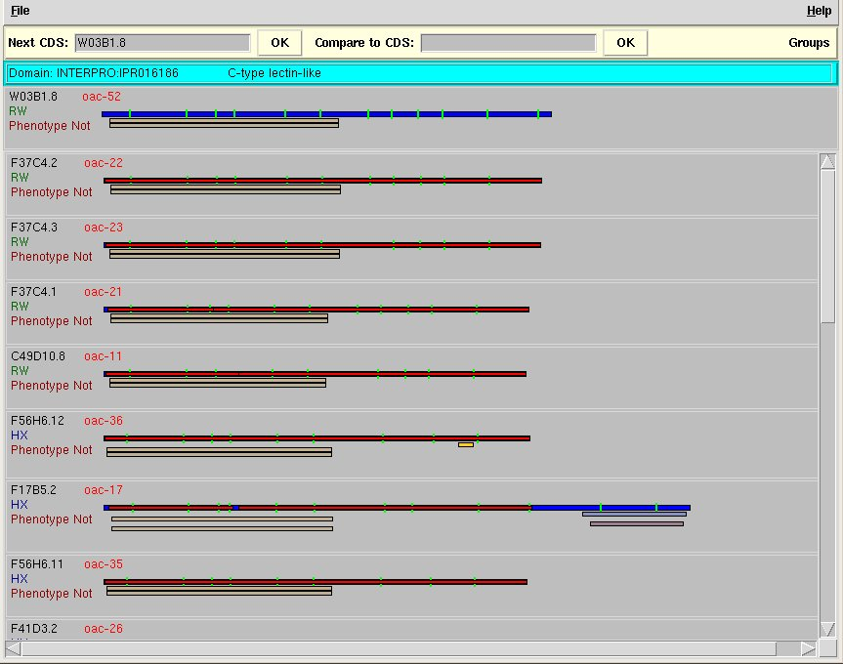
See exons which need work
Start of exon 5 needs work
Three exons to split off at the end

Slide 21
Protein display tool
Outputs protein sequences for further alignment with Kalign/clustal etc.
Display pairwise alignment score of target protein against every homolog and the score of a predicted gene model.
  Tests whether a prediction would be better
Currently closely integrated with acedb
  Could be changed to read from Ensembl/Chado

Slide 22
Future
Want to add indication of:
  which introns are confirmed by transcript data
  coverage of CDS by transcript alignment

Slide 23





California Institute of Technology
Paul Sternberg
Igor Antoshechkin
Juancarlos Chan
Wen Chen
Ranjana Kishore
Raymond Lee
Hans-Michael Mueller
Cecilia Nakamura
Andrei Petcherski
Gary Schindelman
Erich Schwarz
Kimberly Van Auken
Daniel Wang
Xiaodong Wang
Karen Yook
John Spieth
Tamberlyn Bieri
Darin Blasiar
Phil Ozersky
Wellcome Trust Sanger Institute
Richard Durbin
Paul Davis
Michael Han
Anthony Rogers
Mary Ann Tuli
Cold Spring Harbor Laboratory
Lincoln Stein
Norie de la Cruz
Todd Harris
Sheldon McKay
Will Spooner
Zheng Zha

Slide 24
end

Slide 26
Some curation anomaly types
Unmatched TSL (start of gene or isoform)
Introns in UTR
Confirmed intron not in gene model
Overlapping exons
Transcript data overlaps an intron
Exon overlaps repeat region
Split gene by protein groups
Mismatched ESTs (genomic sequence error)

Slide 27
Some curation anomaly types
Unmatched exon of twinscan prediction
Unmatched protein alignment
Unmatched WABA coding potential
Split/merge genes by twinscan prediction
Frame-shifted protein alignment
Split/merge by protein alignment
Unmatched mass-spec peptide
Incomplete Pfam motif

Slide 28
More anomalies
Frame-shifts defined by protein homologies.
Genes to potentially be merged by protein homology evidence.
Genes to potentially be split by protein groups evidence.

Slide 29
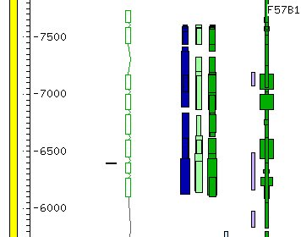
Unmatched anomalies
Twinscan
No curated CDS
C. briggsae
sequence conservations
(codingWABA)
TSL
C. elegans
Protein
C. briggsae
Protein
C. remanei
Protein

Slide 30
Frame-shifts by protein homology
A protein aligned by BLAST.
Frame-shift
Small/no apparent intron.
Near-contiguous regions
of the protein.
Frame 1
Frame 2

Slide 31
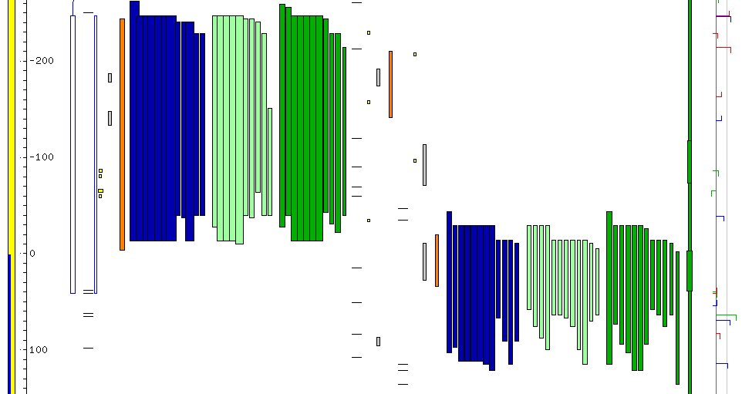
Frameshift in exon

Slide 32
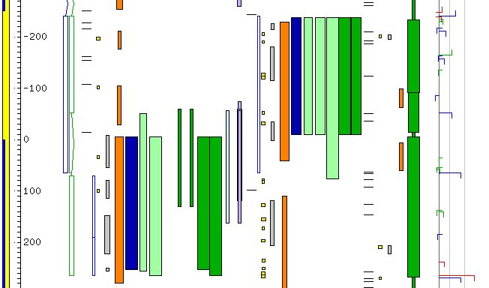
Frameshift in exon

Slide 33
Genes to merge by protein homology?
CDS 1
One protein matches two CDS in contiguous regions of the protein
CDS 2

Slide 34
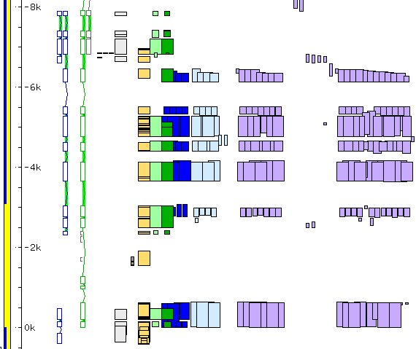
Genes to merge by protein homology?
CDS 1
CDS 2
Flybase, Human, SwissProt, TrEMBL Proteins homologous to the two CDS

Slide 35
Gene to split by protein groups?
CDS
Protein group 2
Protein group 1
No members in common between the two non-overlapping groups.

Slide 36
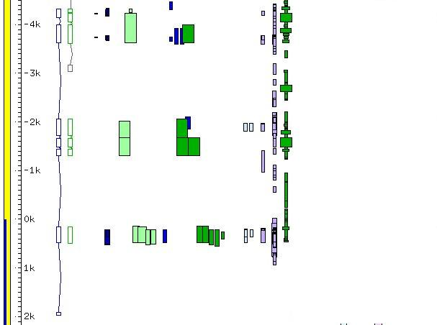
Gene to split by protein groups?
protein group 1
protein group 2
protein group 3

