Slide 1
Two way Interprocess Communication (IPC) for ZMap and otterlace.
Roy Storey
rds@sanger.ac.uk

Slide 2
Subjects I’ll talk about
ZMap and otterlace
IPC or remote control
Perl and C
Usage and application
Summary

Slide 3
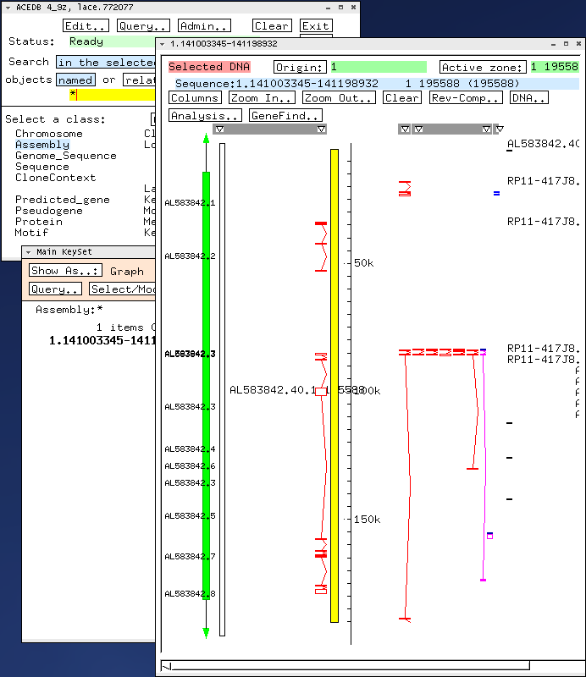
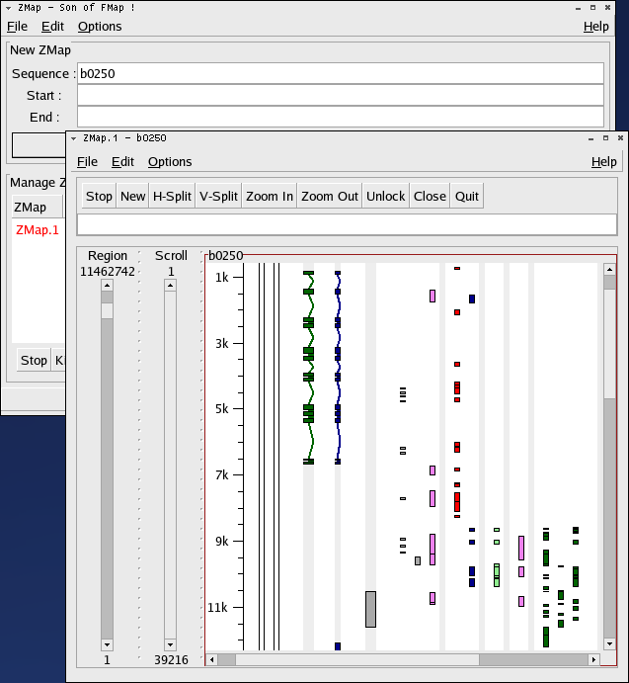
FMap and ZMap
zmap
fmap

Slide 4
ZMap features
Fast (mainly thanks to foocanvas)
Arbitrary splitting of windows
  Multiple views on single sequence
  Multiple sequences
Multiple alignments
Arbitrary zooming
Usability improvements
Multiple data sources

Slide 5
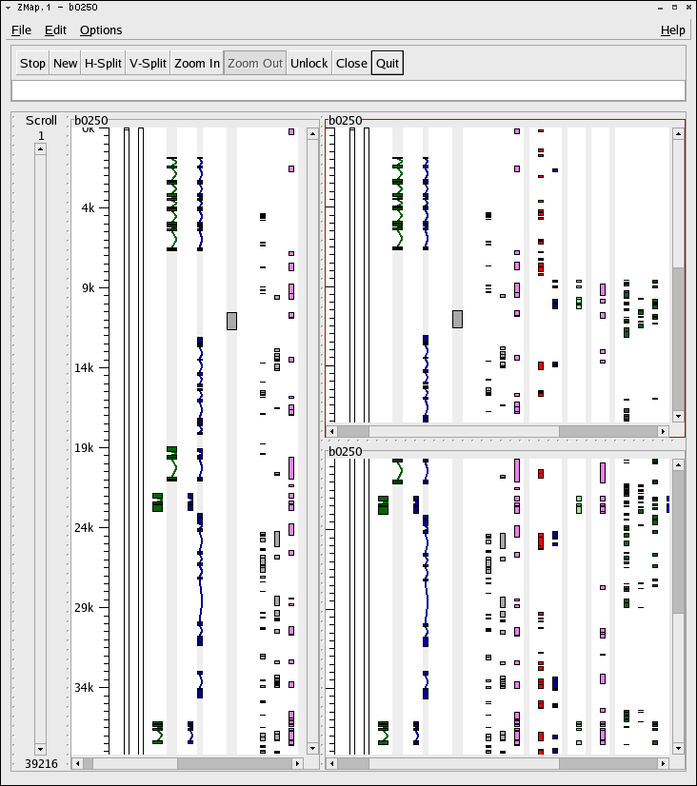

Slide 6
otterlace
Current HAVANA annotation tool
Architecture includes:
  Perl/Tk
  ensembl / ensembl-otter / ensembl-pipeline
  MySQL
  xace
Uses xremote to do IPC (one way)
Generally a large code base.

Slide 7
Why & How IPC
Seems like a good idea…
Reuses existing applications
It’s worked for some time with xace
Original code from Netscape was modified to make xremote (C code)
xremote has limitations

Slide 8
Why & How IPC
Uses X server XAtoms
Perl/XS Module X11::XRemote
Works as Server / Client
Server waits for requests (property notify)
  Tk has a built in property notify.
Client reads the response

Slide 9
Remote Control
xace:
request
xace
(property notify)
xremote
X-atoms
response
Simple acedb requests (seqget, gif, parse file)
Yes / No response (xremote exit status)

Slide 10
Remote Control
zmap:
client (perl) xml request
ZMap
(property notify)
X11::XRemote
response (xml)
X-atoms
response (xml)
Tk
(property notify)
client (zmap) xml request
xremote replaced with perl (XS module)
Transport is still X-atoms
Protocol change
  -xml requests
  -Header, separator, xml response

Slide 11
Remote Control
xremote (command line tool)
Perl
  my $com_str = join(' ; ', @command);
  warn "Sending: '$com_str'\n";
  my @xrem_com = ('xremote',
  -id => $self->xace_window_id,
  -remote => $com_str,
  );
  warn "command = @xrem_com\n";
  if (system(@xrem_com) == 0) {
  return 1;
  } else {
  confess "Failed xremote: (@xrem_com) : $?";
  }

Slide 12
Remote Control
X11::XRemote
Perl
  my $xr = X11::XRemote->new(-id => $winid);
  my @a = $xr->send_commands(@commands);
  print "Sent commands\n";
  for(my $i = 0; $i < @commands; $i++){
  print $commands[$i] . " resulted in " . $a[$i] . "\n";
  }
Perl/Tk
  Perl graphical apps can accept remote commands

Slide 13
Remote Control
Usage:
  my $fruits = [qw(apples pears bananas)];
  my $veg = [qw(carrots potatoes)];
  my $callback = sub{
  my ($zmap, $req, $f, $v) = @_;
  if($req =~ /fruits/){
  print "I know about these fruits: " . join(", ", @$f) . "\n";
  }elsif($req =~ /veg/){
  print "I know about these vegetables: " . join(", ", @$v) . "\n";
  }
  return (200, "printed my knowledge.");
  };
  my $zmap = ZMap::Connect->new();
  $zmap->init($tk, $callback, [$fruits, $veg]);

Slide 14
Perl and C
Modules - Pure Perl and XS
XS modules have compiled shared object files (DBI/DBD, GD, XML::Parser, Tk)
Requires:
  C library of some sort (can be just one function)
  .xs/typedef file as input to the auto generation
  Patience to debug
ExtUtils::MakeMaker

Slide 15
Current Application
Spawning ZMap
Zoom control (zoom in, zoom out and zoom to)
Find Feature by distinguishing properties (zooming to appropriate magnification)
Feature drawing (including multiple features in one request)

Slide 16
Further Applications
Editing
  Perl apps can accept/share editing information
Local quick analysis
  Use analysis code to run and parse analysis programs output.
  Use Perl’s parsing strengths.

Slide 17
Summary
IPC using XML and XAtoms
Protocol is simple
Enables remote control of applications with greater degree of feedback on success and failure.
Uses and extends previous code
Perl module code is built on top of the same C code.

