Slide 1
How Big is your Window ?
Or…..But I want to scroll through the whole chromosome
Ed Griffiths

Slide 2
The Problem…
You want to display a sequence but it’s a bit like this:
Clone:
30000
Chromosome:
60000000
1000
1000

Slide 3
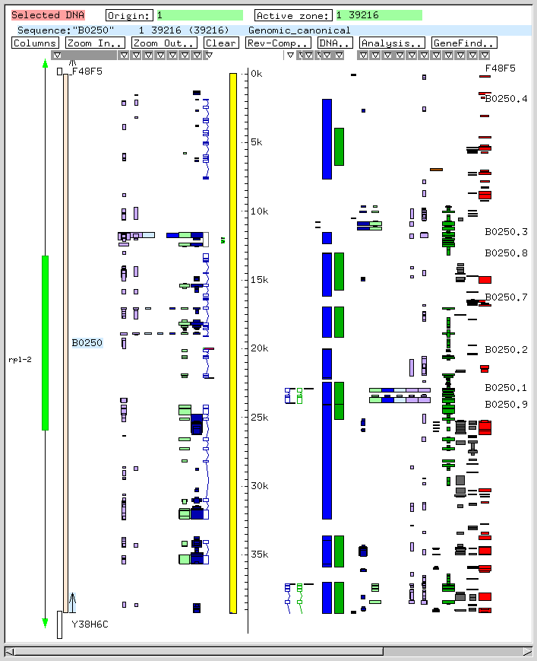
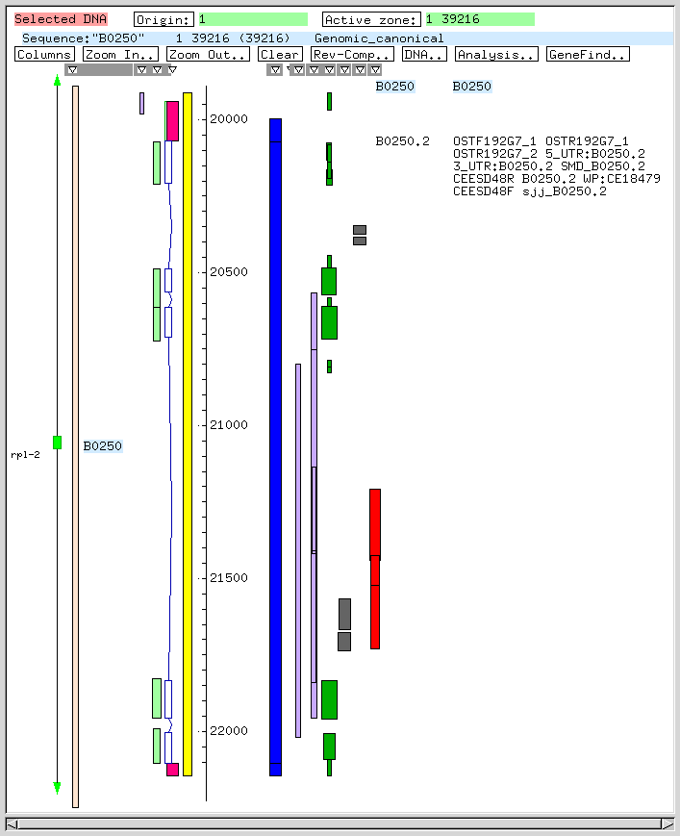
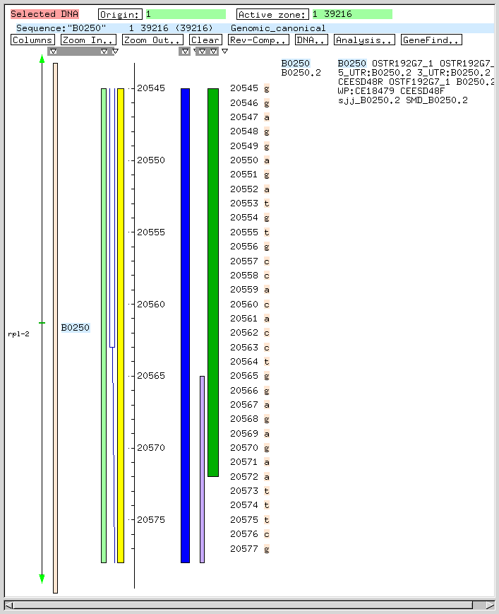
The fixed window approach
Used by acedb/Fmap and lots of other programs:
actgat
Clone
Transcript
Sequence
i.e. whatever section of sequence you are viewing, you pack it in to the visible window on your screen.

Slide 4
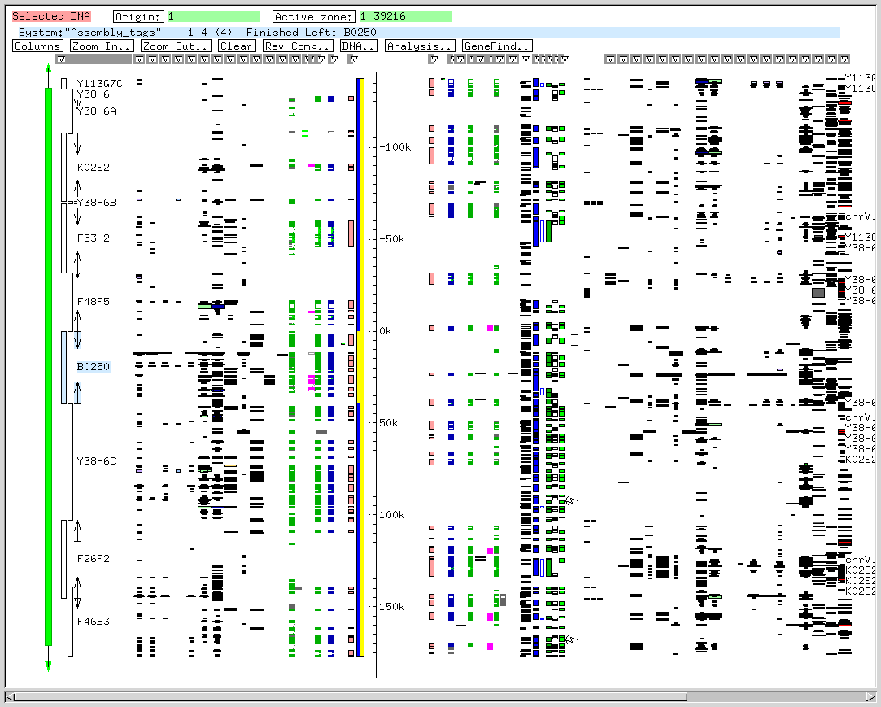
Fmap with lots of clones

Slide 5
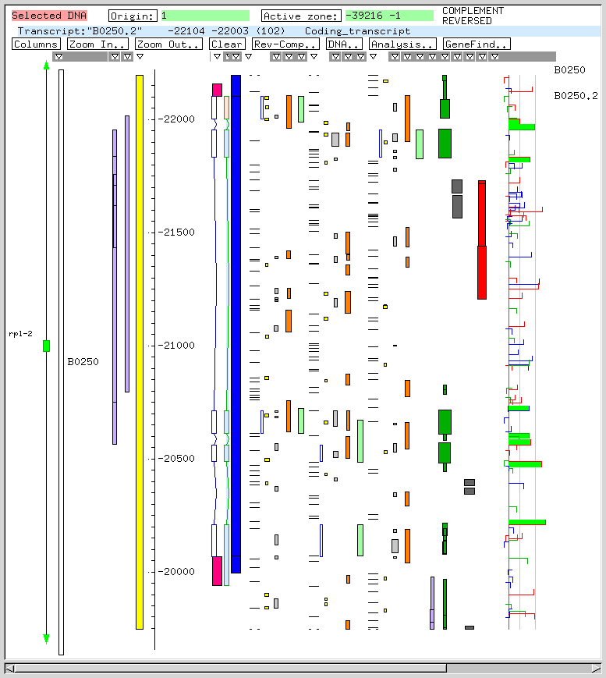
Fmap zoomed in to genes

Slide 6
Pros and Cons
Pros:
  Can always display any length of sequence
  Arbitrary amount of zooming
Cons:
  any scrolling means redrawing features
  zooming often means redoing conversion of sequence features to screen objects.

Slide 7
In an ideal world…
We would like to be able to scroll through a whole chromsome
We would like to zoom in and out anywhere on that chromosome
We’d like it all to work at a reasonable speed

Slide 8
So what to do….
Lets just make a huge window and scroll through it, what could be simpler.
What software shall we use ?
  We could extract the acedb graph package from acedb and modify it to work in a different way….
  Or we could use some new trendy open source thing……..
It was a tricky choice but…..

Slide 9
…open source to the rescue…
Some kind of “canvas” widget:
  Tried GnomeCanvas….too slow, too much memory…..hopeless
  But luckily for us there is son of GnomeCanvas, the FooCanvas…..
It’s a cut down version used by Nautilus, gnumeric and a few other programs….designed for efficiency….

Slide 10
An alternative approach
You just draw your stuff once in a virtual space and as you zoom, the canvas scales up the window…
Should give instantaneous scrolling, what could go wrong ?

Slide 11
Something nasty in the woodshed…..
At this point all looked good, performance was good, scrolling was good, zooming was good
….so time to really zoom in on some long sequences……
and data started to disappear/reappear randomly…..
Well actually it started to disappear when the window got to about 32k in size….

Slide 12
The FooCanvas interface
You draw in a virtual
space in doubles
The canvas
plots in ints
World
coords
Canvas
coords
And surely it just takes care of everything…..

Slide 13
Layers of layers….
(FooCanvas)
Athena
Motif
Gtk
KDE
Xt
Gdk
X lib
X Protocol

Slide 14
What does Gtk say…?
A typical GTK size/position struct...
typedef int gint;
struct GtkAllocation
{
gint x, y; /* the X, Y position of the widgets area */
gint width, height; /* the width/height of the widgets area */
};

Slide 15
What about Xt ?
Widget resource definitions for position/size:
XtNx Position
XtNy Position
XtNheight Dimension
XtNwidth Dimension
which are defined in Intrinsic.h as:
typedef short Position ;
typedef unsigned short Dimension ;

Slide 16
Surely Xlib has the answer…
XCreateWindow(.....
int /* x */,
int /* y */,
unsigned int /* width */,
unsigned int /* height */,
) ;
Um, now we seem to be back to huge windows…

Slide 17
So who is right ?
We need to look in the X Protocol to see what is really passed to the X server…..and there are several places to look:
  X11/Xproto.h
  O’Reilly Xwindows Volume Zero, i.e. the Protocol
And you will find:
x,y: INT16 i.e. 16 bit signed integer
width,height: CARD16 i.e. 16 bit unsigned integer

Slide 18
So what ?
This means we can
….position a window anywhere in the range:
-32768 <= position <= 32767
….and its x/y dimensions can be anywhere in the range:
1 <= dimension <= 65535

Slide 19
Sane ?
This sort of makes sense:
-x, -y
child
0,0
parent

Slide 20
But not really…
In Xlib:
XDrawLine(…..
int, int, /* x1, y1 */
int, int) ; /* x2, y2 */
But in the X Protocol (a PolyLine request):
points: LISTofPOINT where POINT: [x,y:INT16]
i.e. when all is said and done int, int -> short, short

Slide 21
The nub of this is…..
Using all 16 bits to make a very big window is in fact pointless.
Positions of many features can only be expressed using 15 bits meaning they must be in the top quarter of the window:
0
32767
65535
32767
unusable
65535

Slide 22
What’s affected ?
Well nothing much really, just trivial stuff like:
  all text
  all rectangles and subwindows
  all lines and polygons
  reporting of positions in events
And so on………..

Slide 23
So what about FooCanvas ?
Our problem is to constrain the canvas from making huge windows.
If we assume that:
Max zoom = down to individual bases ( = 20 pixels/base)
Max window size = 30k (allowing a good “safety” margin)
This implies at max zoom you can see at most
1500 bases
So clearly there is a mismatch between max window size and how much sequence you can see.

Slide 24
Fortunately it can be done…
Zoom
Scrolled
region
window
canvas
(i.e. Scrolled_region * zoom = win_size)

Slide 25
ZMap and scrolling
Allows two sorts of scrolling:
  Pretty much instantaneous scrolling of the sequence in the scrolled window on the screen
  Slower “scrolling” of the scrolled region within the canvas space
canvas
screen

Slide 26
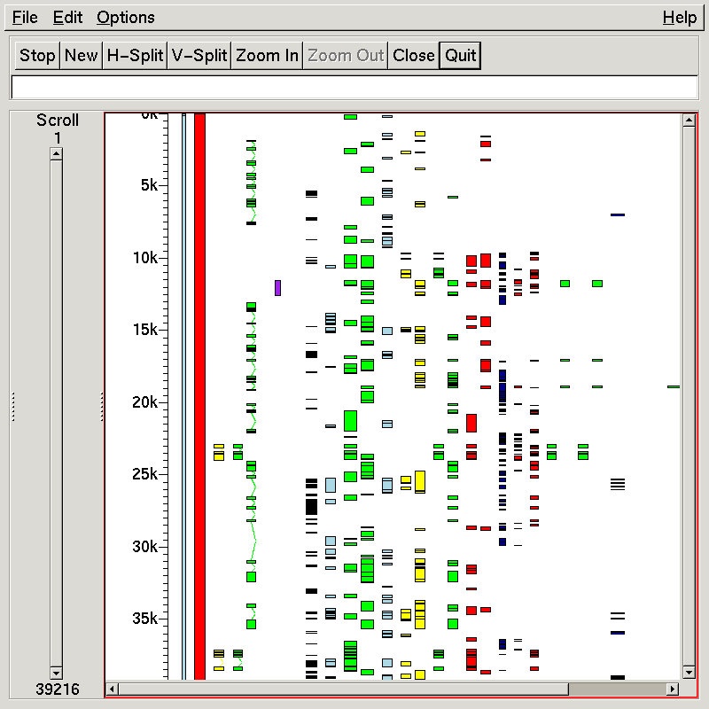
And here’s one I prepared earlier

Slide 27
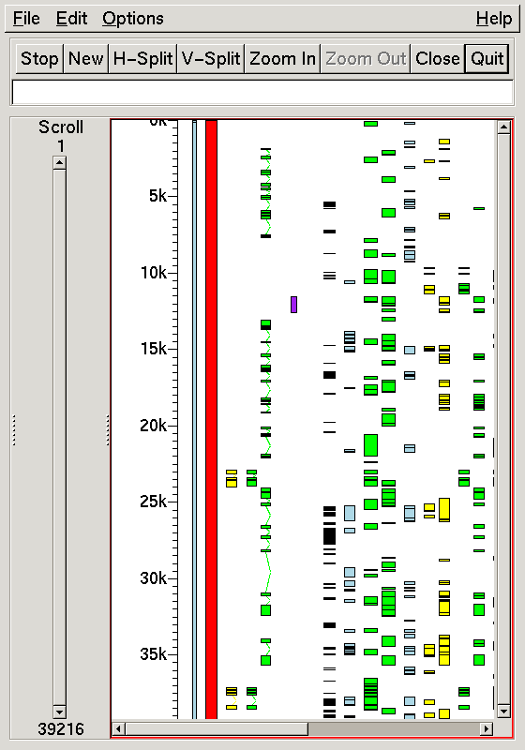
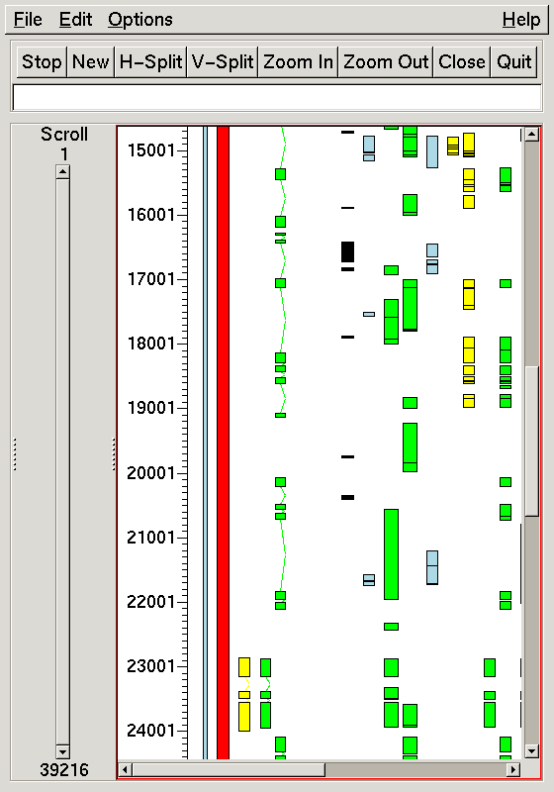
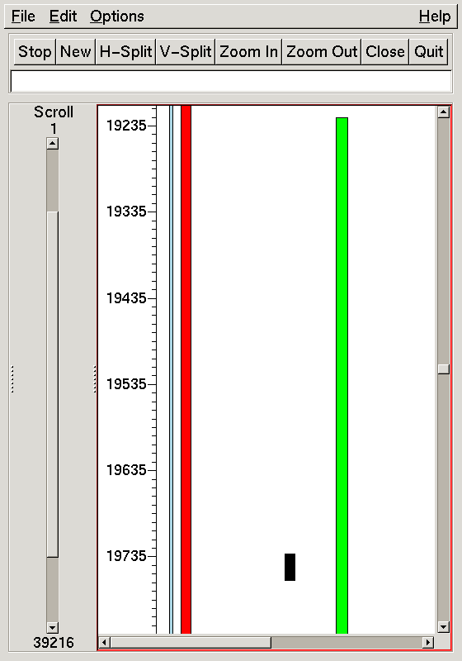
Scrolling away…

Slide 28
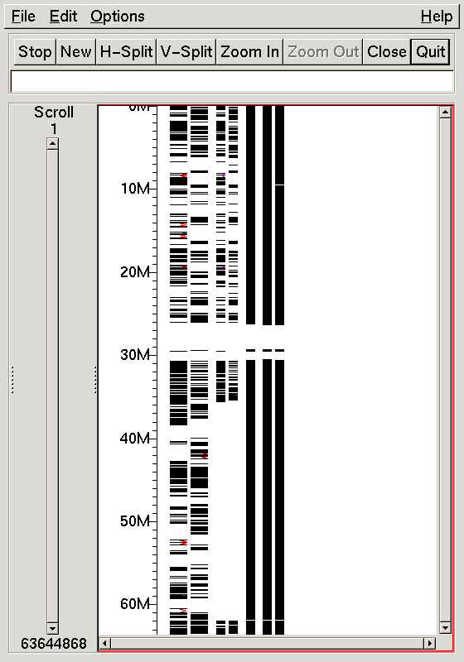
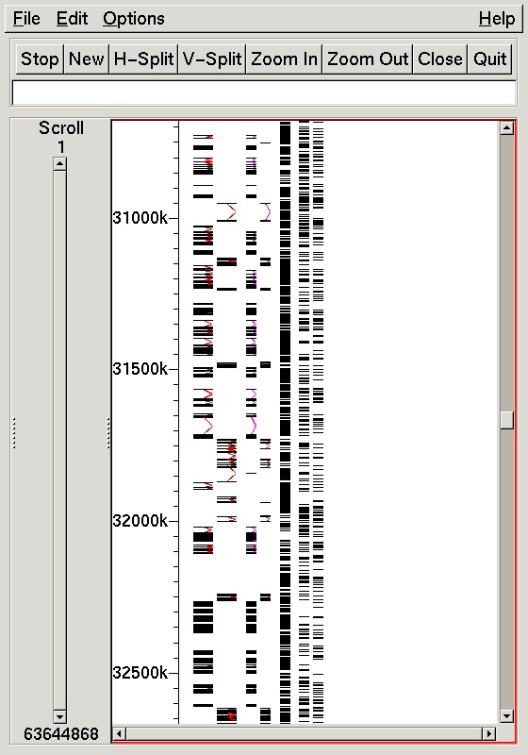
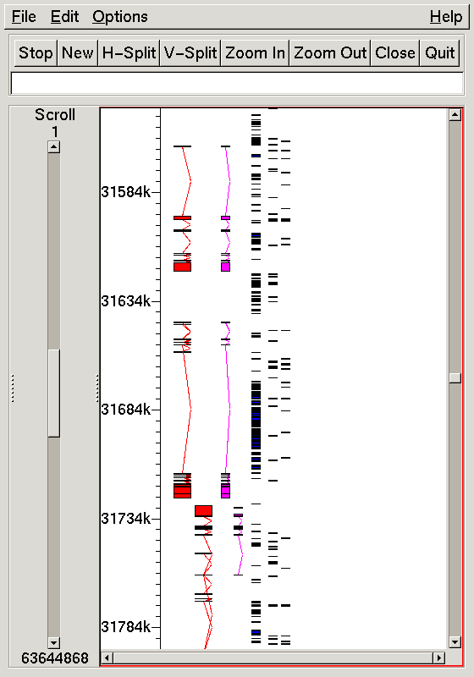
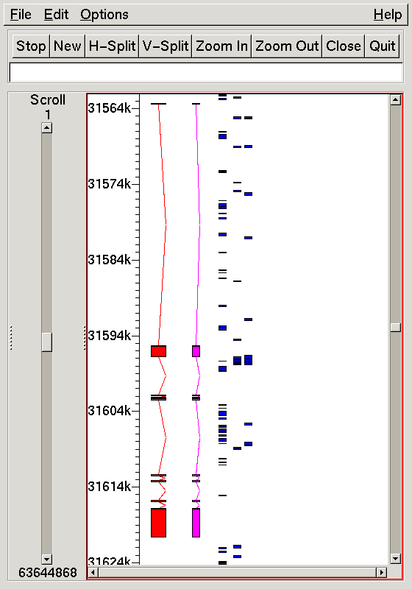
On a chromosome..
63.5m bases
640 pixels
63.5m bases
30k pixels
12m bases
30k pixels
3m bases
30k pixels

Slide 29
In summary…
In the world of X Windows, the biggest useful window you can have is 32k pixels.
Software like the FooCanvas provides a very natural way of displaying sequences:
  provides a system with enough performance to scroll/zoom over long sequences
  you work in the coordinates of the sequence, it does the screen stuff.
BUT it doesn’t deal with the 32k limit at all (either for the window or individual features).

Slide 30
Thanks to….
We owe it all to FooCanvas…well nearly all…..(pity about the documentation….)
Thanks to Rob Clack for his efforts with FooCanvas
And to Roy Storey for not immediately saying upon his arrival in the group “I could do all that in Perl… only better….”

Slide 31
If you found this “captivating”…
Some time after I’d found out all I wanted to know (ever) about the short comings of X Windows, I found this thought provoking paper:
"Why X Is Not Our Ideal Window System"
By Hani Gajewska, Mark Manasse & Joel McCormack
which begins
"We come to praise X, not to bury it."
It explains a lot about why X windows programming is often not as straight forward as you might have hoped....

