Slide 1
Exercise/Homework: ELF3 – Use case for accessing barley genome data
Originally developed by:
MIPS&Carlsberg Lab
April 2013
Manuel Spannagl/Thomas Nussbaumer
Mats Hansson

Slide 2
Exercise objectives
Learn from a „real-world“ use case to query the barley genome resources for:
Orthologous ELF3 genes in barley
Mapping/Location of barley ELF3
Marker evidence
Expression Profile
…

Slide 3
Exercise
Question: Early flowering is an important breeding target. More than 100 genes involved in timing of flowering have been identified in
Arabidopsis thaliana. One of them is Early Flowering 3 (ELF3).
Find the orthologous ELF3 gene in barley and its cDNA sequence.
On which chromosome is it located?
Where on the chromosome/WGS contig is it located?
Which FPC contigs contain ELF3?
Find at least two SNP markers associated with ELF3.

Slide 4
Find the orthologous ELF3 gene in barley and its cDNA/gene sequence
There are many ways to identify the orthologous ELF3 gene in barley.
One way would be to search “ELF3” in the MIPS PlantsDB Arabidopsis thaliana instance at http://mips.helmholtz-muenchen.de/plant/athal/searchjsp/index.jsp.
In the gene report of AT2G25930.1 you could click „Gene family“ and retrieve the barley ortholog from there.
Another way would be to retrieve the Athal ELF3 sequence and use BLAST to search for the best barley hit at http://webblast.ipk-gatersleben.de/barley/viroblast.php.

Slide 5
Find the orthologous ELF3 gene in barley and its cDNA/gene sequence
As a candidate for a putative orthologous ELF3 barley sequence, we find AK365334.
http://mips.helmholtz-muenchen.de/plant/barley/ga/reportsjsp/geneticElement.jsp?gene=AK365334
(where the gene sequences can be obtained from as well)

Slide 6
Background: Available resources for barley anchored physical map
Entry point (genes, expression, anchoring):
http://mips.helmholtz-muenchen.de/plant/barley/download/index.jsp
Positioning information:
ftp://ftpmips.helmholtz-muenchen.de/plants/barley/public_data/anchoring/

Slide 7
On which WGS contig is it located?
Positioning information for AK365334
The gene was annotated on morex_contig_67536.
(RNA-seq support for almost entire gene-model, flcDNA is longer compared to annotated gene model (MLOC_75281)).
The Mapping “gene to WGS contigs” can be extracted here:
ftp://ftpmips.helmholtz-muenchen.de/plants/barley/public_data/genes/barley_HighConf_genes_MIPS_20Aug12_TranscriptsStructure.gtf
or from the MIPS PlantsDB gene report of AK365334.

Slide 8
Where on the chromosome is it located & Which FPC contigs contain ELF3?
ftp://ftpmips.helmholtz-muenchen.de/plants/barley/public_data/anchoring/genes_to_physMap_08062012.tab
Based on the IBSC publication, morex_contig_67536 is assigned to chrom. 1H at 132 cM. As putative Mb position we estimated 463 Mb considering the 75% anchored physical map. morex_contig_67536 is matching the FPC contig “contig 44855”.
Additionally, morex_contig_67536 matches a single clone contig (HVVMRXALLhA0624F14 v3 c11) of the clone/BAC MOKI0166J11.
The underlying sequence information for particular sequences (FPC contig, WGS contig, genes) can be obtained from:
Anchored FPC contigs
ftp://ftpmips.helmholtz-muenchen.de/plants/barley/public_data/anchoring/FPC_PSEUDO_ANCHORED_280512_AC1.FA
Anchored WGS contigs
ftp://ftpmips.helmholtz-muenchen.de/plants/barley/public_data/anchoring/WGS_ANCHORED_280512_AC2.FA
Anchored barley genes
ftp://ftpmips.helmholtz-muenchen.de/plants/barley/public_data/anchoring/GENES_ANCHORED_280512_AC3.FA

Slide 9
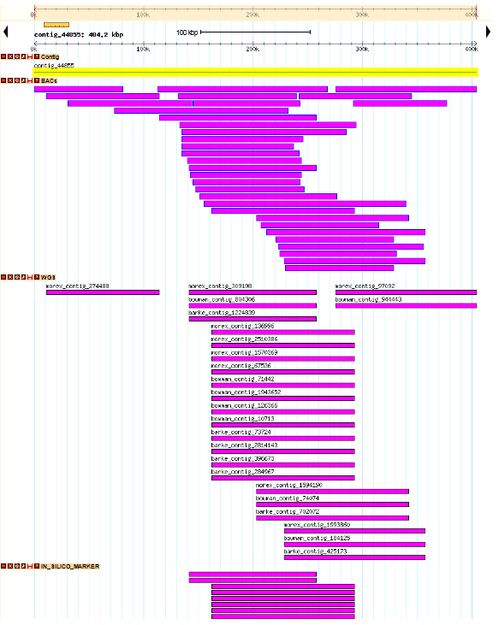
FPC contig 44855
And associated clones,
WGS contigs, in silico marker
And experimental marker
Approx. 500 Kb
Accessible via:
http://seacow.helmholtz-muenchen.de/cgi-bin/gb2/gbrowse/Barley_PhysMap

Slide 10
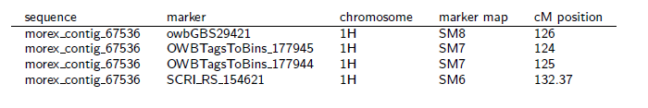
Find at least two SNP markers associated with ELF3
Markers used to anchor morex_contig_67536
ftp://ftpmips.helmholtz-muenchen.de/plants/barley/public_data/anchoring/in_silico_marker/morex_marker.TXT

Slide 11
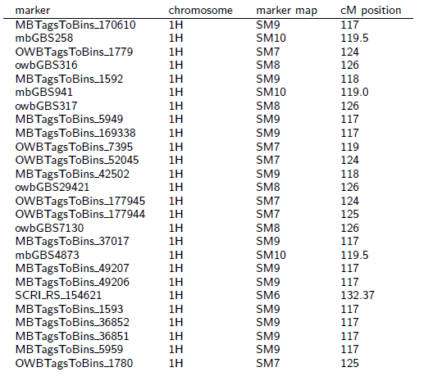
Find at least two SNP markers associated with ELF3
Markers used to anchor FPC contig 44855
ftp://ftpmips.helmholtz-muenchen.de/plants/barley/public_data/anchoring/in_silico_marker/FPC_pseudomolecule_marker.TXT

Slide 12
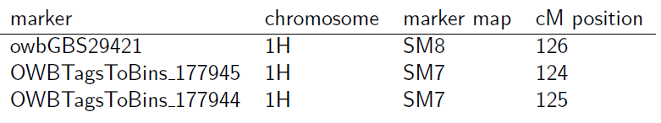
Find at least two SNP markers associated with ELF3
Markers directly associated with AK365334
ftp://ftpmips.helmholtz-muenchen.de/plants/barley/public_data/anchoring/in_silico_marker/flcDNA_marker.TXT
Marker sequences in: ftp://ftpmips.helmholtz-muenchen.de/plants/barley/public_data/anchoring/sequences/IN_SILICO_MARKER.FA

Slide 13
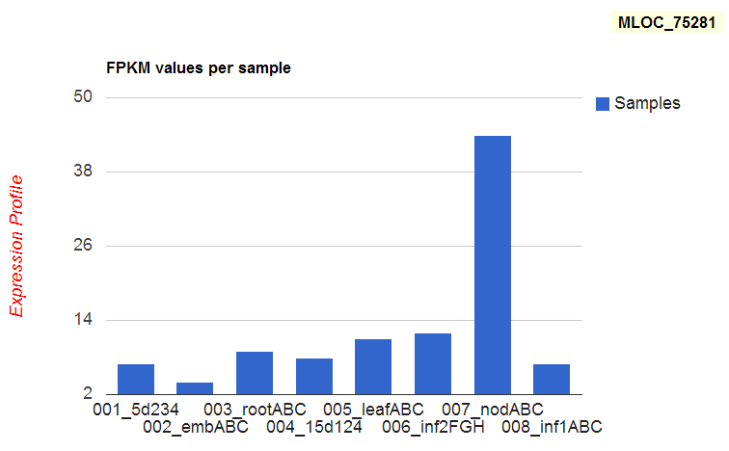
Preview: Get the expression profile of a barley gene
e.g. MLOC_75281
For AK365334 only a partial gene model was annotated on a WGS contig, but this partial gene model (MLOC_75281) allows us to deduce the expression profile. We e.g. observe a FPKM value of 44 for „nodABC“ conditions.
http://seacow.helmholtz-muenchen.de/cgi-bin/db2/Barley/index.php (unpublished)

