Slide 1
Information Systems
CIS*6030 F22
Fangju Wang – University of Guelph

Slide 2
Data Files, Indexes, and Hashing
Subtitle

Slide 3
An Overview
Storing, indexing and hashing data are fundamental tasks in building an information system. In this lecture, we discuss
Storage of data in disk files
Simple indexes
Tree-based indexes
Hashing tables.

Slide 4
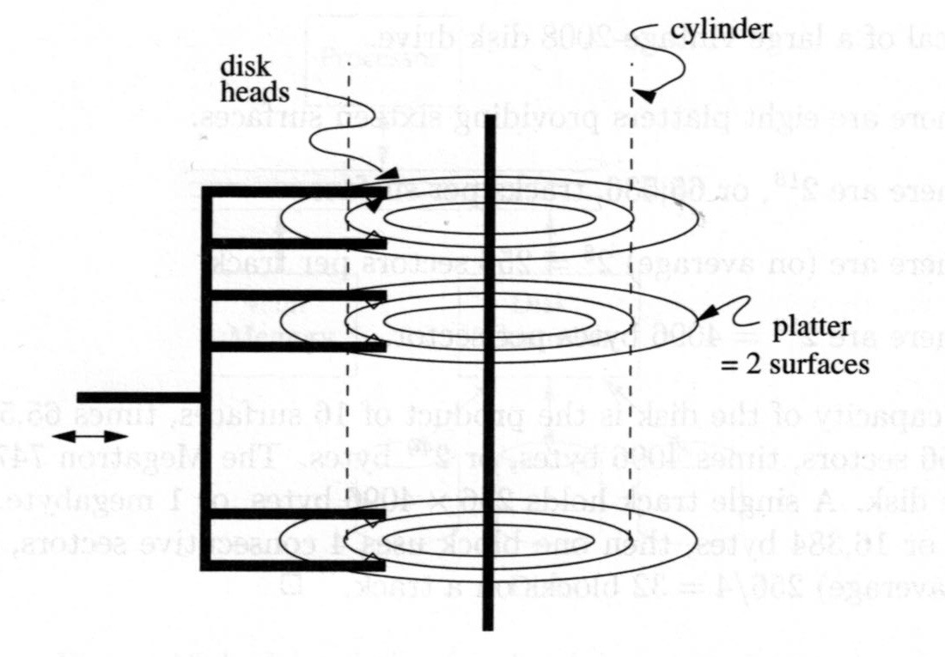
Hard Disks
Hard disks are the main storage devices. They are also called the secondary storage.
A disk system may have one or more platters.
A platter has two surfaces.
A surface has tracks, which are concentric circles.
The tracks of the same radius form a cylinder.
Disk heads read and write data on tracks.

Slide 5
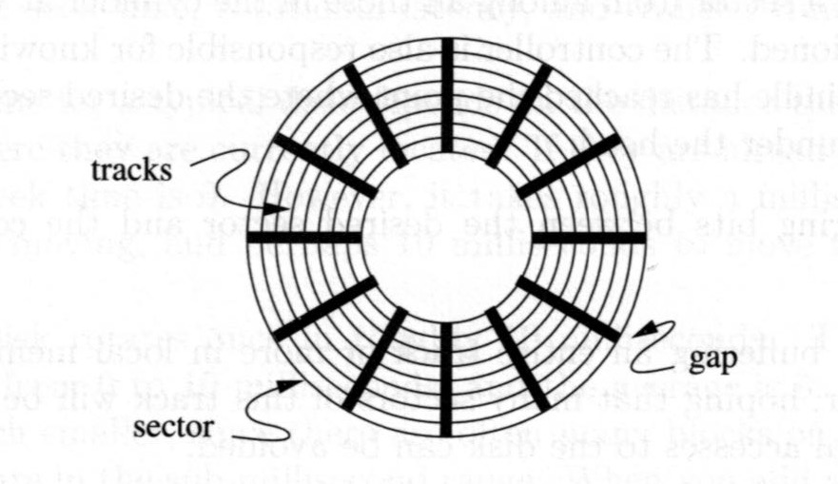
Tracks and Sectors
A surface has tracks, which are concentric circles.
A track are organized into sectors, separated by gaps.
A sector is the minimum unit for disk read/write.
The size of a sector is typically 512 bytes.

Slide 6
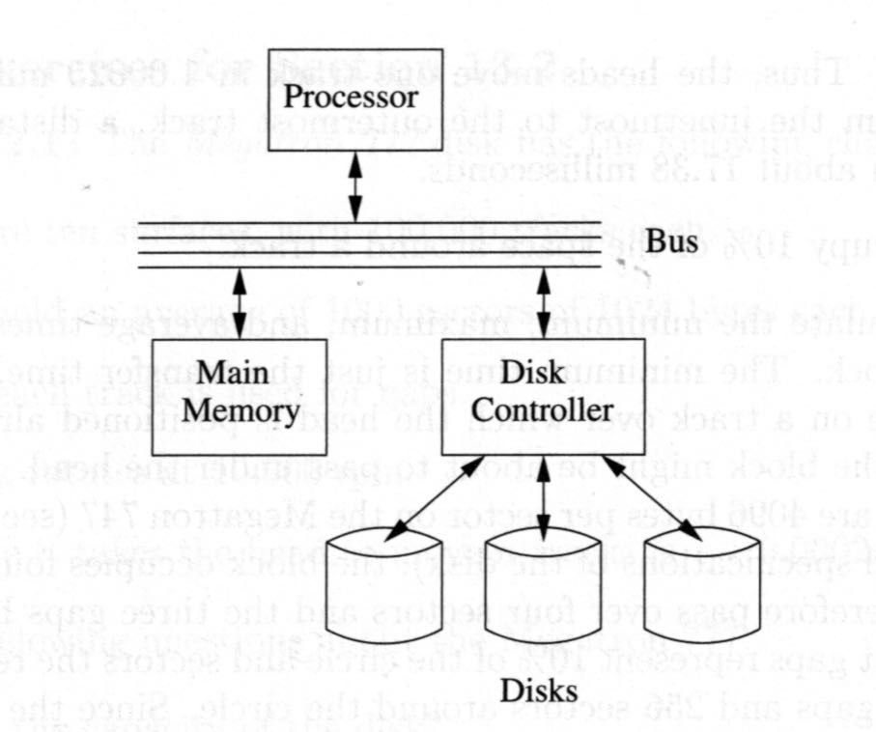
Processor, Main Memory, and Disk
Permanent data is stored on disks.
Data is read into the main memory (RAM) before being processed by the processor.
Processed data is written back to the disk for permanent storage.
Disk read/write (I/O) is very slow. The average access time is 20ms, i.e. 20,000,000ns. (ns – nanosecond)
Data access in main memory is much faster. The average access time is about 100ns.

Slide 7
File, Block, Records, and Fields
In a database, data are organized as records of fields. For example, banking accounts are records, and customer name, SIN, address, balance, etc. are fields of the account records.
Records are stored in disk files.
A file is divided into equal size file blocks.
A block may contain many records.
A file block is a multiple of disk sectors.
…
file
block
block

Slide 8
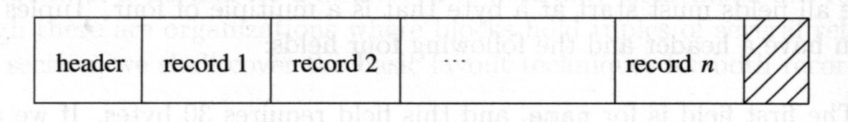
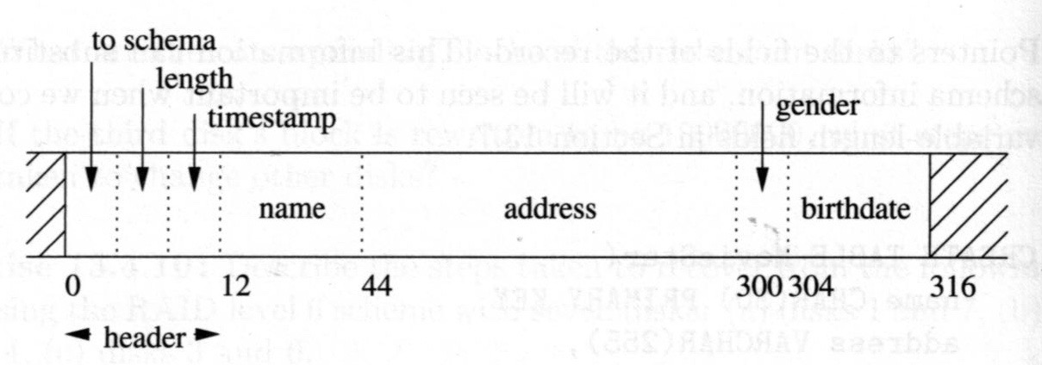
File, Block, Records, and Fields

Slide 9
Storing Data in Files
We discuss how to store relations or object classes in files. Topics include
storing fields,
grouping fields into records,
packing records in blocks,
storing addresses (pointers), and
dealing with record changes.

Slide 10
Headers of Blocks and Records
A key consideration in structuring and storing record data in a disk file is that the data must be "restored" or "interpreted" back to the original records of fields when read from the file to main memory.
The program that reads data from a disk file needs information about how to restore the data.
Each record and block has a header, which is a fixed-length region providing information for correctly restoring the data.

Slide 11
A Record and Fields
A record consists of fields.
A record may have a header stores information about the record and fields.

Slide 12
A Block and Records
Records of the same or different relations (or object classes, etc.) can be packed together into blocks.
A block may have a header stores information about the block and records.

Slide 13
Fixed-length Records
Storing fields and records of fixed-length
A fixed-length field has a fixed size. It can be stored as contiguous bytes.
A fixed-length record is one that has a fixed number of fields, and all the fields are fixed-length. A fixed-length record can be stored by putting the fields together in a predefined order. The order must be followed by programs that write or read the records.
A record may have a header that may include a pointer to the record's schema, etc

Slide 14
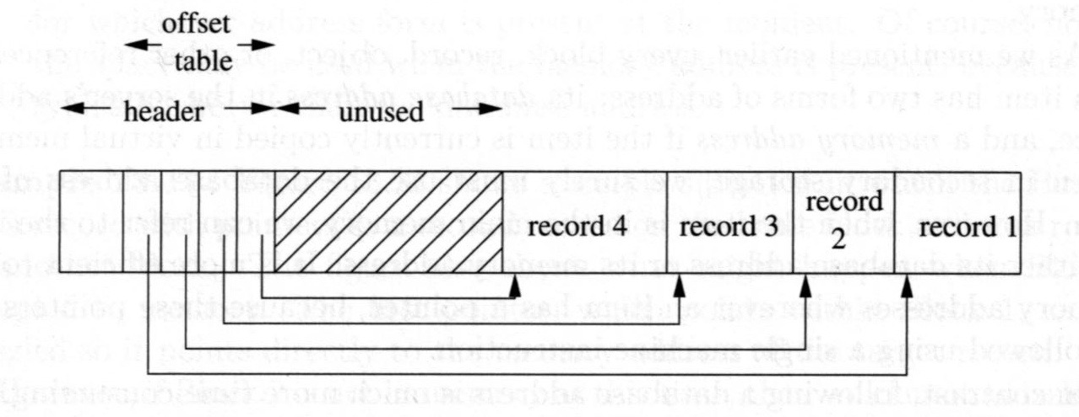
Variable-length Records
A variable length record is one with
variable-length fields,
repeating fields,
variable-format records.
When variable-length records are stored in a block. In the header of the block, pointers to the records must be contained.

Slide 15
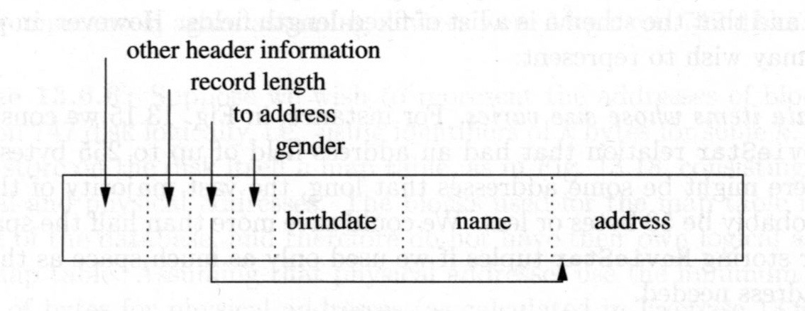
A Record and Pointers to Fields

Slide 16
Storing Records with Variable-length Fields
Store all the fields in the record body.
Place all the fixed-length fields ahead of the variable-length records.
The total length of the record and pointers to the variable-length fields must be included in the record header.

Slide 17
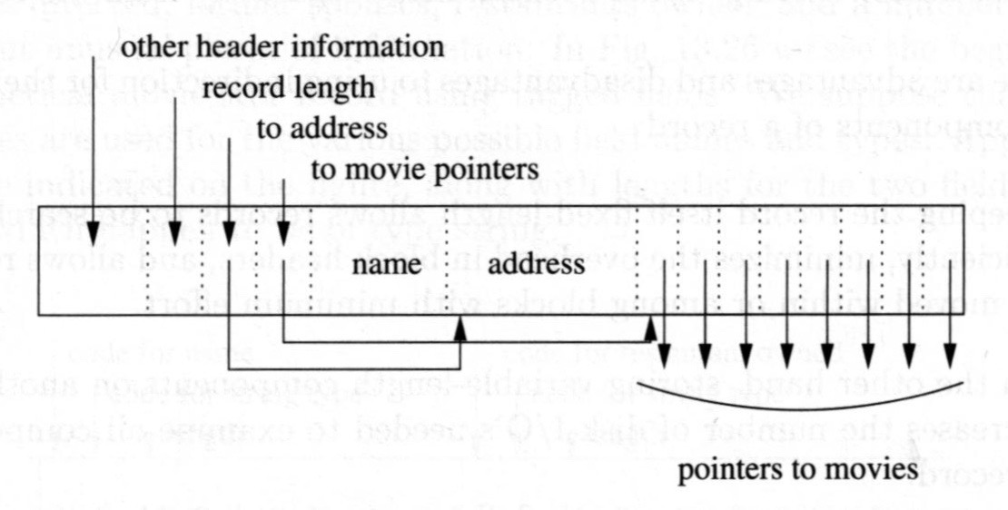
A Record and Pointers to Data in Other Blocks

Slide 18
Storing Records with Repeating Fields
Storing records with repeating fields (of fixed lengths):
Method 1: Store all the fields in the record body. Ahead of the fields, include a pointer to the first repeating field and the number of repetitions, and the length of the fields.
Method 2: Store the repeating fields in a different place. In the record body, store the pointer to the first repeating field, the number of repetitions, and the length of the fields.

Slide 19
Representing Block and Record Addresses
RAM
A record may contain the address of a data item in the same or different block, for accessing the item.
When an item is in the secondary storage, its address should be one in the secondary storage, for example, (device number, block number). We call such address database address.
When an item is in main memory, its address should be one in main memory. We call this address memory address. It may be a four-byte or eight-byte virtual memory address.
A
B
DISK
A
B

Slide 20
Insertion of Records into a File
1
D
G
I
J
D
F
G
I
J
2
D
G
I
J
D
F
G
I
J
3
D
G
I
J
D
G
I
J
H

Slide 21
Insertion of Records into a File
If the records are not ordered, the new record can be added to the end of the file.
If the records are ordered,
if there is enough space in the target block, slide some records towards the end of the block to make space for the new record, insert it, and modify pointers to the records;
if no enough space in the target block but there is enough space in a neighboring block, move some records to that block, and do the insertion in the same way as in the first case. For the records moved to another block, addresses of them must be modified.
if no enough space in the target and neighboring blocks, create an overflow block, move some records to that block, and do the insertion in the same way as in the second case.

Slide 22
Deletion of Records from a File
Delete the record, slide some records, and modify pointers to those records.
If the deleted record is in an overflow block chain, after the deletion, blocks in the chain should be examined to see if a block can be removed (in a database reorganization).
After a deletion, there may still be some pointers to the deleted record. The pointers must be changed to "null" or a "tombstone“ must be placed at the location of the deleted record telling the deletion.

Slide 23
Update
Updating a fixed length record has no effect on the storage system.
Updating a variable-length record can be done by using the methods of deletion and insertion discussed above.

Slide 24
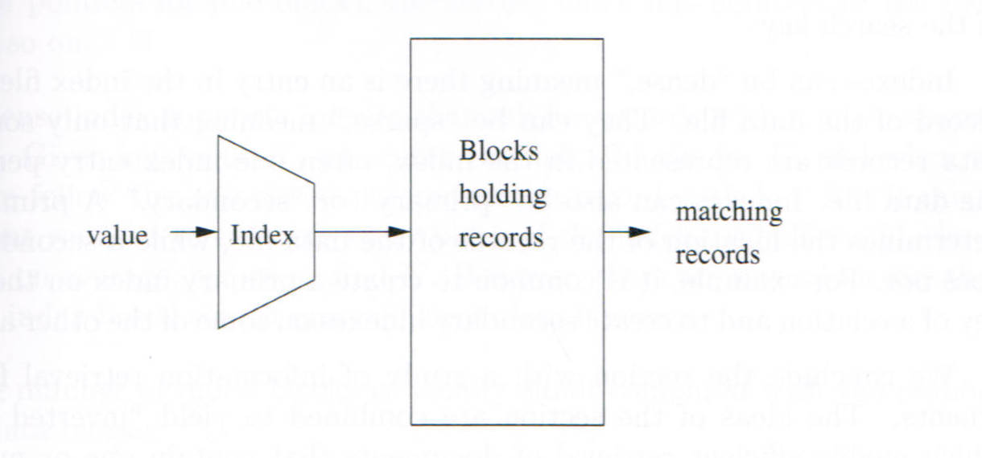
Indexing for Better Efficiency
In finding the record matching a key value from a file, the algorithm of sequential search is inefficient (O(n)).
An index can be used to find the record directly.

Slide 25
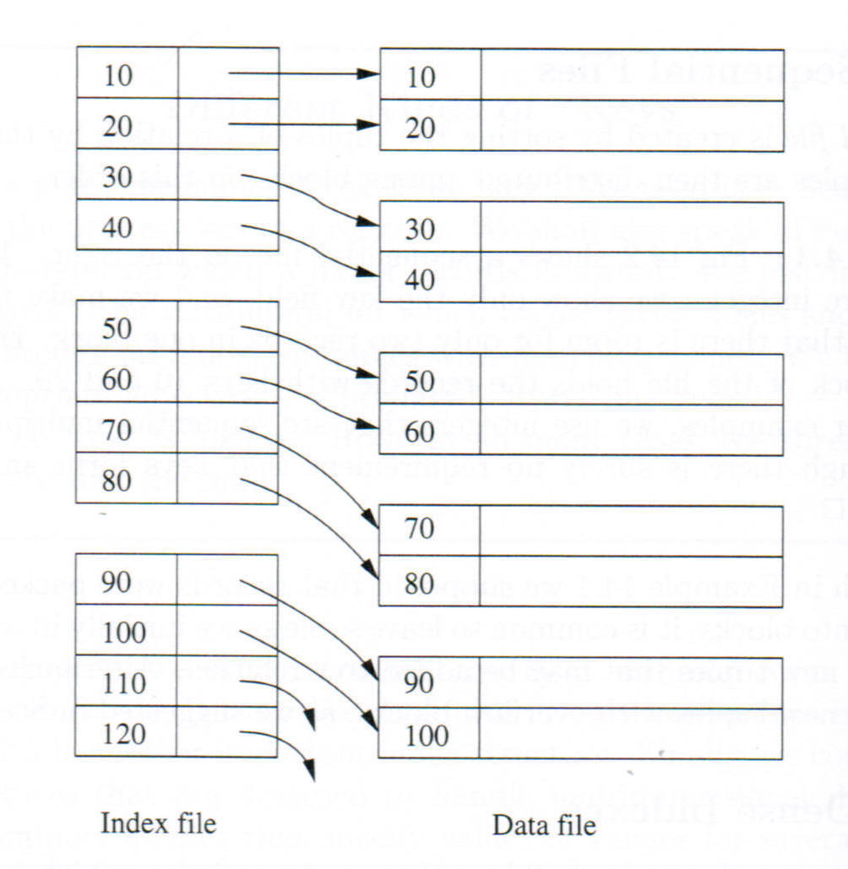
Simple Indexes: Dense Indexes
An index is a sequence of (key, pointer) pairs.
Such a pair is an index entry.
A pointer points to a data record.
An index is much smaller than the data file. It can be in memory.
Searching an index can be much more efficient.
If an index has an entry for every record, the index is a dense index.

Slide 26
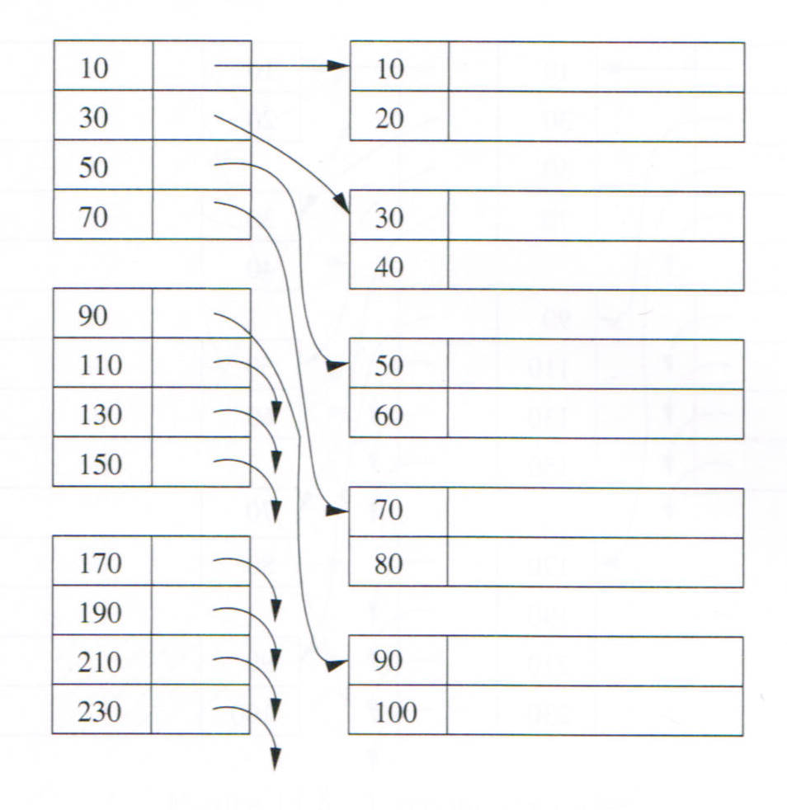
Simple Indexes: Sparse Indexes
If an index does not have an entry for every record, the index is a sparse index.

Slide 27
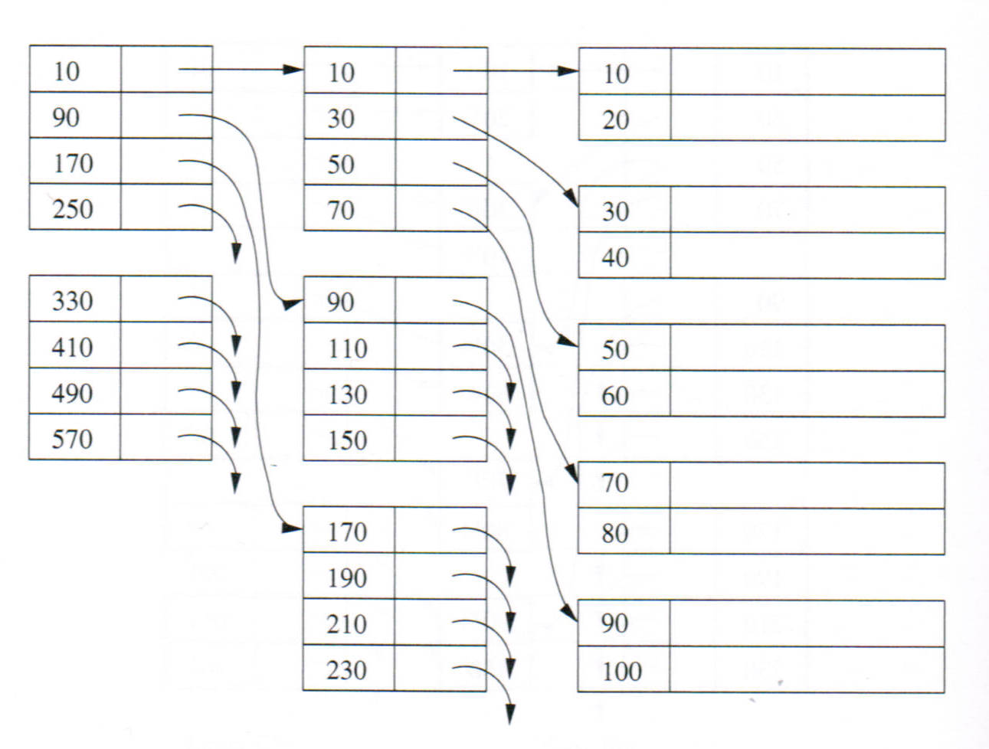
Simple Indexes: Multiple Level Indexes
We may create an index for another index when the latter is too big.
Such an index is a multiple level index.
A multiple level index can be viewed as a tree.
When searching for a record, we go through multiple levels.

Slide 28
Simple Indexes: Multiple Level Indexes
When the tree becomes unbalanced (after many insertions and deletions), searching with the tree may become inefficient.

Slide 29
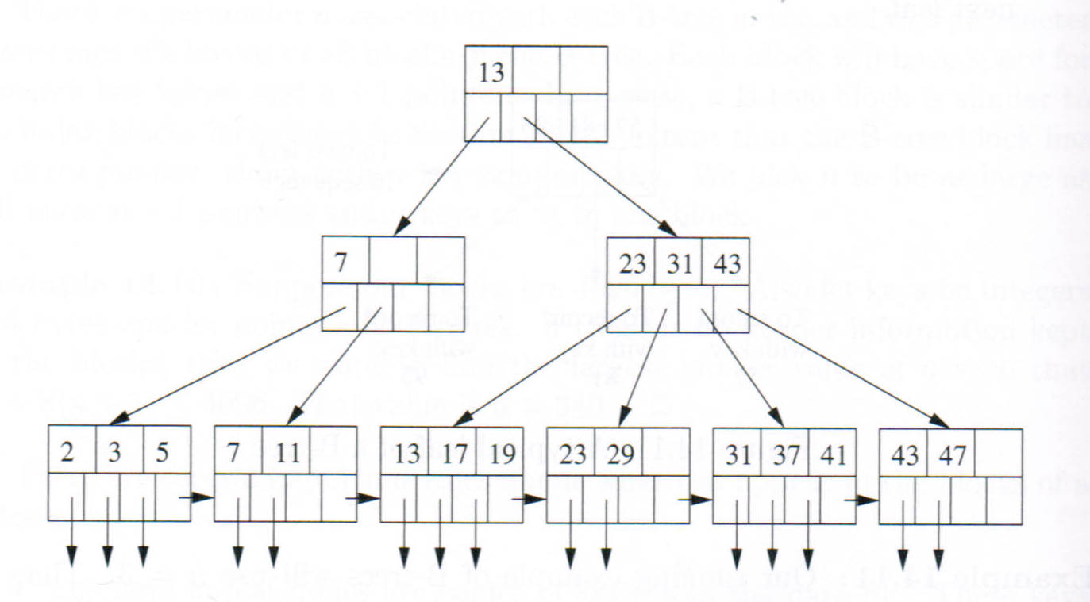

$B^{+}$-Tree: Balanced Tree
A $B^{+}$-Tree of m = 3

Slide 30
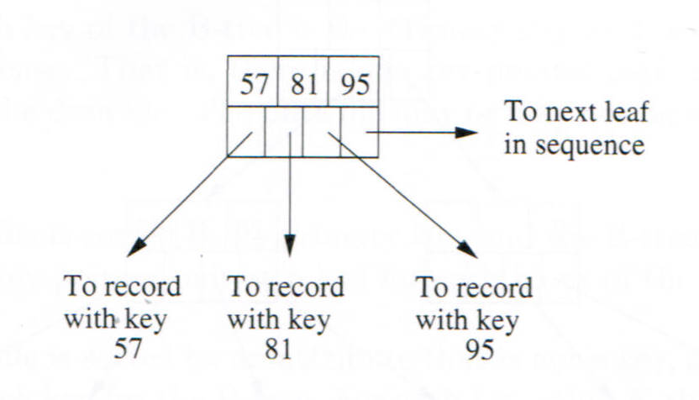

$B^{+}$-Tree: Leaf Node
In a $B^{+}$-Tree, a leaf node has pointers to data records and a pointer to the next leaf node.

Slide 31
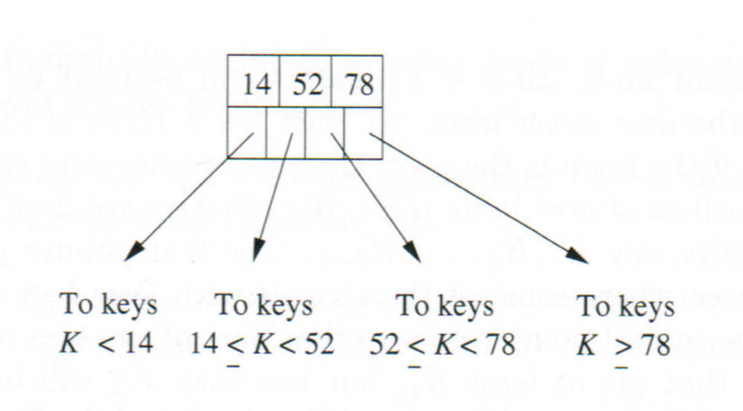

$B^{+}$-Tree: Interior Node
In a $B^{+}$-tree, an interior node has pointers to subtrees.
The keys in the first subtree are smaller than the first key.
The keys in the last subtree are greater than or equal to the last key.
The keys in the $i^{th}$ subtree are between the ${(i−1)}^{th}$ and $i^{th}$ keys.

Slide 32

$B^{+}$-Tree Definition
Denition: A $B^{+}$-tree of parameter m is a balanced (m + 1)-way tree in which
All leaves are on the same level.
At a leaf node, there are at most m keys and at least ⌊(m + 1)/2⌋ keys.
At an interior node, there are at most (m + 1) pointers (to (m + 1) subtrees), and at least ⌈(m + 1)/2⌉ pointers. The number of keys is one less than the number of pointers. The $i^{th}$ key (1 ≤ i ≤ m) is the smallest key in the ${(i+1)}^{th}$ subtree.
The root has at most (m+1) pointers to subtrees, but may have as few as 2 if it is not a leaf, or none if the tree consists of the root alone. The number of keys is one less than the number of pointers.

Slide 33

$B^{+}$-Tree
A $B^{+}$-tree index can be stored in a separate file (from the data file), a block for a node.
At a leaf, there are k keys (⌊(m+ 1)/2⌋ ≤ k ≤ m). The $i^{th}$ pointer (1 ≤ i ≤ k) is the address of the record with the $i^{th}$ key or the address of the block containing the record. The last pointer points to the next leaf in sequence.
At an interior node, there are no pointers to data records.

Slide 34

$B^{+}$-Tree as Index
After inserting a data record into the data file, insert the key-pointer pair of the record into the $B^{+}$-tree.
After deleting a data record from the data file, delete the key-pointer pair from the $B^{+}$-tree.
A $B^{+}$-tree index can be dense or sparse.
$B^{+}$-tree indexes may facilitate range queries.

Slide 35

$B^{+}$-Tree Search
Searching a $B^{+}$-tree with key K starts at the root and goes down to a leaf.
At a leaf node, if the $i^{th}$ key is equal to K, it is found; If none of the keys is equal to K, it cannot be found in the tree.
At an interior node, if the $i^{th}$ key is equal to K, search the ${(i+1)}^{th}$ subtree; Otherwise
if K is less than the first key in the node, search the first subtree;
if K is greater the last key, search the last subtree;
if K is between the $i^{th}$ and ${(i+1)}^{th}$ keys, search the $i^{th}$ subtree.
With a $B^{+}$-tree index, the search efficiency is O(log n) where n is the number of keys in the index.

Slide 36
$B^{+}$-Tree Insertion
To insert a key-pointer pair into a tree, go down to a leaf node N using the lookup method. We may have two situations at the leaf before the insertion -- the node is full or not full:
If N is not previously full, insert the new key-pointer pair at a position such that the keys in the node are still in order after the insertion. Adjust the parent node if necessary.
N
30
Inserting 30

Slide 37
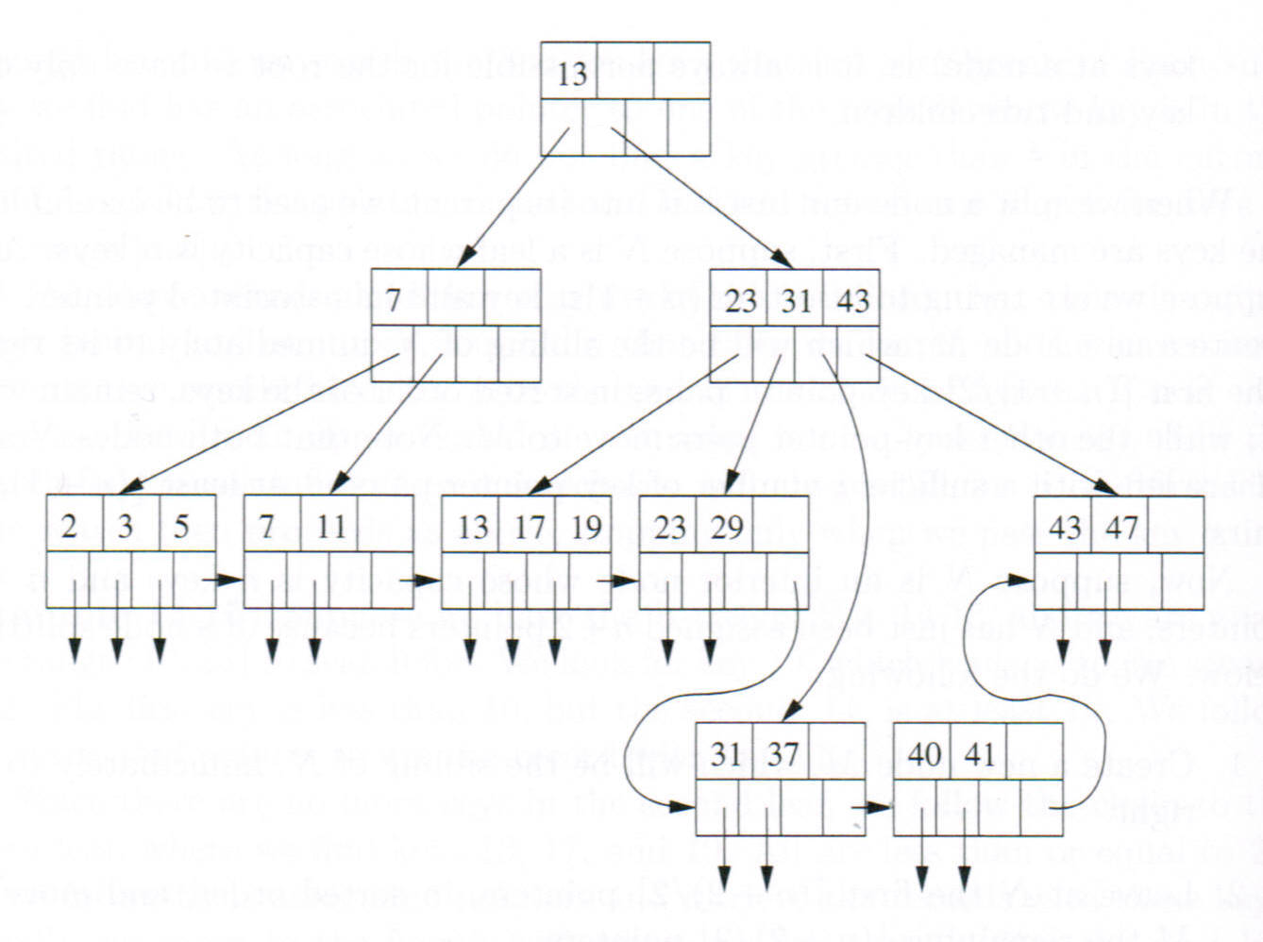
$B^{+}$-Tree Insertion
N
N
M
Inserting 40

Slide 38
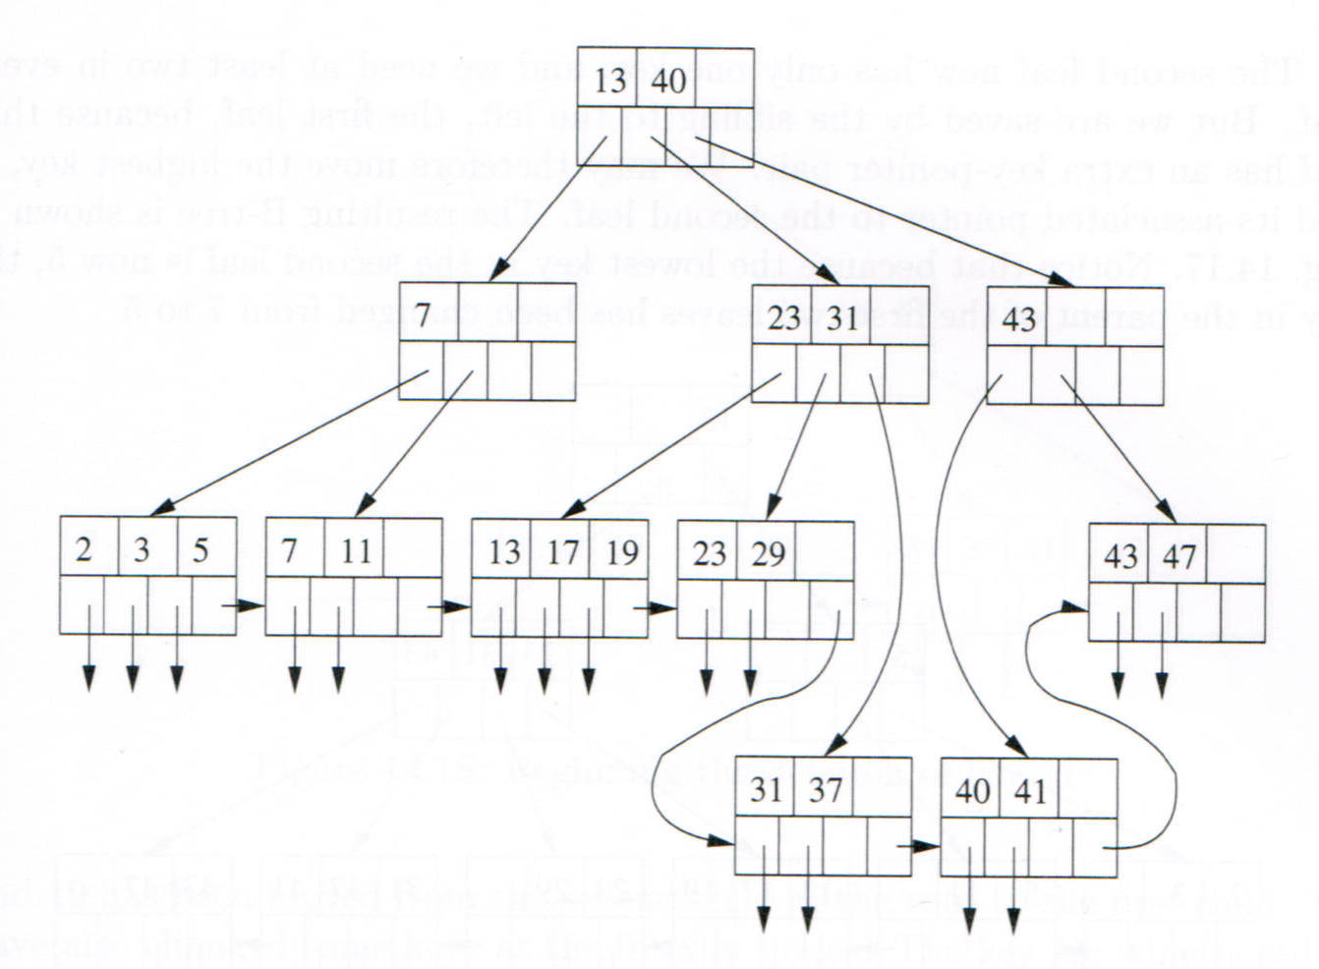
$B^{+}$-Tree Insertion
N
N
M
Inserting 40

Slide 39
$B^{+}$-Tree Insertion
If the leaf N is previously full, split it into two new leaf nodes N and M, with M to the right of N:
Sort the key-pointer pairs in N and the new pair. Partition them into two lists, so that the first ⌈(m + 1)/2⌉ pairs are in the first list and the remaining pairs are in the second list.
Store the lower list into N. Store the higher list into M.
Insert the smallest key in M and the pointer to M into the upper level, that is, the parent of N.

Slide 40
$B^{+}$-Tree Insertion
At interior node (now we call it N), we may also have two situations before the insertion of the key-pointer pair -- the node is full or not full:
If the node N is not previously full, insert the new key-pointer pair at a position such that the keys in the node are still in order. Adjust its parent node if necessary.
If the node N is previously full, split it into two new nodes N and M, with M to the right of N:
Sort the key-pointer pairs in N and the new one.
Leave the first ⌈(m + 2)/2⌉ pointers in N and move the last ⌊(m + 2)/2⌋ pointers into M.
Leave the first ⌈m/2⌉ keys in N and move the last ⌊m/2⌋ keys into M.
Insert the middle key (that is not in N nor in M) and the pointer to M into the upper level, that is, the parent of N.

Slide 41
$B^{+}$-Tree Deletion
To delete a key-pointer pair from a tree, first locate the key-pointer pair in a leaf node N, by using the search method. Delete it from N.
After the deletion,
if the number of keys in N is not less than the required minimum (e.g. 2 in this example), adjust the key in the parent that associated with the pointer to this node if necessary, and finish.
Delete 5, 31, and 13.

Slide 42
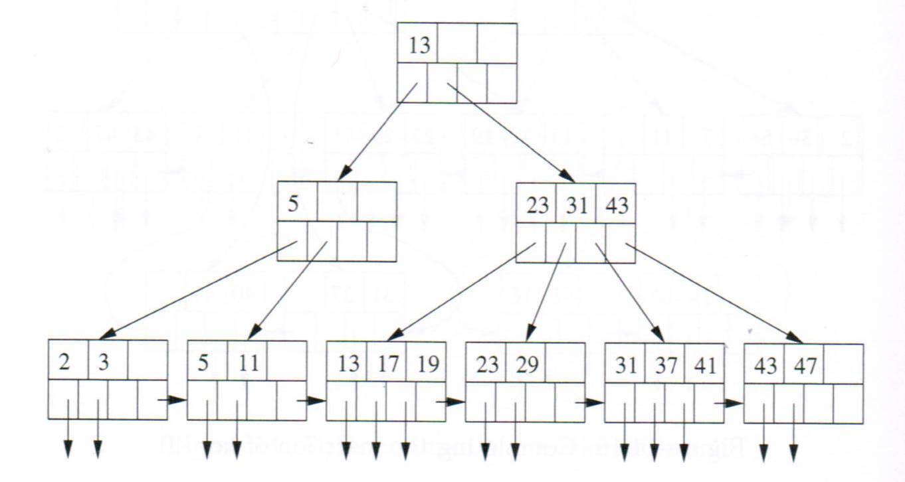
Deletion
N
Delete 7

Slide 43
Deletion
If the number of keys in leaf node N becomes less than the required minimum, check the numbers of keys in the two immediate adjacent sibling nodes (or the immediate sibling if the node is the youngest or oldest).
If the number of keys in a sibling is greater than the required minimum, move the closest key in the sibling into N, and adjust the key in the parent that associated with the pointer to this node or the sibling. Then finish.

Slide 44
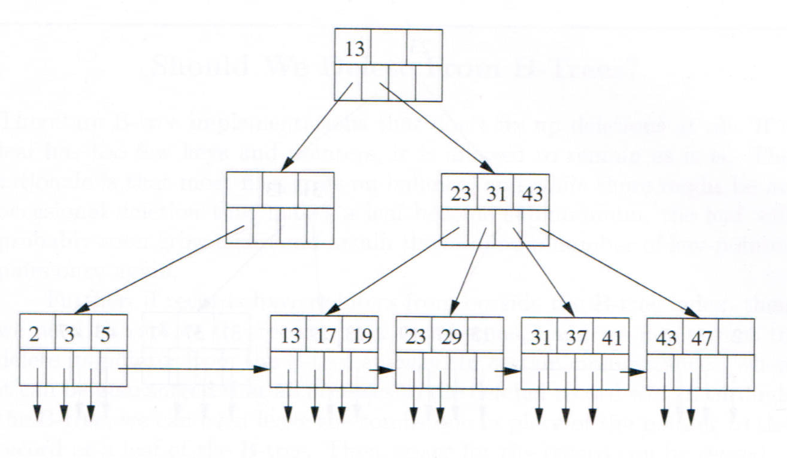
$B^{+}$-Tree Deletion
M
N
Before the deletion of 11.
Beginning the deletion of 11.

Slide 45
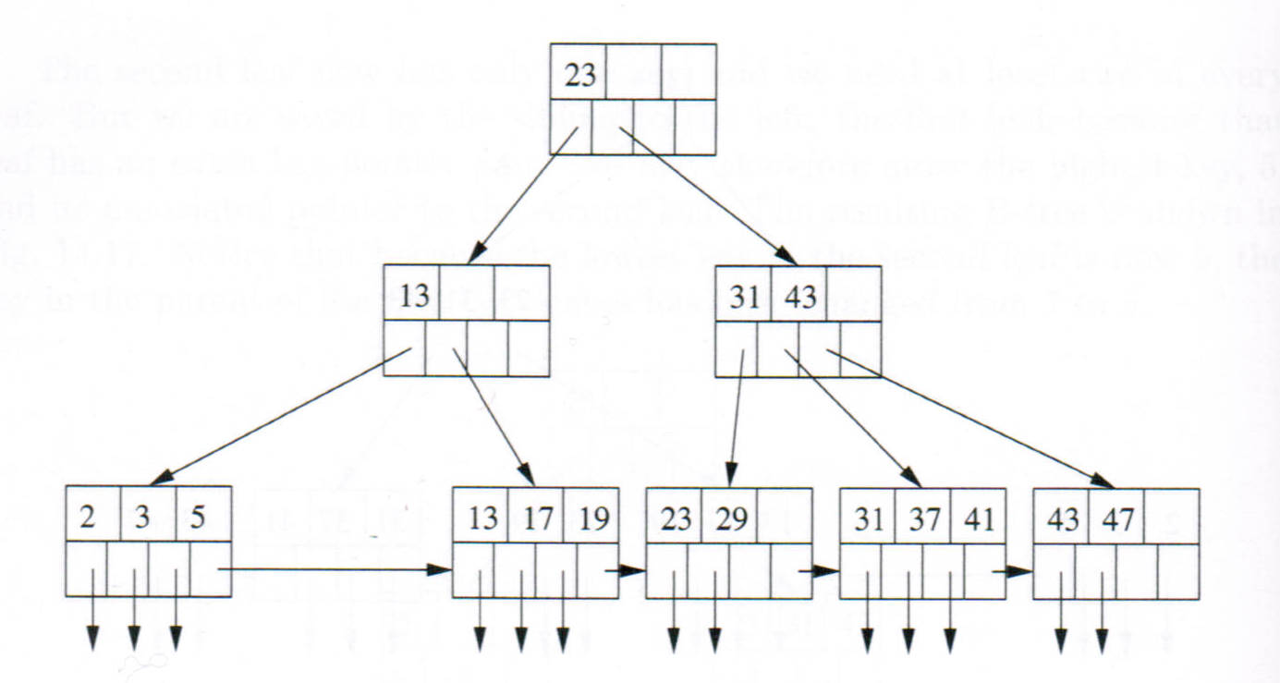
$B^{+}$-Tree Deletion
Before the deletion of 11.
Completing the deletion of 11.

Slide 46
$B^{+}$-Tree Deletion
If the number of keys in leaf node N becomes less than the required minimum, check the numbers of keys in the two immediate adjacent sibling nodes (or the immediate sibling if the node is the youngest or oldest).
If none of the immediate adjacent siblings (or sibling) has an extra key, combine one of the siblings (e.g. M to the right or left of N), and then delete a pointer (e.g. the pointer to M) from the parent and adjust the keys at the parent node.

Slide 47
$B^{+}$-Tree Deletion
At an interior node (now we call it N), after the deletion of a pointer,
if the number of pointers in N is not less than the required minimum, adjust the keys in N, and finish.
if the number of pointers in N becomes less than the required minimum
1. Check numbers of pointers in the two immediate adjacent sibling nodes (or the immediate sibling if the node is the youngest or oldest).
2. If the number of pointers in a sibling is greater than the required minimum, move the closest pointer in the sibling into node N, and adjust the keys in the current node and the sibling. Then finish.
3. If none of the immediate adjacent siblings (or sibling) has an extra pointer, combine N with one of the siblings (e.g. M to the right or left of N), and then delete a pointer (e.g. the pointer to M) from the parent and adjust the keys at the parent node.

Slide 48
Hashing
Hashing is an effective technique for searching data.
A hash table consists of two components: an array of n buckets and a hash function h.
The buckets may contain data records, or pointers to data records that are stored somewhere else.
The hash function takes a search key K as an argument and computes from it an integer in the range 0 to n − 1. The function maps search keys to bucket locations (addresses).
K
h(K)
Hash function
Bucket array

Slide 49
Hashing
For key K, the output of h(K) is called the hash value of K.
Ideally, a data record can be obtained (searched, found) by only one or two disk reads. The number of reads is unrelated to the number of records in the database and is more efficient than a tree index when the number of records is very large. (The efficiency of tree is O(log n)).
Theoretically, the search efficiency of hashing is O(1).
A hash table does not support efficient range queries.
A major problem in a hash table is collisions, which occur when the hash function maps two different keys to the same location.

Slide 50
Buckets Containing Data Records
When the buckets are used to contain data records, the bucket array is in the data file.
A block may contain a bucket.
A data record with key value K is stored in a location determined by h(K).
To search for a data record with a given key value K, the location to find it is determined by h(K).
K
h(K)
Hash function
Bucket array as data file

Slide 51
Buckets Containing Pointers
When the buckets are used to contain pointers, the bucket array is separated from the data file. It may be in the RAM or on disk.
A data record with key value K is first stored in a data block and then the pointer to the block is stored in a bucket determined by h(K).
To search for a data record with a given key value K, the location for finding the pointer to the record is determined by h(K).
K
h(K)
K
Hash function
Bucket array
Data file

Slide 52

Hash Function
Hash function h is a composed function of $h_{1}$ and $h_{2}$:
h(K) = $h_{2}$($h_{1}$(K))
$h_{1}$converts non-numerical keys into integers.
$h_{2}$compresses the integers produced by $h_{1}$into the range of [0, n − 1].

Slide 53
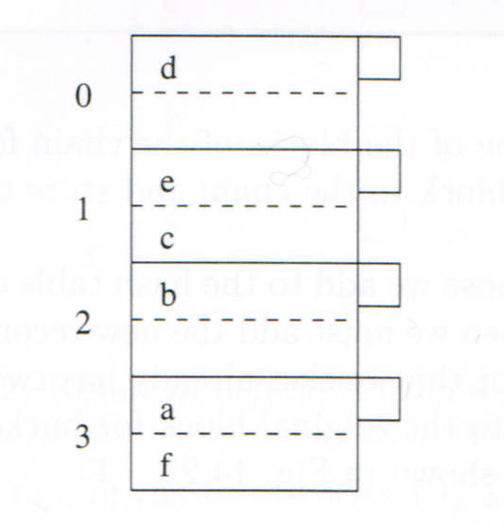
Static Hash Tables
In a static hash table, the number of buckets never changes.
The most straightforward use of the static hash table structure for database is creating n buckets on disk.
The size of a bucket can be the same as the size of a block.
In this example, h(d) = 0, h(e) = 1, h(c) = 1, …
A collision occurs when h(K1) = h(K2), where K1 and K2 are different keys.

Slide 54
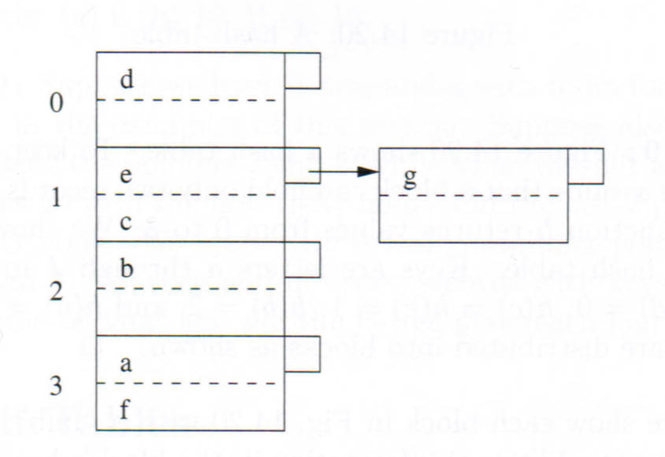
Chaining in Static Hash Tables
When a chaining method is used to handle collisions, a bucket is the first block in a block chain that consists of the bucket and zero or more overflow blocks.
A data record is stored in the block chain determined by the hash function. When the chain is full, an overflow block is added and linked to the chain and the record is stored in the new block.
When a chain becomes long, finding a record may need a large number of disk reads.
After the insertion of g whose hash value is 1.

Slide 55
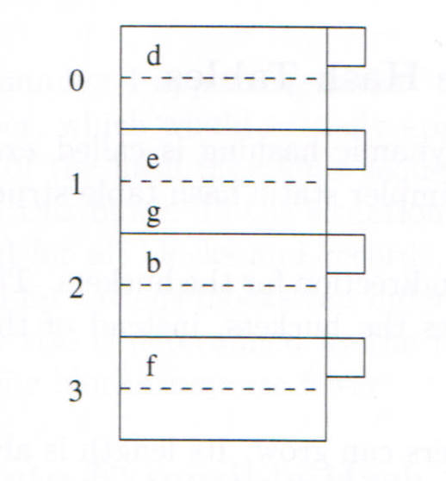
Chaining in Static Hash Tables
After a data record is deleted from a block, some other records are “consolidated”. If the last overflow block becomes empty, it is removed from the chain.
After the deletion of c.

Slide 56
Extensible Hash Tables
An Extensible hash table is a dynamic hash table in which the number of buckets may change.
A bucket contains a pointer to a data block. A block contains a number of records.
There are no block chains.
When the target data block is full, the bucket array may be doubled.
Obtaining a record needs one or two disk reads, depending on if the bucket array is in RAM.

Slide 57
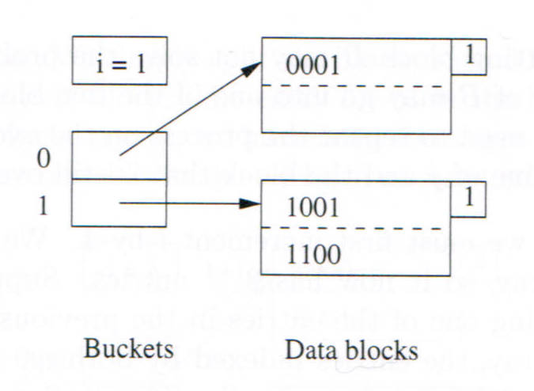

Extensible Hash Tables
Let k be the number of bits in the output of hash function h. At a point of time, only the first (leftmost) i bits are used to determine buckets (1 ≤ i ≤ k).
That is, every bucket has an “address” of i bits.
The number of buckets is $2^{i}$ at this point of time.
In the header of every data block, there is a flag j that is in the range 1 and i (inclusively). The j value indicates that the records are distributed to this block using the first j bits of their h(K) values.
When the number of buckets is doubled, the addresses become i + 1 bits long.

Slide 58
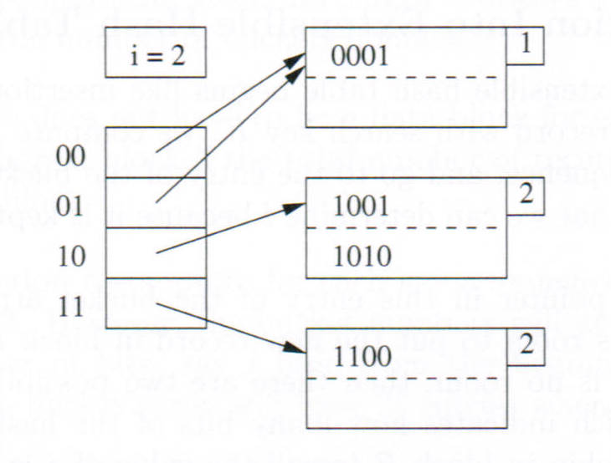
Insertion in an Extensible Hash Table
1010
After the insertion of a record whose hash value is 1010.

Slide 59
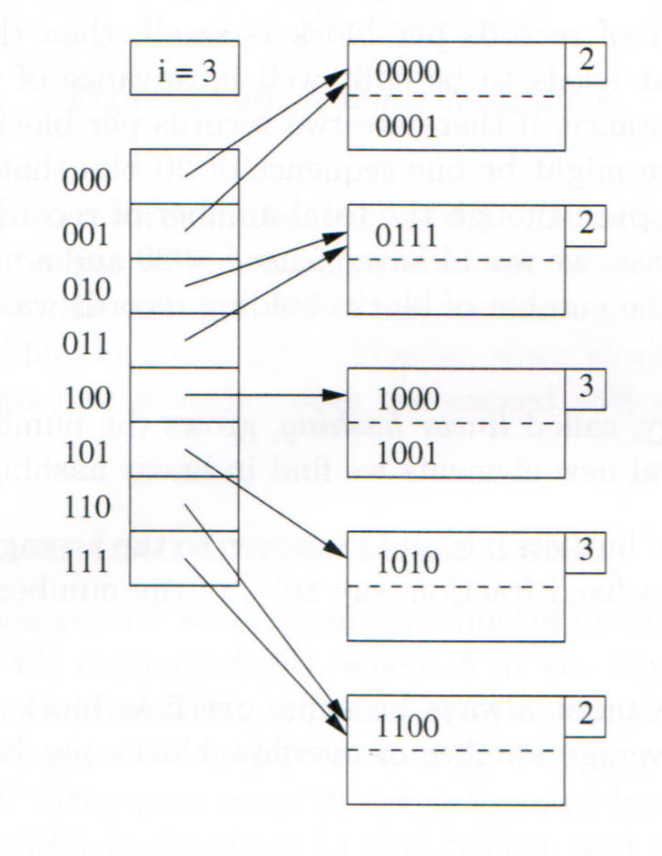
Insertion in an Extensible Hash Table
0111
0000
1000
After the insertions of 0000, 0111, 1000.

Slide 60

Insertion in an Extensible Hash Table
Inserting a record with key value K:
Use the leftmost i bit of h(K) to determine data block B and go to B. If B is not full, store the record in it and finish.
If B is full, check the j value in the header of B. If j < i, likely we do not have to increase i.
Split block B into two.
Distribute the records in B (and the new record) to the two blocks based on the ${(j+1)}^{th}$ bit of their h(K) value.
Update the flag in the block headers into j + 1.
Adjust the pointers in the bucket array to point to the two blocks.
If all of the records go to the same block, the new record still cannot be inserted. We have to increase j by 1 and then insert the new record using the first j + 1 bits of its h(K) value.

Slide 61

Insertion in an Extensible Hash Table
When B is full and in the block header j = i, increase i by 1 and then insert the new record using the first i + 1 bits of its h(K) value.
Increase i by 1:
Double the size of the bucket array.
Assume the address of a bucket before the expansion was $a_{1}a_{2}…a_{i}$. After the expansion, two new buckets replace the bucket. They have addresses $a_{1}a_{2}…a_{i}$0 and $a_{1}a_{2}…a_{i}$1.
Copy the two pointers in the original bucket into the two new buckets.

Slide 62
Disadvantages of Extensible Hash Tables
Major disadvantages:
Costs may be high every time when i is increased by 1 – allocating the space for doubling the bucket array, and copying a large number of pointers.
At the point of time when i is increased, access to the data may be interrupted.

Slide 63

Linear Hash Tables
In a linear hash table:
Buckets store data records.
An overflow block is added when inserting into a full bucket or an overflow block.
When there are n buckets, the last (rightmost) i bits of h(K) is used to determine the buckets to access, where i is ⌈($\log_{2}{n}$)⌉.
That is, the “addresses” of buckets are i bits long.
When needed, a new bucket is added to the hash table.

Slide 64
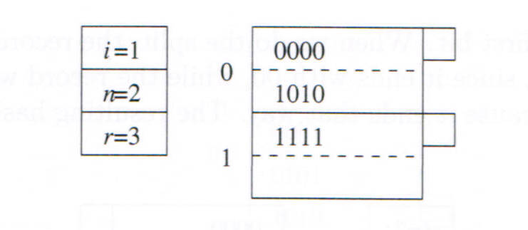
Adding a New Bucket into a Linear Hash Table
There is a pre-defined threshold for r/n where r is the number of records and n is the number of buckets.
The pre-defined threshold depends on b, which is the number of records per bucket. The threshold is defined in order that at any time the average number of record is not greater than, e.g. 0.85b.
The pre-defined threshold is 1.7..
The rightmost 1 bit is used to determine bucket.

Slide 65
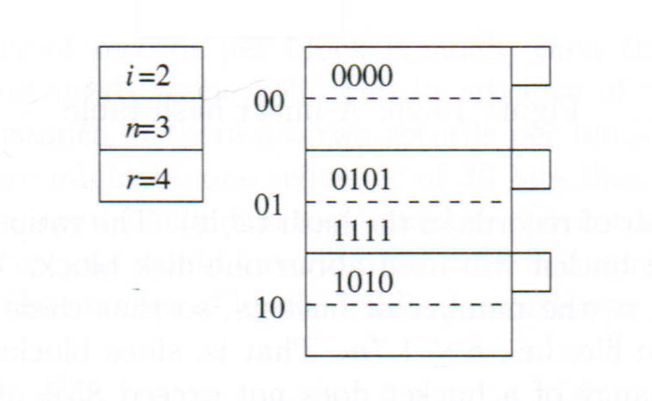

Adding a New Bucket into a Linear Hash Table
0101
The pre-defined threshold is 1.7.
After 0101 is inserted, r/n = 2.0 > 1.7.
A new bucket is added. n becomes > $2^{i}$.
i changes from 1 into 2.
The new bucket has address 10. The existing buckets have addresses 00 and 01.
The records in bucket 00 are split.
What happened if we search 1111 in the changed hash table? No bucket with address 11.

Slide 66
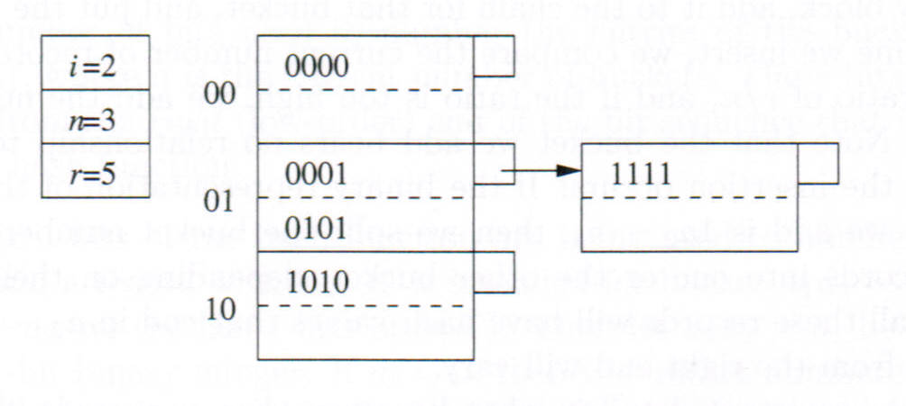
Adding a New Bucket into a Linear Hash Table
0001
The pre-defined threshold is 1.7.
After 0001 is inserted, r/n = 5/3 = 1.67 < 1.7.
The bucket is full before insertion. An overflow block is created.
The overflow block is added to the chain.

Slide 67
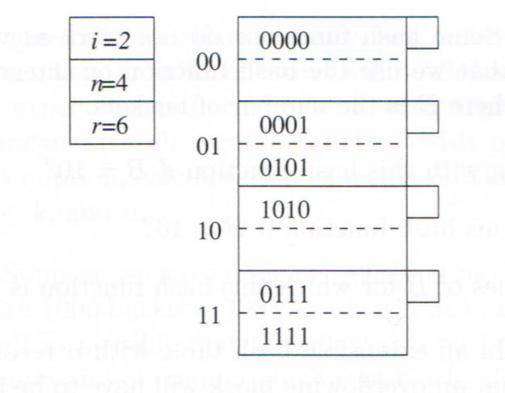
Adding a New Bucket into a Linear Hash Table
0111
The pre-defined threshold is 1.7.
After 0111 is inserted, r/n = 6/3 = 2 > 1.7.
A new bucket is created having address 11.
The records in bucket 01 are split.

Slide 68

Adding a New Bucket into a Linear Hash Table
Adding a new bucket
Every time after a record is inserted into the table, the r/n ratio is calculated. If the ratio is greater than the threshold, a new bucket is added and an existing bucket is split.
New buckets can be added till n reaches $2^{i}$.
Splitting an existing bucket:
After the ${(n+1)}^{th}$ bucket is added, its address is $a_{1}a_{2}…a_{i}$, which is the binary representation of n. $a_{1}$ is always 1.
The records in bucket 0$a_{2}…a_{i}$ are distributed into the two buckets.
The records with the last i bits 0$a_{2}…a_{i}$stay.
The records with the last i bits 1$a_{2}…a_{i}$go to the new bucket.

Slide 69

Searching a Linear Hash Table
In looking up a linear hash table using $a_{1}a_{2}…a_{i}$that is the last i bits of h(K), if a record matches the address, we have to compare its entire key with K to decide if it is the desired.
If the bucket with address $0a_{2}…a_{i}$has not been split yet, it may contain some records with the last i bits $1a_{2}…a_{i}$.
In searching for a record using $1a_{2}…a_{i}$, if there is not a bucket with address $1a_{2}…a_{i}$, search the bucket with address $0a_{2}…a_{i}$.

Slide 70

Increase i by 1
When n exceeds $2^{i}$, i is increased by 1. After that, the addresses of the buckets are (i + 1) bits long and the last (i + 1) bits of h(K) are used as addresses.
After i is increased by 1, the addresses of the existing buckets become i + 1 bits long. Conceptually, this is done by add a 0 to the left of each address. But we do not need to do it physically. The addresses of the $2^{i}$ existing buckets are all the $2^{i}$ binary integers of (i + 1) bits long that start with 0. When a new bucket is added, its address is a binary integer of (i + 1) bit long that starts with 1.

Slide 71
References
H. Garcia-Molina, J. D. Ullman, J. Wildom, Database Sysems, The Complete Book, (second Edition), Pearson, 2009.
R. Elmasri and S. Navathe, Fundamentals of Database Systems (Seventh Edition), Pearson, 2019.

