Slide 1



Loan grade prediction and default detection
By: Ensieh Bahrami
Supervised by: Alison Cossette
Notes:
Lending Club platform allows individuals to lend to other individuals.
Borrowers use the loan for almost any purpose but mostly for consolidating debt, credit card, or home improvement.
Loans are typically with a fixed term (63 or 60 month), a fixed interest rate, and a regular monthly payment schedule.
Of course, not all loans are created equal. Someone who appears to be less risky, will have an easier time getting a loan with a low interest rate than someone who appears to be riskier

Slide 2
Problem Identification
Status Qua:
There were 7 loans out of 10 thousand which were in default
Default loans had different grade (high and low risk)
Lending Club managers need to make good lending decisions based on the right loan grade
Problem:
What are the most important features in grade classification?
What are the most important features in defaulting loans?
Particularly which features help greatly hedge the risk of the lender?
Notes:
Which customers are very risky?

Slide 3
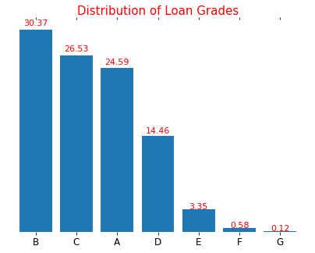
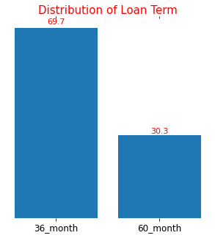
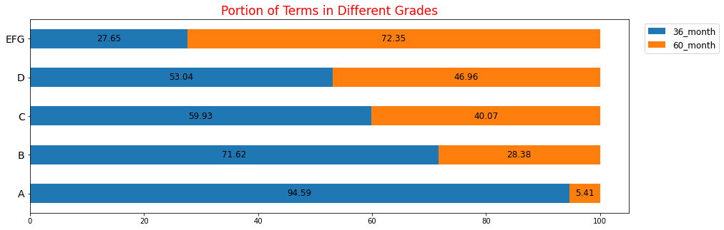
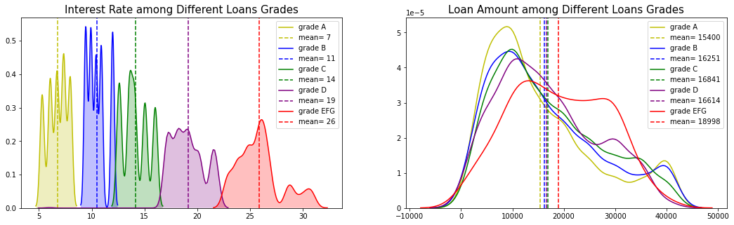
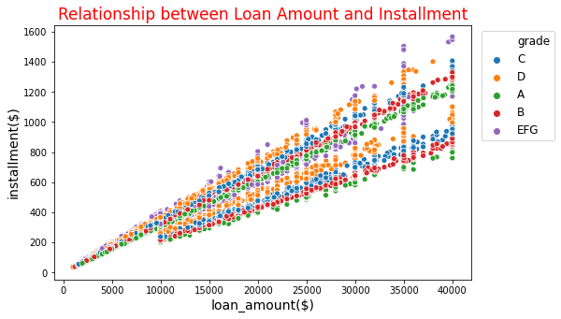
Key findings on grades
Notes:
More than 80% of borrowers had grade A, B, or C and about 4.5% had grade E, F, or G.
Distribution of interest rate is skewed to the left. There are loans with interest rate between 20% and 31%, while 50% of loans have less than 12% interest rate.
Interest rate is totally dependent to the grade of loan. Mean of interest rate for loans with low risk (grade A) is 7%, whereas loans with high risk (EFG) had higher mean of interest rate of 26%.
Average amount of loan with grade A is 15.4k $, which is less than average amount of high-risk loans (grades E, F or G) 18998$.

Slide 4
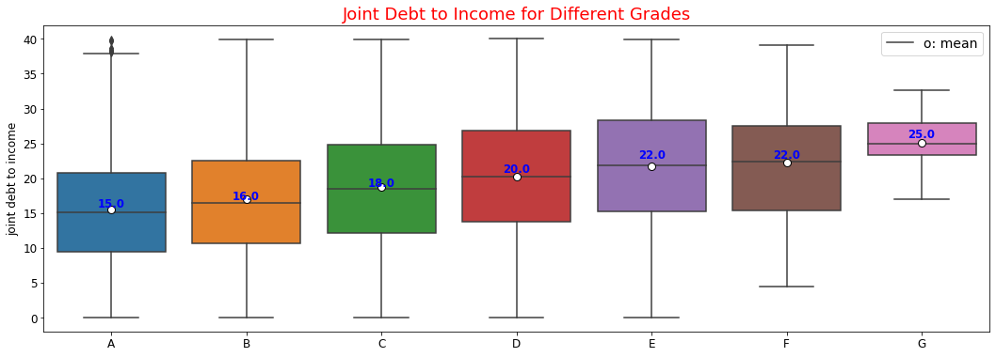
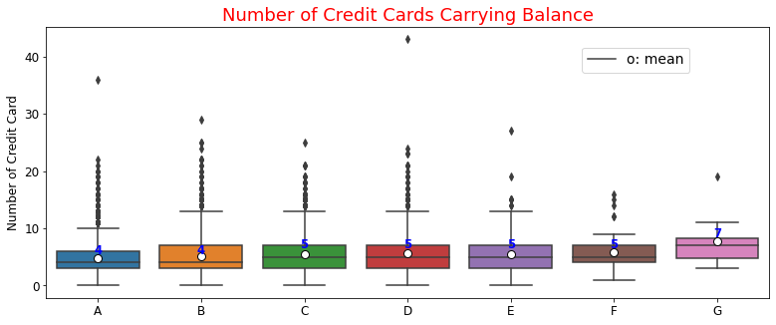
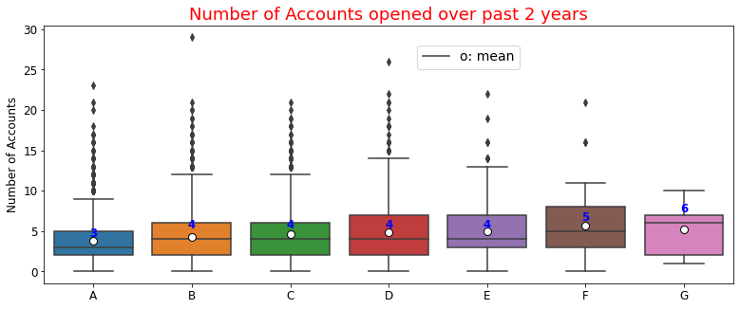
Key findings on grade

Slide 5
Best Random Forest Classifier
Data Preparation:
Performed One-Hot encoding for 2d or 3d categorical variables
70-30 train-test split
Binary encoded high dimensional categorical variables like state
Used SMOTE method to make the train set balanced
Adopted the MinMax Scaler
Fit a multinomial Random Forest Classifier on train data
Hyperparameter search using GridSearchCV
To find the max depth, bootstrap, max number of features that give the best performance
Notes:
best score: 0.99
best param: {'bootstrap': False, 'max_depth': 42, 'max_features': 'auto'}

Slide 6
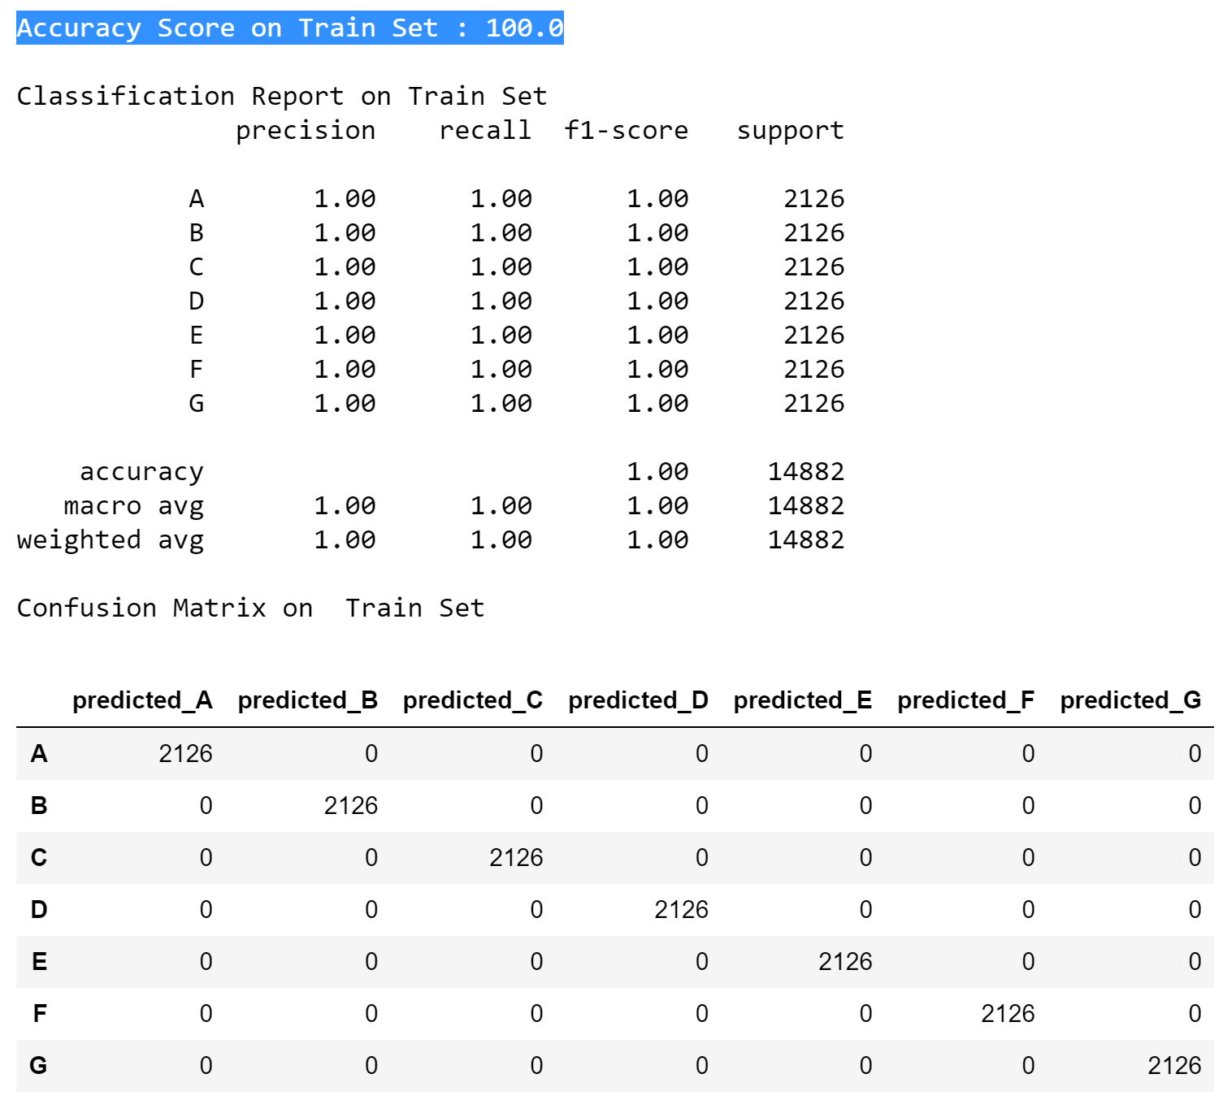
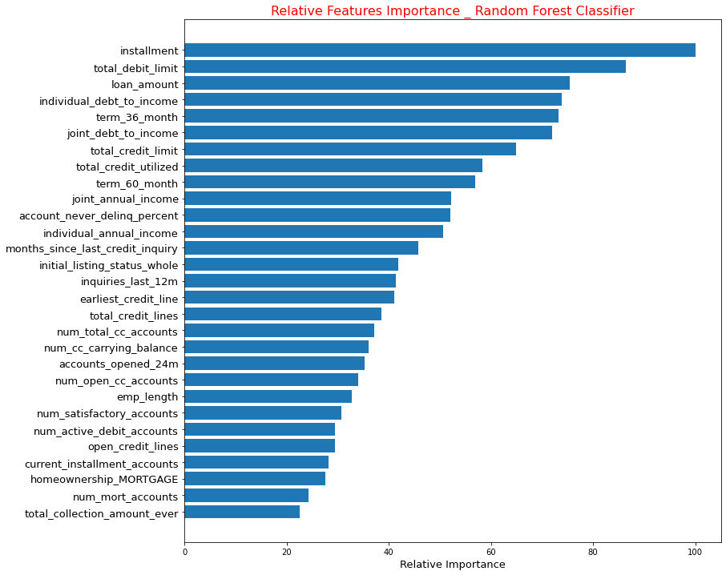
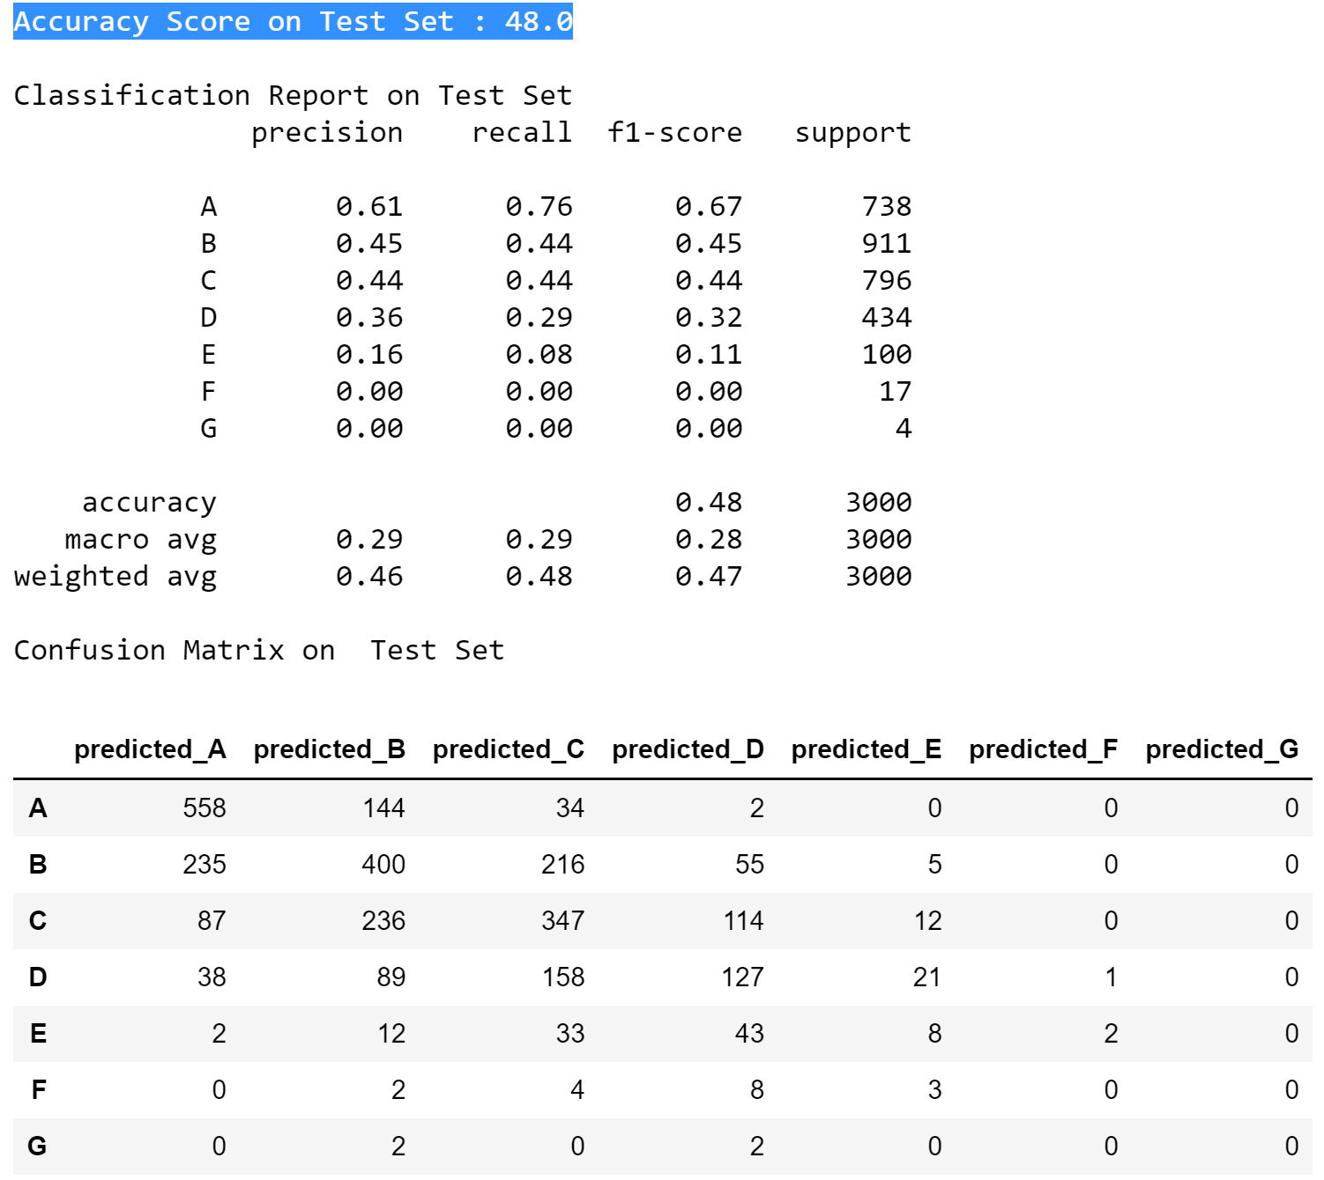
BEST RF CLASSIFIER ANALYSIS
Train
Test
RF clf had 100% accuracy on train set and 48% accuracy on test set.

Slide 7
Best Multinomial Logistic Regression
Data Preparation:
Performed One-Hot encoding for 2d or 3d categorical variables
70-30 train-test split
Binary encoded high dimensional categorical variables like state
Used SMOTE method to make the train set balanced
Adopted the MinMax Scaler
Fit a multinomial Logistic Regression model on train data
Hyperparameter search using GridSearchCV
To find the penalty strength parameter (C) that gives the best performance
Notes:
Used SMOTE method to oversample the minority classes and made the train set balanced
Adopted the MinMax Scaler since some of independent variables were to some extend skewed.

Slide 8

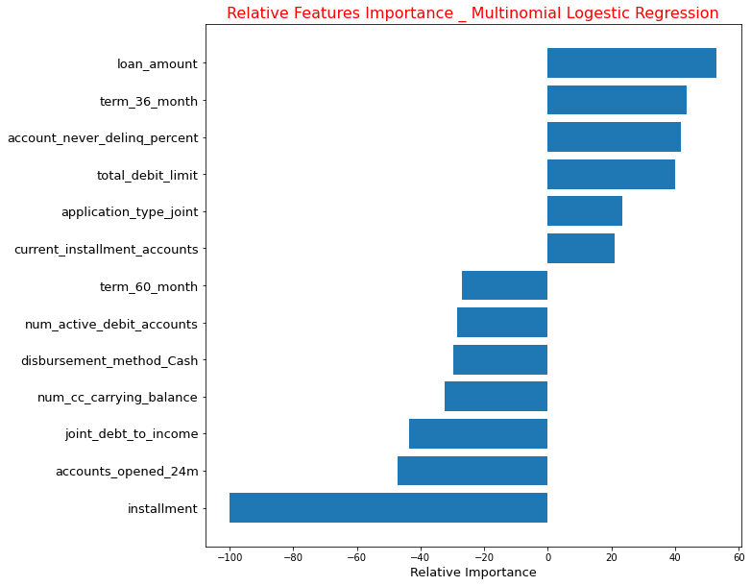
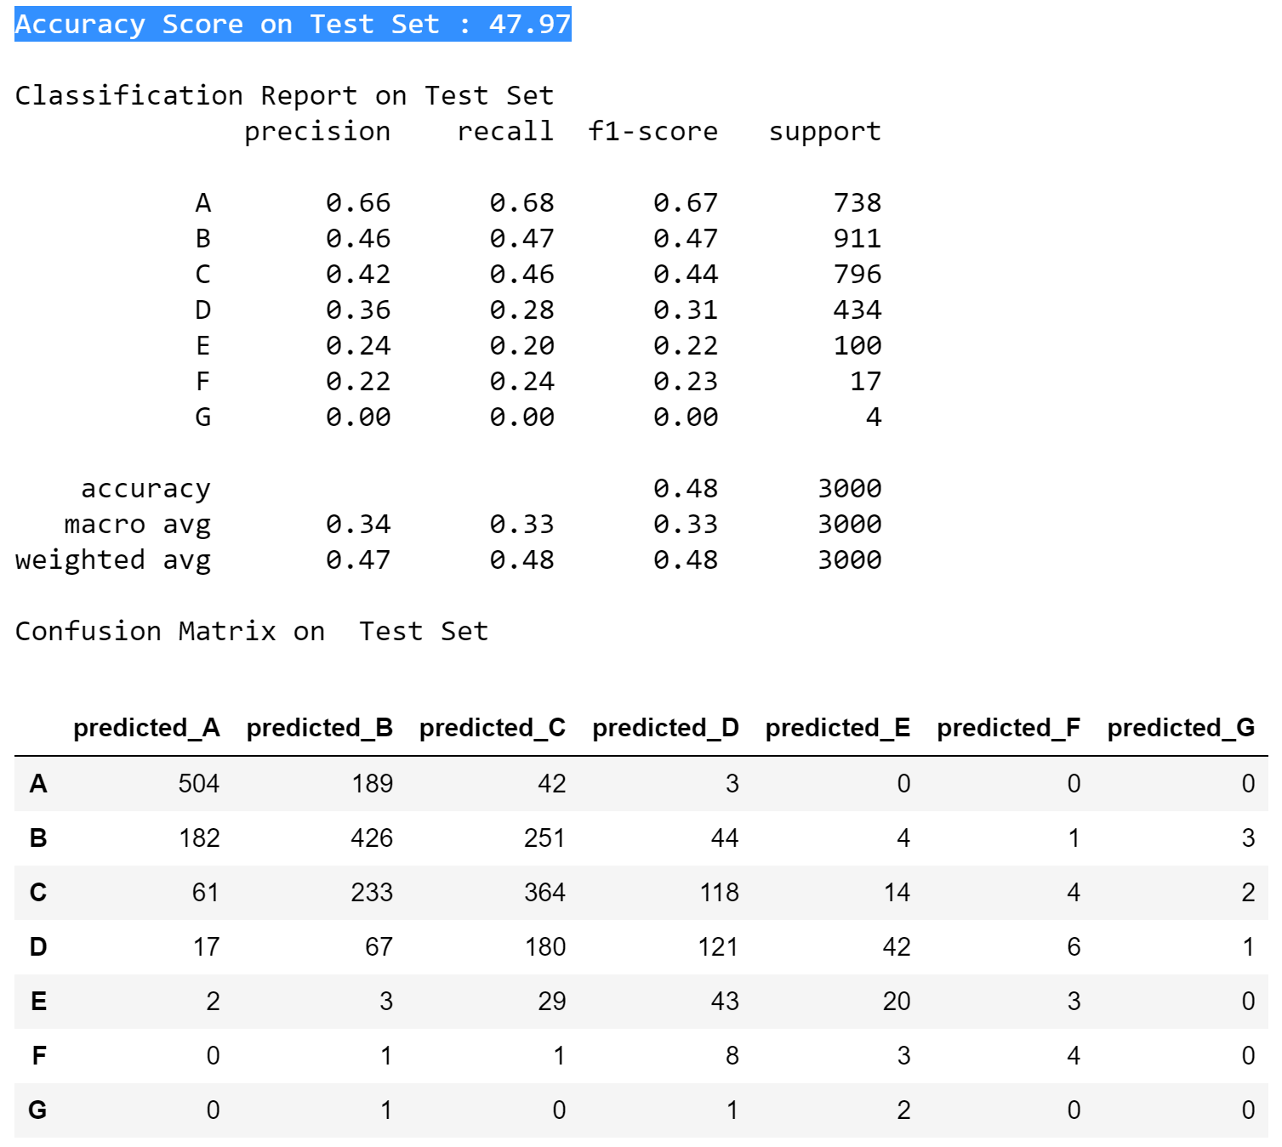
BEST MULTINOMIAL LOG REG ANALYSIS
Train
Test
Multinomial had 65.02% accuracy on train set and 47.97% accuracy on test set.
The most important features which contribute to grade classification were:
Installment
Loan Amount
Term 36 month
Accounts opened over last 2 years
Joint debt to income

Slide 9
Summary on grade classification
Performance on Test Set | Precision_ RF CLF | Precision_ Multinomial LogReg | Recall_ RF CLF | Recall_ Multinomial LogReg | f1-score support _ RF CLF | f1-score support _ Multinomial LogReg
A | 1.00 | 0.99 | 0.97 | 0.99 | 0.98 | 0.99
B | 0.97 | 0.96 | 0.99 | 0.94 | 0.98 | 0.95
C | 0.95 | 0.88 | 0.99 | 0.95 | 0.97 | 0.91
D | 0.95 | 0.91 | 0.91 | 0.85 | 0.93 | 0.88
E | 1.00 | 0.78 | 0.81 | 0.79 | 0.90 | 0.79
F | 0.94 | 0.82 | 0.94 | 0.53 | 0.94 | 0.64
G | 1.00 | 0.00 | 0.50 | 0.00 | 0.67 | 0.00
Random Forest Clf had higher recall rate on all groups, which means classifies fewer negative false.
It is important to correctly classify loans to understand what is the risk associated to each loan.
Notes:
best score: 0.99
best param: {'bootstrap': False, 'max_depth': 42, 'max_features': 'auto'}

Slide 10
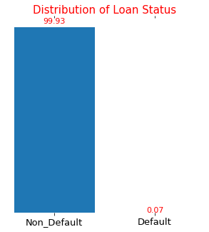
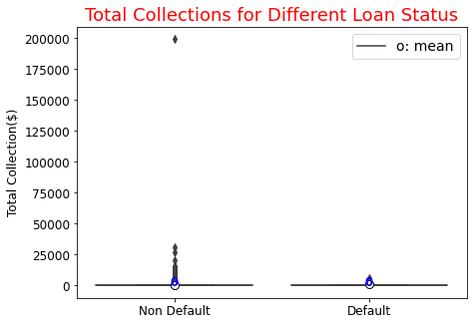
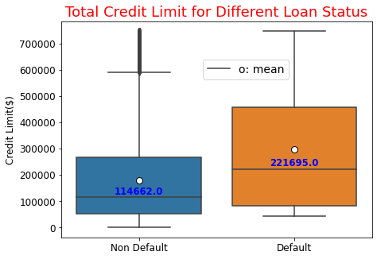
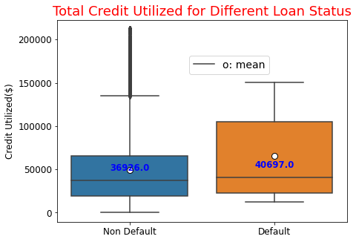
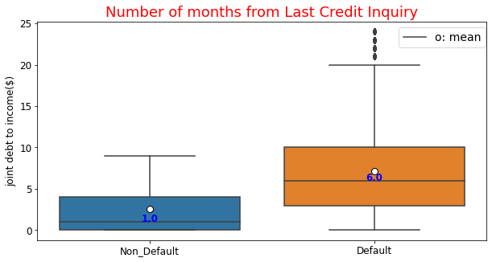
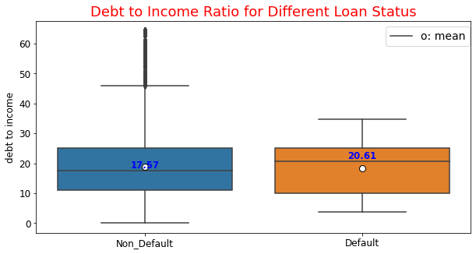
Key findings on Default loans

Slide 11
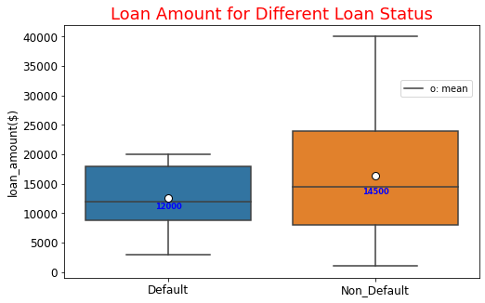
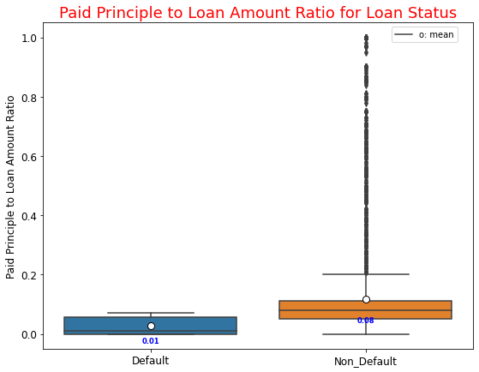
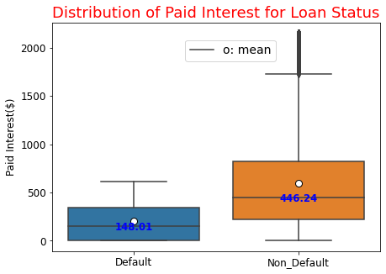
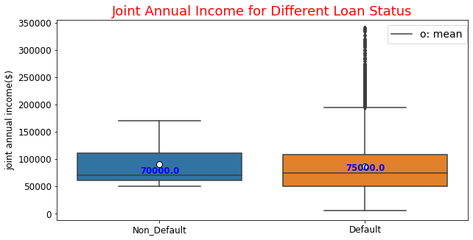
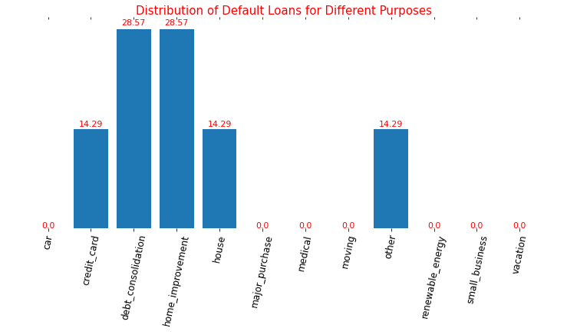
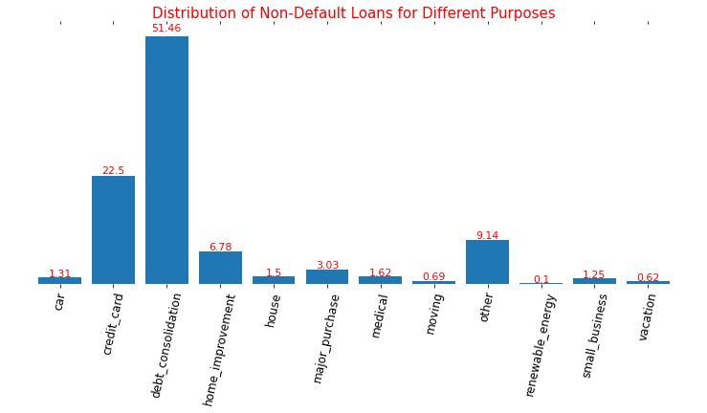
Key findings on Default loans
Notes:
Default loans got more for home improvement and house than non-default loans. And non-default loans received more for credit card pay-off and debt consolidation.
Median of Debt to income for default loans was about about 3% higher that median for non-default.

Slide 12
Best Random Forest Clf on default detection
Fit a Light Gradient Boosting model on train data
Hyperparameter search using Bayesian Optimization
To find the number of leaves, max depth, lambda l1and lambdal2, and min data in leaf on 3 folds that gives the best performance
Fit a Random Forest Classifier on train data
Hyperparameter search using GridSearchCV
To find the number of estimators, max depth, option for max features and bootstrapping on 5 cv that gives the best performance
Fit Logistic Regression, LinearSVC and Ridge Classifier on train data

Slide 13
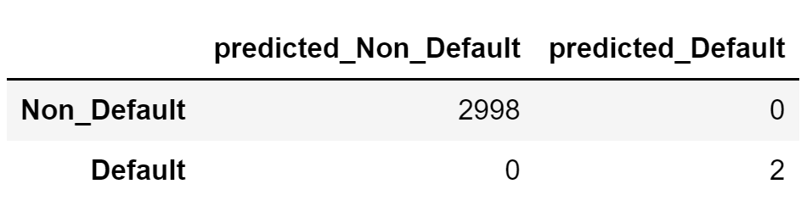
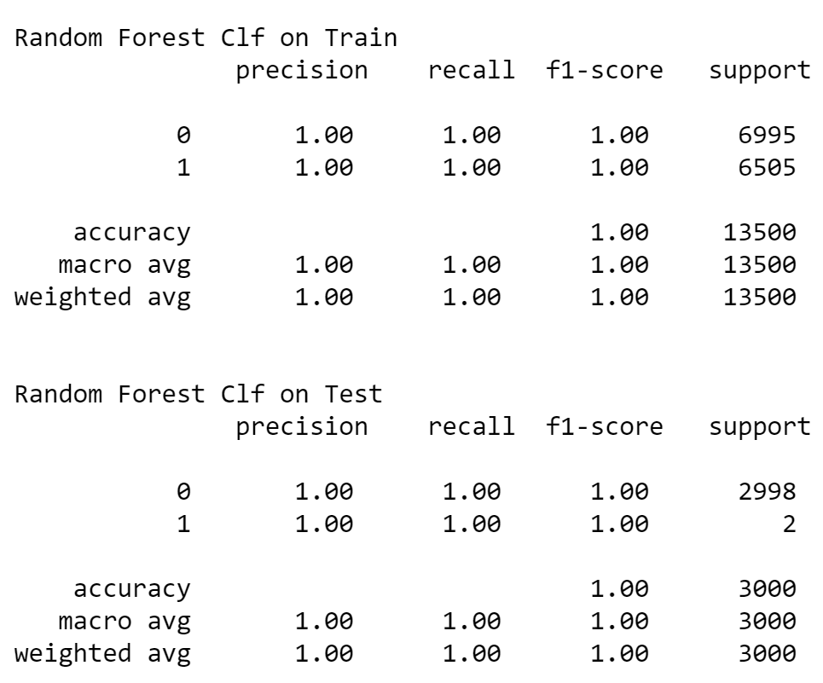
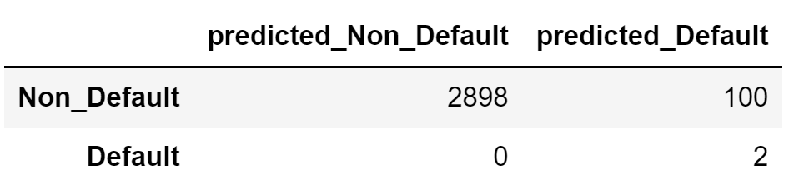
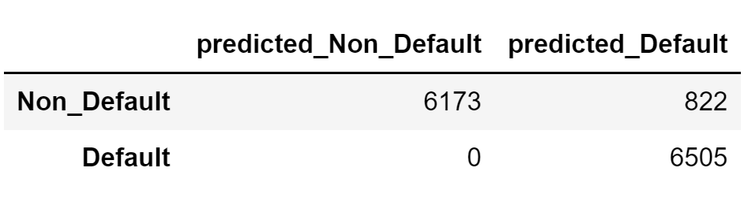
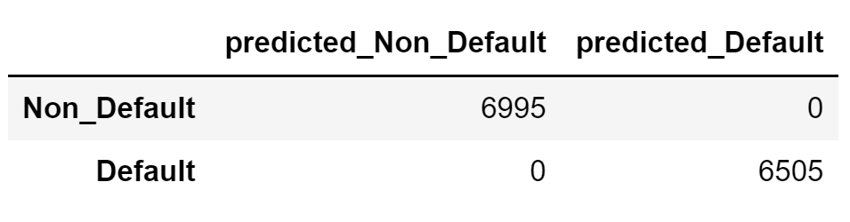
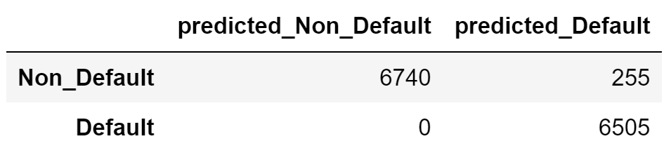
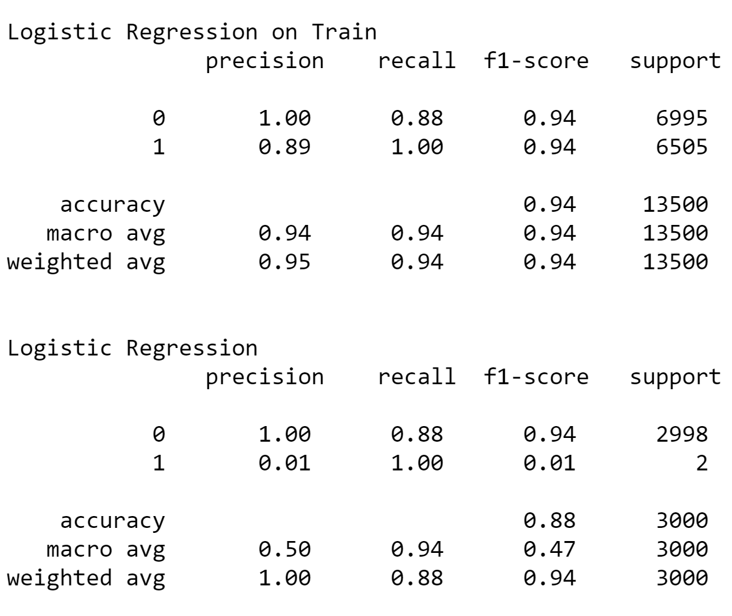
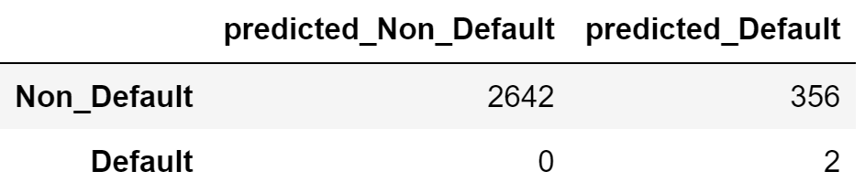
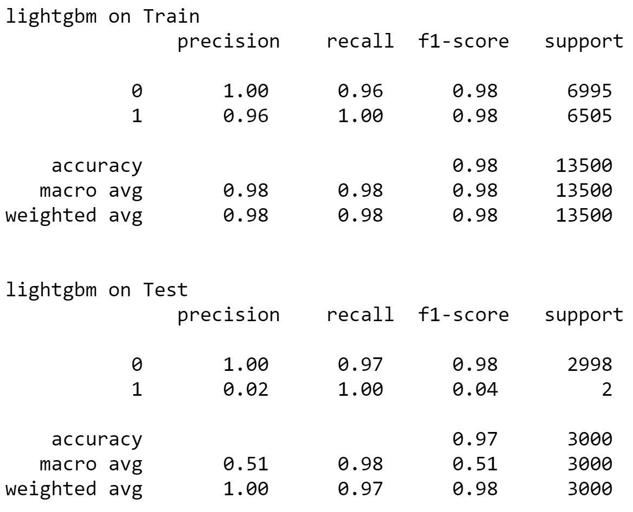
BEST RF Clf on Default
BEST LGBm on Default
Log Reg on Default

Slide 14
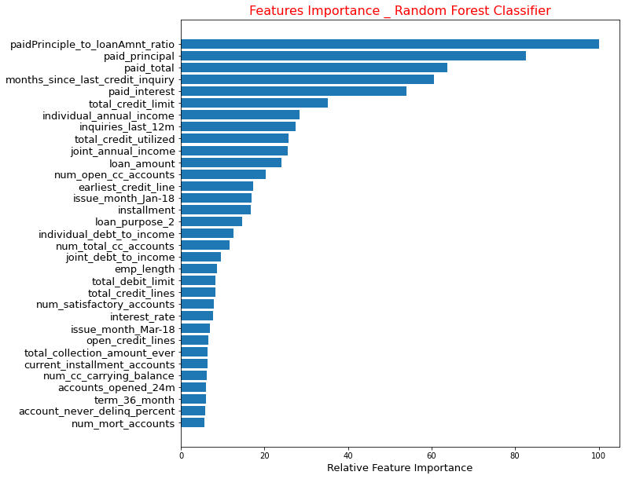
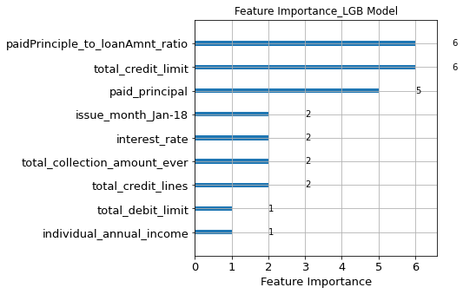
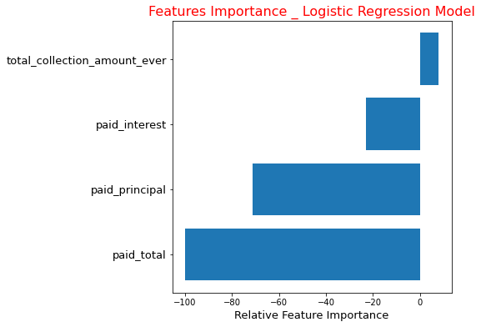
The most important features in default detection:
Paid principle to loan amount ratio
Paid principle and Paid interest and Paid total,
Total credit limit,
Months since last inquiry,

Slide 15
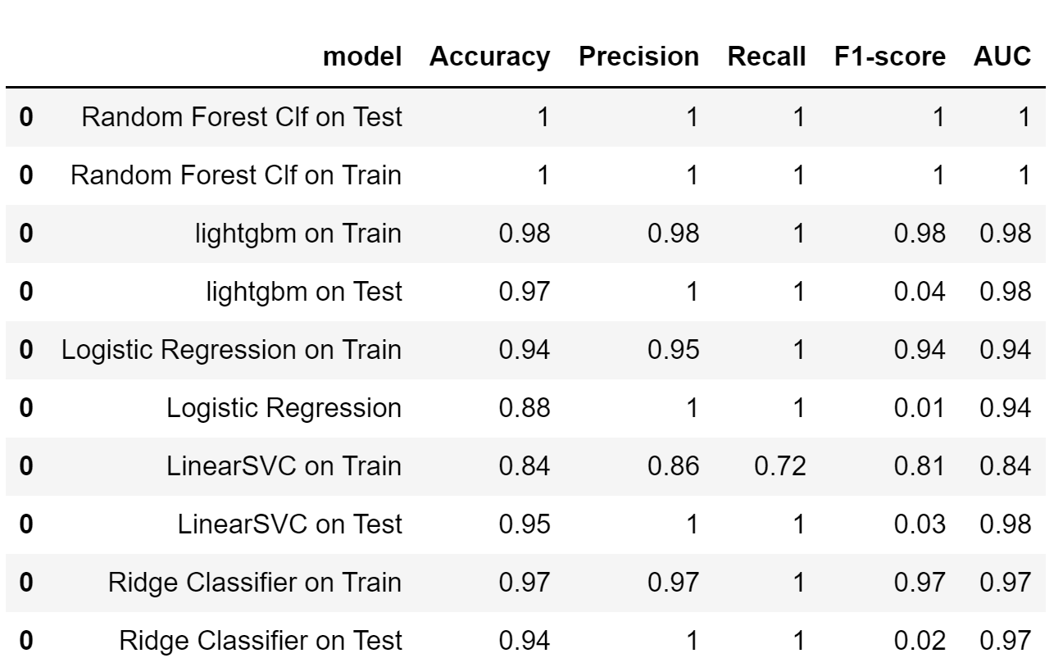
Summary on Default detection
Random Forest Clf, Light Gradien Boosting model and Ridge Clf had very high recall rate while didn’t scarify the precision rate.

Slide 16
Data quality assessment
Problem:
Minority classes in grade classification like grade E, F and G had very few sample
Minority class in default detection, default loan had only 7 sample out of 10 thousand samples
Even hyper tunned models couldn’t train well on minority classes with such few samples
Next Step:
Gathering more sample from minority classes,
The more balance class, the better training the models and more reliable classifiers

