Slide 1
Fermilab Mass Storage
Enstore,
dCache and
SRM
Michael Zalokar
Fermilab

Slide 2
What are they?
Enstore
  In-house, manages files, tape volumes, tape libraries
  End-user direct interface to files on tape
dCache
  Joint DESY and Fermilab, disk caching front-end
  End user interface to read cached files, write files to enstore indirectly via dCache
SRM
  Provides a consistent interface to underlying storage systems.

Slide 3



Software
3 production systems of Enstore
  RunII:
    D0
    CDF
  Everyone else:
    MINOS, MiniBooNE, SDSS, CMS, et. al.
3 production systems of dCache and SRM
  CDF
  CMS
  Everyone else

Slide 4
Requirements
Scalability
Performance
Availability
Data Integrity

Slide 5
PNFS
Provides a hierarchical namespace for users' files in Enstore.
Manages file metadata.
Looks like an NFS mounted file system from user nodes.
Stands for “Perfectly Normal File System.”
Written at DESY.

Slide 6
Enstore Design
Divided into a number of server processes
  Scalability is achieved by spreading these servers across multiple nodes.
  If a node goes down, we can modify the configuration to run that nodes servers on a different node. This increases availability while the broken node is fixed.
Enstore User Interface: encp
  Similar to standard UNIX cp(1) command
  encp /data/myfile1 /pnfs/myexperiment/myfile1

Slide 7
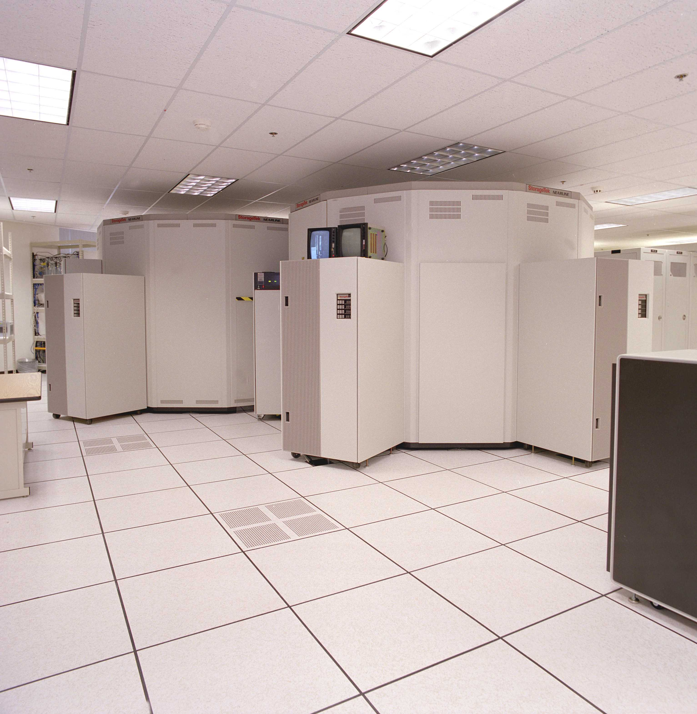
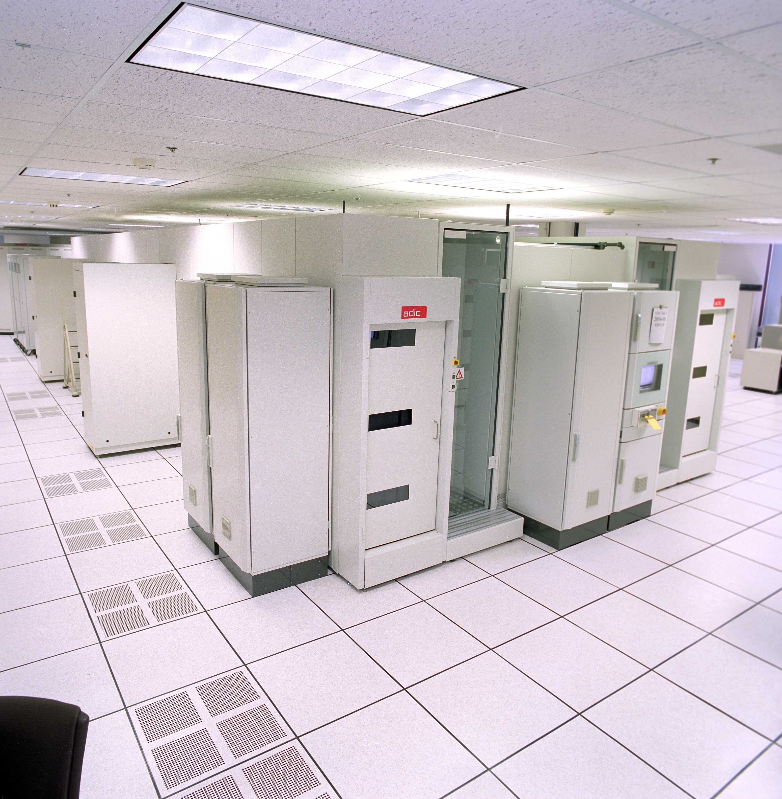
Hardware
Robots
  6 StorageTek Powderhorn Silos
  1 ADIC AML/2
Tape Drives:
  LTO: 9
  LTO2: 14
  9940: 20
  9940B: 52
  DLT (4000 & 8000): 8
127 commodity Linux PCs

Slide 8
Enstore Monitoring
Web pages for current server statuses
Cron Jobs
Plots for resource usage
  Number of tapes written
  Number of tape drives in use
  Number of mounts
  And much more...
entv (ENstore TV)

Slide 9
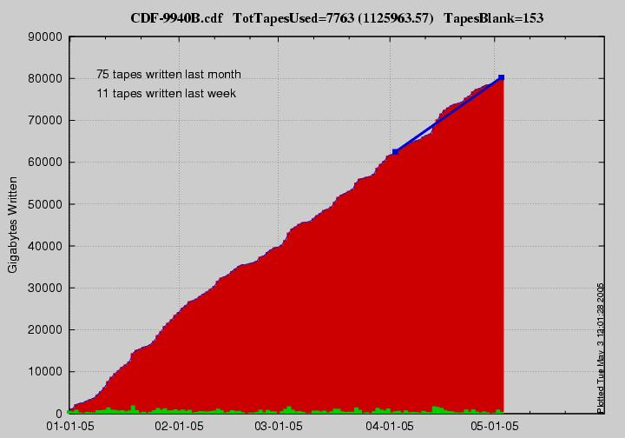
Enstore Monitoring Cont.
X-Axis is time since January 1st 2005 until present
Y-Axis is number of gigabytes written
Includes summary of tapes written in last month and week

Slide 10
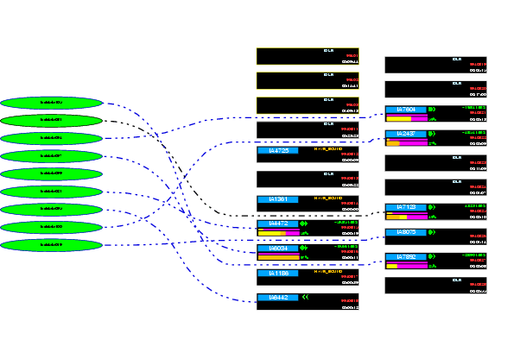
ENTV
Client nodes
Real time animation
Tape & drive information
  Current Tape
  Instantaneous Rate

Slide 11
By the Numbers
User Data on Tape:
  2.6 Petabytes
Number of files on tape:
  10.8 million
Number of volumes:
  ~25,000
One Day Transfer Record
  27 Terabytes

Slide 12
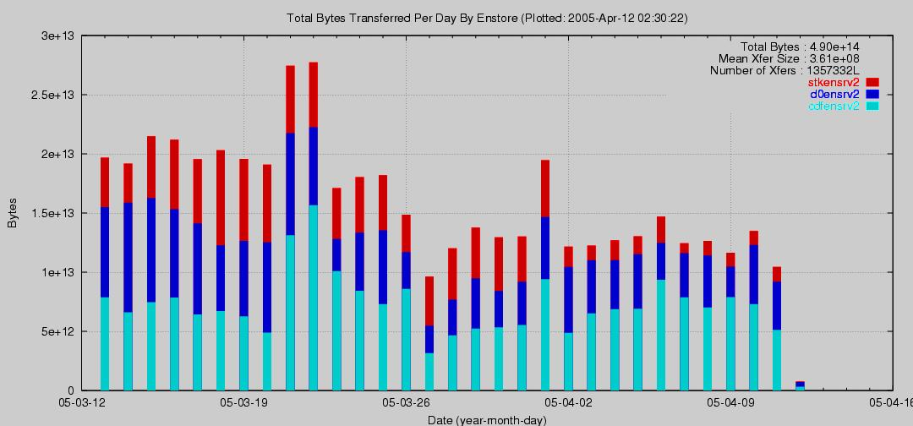
Performance: 27TB
Two days of record transfer rate
CMS Service Challenge in March (In red)
Normal usage

Slide 13
Lessons Learned
Just because the file transferred without error, does not guarantee that everything is fine.
  With Fermilab's load we see bit error corruption.
Users will push the system to its limits.
  Record 27TB transfer days were not even noticed for three days.
Just having a lot of logs, alarms and plots is not enough. They must also be interpretable.

Slide 14
dCache
Works on top of Enstore or as standalone configuration.
Provides a buffer between the user and tape.
Improves performance for 'popular' files by avoiding the need of reading from tape every time a file is needed.
Scales as nodes (and disks) are added.

Slide 15
User Access to Data in dCache
srm – storage resource manager
  srmcp
gridftp
  globus_url_copy
kerberizedftp
weakftp
dcap – native dCache protocol
  dccp
http
  wget, web browers

Slide 16
dCache Deployment
Administrative Node
Monitoring Node
Door Nodes
  Control channel communication
Pool Nodes
  Data channel communication
  ~100 pool nodes with ~225 Terabytes of disk

Slide 17
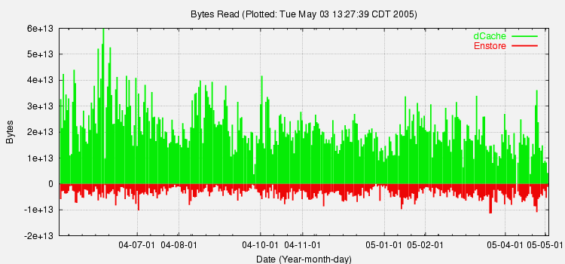
dCache Performance
Record transfer day of 60GB. This is for just one dCache system.

Slide 18
Lessons Learned
Use the XFS filesystem on the pool disks.
Use direct I/O when accessing the files on the local dCache disk.
Users will push the system to its limits. Be prepared.

Slide 19
Storage Resource Manager
Provides uniform interface for access to multiple storage systems via SRM protocol.
SRM is a broker that works on top of other storage systems.
  dCache
    Runs as a server within the dCache.
  UNIXTM filesystem
    Standalone
  Enstore
    In development

Slide 20
CMS Service Challenge
50 MB/s sustained transfer rate
  From CERN, though the dCache to tape in Enstore
  On top of normal daily usage of 200 to 400 MB/s
  Rate throttled to 50 MB/s
700 MB/s sustained transfer rate
  From CERN to dCache disk

Slide 21
Conclusions
Scalability
Performance
Availability
  Modular design
Data Integrity
  Bit errors detected from scans.
Requirements are achieved.

