Slide 1
File Aggregation in Enstore
(Small Files)
https://cdcvs.fnal.gov/redmine/projects/show/fileaggregation
Alexander Moibenko

Slide 2
Problem
Writing or reading a tape mark (EOF) at the end of a file takes about 3 seconds. Writing or reading a full tape of continuous data takes just under 2 hours at top speed.
  Thus, a tape full of 360 MB files would take twice as long—4 hours.
  So files ought to be much larger; a few GB is good.
And as tape capacity and speeds grow, the minimum desirable file size increases also. “Eventually, any file becomes small.”

Slide 3
Project Goals
Automatically aggregate small files into larger “container” files, with configurable definitions of “small” and “larger.”
Transparently aggregate user's files through existing enstore interface (encp)
Assume custodial ownership while staged to disk awaiting aggregation
Preserve end-to-end check-summing
Per customer "small file" policies

Slide 4
What files to aggregate ?
Aggregation of files shall account for read access patterns. Only the experiment, or no one, knows what read patterns will be.
File aggregation policy must be flexible enough to adapt to different patterns without changing code.
Aggregation of files by file family and directory trees is good to start with.

Slide 5
Implementation requirements
File caching component inside Enstore
  temporary storage for incoming files, containers, and unpacked files – must be almost as safe as tape.
  full control over cache disk access to optimize
    IO bandwidth to tape
    concurrent Read and Write operations
  enstore disk movers can access any unpacked file in cache; tape movers can access any container.
Compatibility with name-space (pnfs now, chimera later) and current client tools (encp).

Slide 6
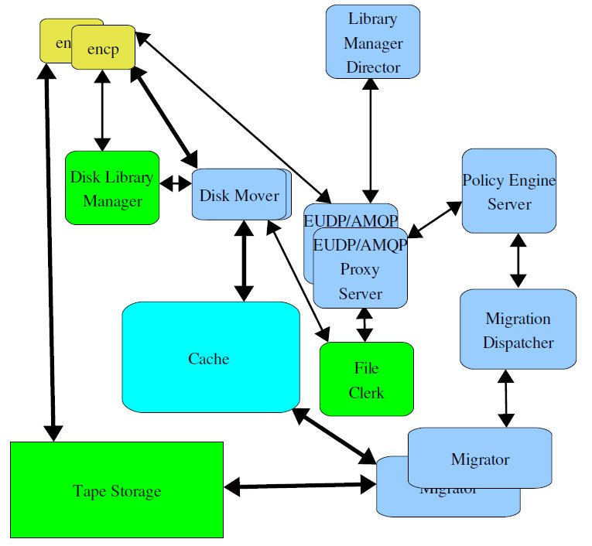
Structure of integrated data caching and tape system using encp and disk movers.

Slide 7
Description of components
Library Manager Director – receives write requests from encp and determines whether to send data to tape directly or to cache for aggregation.
Disk Library Manager – modified enstore library manager configured for disk movers
Disk Movers – modified enstore disk movers
File Clerk – modified file clerk, sends events to Policy Engine Server
EUDP2AMQP proxy server – translates messages from enstore UDP protocol to AMQP and back.

Slide 8
Description of components (cont.)
Policy Engine Server receives event from file clerk specifying that the new file arrived into cache or the file written to tape needs to get staged from it. PE Server has 3 types of file lists:
  Archive – files to be written to tape.
  Stage – files to be staged from tape(s) to cache.
  Purge – files to be purged in cache.
Migration dispatcher – receives file lists from Policy Engine Server and dispatches them to migrators
Migrators aggregate data in cache and write containers to tape. They also stage aggregated data and unpack files for read requests. All files in a container read from tape get unpackaged and cached, even if not requested.

Slide 9
New enstore servers
New enstore servers are
  Udp2amqp proxy server
  LM director
  Dispatcher (Policy Engine Server & Migration Dispatcher)
  Migrator
Currently all servers are implemented in python, later some of them, requiring use of Policy engine will be implemented in Java (LM director, Dispatcher).

Slide 10
Writing files.
encp
EUDP/AMQP
Proxy
Server
Library
Manager
Director
1
2
4
3
7
5
10
File
Clerk
Disk Library
Manager
9
11
6
Policy Engine
Server &
Migration
Dispatcher
Cache
Disk Mover
8
13
12
13
13
Tape Storage
Migrator
14
encp

Slide 11
Reading files.
encp
Disk Library
Manager
File
Clerk
1
2
10
3
5
4
Policy Engine
Server &
Migration
Dispatcher
Cache
Disk Mover
9
8
6
8
8
Tape Storage
Migrator
7
encp

Slide 12
Installation
New rpm “enstore_cache....rpm” to not iterfere with installed enstore rpm
enstore_cache rpm
  installs code into /opt/enstore_cache
  Modifies /etc/sudoers to run migartors
  Creates /etc/init.d/qpid_broker to automatically start qpid_broker

Slide 13
New configuration entries
AMQP broker (not enstore server):
configdict['amqp_broker'] = {
'host':enstore_qpid_broker_host,
'port':5672,
}

Slide 14
New configuration entries (cont.)
Udp2amqp proxy server (multiple):
configdict['lmd.udp_proxy_server'] = { # udp to amq proxy server
'norestart':'INQ',
'host': 'dmsen02.fnal.gov',
'port': 5601,
'udp_port' : 7710, # udp messages come through this port
'target_addr':'udp_relay_test', # amqp queue name
}

Slide 15
New configuration entries (cont.)
Library Manager Director (unique):
configdict['lm_director'] = {
'norestart':'INQ',
'host': 'dmsen02.fnal.gov',
'port': 5602,
'udp_port' :5602,
'logname':'LMDSRV',
'queue_in': 'udp_relay_test',
'udp_proxy_server': 'lmd.udp_proxy_server',
'policy_file': "/home/enstore/policy_files/lmd_policy.py"
}

Slide 16
New configuration entries (cont.)
Dispatcher (unique):
configdict['dispatcher'] = {
'host': 'dmsen02.fnal.gov',
'port': 5603,
'logname':'DISP',
'queue_work': 'policy_engine', # input queue name for events (from file clerk)
'queue_reply': 'file_clerk',
'migrator_work': 'migrator', # common migrators input queue name
'migrator_reply': 'migrator_reply', # common migrators reply queue name
'policy_file': "/home/enstore/policy_files/lmd_policy.py",
'max_time_in_cache': 600, # consider to purge files in cache if longer than this time
'purge_watermarks':(.8, .4), # start purging if occupied > .8, stop if .4
}

Slide 17
New configuration entries (cont.)
Migrator (multiple):
cconfigdict['M1.migrator'] = {
'host':'dmsen02.fnal.gov',
'port': 5610,
'logmname': "M1MG",
'data_area': write_cache_area, # put written files here
'archive_area': archive_area, # use this area for archiving written files
'stage_area': stage_area, # use this area to keep staged from tape files
'tmp_stage_area': tmp_stage_area, # tepmorary area for staging files from tape
'norestart':'INQ',
'migration_dispatcher':'dispatcher' # my migration dispatcher
}

Slide 18
Enstore commands for new servers
Udp2amqp proxy server:
[enstore@dmsen02 test_dir]$ enstore udp
Usage:
udp [ -ha --alive --help --retries= --timeout= --usage ] udp_proxy_server
-a, --alive prints message if the server is up or down.
-h, --help prints this message
--retries <ALIVE_RETRIES> number of attempts to resend alive requests
--timeout <SECONDS> number of seconds to wait for alive response
--usage prints short help message

Slide 19
Enstore commands for new servers (cont.)
Library Manager Director:
[enstore@dmsen02 test_dir]$ enstore lmd
Usage: lmd [OPTIONS]...
-a, --alive prints message if the server is up or down.
--do-alarm <DO_ALARM> turns on more alarms
(snip ...)
--load load a new policy file
--retries <ALIVE_RETRIES> number of attempts to resend alive requests
--show print the current policy in python format
--timeout <SECONDS> number of seconds to wait for alive response
--usage prints short help message

Slide 20
Enstore commands for new servers (cont.)
Dispatcher:
[enstore@dmsen02 test_dir]$ enstore disp
Usage: disp [OPTIONS]...
-a, --alive prints message if the server is up or down.
--do-alarm <DO_ALARM> turns on more alarms
(snip ...)
--get-queue print content of pools
--load load a new policy file
--retries <ALIVE_RETRIES> number of attempts to resend alive requests
--show print the current policy in python format
(snip ..)

Slide 21
Enstore commands for new servers (cont.)
Dispatcher get-queue command:
[enstore@dmsen02 test_dir]$ enstore disp --get-q
{'cache_missed': {},
'cache_purge': {},
'cache_written': {},
'migrartion_pool': {}}

Slide 22
Enstore commands for new servers (cont.)
Migrator
[[enstore@dmsen02 test_dir]$ enstore mig
Usage:
mig [ -ha --alive --help --retries= --timeout= --usage ] migrator
-a, --alive prints message if the server is up or down.
-h, --help prints this message
--retries <ALIVE_RETRIES> number of attempts to resend alive requests
--timeout <SECONDS> number of seconds to wait for alive response
--usage prints short help message

Slide 23
File clerk command line options
--list – shows files inside of package, location cookies for all files in the package are the same
--package --list -- shows all non-packaged files and package files on a tape
--pkginfo --list -- for packaged files show additional information
--replay – re-send all events in files_in_transiton table

Slide 24
Encp option
--enable-redirection – for write requests communicate with Library Manager Director for the “correct” Library Manager based om the policy for a given (from pnfs tag) Library Manager

Slide 25
Monitoring
Enstore alarms
Enstore web pages
  http://dmsen02.fnal.gov/enstore/enstore_saag.html
  http://dmsen02.fnal.gov/enstore/status_enstore_system.html
Web based qpid broker monitor.
Monitoring and audition scripts under development.

