Slide 1
CD central data storage and movement

Slide 2
Facilities
Central Mass Store
Enstore
Network connectivity

Slide 3
Central Mass Store
Disk cache
Tape library
Server Software
Network
Client Software
FNALU integration
Exabyte Import and Export
Policies

Slide 4
Hardware
IBM 3494 Library
8 IBM 3590 tape drives
1 TB of staging disk internal to system
Three IBM TBD mover node
FDDI network, 10 MB/sec to outside world
Servers

Slide 5
A cache
Conceptually a cache, not a primary data repository.
Implemented as a hierarchical store, with tape at the lowest level.
The data are subject to loss should the tape fail.
Quotas are refunded as tapes are squeezed.
For “large files”

Slide 6
Allocation
The CD Division office gives an allocation in terms of 10 GB volumes
Experiments are to use system

Slide 7
Interface

Slide 8
Enstore

Slide 9
Service Envisioned
Primary data store for experiments large data sets.
Stage files to/from tape via LAN
High fault tolerance - ensemble reliability of a large tape drive plant, availability sufficient for DAQ.
Allow for automated tape libraries and manual tapes.
Put names of files in distributed catalog (name space).
CD will operate all the tape equipment
Do not hide too much that it is really tape.
Easy administration and monitoring.
Work with commodity and “data center” tape drives.

Slide 10
Hardware for Early Use
1 each - STK 9310 “powderhorn” silo
5 each - STK 9840 “eagle” tape drives
  10 MB/second
  used at BaBar, Cern, Rhic
1500 - STK 9840 tape cartridges
  20 GB/ cartridge
LINUX Server and Mover computers
FNAL standard network

Slide 11
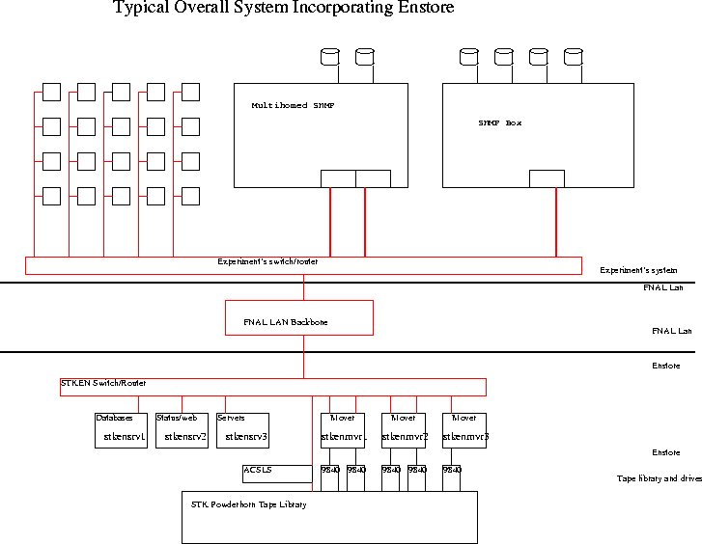

Slide 12
Service for First Users
Software in production (4 TB) for D0 Run II AML/2 tape library: 8MM, DLT drives.
STK system:
  Only working days, working hours.
  Small data volumes ~1 TB for trial use.
  Willing to upgrade lan, network interfaces.
  Willing to point out bugs and problems.
  New hardware => small chance of data loss.

Slide 13
Vision of ease of use
Experiment can access tape as easily as a native file system.
Namespace viewable with UNIX commands
Transfer mechanism is similar to the unix cp command
Syntax: encp infile outfile
encp myfile.dat /pnfs/theory/project1/myfile.dat
encp * /pnfs/theory/project1/
encp /pnfs/theory/project1/myfile.dat myfile.dat

Slide 14
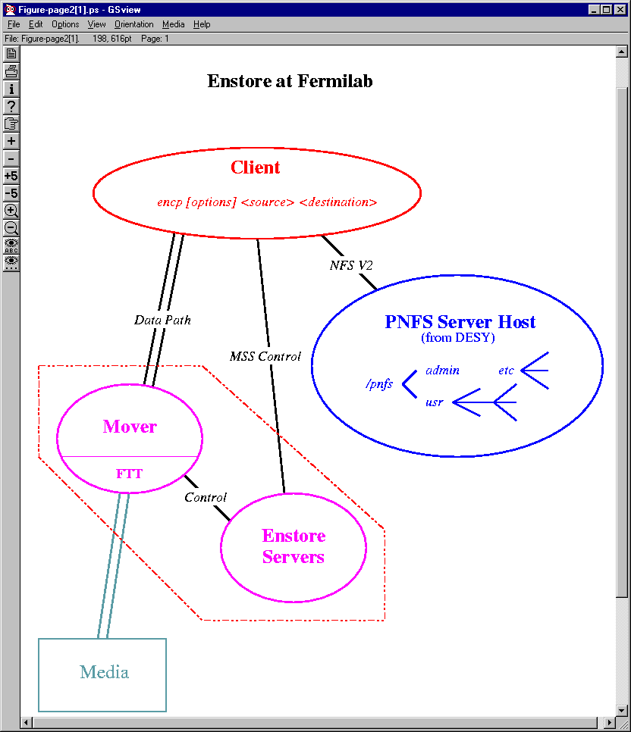
Basic Structure
“PNFS” to name tape files using UNIX like paths, served with NFS 2 transport
Servers to schedule, configure, manage.
Movers to bridge between network and tape drives

Slide 15
Software for Experiments (Clients)
Use the Unix Mount command to view the PNFS namespace.
Obtain the “encp” product from kits
  “encp command”
  miscellaneous “enstore <command>”
    enstore file --restore
    enstore volume [--add | --delete | --restore]
    enstore library [--delete_work --get_queue -priority]

Slide 16
Volume Principles
Do Support clustering related files on the same tapes.
  Enstore provides grouping primitives.
Do not assume we can buy a tape robot slot for every tape.
  Enstore provides quota in tapes and quotas in “slots”
  Experiment may have more tapes than slots
Allow users to generate tapes outside our system
  Enstore provides tools to do this.
Allow tapes to leave our system and be readable with simple tools
  Enstore can make tapes dumpable with cpio

Slide 17
Grouping on tapes
Grouping by Category
  “File families” Only files of the same family are on the same tape.
  A family is just an ascii name
  names are administered by the experiment.
Grouping by time
  Enstore closes volume for write when the next file does not fit.
Constrained parallelism
  “width” associated with a “file family” limits the number of volumes open for writing, concentrates files on fewer volumes.
  Allows bandwidth into a file family to exceed the bandwidth of a tape drive.

Slide 18
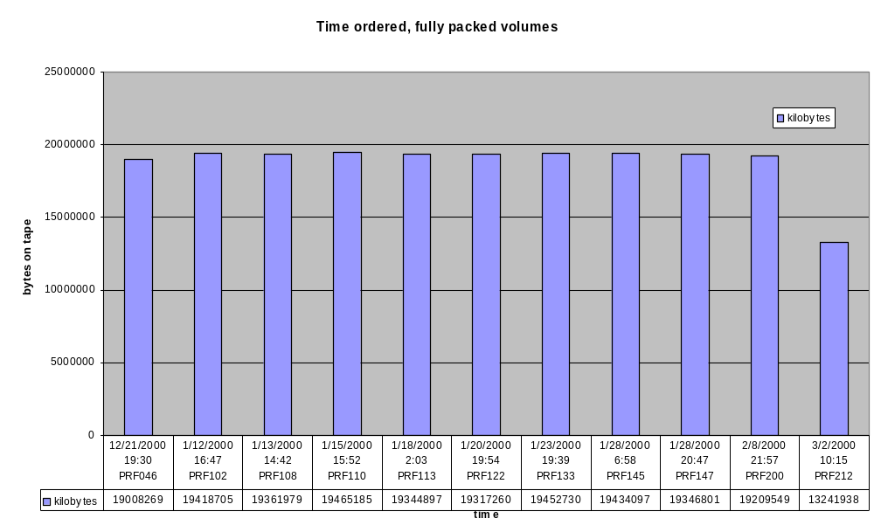
File family, width=1 over time

Slide 19
Tape Details
In production, implementation details are hidden.
Files do not stripe or span volumes.
Implementation details:
  Tapes have ANSI VOL1 headers.
  Tapes are file structured as CPIO archives.
    one file to an archive, one filemark per archive.
You can remove tapes from Enstore and just read them with GNU CPIO (gives a 4GB limit right now).
ANSI tapes planned, promised for D0.

Slide 20
Enstore “Libraries”
A set of tapes which are uniform with respect to
  media characteristics
  low level treatment by the drive
One mechanism to mount/unmount tapes
An Enstore system can consist of many “Libraries’ : D0 (ait, mam-1, dlt. Mam-2. Ait-2)
An Enstore system may have diverse robots (STKEN has STK 9310, and ADIC AML/J)

Slide 21
Namespace: functions
Provide a tree to name files as you wish.
Provide a tree named as “volume map”
  /pnfs/<mountpoint>/<ffname>/<volume>/<P-_B_fm>
Provide information on how new files should be created, which the experiment can administer.
Provide additional information about each file.

Slide 22
Namespace:UNIX features
Implemented using PNFS from DESY. NFS v2 “Transport”
“Almost all” UNIX Utilities work, ls, find
Standard utility reads/writes fail by design
Many files in a directory is a poor choice “by design”
$ pwd
/pnfs/sam/mammoth/mcc99_2/in2p3
[$ du -sk
267171544 .
$ ls -al sim.pmc02_in2p3.pythia.qcd_pt20.0_skip5800_mb1.1av_200evts.299_1138
-rw-r--r-- 1 sam root 250184748 Nov 30 17:25 sim.pmc02_in2p3.pythia.qcd_pt20.0_skip5800_mb1.1av_200evts.299_1138
rm sim.pmc02_in2p3. pythia.qcd_pt20.0_skip5800_mb1.1av_200evts.299_1138
rm: sim.pmc02_in2p3 .pythia.qcd_pt20.0_skip5800_mb1.1av_200evts.299_1138: Permission denied
$ cat sim.pmc02_in2p3.pythia.qcd_pt20.0skip5800_mb1.1av_200evts.299_1138 > /dev/null
cat: sim.pmc02_in2p3.pythia.qcd_pt20.0_skip5800_mb1.1av_200evts.299_1138: Input/output error

Slide 23
Namespace:defaults for new files
Metadata “tags” are associated with directories
Accessed by the “enstore pnfs” command.
Inherited on “mkdir”.
Initial tag on initial directory given by ISD dept
Administered by the experiment
[petravic@d0enmvr17a in2p3]$ enstore pnfs --tags .
.(tag)(library) = sammam
.(tag)(file_family) = in2p3
.(tag)(file_family_width) = 1
.(tag)(file_family_wrapper) = cpio_odc

Slide 24
Namespace: File Metadata
Describes an existing file
Accessed by the “enstore pnfs” command
Set by encp when the file is created
$ enstore pnfs --info sim.pmc02_in2p3.pythia.qcd_pt20.0_10000evts_skip5800_mb1.1av_200evts.299_1138
bfid="94400431100000L";
volume="PRF020";
location_cookie="0000_000005442_0000004";
size="250184748L";
file_family="in2p3";
map_file="/pnfs/sam/mammoth/volmap/in2p3/PRF020/0000_000005442_0000004";

Slide 25
Some encp command options
--crc : data integrity
--data_access_layer : structured error msgs
--ephemeral : make a tape for export
--file_family : override default ff
--priority : get first claim on resources
--del_pri : get a greater claim if waiting
--verbose : be chatty

Slide 26
Removing Files
Files may be removed using “rm”.
User can scratch tape when all files on it are rm’ed. [enstore volume --delete]
User can use a recovery utility to restore files up until the time the volume is scratched. [enstore file --restore]
Files are recovered to pathname they were created with.

Slide 27
Sharing the Central Enstore System
We make mount point(s) for your experiment
  Host-based authentication on the server side for mounts.
  Your meta data is in its own database files.
  Under the mount point, UNIX file permission apply.
  Make your uids/gid’s uniform! (FNAL uniform UID/GIDS).
  file permissions apply to the tag files as well.
“Fair Share” envisioned, for tape drive resources.
  Control over experiment resources by the experiment
Priorities implemented for Data Acquisition.
  Quick use of resources for the most urgent need

Slide 28
System Integration
Hardware/system:
  Consideration of upstream network.
  Consideration of your NIC cards.
  Good scheduling of the staging program.
  Good throughput to your file systems.
Software configuration
  Software built for FUE platforms
    Linux, IRIX, SunOS, OSF1

Slide 29
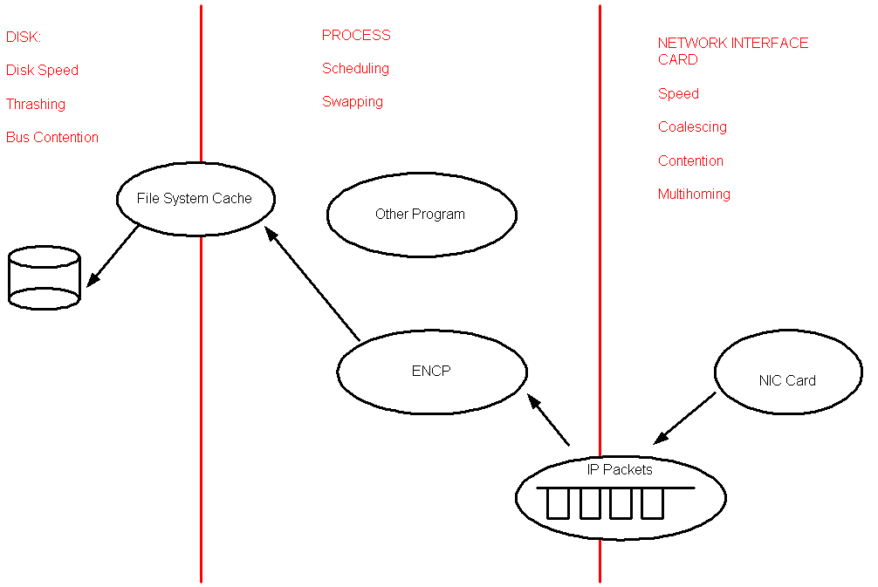
Elements of Good Throughput

Slide 30
http://stkensrv2.fnal.gov/enstore/
Source of interesting monitoring info
Most updates are batched.
Can see
  recent transfers
  the system is up or down
  what transfers are queued
  more

Slide 31
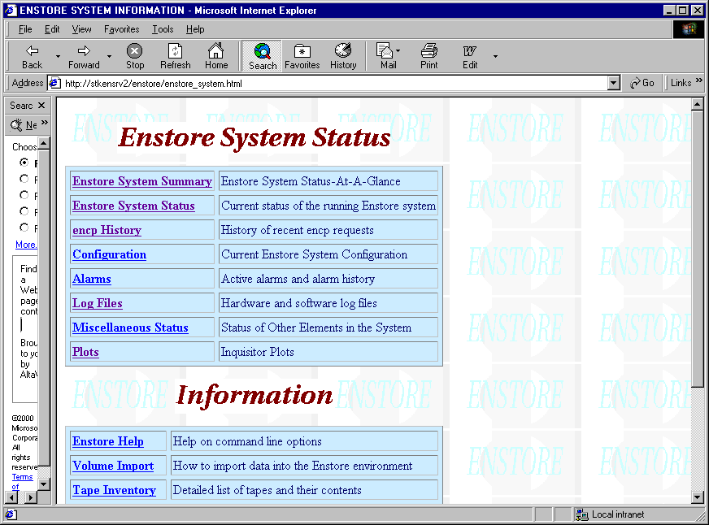
http://stkensrv2/enstore/

Slide 32
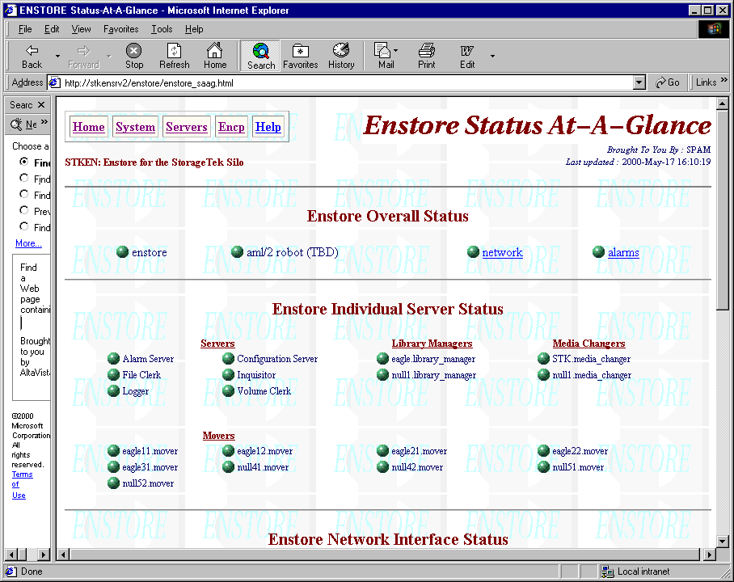
System Status: Green == Good

Slide 33
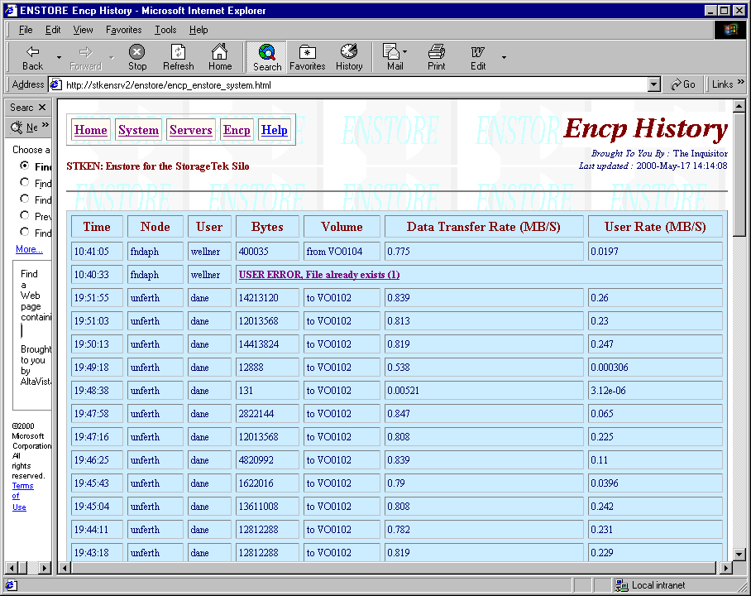
History of Recent Transfers

Slide 34
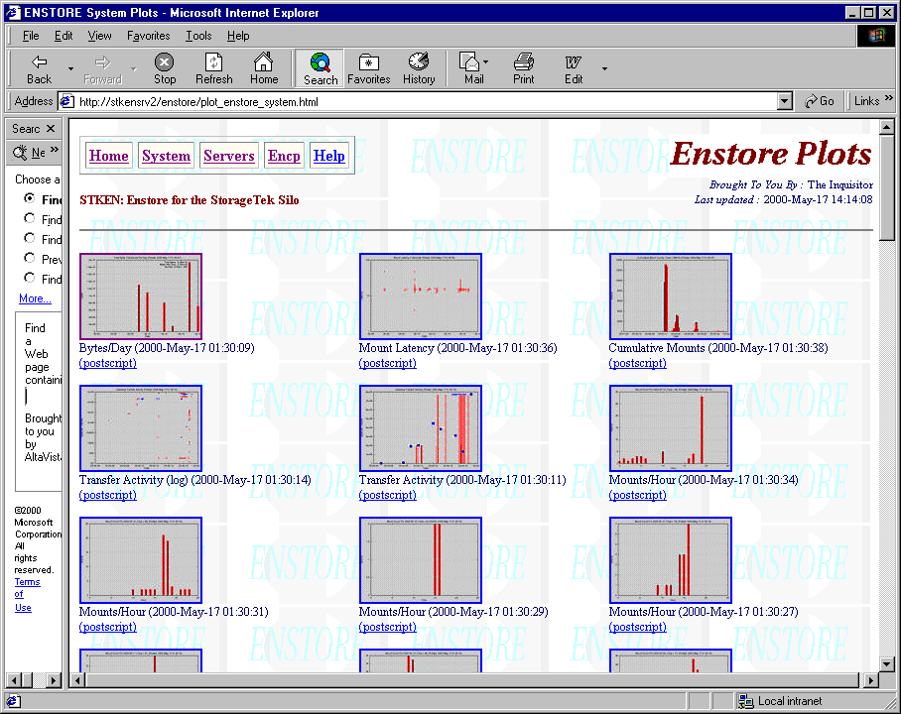
Status Plots

Slide 35
Checklist to use Enstore
Be authorized by the computing division.
Identify performant disks and computers.
  Use “bonnie” and “streams”
Provide suitable network connectivity.
  Use “enstore monitor” to measure.
Plan use of namespace, file families.
Regularize UIDs and GIDs if required.
Mount the namespace.
Use encp to access your files.

