Slide 1
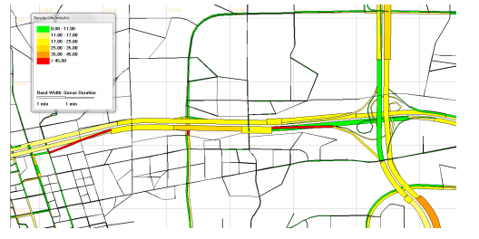
Open-sourece STALite/NeXTA library based on GMNS
Dr. Xuesong (Simon) Zhou
xzhou74@asu.edu
Arizona State University
May 4th, 2020

Slide 2
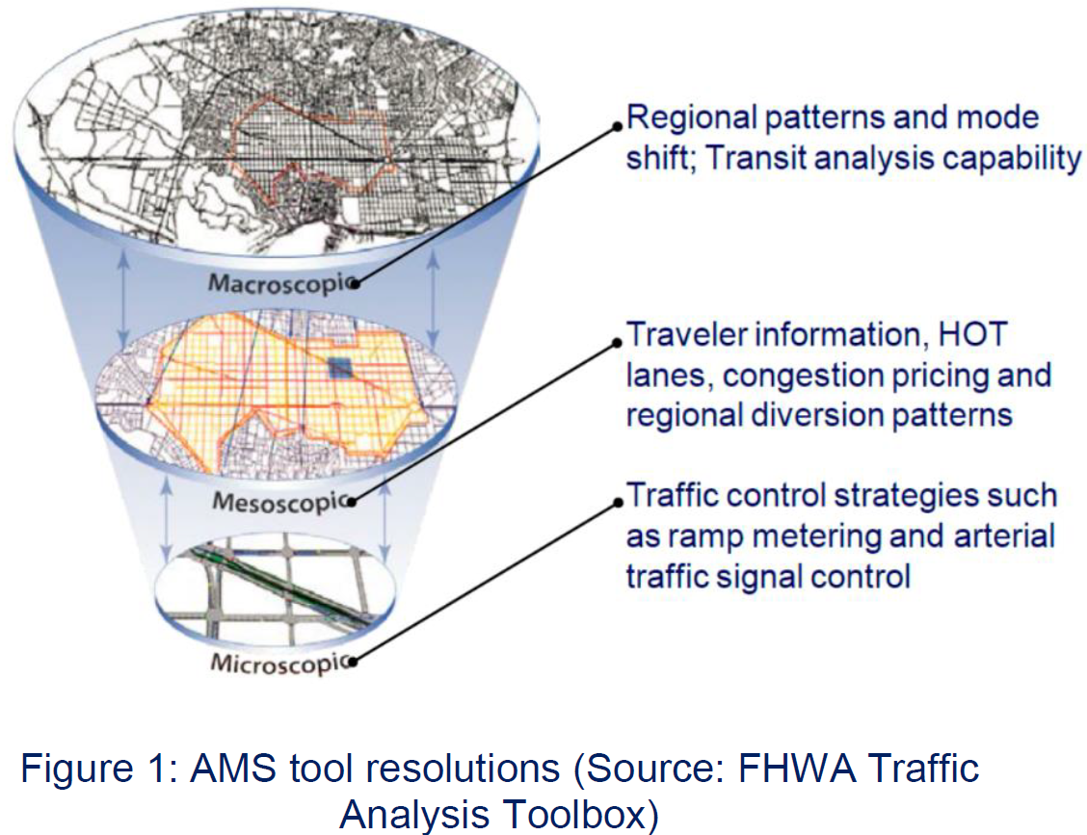
1.Quick introduction of STAlite
Macroscopic assignment: --STAlite (Semi-dynamic assignment)
Mesoscopic assignment: --DTAlite (Dynamic assignment)
Microscopic assignment: --CAlite (Cellular Automatonassignment )

Slide 3
Quick introduction of STAlite
Macroscopic assignment: --STAlite (Semi-dynamic assignment)
Mesoscopic assignment: --DTAlite (Dynamic assignment)
Microscopic assignment: --CAlite (Cellular Automatonassignment )

Slide 4
Quick introduction of STAlite
Welcome to STAlite (Light-weight computational engine of Static Traffic Assignment and Semi-dynamic assignment)
STAlite is an open-source AMS library for efficiently macroscopic traffic assignment
based on General Modeling Network Specification (GMNS) format
Network representation based on GMNS format
Easy to include demand from different multiple time periods( AM, MD, PM, NT or Hourly)
Provide API for both C++ and Python interface
Efficiently multi-threading parallel computation and memory management, implemented in C++
Utilize up to 40 CPU cores, 200 GB of Memory for networks with more than 50K nodes
5. Extendable Volume Delay Function (VDF) functions：
Standard BPR function
BPR_X function that can obtain dynamic travel time efficiently

Slide 5
2. Network representation based on the General Modeling Network Specification (GMNS)

Slide 6
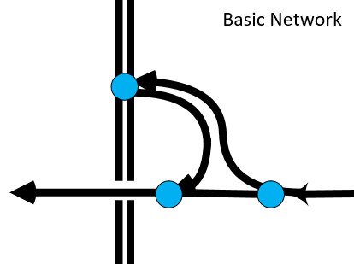
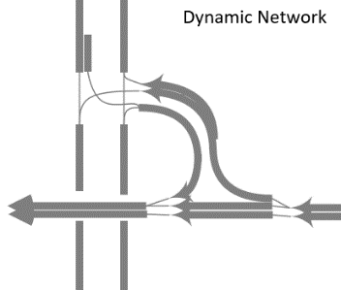
Network representation based on GMNS github.com/zephyr-data-specs/GMNS
The objective of the General Modeling Network Specification (GMNS) is to provide a common human and machine-readable format for sharing routable road network files
It is designed to be used in multi-resolution and multi-modal static and dynamic transportation planning and operations models
It will facilitate the sharing of tools and data sources by modelers
The project is overseen by a project management group, with MPO, city, industry, academic and US DOT participation. In 2019, with support from the Federal Highway Administration, the team developed requirements and an initial release of the specification

Slide 7
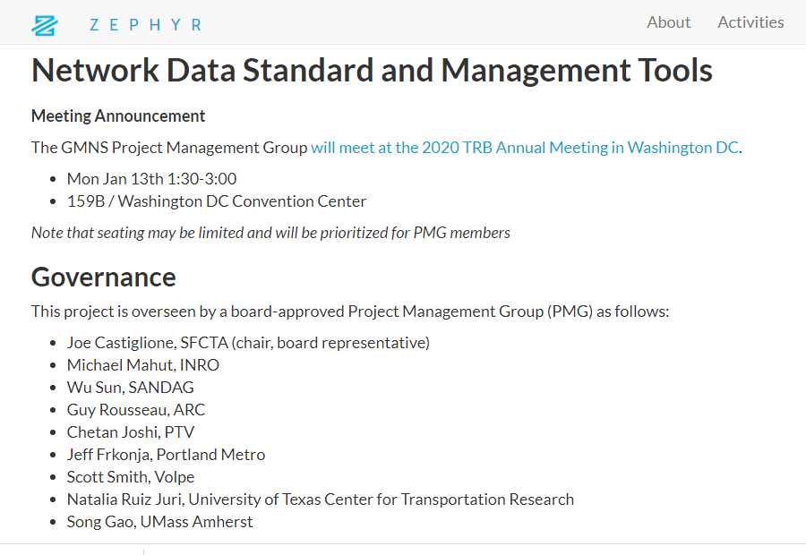
Network representation based on GMNS github.com/zephyr-data-specs/GMNS

Slide 8
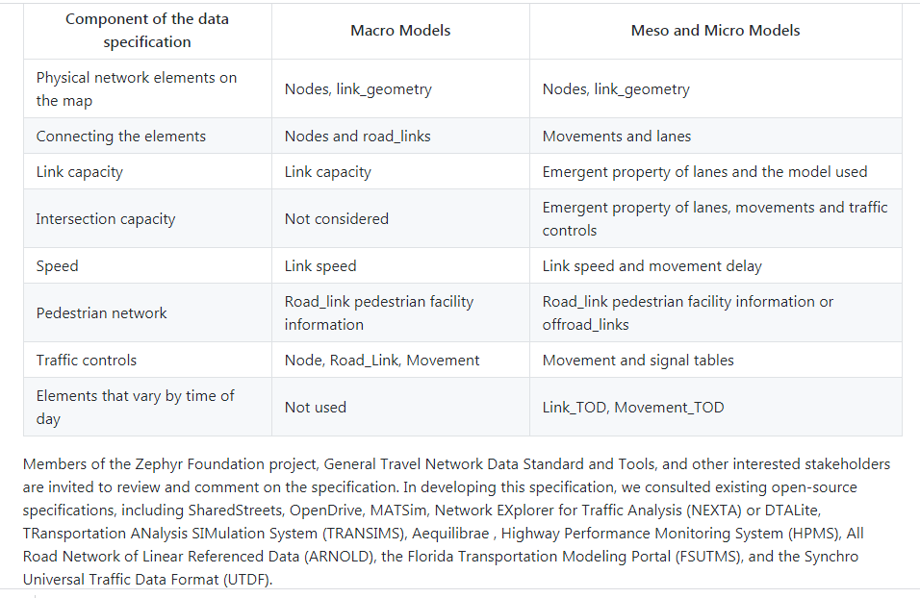
Network representation based on GMNS github.com/zephyr-data-specs/GMNS

Slide 9

3. Open-source Nexta AMS data hub for GMNS format

Slide 10
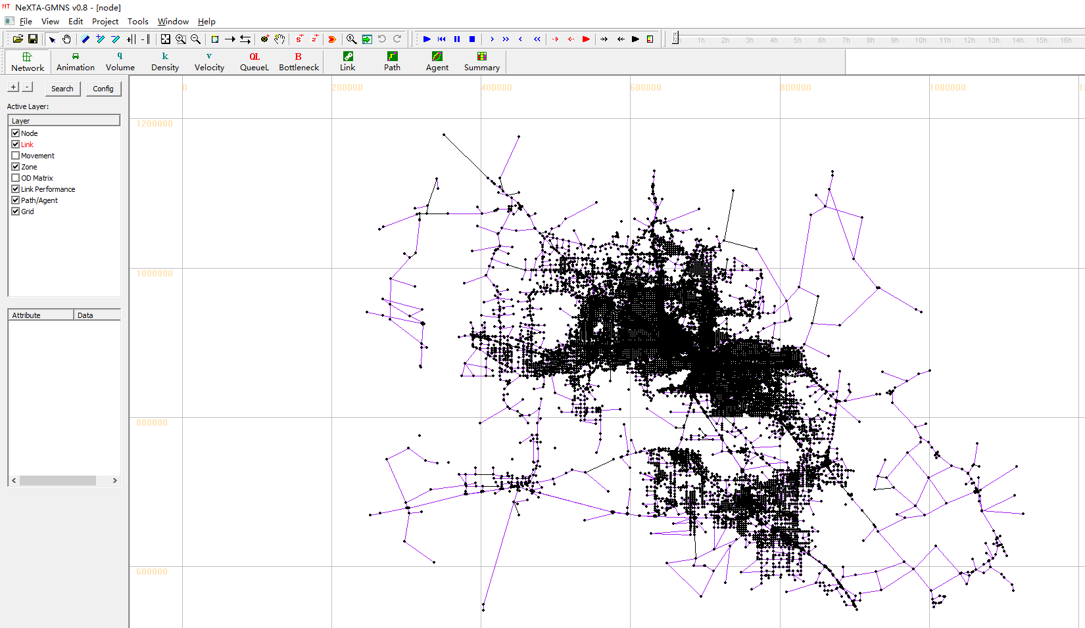
Open-source Nexta AMS data hub for GMNS format

Slide 11
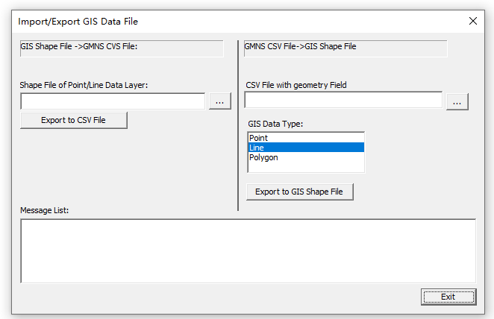
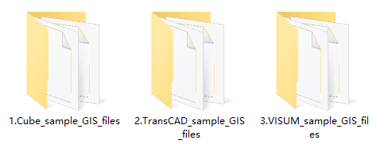
Open-source Nexta AMS data hub for GMNS format
A. Convert GIS Shape File to GMNS CVS files
Shape files 2 GMNS CVS files
Cube GIS files
TransCAD GIS files
VISUM GIS files

Slide 12
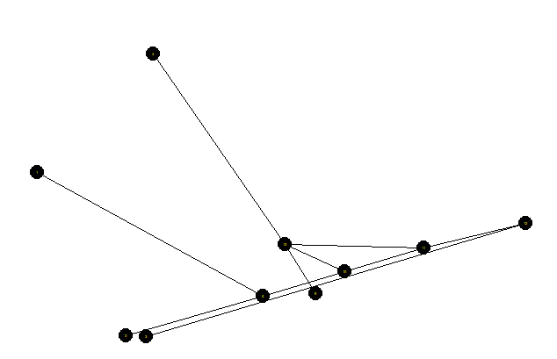
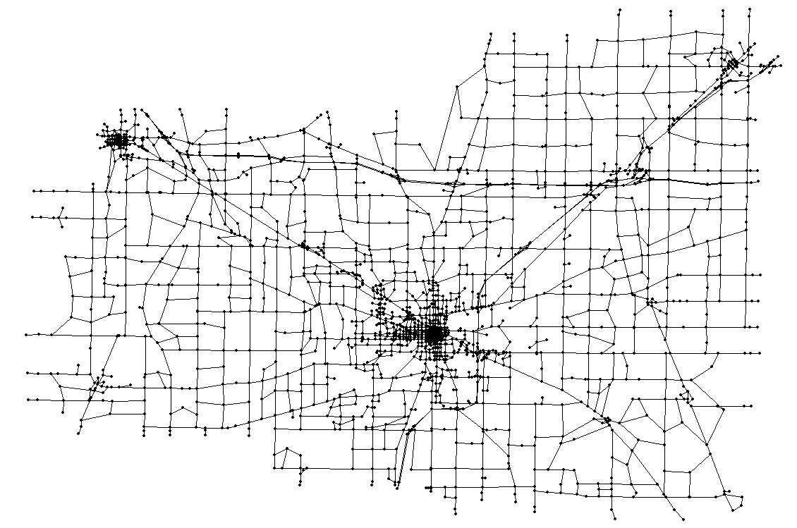
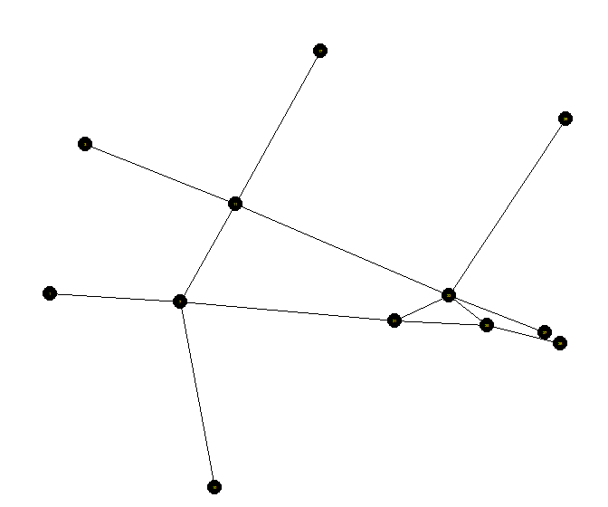
Open-source Nexta AMS data hub for GMNS format
B. Display Macroscopic Network
Freeway Interchange
Macro-network of Lima
Bicycle multiple facilities
Three working examples in Github https://github.com/zephyr-data-specs/GMNS/

Slide 13
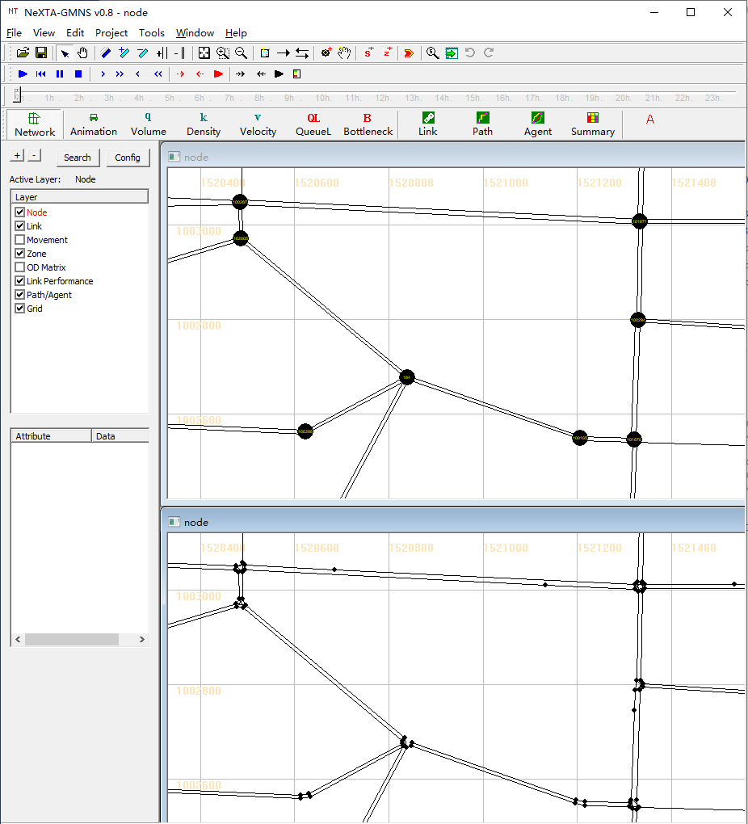
Open-source Nexta AMS data hub for GMNS format
C. Convert Macroscopic network to mesoscopic network
Tile horizontally
Network generation procedure:
Step 1: Obtain the exact geometry string for each link by performing lane-based offset with respect to the original geometry coordinate.
Step 2: Split links into segments based on provided segment data so that the number of lanes on each segment keeps the same
Step 3: Generate mesoscopic links for each segment
Step 4: Create a connector (mesolink) to connect corresponding inbound mesolink and outbound mesolink for each movement at intersections
Step 5: Build microscopic network by discretizing each mesolink into cells with constant length, where two consecutive cells are connected by a micronode.
Step 6: Output networks
Macro-Net
Meso-Net

Slide 14
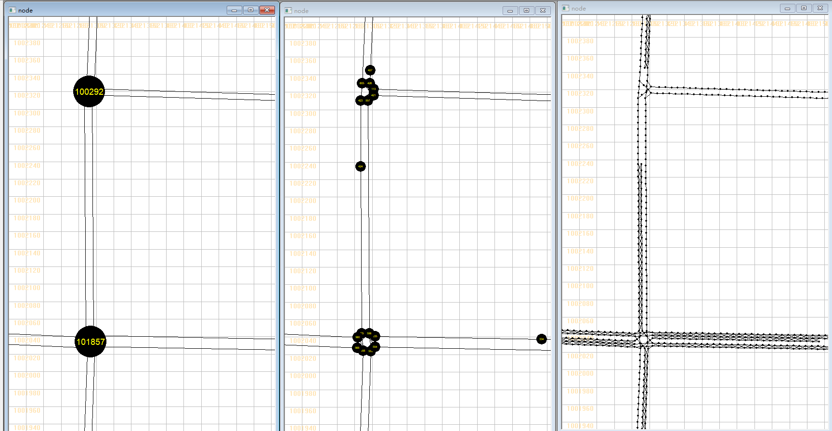
Open-source Nexta AMS data hub for GMNS format
D. Macroscopic network → Mesoscopic network →Microscopic network
Macroscopic Network
Mesoscopic Network
Microscopic Network
Microscopic network: cell-based network (5 meters or 15 feet per cell)

Slide 15
4. Source codes of STAlite

Slide 16
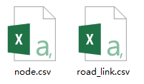
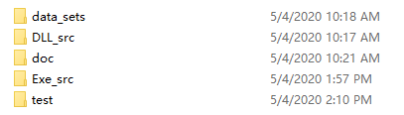
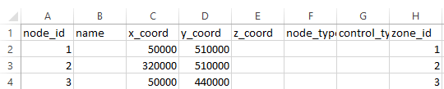
Dataset
STAlite foleder include: data_sets, DLL_src,
Data_sets is the folder with input data (GMNS format)
Network information
node.csv
road_link.csv

Slide 17
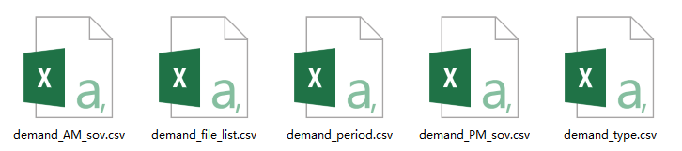


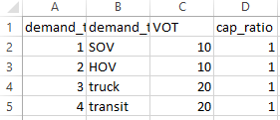
Dataset (cont'd )
Data_sets is the folder with input data (GMNS format)
Demand files
Managing demand files for different time periods
How many time periods are considered?
HHMM format

Slide 18



Source code structure
You probably want to choose a programming environment from which to use STAlite. We have two available interfaces to use STAlite:
Execute STAlite using C++ interface
Execute STAlite using Python interface
Python API
Python interface
ctypes.cdll.LoadLibrary (“STAlite.dll”)
DLL_src
read
data_set
C++ interface
# include “main_api.cpp”

Slide 19
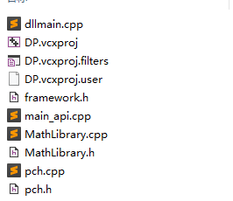
Source code for building STALite DLL as Python API
DLL_src is a dynamic link library folder used for holding various key STAlite functions and procedures for traffic assignments

Slide 20
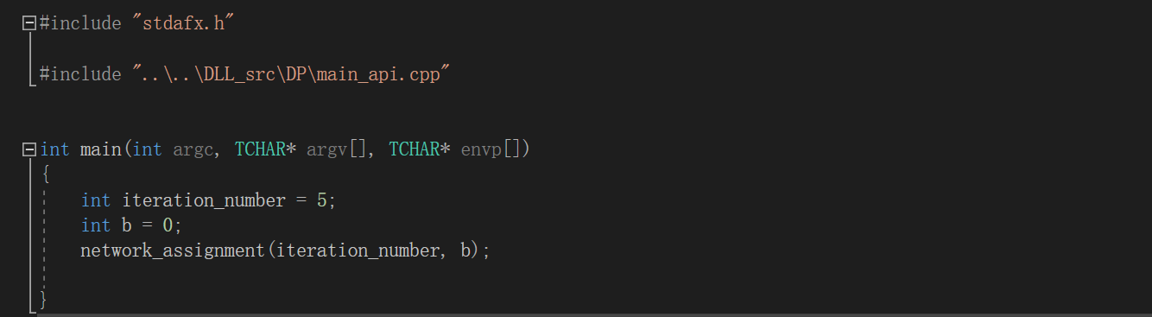
Source code for building STALite Executable
Exe_src includes executable console of C++ to run STAlite
Import Application Programming Interface (API) from DLL_src folder
Set parameters for network assignment function

Slide 21
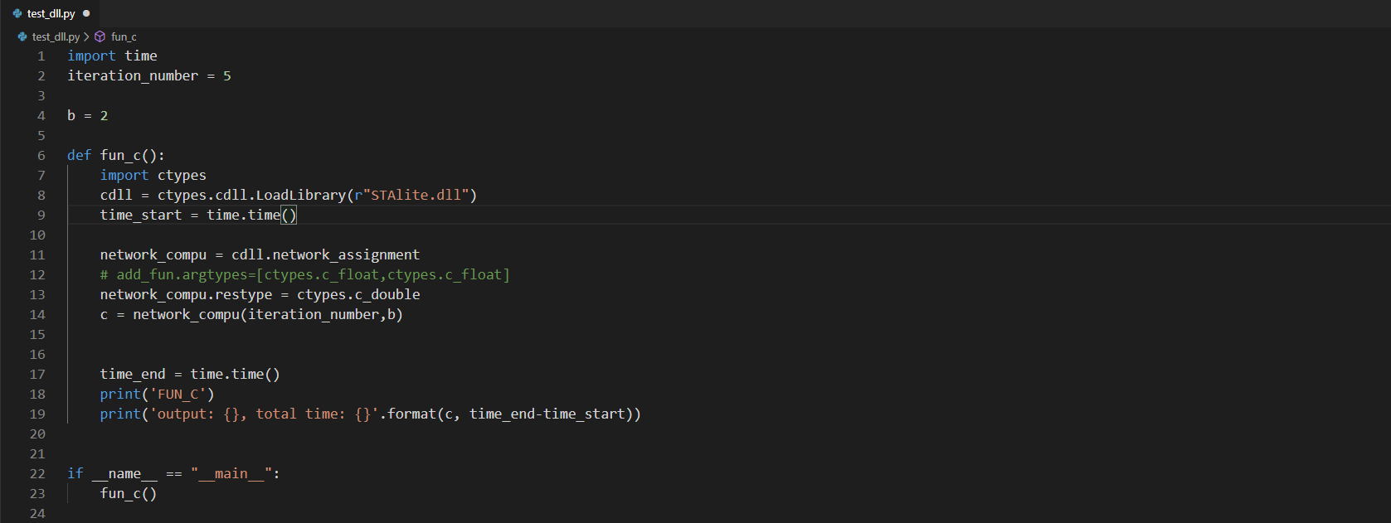
Python API test environment
test includes executable console Python to run STAlite
Import STAlite.dll file
Use network_assignment function
Set parameter of network_assignment function

Slide 22
THANKS

