Slide 1


Slide 2
Index
Technologies used
Database
Features
Team distribution
Lessons learned
Demo / Screencast
Q&A

Slide 3
Technologies used
Responsive design: Bootstrap
OR Mapper: Propel
Libs & autoloading: Composer
Cross plattform js: Jquery
Application logic: PHP
Webserver: Apache | Lighttpd
DBMS: SQLite | MySQL

Slide 4
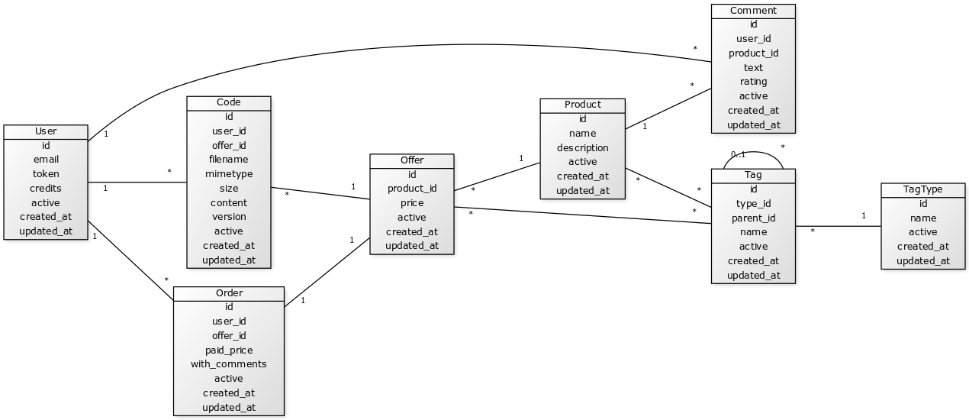
Database
ERD

Slide 5


Database
PDO Database abstraction

Slide 6
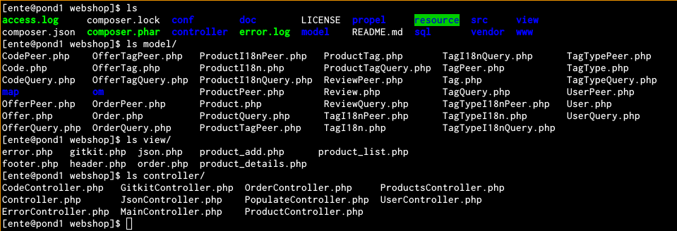
Features
Strict MVC

Slide 7
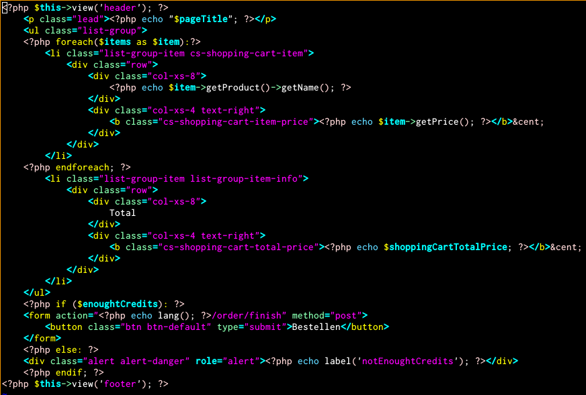
Features
PHP templating

Slide 8
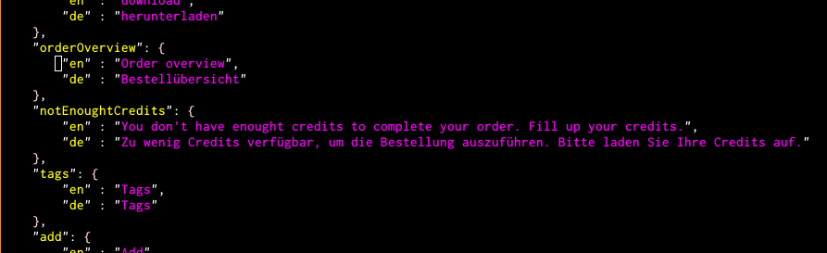
Features
i18n - Labels

Slide 9
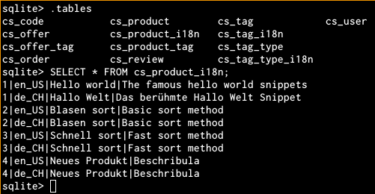
Features
i18n - Database

Slide 10
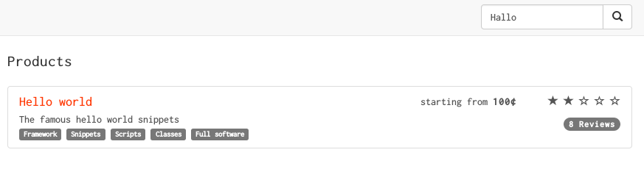
Features
i18n – search

Slide 11
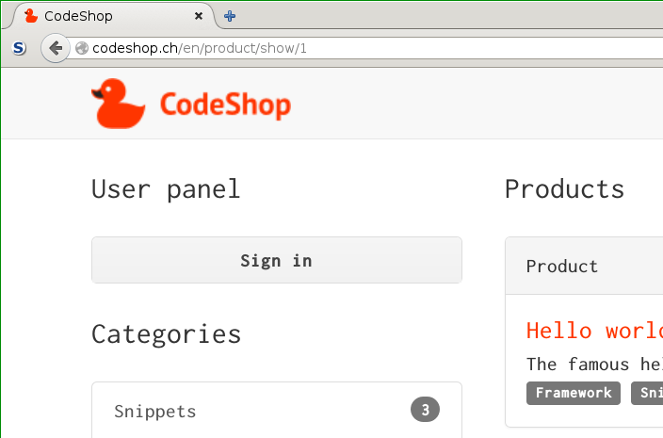
Features
i18n – url

Slide 12
Features
Clean url

Slide 13



Features
Responsive design

Slide 14
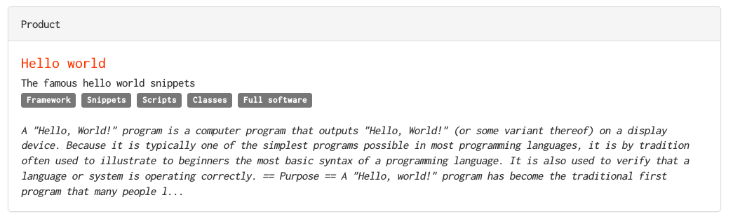
Features
Wikipedia web service consuming

Slide 15
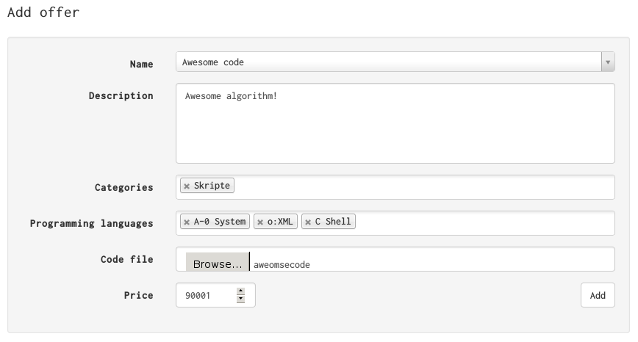
Features
User content – add offers

Slide 16
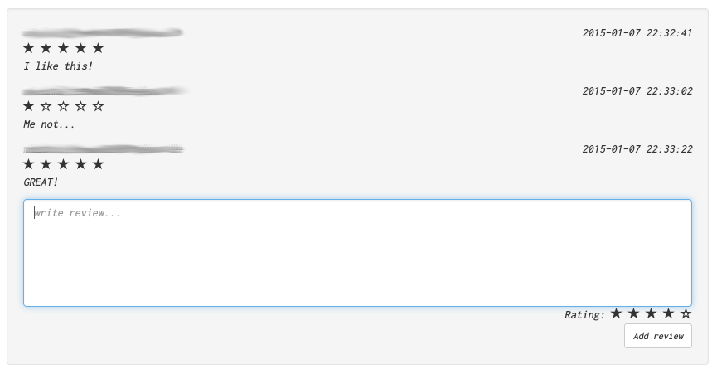
Features
User content – add reviews

Slide 17
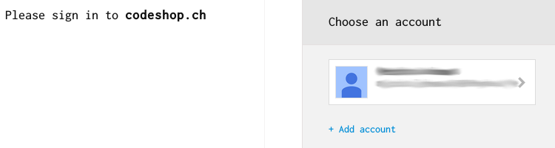
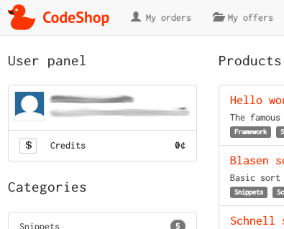
Features
Google login

Slide 18
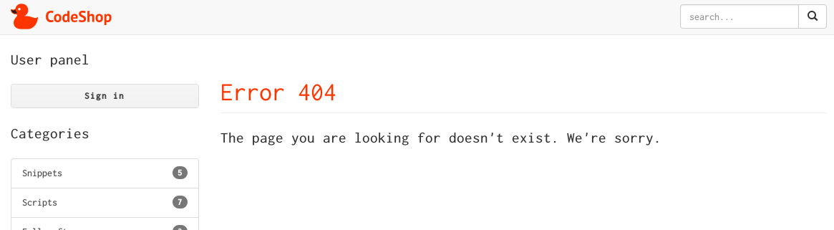
Features
Security - error handling

Slide 19
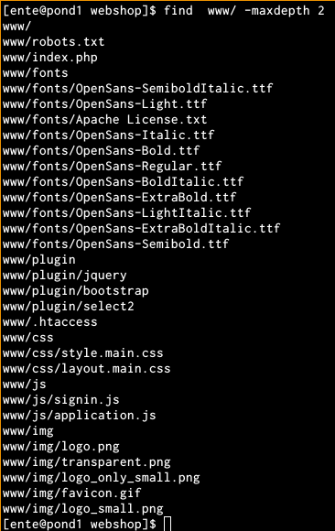
Features
Security - minimal code exposure

Slide 20
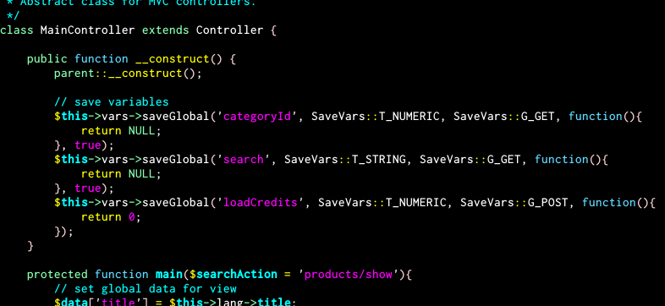
Features
Security - typed superglobals

Slide 21
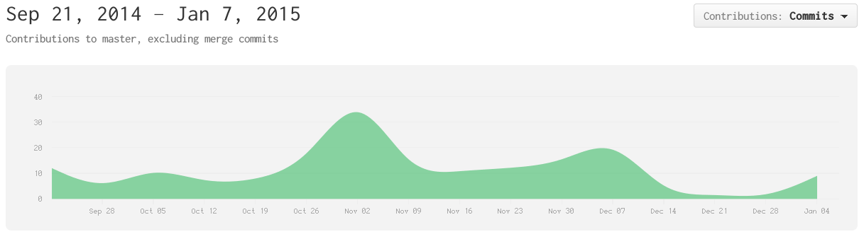
Team distribution
Overall

Slide 22
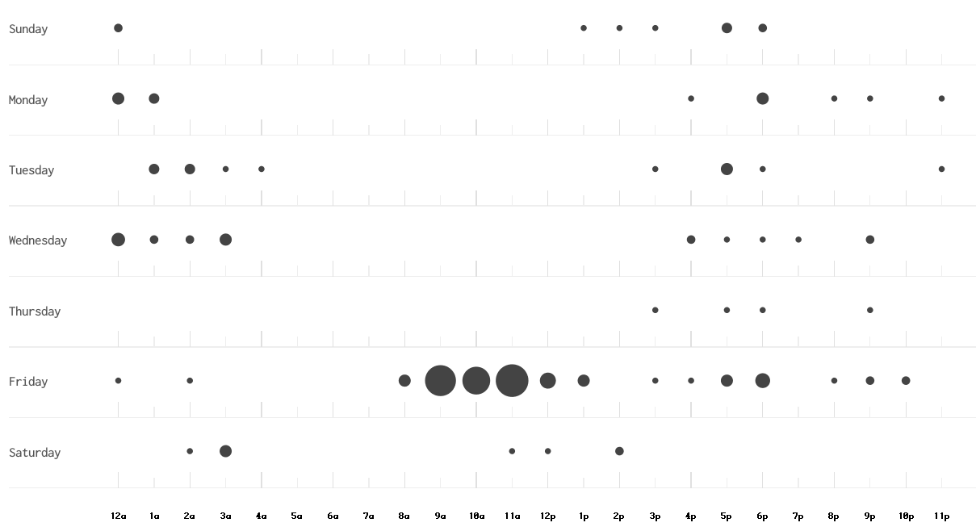
Team distribution
Punch card

Slide 23
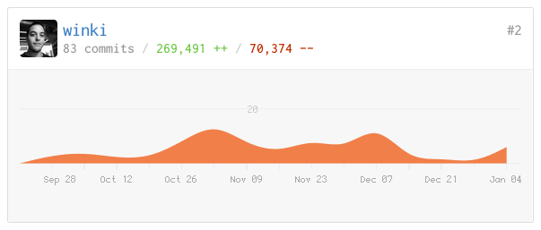
Team distribution
Mathias
MVC
Layout
File upload
i18n

Slide 24
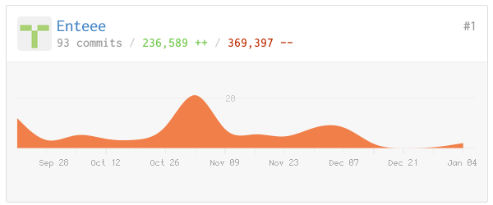
Team distribution
Mischa
Composer
SaveVars
JsonController
Google login

Slide 25
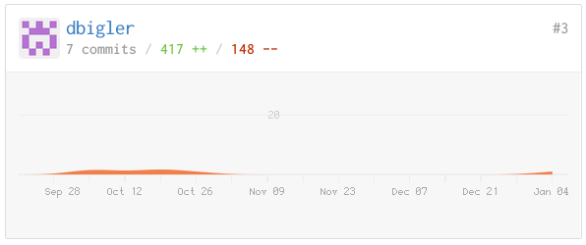
Team distribution
Dominik
Favicon
Installation manual
Testing

Slide 26
Lessons learned
ERD @ the beginning was awesome
Autoloaders are dangerous
Tags made stuff a bit complicated
External login was a good idea
Php templating works quite well
When changing something make sure that other things don’t break -> Unit tests would help
Bootstrap is hilarious!
Php oop fails

Slide 27
Demonstration / Screencast
http://codeshop.ch

Slide 28
Q & A
?

