Slide 1


Slide 2
Unit Testing
Ryan Kotzen
Code Dojo

Slide 3
Software
Prerequisites
Visual Studio 2012+
Nunit
Git
Recommended
Resharper - Latest version compatible with your version of Visual Studio, 30 day trial is fine for now.
Git Extensions

Slide 4
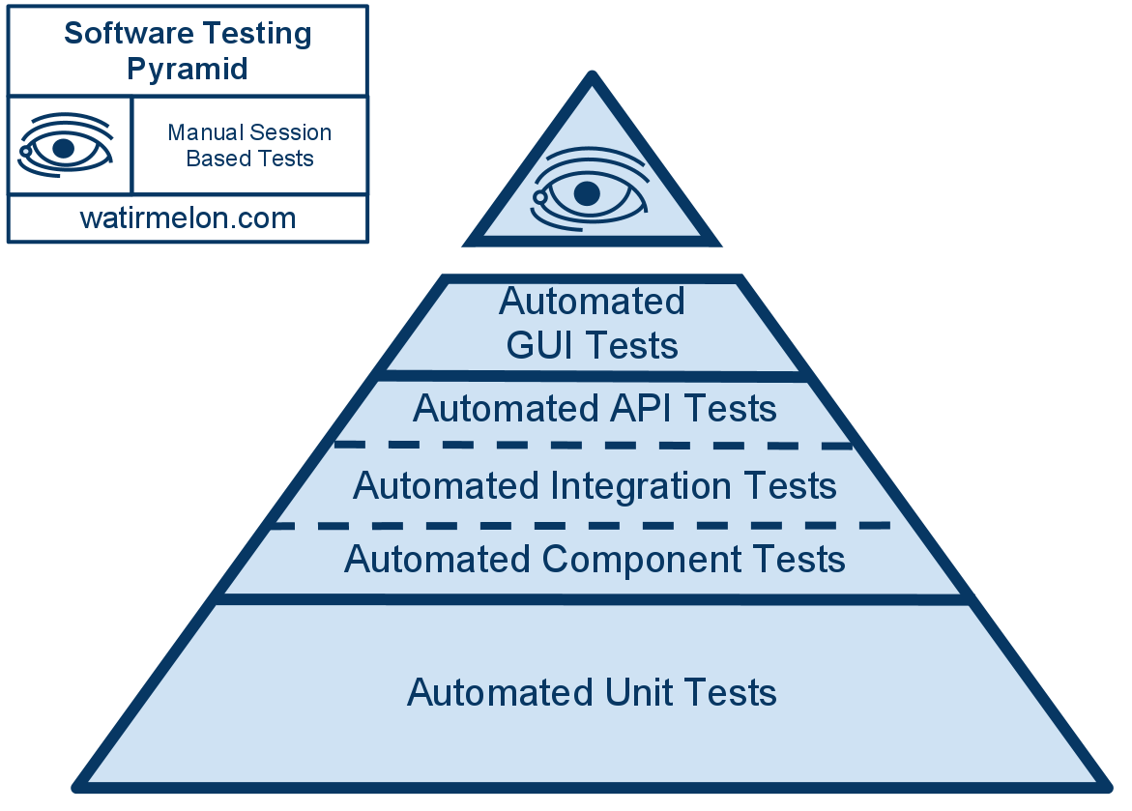
Testing Pyramid

Slide 5
Unit VS Integration Testing
Unit tests test individual software components. They supply mocks or fake versions of dependencies (such as a database) so that the unit test doesn’t rely on any external code and any failures can be pinpointed exactly. Unit testing is central to Test Driven Development – the entire TDD process is driven by unit testing.
Integration tests test your entire software stack working together. These tests don’t mock or fake anything (they use the real database, and real network connections) and are good at spotting if your unit-tested components aren’t working together as you expected. In general, it’s best to put most of your effort into building a solid suite of unit tests, and then adding a few integration tests for each major feature so you can detect any catastrophic incompatibilities or configuration errors before your customers do.
http://blog.stevensanderson.com/2009/06/11/integration-testing-your-aspnet-mvc-application/

Slide 6
Which Test To Use?
Goal | Strongest technique
Finding bugs (things that don’t work as you want them to) | Manual testing (sometimes also automated integration tests)
Detecting regressions (things that used to work but have unexpectedly stopped working) | Automated integration tests (sometimes also manual testing, though time-consuming)
Designing software components robustly | Unit testing (within the TDD process)
(Note: there’s one exception where unit tests do effectively detect bugs. It’s when you’re refactoring, i.e., restructuring a unit’s code but without meaning to change its behaviour. In this case, unit tests can often tell you if the unit’s behaviour has changed.)

Slide 7
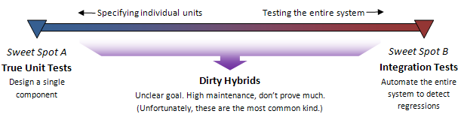
Unit VS Integration Testing

Slide 8
Guidelines
A good test…
Establish initial context; Interact with system; Check the results
Arrange…Act…Assert…
Given…When…Then…
SetContext…BecauseOf…ItShould…
KISS
Easy to implement
Easily runnable, by anyone, anytime
Runs quickly
Make each test orthogonal (i.e., independent) to all the others
- Don’t make unnecessary assertions
- Test only one code unit at a time
- Mock out all external services and state
- Avoid unnecessary preconditions Initialize/setup for itself
Leave environment as it was when it started, cleanup!
Measure code coverage
Write tests to recreate bugs
Test edge cases, and not only positives, negatives as well
Treat tests as production code
Distinguish between different levels/types
Integrate in to SDLC, build & deployment processes, CI etc.
Be careful changing code to fit tests; code must be testable, but don’t change code to accommodate a test for that sole purpose

Slide 9
Right BICEP
Right — Are the results right?
B — Are all the boundary conditions CORRECT?
Conformance — Does the value conform to an expected format?
Ordering — Is the set of values ordered or unordered as appropriate?
Range — Is the value within reasonable minimum and maximum values?
Reference — Does the code reference anything external that isn’t under direct control of the code itself?
Existence — Does the value exist (e.g., is non-null, nonzero, present in a set, etc.)?
Cardinality — Are there exactly enough values?
Time (absolute and relative) — Is everything happening in order? At the right time? In time?
I — Can you check inverse relationships?
Some methods can be checked by applying their logical inverse. For instance, you might check a method that calculates a square root by squaring the result
C — Can you cross-check results using other means?
Perhaps there is an easier, but slower algorithm that you can use to verify your new faster algorithm still gets the correct answer.
E — Can you force error conditions to happen?
P — Are performance characteristics within bounds?

Slide 10
Dummies
Objects passed around but never actually used (used to fill parameter lists), “empty” implementation
public class FooDummy : Foo
{
public String bar() { return null; }
}
public class FooCollectionTest
{
[Test]
public void it_should_maintain_a_count()
{
FooCollection sut = new FooCollection();
sut.Add(new FooDummy());
sut.Add(new FooDummy());
Assert.AreEqual(2, sut.Count());
}
}

Slide 11
Stubs
Implementation of interface, but with canned responses
class FooStub : Foo
{
public String Bar()
{
return "baz";
}
}
public class FooCollectionTest
{
[Test]
public void it_should_return_joined_bars()
{
FooCollection sut = new FooCollection();
sut.Add(new FooStub());
sut.Add(new FooStub());
Assert.AreEqual("bazbaz", sut.Joined());
}
}

Slide 12
Fakes
Actual working implementation, but have some shortcut which means they unsuitable for production
class InMemoryUserRepository : UserRepository
{
private UserCollection users = new UserCollection();
public bool Add(User user)
{
return this.users.Add(user);
}
public bool Delete(User user)
{
return this.Delete(user.GetIdentifier());
}
}

Slide 13
Mocks
Different to others which assert on state, mocks assert on behaviour. Mocks say “I expect you to do xyz”
public class OrderInteractionTester : MockObjectTestCase
{
public void testFillingRemovesInventoryIfInStock()
{
//setup - data
Order order = new Order("TALISKER", 50);
var warehouseMock = new Mock<Warehouse>();
//setup - expectations
warehouseMock.Expects(Once()).Method("hasInventory")
.With(Equal("TALISKER"),Equal(50))
.Will(ReturnValue(true));
warehouseMock.Expects(Once()).Method("remove")
.With(Equal("TALISKER"), Equal(50))
.Will(ReturnValue("TALISKER"), Equal(50))
.After("hasInventory");
//exercise
order.Fill((Warehouse) warehouseMock.Proxy());
//verify
warehouseMock.Verify();
Assert.AreEqual(true, (order.IsFilled());
}
}
protected void SetUp()
{
warehouse.Add("TALISKER", 50);
warehouse.Add("HIGHLAND_PARK", 25);
}
public void testOrderIsFilledIfEnoughInWarehouse()
{
Order order = new Order("TALISKER", 50);
order.Fill(warehouse);
Assert.AreEqual(true, order.IsFilled());
Assert.AreEqual(0, warehouse.GetInventory("TALISKER"));
}
Notes:
The distinction here is the call to verify. Without it, then the test double is just a stub (even though we using a Mocking framework to create it)
Stubs assert state (what is the result), mocks assert behaviour (set up expectations, how was the result achieved)
Some say the difference is that mocks can fail a test, but stubs cannot i.e. mocks run asserts, stubs do not

Slide 14
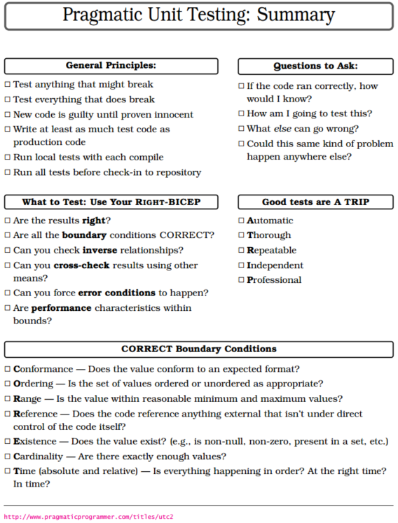

Slide 15
Exercise 1 - NUnit
NUnit cheat sheet demo

Slide 16
Exercise 2 – ZLand

Slide 17
References
http://blog.stevensanderson.com/2009/08/24/writing-great-unit-tests-best-and-worst-practises/
http://blog.stevensanderson.com/2009/06/11/integration-testing-your-aspnet-mvc-application/
https://lukewickstead.wordpress.com/2013/01/16/nunit-cheat-sheet/
http://martinfowler.com/bliki/UnitTest.html
http://artofunittesting.com/definition-of-a-unit-test/
http://stackoverflow.com/questions/4904096/whats-the-difference-between-unit-functional-acceptance-and-integration-test
https://github.com/lukewickstead/DOT-NET-on-Linux

Slide 18
Further Reading
http://www.amazon.com/Test-Driven-Development-By-Example/dp/0321146530
http://www.amazon.com/The-Art-Unit-Testing-Examples/dp/1933988274
https://github.com/dennisdoomen/fluentassertions/wiki
Pragmatic Unit Testing in C# with NUnit, 2nd Edition

