Slide 1


Slide 2
Unit Testing
Ryan Kotzen
Code Dojo

Slide 3
What is a Code Dojo
A place to learn from other people
Practical, Lean by doing
Deliberate practice
Fail safely
Building a community
Show what you have done and get feedback
Notes:
Injection types
Constructor paramaters

Slide 4
Format
Pre-reading & installation of prerequisites
Quick presentation
Divide into groups of 2 (pair programing)
Swap pilot and co-pilot every 10-15min
Show & Tell

Slide 5
Testing
Prerequisites
Visual Studio 2012+
NUnit
Recommended
Resharper - Latest version compatible with your version of Visual Studio, 30 day trial is fine for now.

Slide 6
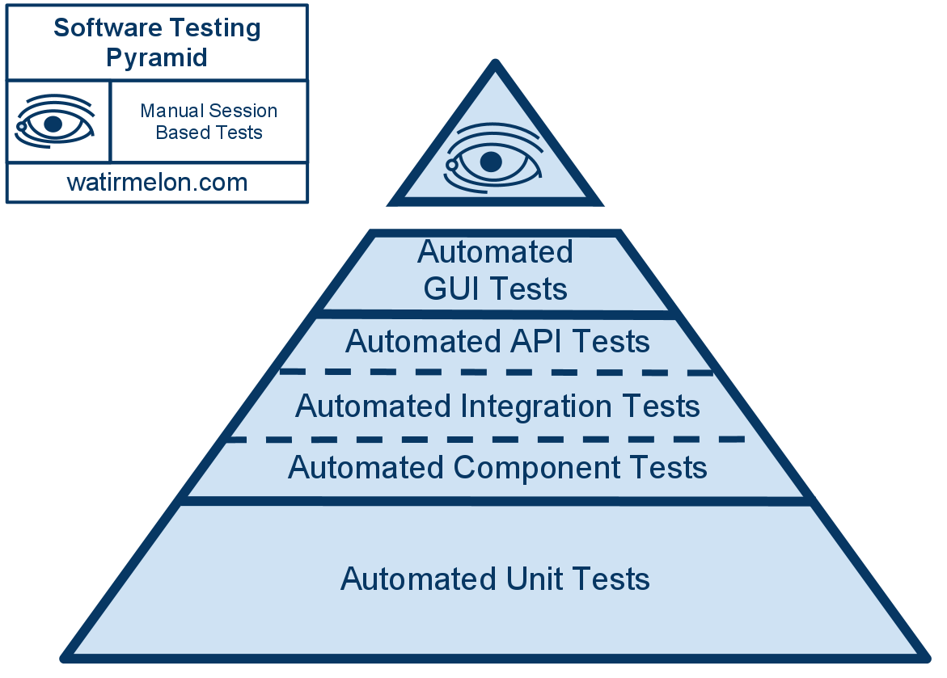
Testing Pyramid

Slide 7
Unit VS Integration Testing
Unit tests test individual software components. They supply mocks or fake versions of dependencies (such as a database) so that the unit test doesn’t rely on any external code and any failures can be pinpointed exactly. Unit testing is central to Test Driven Development – the entire TDD process is driven by unit testing.
Integration tests test your entire software stack working together. These tests don’t mock or fake anything (they use the real database, and real network connections) and are good at spotting if your unit-tested components aren’t working together as you expected. In general, it’s best to put most of your effort into building a solid suite of unit tests, and then adding a few integration tests for each major feature so you can detect any catastrophic incompatibilities or configuration errors before your customers do.
http://blog.stevensanderson.com/2009/06/11/integration-testing-your-aspnet-mvc-application/

Slide 8
Which Test To Use?
Goal | Strongest technique
Finding bugs (things that don’t work as you want them to) | Manual testing (sometimes also automated integration tests)
Detecting regressions (things that used to work but have unexpectedly stopped working) | Automated integration tests (sometimes also manual testing, though time-consuming)
Designing software components robustly | Unit testing (within the TDD process)
(Note: there’s one exception where unit tests do effectively detect bugs. It’s when you’re refactoring, i.e., restructuring a unit’s code but without meaning to change its behaviour. In this case, unit tests can often tell you if the unit’s behaviour has changed.)

Slide 9
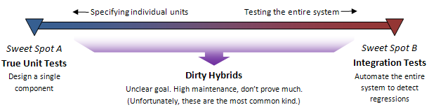
Unit VS Integration Testing

Slide 10
NUnit
NUnit cheat sheet demo

Slide 11
Exercise 1

Slide 12
Exercise 2 – Game Of Life
Use Unit Tests to design a solution for Conway’s Game Of Life: http://en.wikipedia.org/wiki/Conway%27s_Game_of_Life
Any live cell with fewer than two live neighbours dies, as if caused by under-population.
Any live cell with two or three live neighbours lives on to the next generation.
Any live cell with more than three live neighbours dies, as if by overcrowding.
Any dead cell with exactly three live neighbours becomes a live cell, as if by reproduction.

Slide 13
References
http://blog.stevensanderson.com/2009/08/24/writing-great-unit-tests-best-and-worst-practises/
http://blog.stevensanderson.com/2009/06/11/integration-testing-your-aspnet-mvc-application/
https://lukewickstead.wordpress.com/2013/01/16/nunit-cheat-sheet/
https://github.com/dennisdoomen/fluentassertions/wiki
http://martinfowler.com/bliki/UnitTest.html
http://artofunittesting.com/definition-of-a-unit-test/
http://stackoverflow.com/questions/4904096/whats-the-difference-between-unit-functional-acceptance-and-integration-test
https://github.com/lukewickstead/DOT-NET-on-Linux

Slide 14
Further Reading
http://www.amazon.com/Test-Driven-Development-By-Example/dp/0321146530
http://www.amazon.com/The-Art-Unit-Testing-Examples/dp/1933988274

