Slide 1
TDD with Javascript
AN introduction

Slide 2
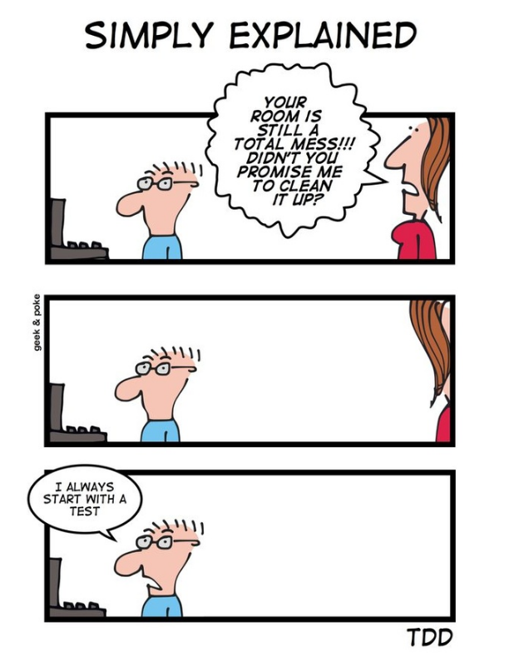
Overview
What is TDD
Why TDD
TDD with Angular
Technologies
TDD with NodeJS
Technologies
Aiding technologies
Examples
Prac

Slide 3
WHAT IS tdd
Test Driven Development
A bit of a religion
Write what you expect
Then make the code give that result

Slide 4
Why tdd
Tests cover actual expectations
Tests don’t check that the code does what it already does
Leads to testable code
No struggle to figure out how to test something because of how it was built
Smaller units
Each component is tested and therefore written in smaller parts

Slide 5
TDD with Angular
Karma
Command line tool
Spawns web server
Displays test results
Jasmine
Testing framework
Provides test structuring functions
Provides mocking functionality
Provides assertions
Recommended by official Angular site

Slide 6
TDD with Angular
Mocha - alternative to Jasmine
No built in assertions, combine with:
Chai
Expect.js
Should.js
No build in spies / test-doubles / mocks
Sinon
Qunit – another alternative
Used by JQuery

Slide 7
TDD with Angular
More behaviour driven approach: CUCUMBER
Feature files in English
Can be written by business / testers
Use Regex to match test scenarios
Can re-use scenarios
Protractor
End to end testing framework
Uses web-driver
Selenium

Slide 8
TDD with Node JS

Slide 9
Aiding Technologies
Test coverage
Percentage of code ran by the tests
Not single source of truth – only a guideline
Can use:
Istanbul – most popular
Blanket.js
JSCover

Slide 10
Angular Examples

Slide 11
Node JS examples

Slide 12
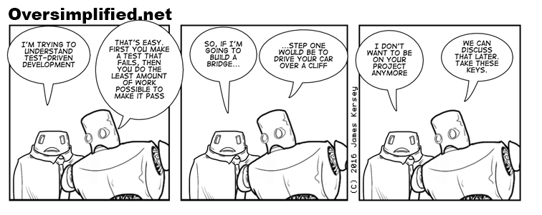
Prac

