Slide 1
What is Happening With Medicaid and the Children’s Health Insurance Program (CHIP) Right Now?
Notes:
Talking Points:
Good afternoon/morning. I’m [Insert Name and Title]. Today I’m sharing information with you all about what is happening with the Medicaid program and Children’s Health Insurance Program (also known as CHIP) and how partners like you, can make sure people keep health coverage.
Medicaid and CHIP have been a lifeline for many families during the pandemic. States are now checking to see if each person enrolled in their Medicaid and CHIP programs still qualifies for coverage.
We know that you all may work with or serve people covered by Medicaid and CHIP. We want to make sure that you all have the information you need to share with your partners, colleagues, and other people in your community to help people enrolled in these programs maintain health insurance coverage.

Slide 2
What is Medicaid?
Medicaid provides health coverage to over 86 million* Americans, including eligible low-income adults, children, pregnant women, elderly adults and people with disabilities. States may choose to cover additional groups.
Medicaid is the single largest source of health insurance coverage in the United States.
Each state runs their own Medicaid program.
Medicaid may be called by a different name depending on the state. For example, in [Tennessee], the Medicaid program is called [TennCare].
Visit Medicaid.gov/renewals to find more information about your state’s Medicaid program.
*Source: https://www.medicaid.gov/medicaid/program-information/medicaid-and-chip-enrollment-data/report-highlights/index.html
Notes:
Talking Points
To start off, we would like to talk about what Medicaid is.
Medicaid provides health coverage to over 86 million Americans, which include low-income adults, children, pregnant women, elderly adults, and people with disabilities. Medicaid is also the single largest source of health coverage in the United States
Each state runs their own Medicaid program, and they all have different names. It might be called something else in one state. For example, the Medicaid Program in Tennessee is called TennCare.
Feel free to fill in the blanks with your own state and Medicaid program name so it resonates with your community.
Visit Medicaid.gov/renewals for more information about your state’s Medicaid program

Slide 3
What is the Children’s Health Insurance Program (CHIP)?
The Children’s Health Insurance Program (CHIP) provides health coverage to over 7 million* uninsured children in low-income families.
Similar to Medicaid, each state runs their own CHIP program.
CHIP programs may also be called by a different name depending on the state. For example, in [Georgia], CHIP is called [PeachCare].
*Source: https://www.medicaid.gov/medicaid/program-information/medicaid-and-chip-enrollment-data/report-highlights/index.html
Notes:
Talking Points
What is the Children’s Health Insurance Program, also known as CHIP?
CHIP provides health coverage to over 7 million uninsured kids in low-income families
Just like Medicaid, each state runs their own CHIP program, and they may have different names. For example, the CHIP program in Georgia is called PeachCare.
Feel free to fill in the blanks with your own state and CHIP program name, so it resonates with your community.

Slide 4
Why are Medicaid and CHIP Renewals Happening Now?
For the past three years, people on Medicaid were not required to renew their coverage due to the COVID-19 Public Health Emergency. This was referred to as the ‘continuous enrollment condition’.
The continuous enrollment condition ended on March 31, 2023, and as of April 1, 2023, states are able to terminate Medicaid and CHIP enrollment for individuals no longer eligible.
States will have up to 12 months to return to normal eligibility and enrollment operations.
The expiration of the continuous enrollment condition now presents the single largest health coverage transition event since the first open enrollment period of the Health Insurance Marketplace.
Notes:
Talking Points
For the past three years, people on Medicaid and the Children’s Health Insurance Program (CHIP) were not required to renew their coverage because of the COVID-19 pandemic. During this time, we paused renewals to ensure as many people as possible stayed covered during the pandemic. This was referred to as the "continuous enrollment condition”
The continuous enrollment condition ended on March 31, 2023, and states have now resumed the yearly process of Medicaid and CHIP eligibility renewals and are contacting people to determine if they are still eligible.
Over the next 12 months, everyone with Medicaid or CHIP coverage will need to renew their coverage.
The expiration of the continuous enrollment condition is the single largest health coverage transition event since the first open enrollment period of the Health Insurance Marketplace.

Slide 5
What Is Happening Right Now With Medicaid and CHIP?
States are now contacting individuals to determine if they are still eligible for Medicaid and CHIP.
Some individuals might not qualify for Medicaid or CHIP and will lose coverage.
During a 12-month period, states will be spreading out renewals. Not everyone will have their Medicaid or CHIP coverage renewed at the same time.
[Insert your state’s timeline]
Notes:
Talking Points
As mentioned, states are now contacting individuals to see if they are eligible for Medicaid and CHIP.
If an individual is no longer eligible for Medicaid or CHIP, they can transition to another form of health insurance coverage, such as finding coverage on HealthCare.gov, Medicare, or employer-sponsored insurance coverage.
Over the next 12 months, states will spread out renewals, which means not everyone will have their Medicaid and CHIP coverage renewed at the same time.
Each state has a different renewal timeline, and you can find that timeline on Medicaid.gov/unwinding under the Planning Tools & Templates section. You can add your own state’s timeline here.

Slide 6
How Will This Impact People in My Community?
About 15 million people are predicted to lose Medicaid and CHIP coverage over the next year. Of that, 6.8 million people are expected to lose coverage even though they still qualify for Medicaid and CHIP.
5.3 million children are predicted to lose their Medicaid or CHIP coverage.
Nearly 4.6 million people predicted to lose coverage are Latino and 2.2 million people are Black.
People enrolled in Medicaid and CHIP need to take steps to renew their coverage, if eligible.
People who no longer qualify for Medicaid or CHIP will need to find another option for health insurance coverage.
Source: https://aspe.hhs.gov/reports/unwinding-medicaid-continuous-enrollment-provision
Notes:
Talking Points
How will this impact people in your community?
Over 15 million people are expected to lose Medicaid or CHIP coverage. That includes nearly 5.3 million children. Nearly 4.6 million people predicted to lose coverage identify as Latino, and 2.2 million people identify as Black.
People enrolled in Medicaid and CHIP need to take action now to renew their coverage, if eligible.
If found not eligible for Medicaid or CHIP, people will be able to transition to the Health Insurance Marketplace or another form of coverage.
We need partners like YOU to help make sure that people enrolled in Medicaid and CHIP complete the steps to renew their coverage or know what options they have for other health insurance coverage.

Slide 7
What Do People Enrolled in Medicaid and CHIP Have to Do to Renew Their Coverage?
States will use the information they have to decide if a person or their family member(s) will keep their Medicaid or CHIP coverage.
If the state needs more information, they will send a renewal letter to that person in the mail.
For some people, this will be the first time their coverage will be renewed.
Many people may not know that they need to renew their coverage or be on the look out for information from their state.
Notes:
Talking Points:
What do people enrolled in Medicaid and CHIP have to do to renew their coverage?
States will use information they already have to decide if people are still eligible for Medicaid or CHIP.
If the state needs more information, they will send a renewal letter in the mail. We are asking people to check their mail to see if their Medicaid or CHIP office sent a renewal form.
This may be the first-time renewing coverage for some people, so we want to make sure people know what steps they need to take to renew their coverage if they are still eligible.

Slide 8
What Steps Do People Need to Take if They Have Not Gotten Anything From Their State Medicaid or CHIP Program Yet?
Update your contact information – Make sure your state Medicaid or CHIP program has your current mailing address, phone number, email, or other contact information. This way, they’ll be able to contact you about your Medicaid or CHIP coverage. [Insert state website and/or phone number]
Check your mail and open any mail from your state Medicaid or CHIP program - Your state Medicaid or CHIP program will mail you a letter about your Medicaid or CHIP coverage. This letter will also let you know if you need to complete a renewal form to see if you still qualify for Medicaid or CHIP. [insert name of your state program, if not called Medicaid]
Notes:
Talking Points
If you haven’t gotten anything from your state Medicaid or CHIP program yet, you can do the following:
Update your contact information with your state Medicaid or CHIP program. This includes your current mailing address, phone number, email, or other contact information.
Check your mail and open any mail from your state Medicaid or CHIP program. The letter will let you know if you need to complete a renewal form to see if you are still eligible for Medicaid or CHIP.

Slide 9
What Steps Do People Need to Take if They Have Received a Renewal Form From Their State?
Read the entire letter!
Complete your renewal form and send it back– Fill out the form and return it to your state Medicaid or CHIP program right away to help avoid a gap in your Medicaid or CHIP coverage. Provide the information your state is asking for and any documents to support that information.
Even if a parent is no longer eligible for Medicaid, their child may still be eligible for Medicaid or CHIP. It is important to always return the renewal form so your state can see if you or anyone in your family qualifies for coverage.
Look out for follow-up information from your state about your coverage – State Medicaid and CHIP offices will follow-up with people once they have reviewed a person’s information to share if their coverage has been renewed. States will also let people know if they found that a person is no longer eligible for Medicaid or CHIP and when their coverage will end.
Notes:
Talking Points
If you have received a renewal from your state Medicaid or CHIP program, please read the letter.
After reading the letter, complete your renewal form. Fill out the form, and return it back to your state Medicaid or CHIP program right away to help avoid a gap in coverage. We are asking parents to still complete the renewal form as their kids may still be eligible for Medicaid or CHIP even if they are not.
After completing the renewal form, look out for follow-up information from your state about your coverage. States will let people know if they are no longer eligible for Medicaid and CHIP and when their coverage will end.

Slide 10
What Steps Do People Need to Take if They Have Lost Their Medicaid or CHIP Coverage?
Review the notice from your state to see why you lost Medicaid or CHIP coverage
If the state ended your coverage because they did not have the information they needed to complete the renewal, then you can contact your state to provide the missing information. Find your state’s contact information at Medicaid.gov/renewals.
If the state ended your coverage because they found that you are no longer eligible for the program, you will need to find another option for health coverage.
Appeal the decision or re-apply for Medicaid or CHIP
If you think that you are still eligible for Medicaid or CHIP and the state wrongly ended your coverage, you can ask the state for a second review and appeal the decision.
If there is a change in your situation (ex: your income changes), you can reapply for Medicaid or CHIP at any time. Visit Medicaid.gov to find out how you can contact your state to re-apply.
Notes:
Talking Points
If you have lost Medicaid or CHIP coverage, you can follow three steps:
Step one: Look over your notice from your state to see why you lost Medicaid or CHIP coverage. If your state ended your coverage because they did not have the information they needed to complete the renewal, then you can contact your state to provide the missing information. You can find your state’s contact information at Medicaid.gov/renewals. If the state ended your coverage because they found that you are no longer eligible for the program, you will need to find another option for health coverage.
Step two: Appeal the decision or re-apply for Medicaid/CHIP. If you think that you are still eligible for Medicaid/CHIP and the state wrongly ended your coverage, you can appeal the decision and ask the state to do a second review. If there is a change in your situation, such as income change, you can reapply for Medicaid or CHIP at any time. Visit Medicaid.gov to find out how you can contact your state to re-apply.

Slide 11
What Steps Do People Need to Take if They Have Lost Their Medicaid or CHIP Coverage? (Continued)
Look at other health coverage options and find the one that is best for you
The Health Insurance Marketplace – HealthCare.gov
Most people can find a plan for $10 or less per month with financial help.
People can qualify for savings on a health plan that lowers the monthly cost.
All plans cover doctor visits, prescription drugs, emergency care, and more.
Medicare (for people 65 or older) – Medicare.gov
People can qualify for a “Special Enrollment Period” to enroll in Medicare without paying a penalty if they missed their initial enrollment period.
Employer-sponsored coverage – check with your employer
People can enroll in an employer plan outside of open enrollment if they recently lost Medicaid or CHIP.
Notes:
Talking Points
The last step is to look for other health insurance coverage options, including the Health Insurance Marketplace, Medicare, or employer-sponsored coverage.
For the Health Insurance Marketplace, most people can find plans for $10 or less with financial help. All plans cover doctors' visits, prescription drugs, emergency care, and more. People can apply for Marketplace coverage as soon as they lose Medicaid coverage – you don’t have to wait until open enrollment. For more information, visit HealthCare.gov.
For Medicare, people 65 or older can enroll in Medicare without paying a penalty if they missed their initial enrollment period. For more information, visit Medicare.gov.
For employer-sponsored coverage, please check with your employer. People can enroll in an employer plan outside of open enrollment if they recently lost Medicaid or CHIP.

Slide 12
What Can I Do to Help People With Medicaid and CHIP in My Community?
Help raise awareness. Make sure that your patients, customers, friends and family members who have Medicaid and CHIP know that they need to take action to renew their coverage.
Share resources. CMS has created materials to help partners share information located on Medicaid.gov/Unwinding. [Many states also have their own materials that you can use to educate people in your communities. – Partners can add information about state-specific resources]
Let people know where they can go if they have questions or need assistance. Help guide people to the right resources if they have questions about renewing their coverage or enrolling in another health coverage option. [enter state or local resource]
Partner with other organizations in your community. It is important that people hear information about renewing Medicaid and CHIP coverage from multiple voices in the community. Work together with other groups and trusted voices who may work with people enrolled in Medicaid and CHIP to help share information.
Notes:
Talking Points
This work is all hands-on-deck and will continue to be. We urge our partners in the public and private sectors to directly reach Medicaid enrollees and help them complete their renewals and help connect them to other coverage as appropriate.
On this slide, we have listed four ways to help people with Medicaid and CHIP in your community. We encourage you to:
Help raise awareness.
Share resources with your community, and begin incorporating information about Unwinding into materials, presentations, and workplans you have in development. CMS’s Communications Toolkit has a lot of great resources and language that you can adapt to fit the needs of your organization and the audiences you reach.
Let people know where to go for more help. We will walk-through where to direct people to on the next slide.
Partner with other organizations in your state, region and/or community to reach people with Medicaid and CHIP coverage. Think about organizations that might not consider themselves Medicaid experts, such as food banks who work with a lot of people that likely have Medicaid and CHIP.
We appreciate your partnership in helping to make sure that people remain connected to health coverage, and we are here to support our partners anyway that we can throughout the Medicaid and CHIP renewal process.

Slide 13
Where Should I Direct People To If They Have Questions?
For questions about Medicaid or CHIP – Contact your state Medicaid or CHIP office directly
Find the contact information for your state Medicaid office at Medicaid.gov/renewals [or enter direct state Medicaid URL here]
For questions about the Health Insurance Marketplace® – Visit HealthCare.gov or contact a local enrollment assister in your area
Find a list of enrollment assisters in your area at LocalHelp.HealthCare.gov
You can also call 1-800-318-2596. TTY users can call 1-855-889-4325.
Help is available 24 hours a day, 7 days a week in over 200 languages.
For questions about enrolling in Medicare (generally for people age 65 and older) – Visit Medicare.gov
You can also call 1-800-MEDICARE (1-800-633-4227). TTY users can call 1-877-486-2048.
To get help with the enrollment form, contact your local Social Security Administration field office. Find an office near you at www.ssa.gov/locator or Call Social Security at 1-800-772-1213. TTY users can call 1-800-325-0778.
Notes:
Talking Points
On this slide, we have included where you can direct people to if they have any questions.
For questions about Medicaid or CHIP, contact your state Medicaid or CHIP office directly
For questions about the Health Insurance Marketplace, visit HealthCare.gov or find local help in your area by going to LocalHelp.HealthCare.gov. You can also call the Marketplace Call Center at 1-800-318-2596. Help is available 24 hours a day, 7 days a week in over 200 languages.
Just for background, the federal government runs the Marketplace (sometimes known as the "Exchange") for individuals and families in some states while other states run their own Marketplaces at a different website. CMS works in close partnership with those states as well.
For questions about Medicare, visit Medicare.gov or call 1-800-MEDICARE. If you need help with the enrollment form, you can contact your local Social Security Administration field office by visiting www.ssa.gov/locator or calling 1-800-722-1213.

Slide 14
Additional Resources
Notes:
* CMS resources can be included in the deck trainers are using to educate others if appropriate.*
Notes for Later Talking Points:
The following set of slides walk-through some additional resources that are available to help share information about Medicaid and CHIP renewals in your community.

Slide 15

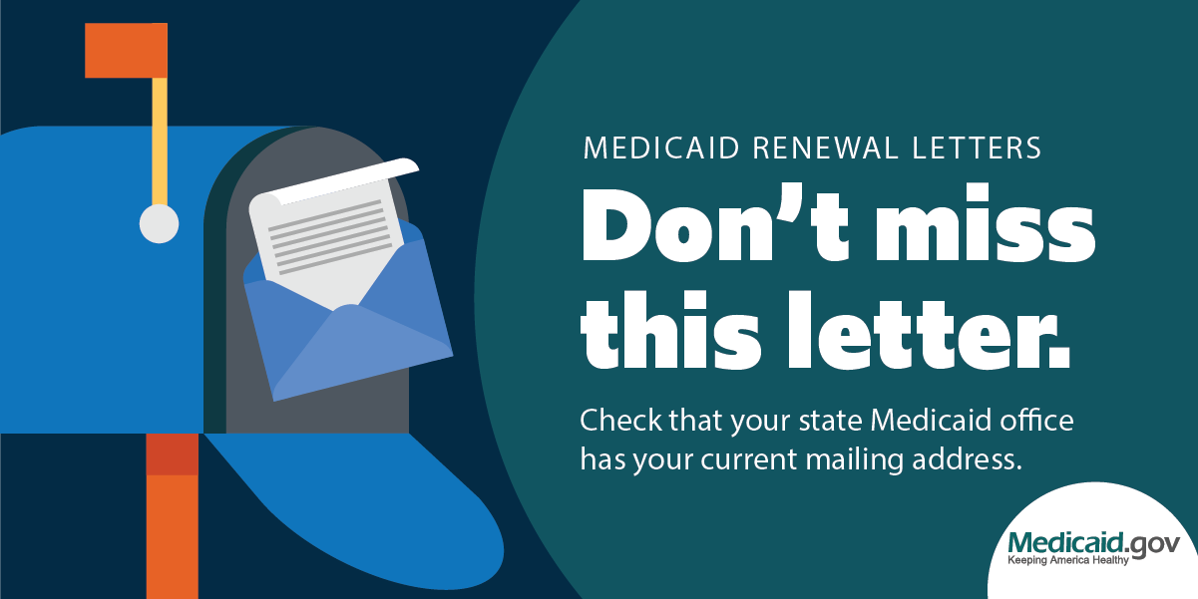
What Materials Can I Share To Help People in My Community Get Ready to Renew Their Medicaid or CHIP Coverage?
CMS has resources in English and Spanish that you can share with people in your community to help raise awareness about renewing coverage, including:
Fillable Flyers to customize with state information
Non-fillable Flyers
Conference Cards
Cards for Display Stands
Post Cards
Tear Off Pad
Materials for Health Care Providers
Social Media Graphics
All these materials and the full Communications Toolkit can be found on Medicaid.gov/Unwinding.
All materials are available in English and Spanish. Select materials are available in additional languages.
Notes:
Talking Points
CMS has created a series of resources to help raise awareness about renewing Medicaid and CHIP coverage.
On this slide you'll see a sampling of some of these materials, such as fillable flyers for states to customize, conference cards, post cards, materials for health care providers, social media graphics, and more.
These materials are meant for people who have not received their renewal form from their state yet. The messages in these materials focus on updating your contact information with your state and keeping an eye out in the mail for anything from your state Medicaid or CHIP office.
All materials are available in English and Spanish, and select materials are available in additional languages.
All of these materials can be found on the Medicaid.gov/Unwinding webpage under the Outreach and Educational Resources section.

Slide 16

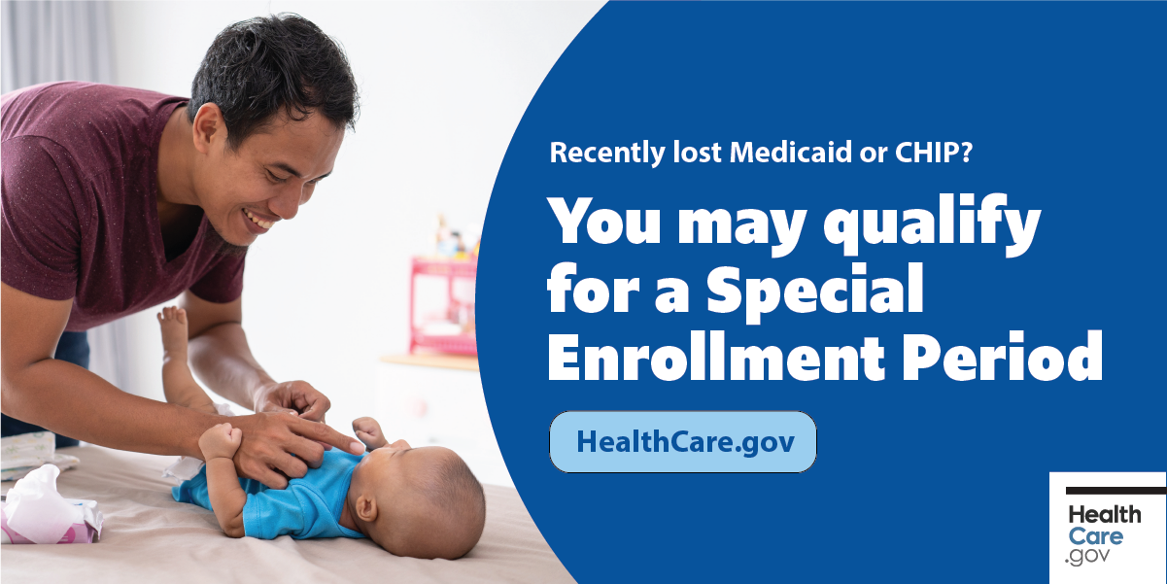
What Materials Can I Share to Help People in My Community Who Have Lost Medicaid or CHIP Coverage?
CMS has also created materials with information about next steps for finding other health insurance coverage if you have lost Medicaid or CHIP, including:
Partner Tip Sheet
Health Care Options Factsheet
Healthcare.gov Post Card
Medicare Special Enrollment Period Factsheet
Employer Factsheet
Post Card
Tear Off Pad
Social Media Graphics
All these materials and the full Communications Toolkit can be found on Medicaid.gov/Unwinding.
All materials are available in English and Spanish. Select materials are available in additional languages.
Notes:
Talking Points
CMS has created a series of resources to help people who have lost Medicaid or CHIP coverage learn about next steps for finding other health insurance coverage options.
On this slide you'll see a sampling of some of these materials, which include a tip sheet for partners, a factsheet on what to do if you no longer qualify for Medicaid or CHIP, a fact sheet on transitioning to Medicare, and one of the social media graphics to encourage people to visit HealthCare.gov.
We also have some additional materials for employers who may have employees that are losing Medicaid coverage.
These materials are also available in English and Spanish, and select materials are available in additional languages.
All of these materials can be found on the Medicaid.gov/Unwinding webpage under the Outreach and Educational Resources section.

Slide 17

What Information Can I Share With Families and Children in My Community?
Even if a parent is no longer eligible for Medicaid, their child may still be eligible for Medicaid or CHIP.
It is important to always return renewal forms to your state in a timely manner, even if you think you are no longer eligible so that the state can confirm if you or members of your family may still be eligible.
There are resources available specifically for making sure parents understand that their children may still be eligible for Medicaid or CHIP. These materials include:
Post Card for Kids with Medicaid or CHIP
Fillable Post Card for Kids with Medicaid or CHIP
Post Card for Renewing Kids’ Medicaid or CHIP
Fillable Post Card for Renewing Kids’ Medicaid or CHIP
Notes:
Talking Points
CMS has also created messages and resources for kids and families, which include fillable and nonfillable post cards. We have postcards for families with kids covered by Medicaid or CHIP and information about renewing kids’ Medicaid or CHIP coverage.
These materials focus on making sure families know what steps they need to take to renew their kid’s Medicaid/CHIP coverage. Parents should respond to the renewal letter even if they don’t think they are eligible – their kids could still be eligible!
All of these materials can be found on the Medicaid.gov/Unwinding webpage under the Outreach and Educational Resources section.

Slide 18
How Can I Use These Materials?
Print materials to post or hand out in office spaces, community centers, congregations or at local events. Flyers can be posted in the community where people regularly visit. Materials can also be handed out in offices and other businesses to increase awareness and answer questions about next steps. Events in the community where many families gather is also a great opportunity to share this information.
Send Listserv messages. Send messages out to your members, customers, patients, or constituents about Medicaid renewals.
Post graphics on social media. The CMS Communications Toolkit provides social media graphics and text to make it easy to share on social media channels. Many states also have their own social media toolkits for partners. You can also re-post information shared by CMS or your state Medicaid office.
Use the CMS materials as inspiration for your own materials. Use the information in these materials to help your organization create customized materials that are most useful to the people that you serve.

Slide 19
What Is My Call To Action Now That I Have Completed This Training?
Educate other organizations in your network/community about Medicaid and CHIP renewals and the importance of getting this information out to people enrolled in Medicaid and CHIP. Use this slide deck as a guide to train other people about Medicaid and CHIP renewals and the options available for people who are no longer eligible for Medicaid or CHIP.
Share information and resources with your clients, customers, or patients. Use the information shared today to help start conversations with the people you serve. The CMS handouts are a great conversation guide to walk through next steps no matter where someone is in the process for renewing their coverage.
Think of different ways that you may be able to reach people in your community that have not gotten this information yet. Use your existing connections and communications to share information, but also look into forming new partnerships to make sure everyone in your community receives this information.

Slide 20
Additional Resources Available Online
CMS Medicaid Unwinding Homepage on Medicaid.gov
www.medicaid.gov/unwinding
Medicaid and CHIP Beneficiary Renewals Page
www.medicaid.gov/renewals
CMS Medicaid and CHIP Renewals Communications Toolkit
English: https://www.medicaid.gov/resources-for-states/downloads/unwinding-comms-toolkit.pdf
Spanish: https://www.medicaid.gov/resources-for-states/downloads/unwinding-comms-toolkit-esp.pdf
CMS Medicaid and CHIP Renewals Outreach and Educational Resources Page
https://www.medicaid.gov/resources-for-states/coronavirus-disease-2019-covid-19/unwinding-and-returning-regular-operations-after-covid-19/medicaid-and-chip-renewals-outreach-and-educational-resources/index.html

