Slide 1
MITA 4.0 Artifacts & Viewpoints

Slide 2
Topics
Capability Architecture Overview
Capability Architecture Components
Capability Architecture Artifacts
Capability Architecture Viewpoints
Concept of Operations

Slide 3
Capability Architecture Overview
What is enterprise architecture?
A framework that helps organizations align the roles, business processes, information and technology to achieve their desired outcomes.
How is the enterprise architecture built in MITA 4.0?
The MITA 4.0 is focused on building the enterprise architecture for an SMA incrementally by capability
Each capability architecture represents a view of the enterprise architecture for the SMA

Slide 4
Capability Architecture Overview
What is a capability architecture?
A framework that helps organizations align the roles, business processes, information and technology that support a capability to achieve their desired outcomes. ORBIT model in practice.
Why is a capability architecture important?
Ensures IT strategies align with business goals and outcomes
Enhances decision-making and helps solve organizational problems
Streamline processes, making organizations more agile in responding to changes
Reduces IT complexity by standardizing systems and eliminating redundancies
Improves efficiency leading to better resource allocation and reduced operational costs
Fosters collaboration across departments by providing a shared vision of the organization
Establishes governance frameworks that ensure compliance with industry standards

Slide 5
Capability Architecture Overview
What is in a capability architecture?
The key components that are included in the capability architecture include:
O: Outcome – The desired goals and outcomes that the organization would like to achieve.
R: Role – The roles and skills that are responsible for delivering a capability.
B: Business Process – The processes and activities that are performed to deliver a capability.
I: Information – The data and information that are accessed and used in order to deliver a capability.
T: Technology – The applications and technology that are used to automate the delivery of a capability.

Slide 6
Capability Architecture Overview
How is a capability architecture organized?
Capability architecture is organized into segments that represent different perspectives of the capability architecture
Capability architecture includes the following segments:
Business Architecture – Provides a view of the enterprise from the business perspective. Responsible for defining and managing the business processes and business roles.
Information Architecture- Provides a view of the enterprise from the information perspective. Responsible for defining and managing the information and data governance roles.
Technical Architecture – Provides a view of the enterprise from the technical perspective. Responsible for defining and managing the applications, technology and technical roles.
Enterprise Architecture – Provides an integrated view of the enterprise that brings together business, information and technical architectures. Responsible for defining and managing items that impact all architectures including the outcomes, requirements, etc.

Slide 7
Capability Architecture Overview
How is a capability architecture communicated?
Capability architecture is usually represented by means of one or more architecture models that together provide a coherent description of the full capability architecture.
A single, comprehensive model is often too complex to be understood and communicated in its most detailed form, showing all the relationships between the various components.
As with the architecture of a building, it is normally necessary to develop multiple views of the architecture, to enable the architecture to be communicated to, and understood by, the different stakeholders in the system.
How is the capability architecture defined?
Capability architecture are defined through a collection of artifacts
Each artifact may represent either a catalog, matrix or diagram

Slide 8
Capability Architecture Overview
What is the Concept of Operations (COO)?
COO consolidates key architectural artifacts in a comprehensive document to provide the audience with an understanding of the organization's operations.
COO can be developed at different levels of granularity including:
Capability COO – Consolidates the architectural artifacts in a comprehensive document to provide the audience with an understanding of how the organization delivers a specific capability to meet desired goals and outcomes.
Enterprise COO – Consolidates the architectural artifacts in a comprehensive document to provide the audience with an understanding of how the organization is structured to meet desired goals and outcomes.

Slide 9
Capability Architecture Components
Outcome
Business Process
Application Component
Technical Component
Information Asset
Role

Slide 10
Information Asset Overview
Information Asset - A valuable piece of information that is organized and managed by a company or organization. The information assets will include the following:
Baseline Information Asset – A valuable piece of information that is currently used by an organization to support their current business processes. These assets are used by the organization for decision-making and operational efficiency. Examples include:
Database
Data Warehouse/Data Lake
Data File
Report
Table/Column
Target Information Asset – A valuable piece of information that is needed to support target business processes and will enable the organization to make decisions that meet their desired outcomes. The target information asset is conceptual and support the ability to identify data needs and requirements.

Slide 11
IA Metamodel
Capability
Information
Outcome
Drives
Baseline Information Asset
Role
Supply/Consume/Manage
Business Process
Accesses
Target Information Asset
Technology
Accesses

Slide 12
IA Metamodel in Action
Used to define the data needed by the SMA to meet their desired outcomes.
Target (To-Be)
Target Information Asset
Comparison used to identify gaps in data and drive requirements.
Used to describe the baseline data that is currently used by the SMA.
Baseline (As-Is)
Baseline Information Asset

Slide 13
IA Metamodel - Baseline
Capability
Baseline Information Asset
Desired Outcome
Drives
Baseline Data Role
Supply/Consume/Manage
Baseline Business Process
Accesses
Baseline Application
Accesses

Slide 14
IA Metamodel - Target
Capability
Target Information Asset
Desired Outcome
Drives
Target Data Role
Supply/Consume/Manage
Target Business Process
Accesses
Target Application,
Accesses

Slide 15
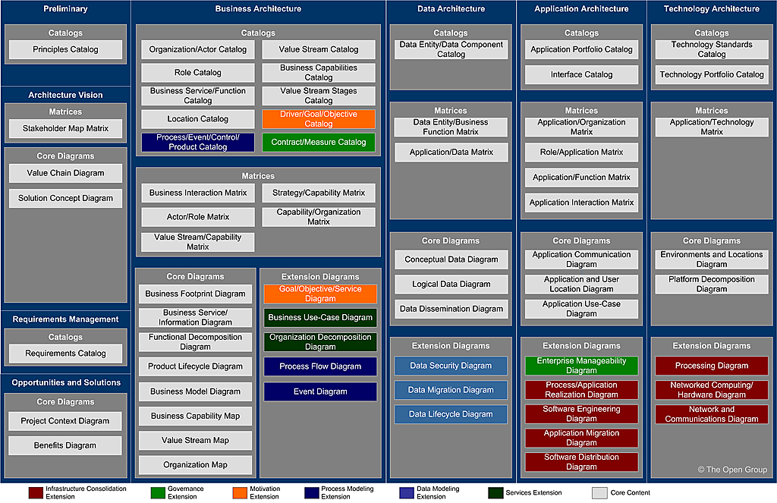

TOGAF Artifacts

Slide 16
MITA 4.0 Artifacts
Integration Architecture Artifacts
Catalogs
Matrices
Diagram
Role Catalog**
Capability/Organization Matrix**
Capability Catalog**
Requirements Catalog*
**Required & Included in COO
*Required Standalone Artifact
Recommended Artifact

Slide 17
MITA 4.0 Artifacts
Business Architecture Artifacts
Catalogs
Matrices
Diagram
**Required & Included in COO
*Required Standalone Artifact
Recommended Artifact

Slide 18
MITA 4.0 Artifacts
Information Architecture Artifacts
Catalogs
Matrices
Diagram
Data Asset Catalog**
Data to Business Process Matrix**
Conceptual Data Model Diagram**
Logical Data Dictionary Catalog*
Data to Application Matrix**
Logical Data Model Diagram
Physical Data Dictionary Catalog*
Data Transformation Matrix*
Physical Data Model Diagram
Reference Data Catalog*
Reference Data Crosswalk*
Data Lineage Diagram
Business Glossary
Data Rule Catalog
Report Catalog
**Required & Included in COO
*Required Standalone Artifact
Recommended Artifact

Slide 19
MITA 4.0 Artifacts
Technical Architecture Artifacts
Catalogs
Matrices
Diagram
**Required & Included in COO
*Required Standalone Artifact
Recommended Artifact

Slide 20
Concept of Operations

Slide 21
What is a View?
Architecture View
Representations of the overall architecture that is meaningful to one or more stakeholders within the SMA.

Slide 22
What are the different types of Views?
Catalog Views Structured lists that present key architectural elements within a system. These elements can include business functions, applications, data entities, roles, technologies, or any other components relevant to the architecture. Catalog views help stakeholders understand the scope and content of the architecture, supporting activities such as gap analysis, impact assessment, and governance.
Matrice Views A tabular format illustrating relationships or mappings between different architectural elements. For example, a matrix can show how business processes relate to applications, which roles access specific data, or how requirements are addressed by different components. These views are valuable for identifying dependencies, overlaps, or gaps, and for supporting decision-making regarding integration, compliance, and optimization.
Diagram Views Graphical representations that visually depict the structure, relationships, and interactions among various architectural elements. Diagrams can take many forms, such as flowcharts, network diagrams, entity-relationship diagrams, or component diagrams. These views are especially useful for communicating complex concepts in an accessible and intuitive manner, facilitating shared understanding among technical and non-technical stakeholders.

Slide 23
What is a Viewpoint?
Architecture Viewpoint
Defines the perspective from which a view is taken
Defines how to construct and use a view, information that should appear in the view, the modeling techniques for expressing and analyzing the information, rationale for these choices
View vs. Viewpoint
View is what you see. A viewpoint is where you are looking from, the vantage point or perspective that determines what you see
Viewpoints are generic, a view is always specific to the architecture.
Every view has an associated viewpoint that describes it

Slide 24
What is in a Viewpoint?
Each architecture viewpoint will include the following components:
Description – High-level summary that describes the viewpoint.
Roles– Identifies the key stakeholders that the view is designed to support.
Concerns – Identifies the key concerns that the view seeks to address.
Elements – Identifies the architectural elements that are included in the view.
Type – Catalog, Diagram or Matrix
Modeling Technique – Identifies the key modeling technique that is used to create the view.

Slide 25
Catalogs

Slide 26
Data ASSET Catalog
Component
Description | A list of all the data used across the enterprise, including data entities and also the datasets, databases, files, and data repositories where data entities are stored. A data catalog supports the definition and application of information management and data governance policies and also encourages effective data sharing and re-use.
Stakeholders | Executive, Data Owner, Data Steward, Data Architect, Data Governance Committee
Concerns | Data ownership, data sensitivity, data classification, data usage, data privacy, data quality, regulatory compliance, discoverability
Elements | Data Asset
Type | Catalog
Modeling Technique | Table that contains the following fields: Data Asset Name Data Asset Description Data Asset Type: Data At Rest, Data in Motion MITA 4.0 Data Domain Baseline Data Standard Target Data Standard

Slide 27
Data Dictionary Catalog
Component
Description | A repository that defines and describes the structure, attributes, and semantics of data assets within the organization. The Data Dictionary Catalog provides standardized definitions, data types, allowable values, and relationships for each data element, supporting consistency, interoperability, and data quality.
Stakeholders | Data Architect, Data Steward, Database Administrator, Data Analyst, Application Developer, Business Analyst
Concerns | Data consistency, naming conventions, data definitions, metadata management, data quality, system integration, semantic clarity, compliance
Elements | Data Element (Field/Attribute)
Type | Catalog
Modeling Technique | Table for each data asset that contains the following: Data Asset Name Data Entity Data Field Data Field Type Data Field Description Code Set Name (If applicable)

Slide 28
Logical Data Dictionary Catalog
Component
Description | A Logical Data Dictionary Catalog provides detailed definitions and descriptions of data elements within a logical data model. It includes data types, allowable values, relationships, and business meanings, supporting data consistency and clarity across applications and systems.
Stakeholders | Data Architect, Data Steward, Database Administrator, Data Analyst, Application Developer, Business Analyst
Concerns | Data consistency, semantic clarity, metadata management, naming conventions, data quality, compliance
Elements | Data Element (Field/Attribute), Data Type, Allowed Values, Description, Relationships
Type | Catalog
Modeling Technique | Table for each data asset that contains the following: Data Element Name Data Entity Data Field Data Field Type Data Field Description Allowed Values Relationships and Dependencies

Slide 29
Physical Data Dictionary Catalog
Component
Description | A Physical Data Dictionary Catalog provides detailed definitions and descriptions of data elements within a physical data model. It includes technical specifications like data types, field sizes, indexes, and constraints, supporting system implementation and database management.
Stakeholders | Database Administrator, Data Architect, Application Developer, System Integrator, Data Steward
Concerns | Data type specifications, indexing, performance optimization, storage requirements, data integrity, implementation constraints
Elements | Data Field (Column), Data Type, Field Size, Index, Constraint (e.g., Primary Key, Foreign Key), Default Values
Type | Catalog
Modeling Technique | Table for each data asset that contains the following: Data Element Name Data Field Data Field Type Data Field Size and Precision Indexing Options Constraints and Default Values

Slide 30
Reference Data Catalog
Component
Description | A Reference Data Catalog contains standardized sets of data used across multiple systems and applications. It includes non-volatile, predefined data such as codes, classifications, and enumerations, ensuring consistency and interoperability across the organization.
Stakeholders | Data Steward, Business Analyst, Application Developer, Data Architect, System Integrator
Concerns | Consistency of reference data, standardization, version control, data governance, integration across systems
Elements | Reference Data Set, Code, Description, Valid Values, Version
Type | Catalog
Modeling Technique | Table for each data asset that contains the following: Reference Data Set Name Code (unique identifier) Description Valid Values Version Information

Slide 31
Business Glossary Catalog
Component | Description
Description | A curated collection of business terms and their definitions, used to ensure a common and consistent understanding of vocabulary across the organization. The Business Glossary Catalog clarifies meaning, reduces ambiguity, and aligns business and technical stakeholders on terminology and data usage.
Stakeholders | Business Analyst, Data Steward, Data Governance Committee, Data Owner, Compliance Officer, Subject Matter Expert, Project Manager
Concerns | Terminology consistency, semantic clarity, business-IT alignment, regulatory compliance, communication, standardization, data governance
Elements | Business Term
Type | Catalog
Modeling Technique | Table that contains Acronym (If applicable) Term Term Definition Synonyms/Aliases MITA 4.0 Data Domain

Slide 32
Data Rule Catalog
Component | Description
Description | A centralized repository of data rules that define the policies, standards, and constraints governing the creation, management, and usage of data within the organization. The Data Rule Catalog helps ensure data quality, compliance, and consistency by documenting validation, transformation, privacy, and business rules.
Stakeholders | Data Steward, Data Owner, Data Governance Committee, Compliance Officer, Data Architect, Business Analyst, Quality Assurance
Concerns | Data quality, data validation, data integrity, regulatory compliance, data privacy, standardization, business process alignment, enforceability
Elements | Data Rule (Validation Rule, Business Rule, Transformation Rule)
Type | Catalog
Modeling Technique | Table that contains the following fields: • Rule Name • Rule Description • Rule Type (e.g., validation, business, transformation) • Applicable Data Element/Asset • Business Rationale • Enforcement Mechanism • Compliance Requirement

Slide 33
Report Catalog
Component | Description
Description | A Report Catalog is a comprehensive repository of all reports generated and used within an organization. It documents the purpose, content, structure, and distribution of reports, facilitating efficient report management and access.
Stakeholders | Business Analyst, Report Developer, Data Analyst, Business User, Data Steward, IT Support
Concerns | Report accessibility, accuracy, consistency, distribution, security, version control, alignment with business needs
Elements | Report Name, Description, Data Sources, Frequency, Format, Audience, Owner
Type | Catalog
Modeling Technique | Table that contains the following fields: • Report Name • Report Description • Data Sources • Frequency • Format • Audience • Owner

Slide 34
Matrices

Slide 35
Data to Business Process Matrix
Component
Description | A matrix that maps data entities or data sets to the business processes that create, use, or modify them. This matrix helps organizations understand how data supports key business operations, identify critical data, and assess the impact of process or data changes.
Stakeholders | Business Process Owner, Data Steward, Business Analyst, Data Architect, Process Manager, Compliance Officer
Concerns | Data ownership, process-data alignment, regulatory compliance, data usage, process optimization, risk management, data quality, impact analysis
Elements | Data Entity (or Data Set), Business Process
Type | Matrices
Modeling Technique | Two-dimensional matrix with Data Entities as rows and Business Processes as columns (or vice versa). Matrix cells indicate the relationship (e.g., “Created”, “Used”, “Modified”, “Archived”) between data and process. Cells may be annotated with CRUD or similar codes.

Slide 36
Data to Application Matrix
Component
Description | A matrix that maps data entities or data sets to the applications that create, use, update, or delete them. This matrix helps identify data ownership, integration points, data redundancy, and supports impact analysis for changes in data or applications.
Stakeholders | Data Architect, Application Owner, Solution Architect, Data Steward, Business Analyst, System Integrator
Concerns | Data redundancy, data integration, ownership, system dependencies, data flow, change impact, data lifecycle management, compliance
Elements | Data Entity (or Data Set), Application
Type | Matrices
Modeling Technique | Two-dimensional matrix with Data Entities as rows and Applications as columns (or vice versa). Matrix cells indicate relationships such as “Create”, “Read”, “Update”, “Delete” (CRUD) or other relevant interactions.

Slide 37
Data Mapping Specification
Component
Description | A detailed specification that defines how data elements from a source system are mapped to corresponding elements in a target system. It documents field-to-field relationships, data transformation rules, and logic for integration, migration, or interface projects.
Stakeholders | Data Architect, Data Engineer, Solution Architect, Integration Developer, Business Analyst, Data Steward, QA Analyst
Concerns | Data accuracy, transformation logic, data integrity, system compatibility, migration risk, traceability, regulatory compliance, documentation quality
Elements | Source Data Element, Target Data Element, Transformation Rule, Data Type, Default Value, Business Rule
Type | Matrices
Modeling Technique | Tabular specification listing Source Fields (with metadata) and their corresponding Target Fields, including columns for Transformation Logic, Data Type Conversions, Default Values, Validation Rules, and Comments. Often implemented in spreadsheets or mapping tools.

Slide 38
Data Transformation Matrix
Component
Description | A Data Transformation Matrix details the processes and rules for converting data from one form to another, often during data migration or integration projects. It ensures data consistency, quality, and alignment with business requirements.
Stakeholders | Data Architect, ETL Developer, Data Analyst, Business Analyst, Database Administrator, System Integrator
Concerns | Data accuracy, transformation rules, data lineage, consistency, performance, error handling, compliance
Elements | Source Data, Target Data, Transformation Rules, Mapping, Validation Rules, Error Handling
Type | Matrices
Modeling Technique | Structured matrix or documentation that defines transformations with attributes, including: Source Data (origin of data); Target Data (destination of transformed data) Transformation Rules (logic and operations applied) Mapping (correspondence between source and target) Validation Rules (criteria for correctness) Error Handling (procedures for managing exceptions)

Slide 39
Reference Data Crosswalk
Component
Description | A crosswalk provides a mapping between reference data values used in different systems, domains, or standards. It enables interoperability, data integration, and consistency by aligning codes or values such as country codes, statuses, or terminologies across platforms.
Stakeholders | Data Steward, Data Architect, Integration Developer, Business Analyst, System Owner, Compliance Officer
Concerns | Data consistency, value alignment, interoperability, integration accuracy, compliance with standards, change management, documentation
Elements | Source Reference Value, Target Reference Value, Source System, Target System, Mapping Rule, Description
Type | Matrices
Modeling Technique | Tabular crosswalk listing Source Values and corresponding Target Values, with additional columns for System/Standard Name, Mapping Rules, Descriptions, and Effective Dates. Can be implemented in spreadsheets, mapping tables, or data governance tools.

Slide 40
Diagrams

Slide 41
Conceptual Data model Diagram
Component
Description | A Conceptual Data Model Diagram provides a high-level, business-oriented view of an organization’s core data entities and their relationships. It focuses on defining what data is important, using business language, and is independent of technology or detailed data structure.
Stakeholders | Business Analyst, Data Architect, Solution Architect, Business Owner, Project Manager, Data Steward
Concerns | Business terminology alignment, scope definition, stakeholder consensus, data requirements gathering, integration points, conceptual clarity
Elements | Entity (business concepts), Relationship (associations between entities); typically, no attributes or only key attributes are shown
Type | Matrices
Modeling Technique | High-level Entity-Relationship Diagram (ERD) notation, simple rectangles for entities, labeled lines for relationships, business-oriented names, minimal or no attributes, no technical or implementation details

Slide 42
Logical Data model Diagram
Component
Description | A Logical Data Model Diagram provides a detailed representation of the data requirements and structure for a business domain, independent of any specific technology or physical implementation. It elaborates entities, attributes, and relationships, often including data types and cardinality, but not physical storage details.
Stakeholders | Data Architect, Business Analyst, Data Modeler, Solution Architect, Data Steward, Application Developer
Concerns | Data structure accuracy, normalization, business rule enforcement, integration consistency, data quality, requirements traceability, support for future physical design
Elements | Entity, Attribute (with data types and constraints), Relationship (with cardinality and optionality), Primary and Foreign Keys (logical), Unique Constraints
Type | Matrices
Modeling Technique | Entity-Relationship Diagram (ERD) notation, Crow’s Foot or UML Class Diagram notation; entities as rectangles, attributes within or linked to entities, relationships as lines with cardinality symbols, explicit naming conventions.

Slide 43
Physical Data model Diagram
Component
Description | A Physical Data Model Diagram represents the actual implementation of a database, including tables, columns with data types, indexes, constraints, and relationships as they will exist in a specific database management system (DBMS). It provides the blueprint for database creation and optimization, including storage and access methods.
Stakeholders | Database Administrator (DBA), Data Architect, Application Developer, Data Modeler, System Integrator, Solution Architect
Concerns | Database performance, storage optimization, indexing, referential integrity, compliance with DBMS standards, physical constraints, security, scalability, backup and recovery
Elements | Table, Column (with physical data types and lengths), Primary Key, Foreign Key, Index, Constraint (e.g., unique, check), View, Partition, Tablespace
Type | Matrices
Modeling Technique | Enhanced Entity-Relationship Diagram (ERD) notation or DBMS-specific modeling tools; tables as rectangles, columns listed within tables, relationships as lines with crow’s foot or other notation, explicit PK/FK indications, physical storage attributes, and DBMS-specific conventions.

Slide 44
Data Lineage Diagram
Component
Description | A Data Lineage Diagram visually maps the flow and transformation of data from its origin to its final destination, illustrating the data’s journey through various systems, processes, and transformations. It is essential for understanding data dependencies, ensuring data quality, and supporting compliance and governance efforts.
Stakeholders | Data Architect, Data Steward, Business Analyst, ETL Developer, Compliance Officer, Database Administrator
Concerns | Data traceability, accuracy, transformation transparency, compliance, data quality, impact analysis, data governance
Elements | Data Sources, Data Targets, Transformation Processes, Data Stores, Data Flows, Metadata
Type | Matrices
Modeling Technique | Visual diagrams or flowcharts representing data movement and transformation, including: Data Sources Data Targets Transformation Processes (logic and operations applied to data) Data Stores Data Flows (arrows indicating movement of data) Metadata (additional information about data, such as format, quality, and lineage details)

Slide 45
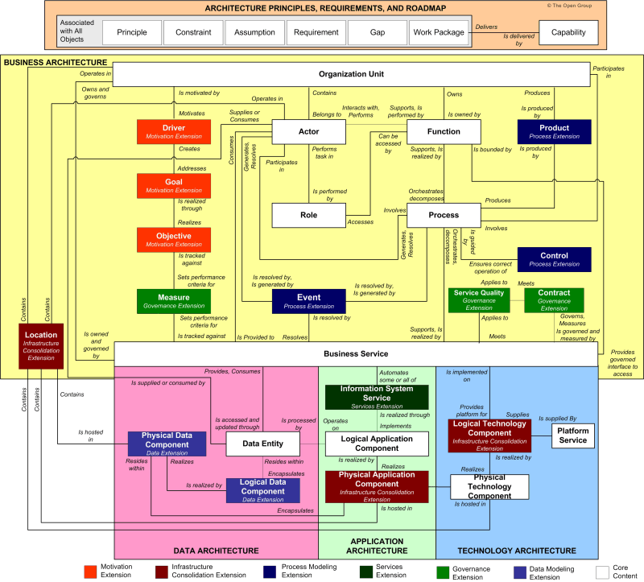

Slide 46
Defining Information
What is information?
TBD
What are the building blocks that are used in the capability architecture for information?
Option 1: Data Entity, Logical Data Component, Physical Data Component
Option 2: Baseline Information Asset, Target Information Asset

Slide 47
Option 1: Use TOGAF Elements
Leverage TOGAF to define the “Information” in the ORBIT model to represent (3) levels of granularity:
Data Entity - An encapsulation of data that is recognized by a business domain expert as a discrete concept. Data entities can be tied to applications, repositories, and services and may be structured according to implementation considerations.
Logical Data Component – An abstract representation of data that defines the structure and relationships of data elements without specifying how they are physically implemented. It serves as a blueprint for data architecture, helping to ensure that data management aligns with business needs and processes.
Physical Data Component - The actual implementation of data storage and management resources within an organization. It includes the specific technologies and systems used to store data, such as databases and data warehouses, ensuring that data is accessible and managed effectively.

Slide 48
Information Architecture Components Option 1
Target (To-Be)
Data Entity
Used to define the data needed by the SMA to meet their desired outcomes.
Logical Data Component
Comparison used to identify gaps in data and drive requirements.
Used to describe the baseline data that is currently used by the SMA.
Baseline (As-Is)
Physical Data Component

Slide 49
IA Metamodel (Option 1)
Capability
Physical Data Component
Baseline Data Role
Supply/Consume/Manage
Baseline Business Process
Accesses
Baseline Application
Accesses

Slide 50
IA Metamodel (Option 1)
Capability
Data Entity
Logical Data Component
Desired Outcome
Drives
Target Data Role
Supply/Consume/Manage
Target Business Process
Accesses
Target Application
Accesses

Slide 51
IA Metamodel in Action
Used to define the processes, data, and technology needed by the SMA to meet their desired outcomes.
Target (To-Be)
Target processes, data, and technology
Comparison used to identify gaps in processes, data, and technology to drive requirements.
Used to describe the baseline processes, data, and technology that is currently used by the SMA.
Baseline (As-Is)
Baseline processes, data, and technology

