Slide 1

Database Systems
Entity Relationship (ER) Modeling

Slide 2
Objectives
  The main characteristics of entity relationship components
  How relationships between entities are defined, refined, and incorporated into the database design process
  How ERD components affect database design and implementation
  That real-world database design often requires the reconciliation of conflicting goals

Slide 3
Entity–relationship model (ER model)
An Entity–relationship model (ER model) describes the structure of a database with the help of a diagram, which is known as Entity Relationship Diagram (ER Diagram). An ER model is a design or blueprint of a database that can later be implemented as a database. The main components of E-R model are: entity set and relationship set.

Slide 4
What is an Entity Relationship Diagram (ER Diagram)?
An ER diagram shows the relationship among entity sets. An entity set is a group of similar entities and these entities can have attributes.
In terms of DBMS, an entity is a table or attribute of a table in database, so by showing relationship among tables and their attributes, ER diagram shows the complete logical structure of a database.

Slide 5
Data Model Basic Building Blocks
Entity: Unique and distinct object used to collect and store data
  Attribute: Characteristic of an entity
Relationship: Describes an association among entities
  One-to-many (1:M)
  Many-to-many (M:N or M:M)
  One-to-one (1:1)
Constraint: Set of rules to ensure data integrity

Slide 6
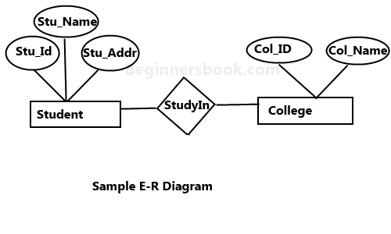
A simple ER Diagram
Student entity has attributes such as Stu_Id, Stu_Name & Stu_Addr and College entity has attributes such as Col_ID & Col_Name.

Slide 7
Geometric shapes and their meaning in an E-R Diagram
Rectangle: Represents Entity sets.
Ellipses: Attributes
Diamonds: Relationship Set
Lines: They link attributes to Entity Sets and Entity sets to Relationship Set
Double Ellipses: Multivalued Attributes
Dashed Ellipses: Derived Attributes
Double Rectangles: Weak Entity Sets
Double Lines: Total participation of an entity in a relationship set

Slide 8
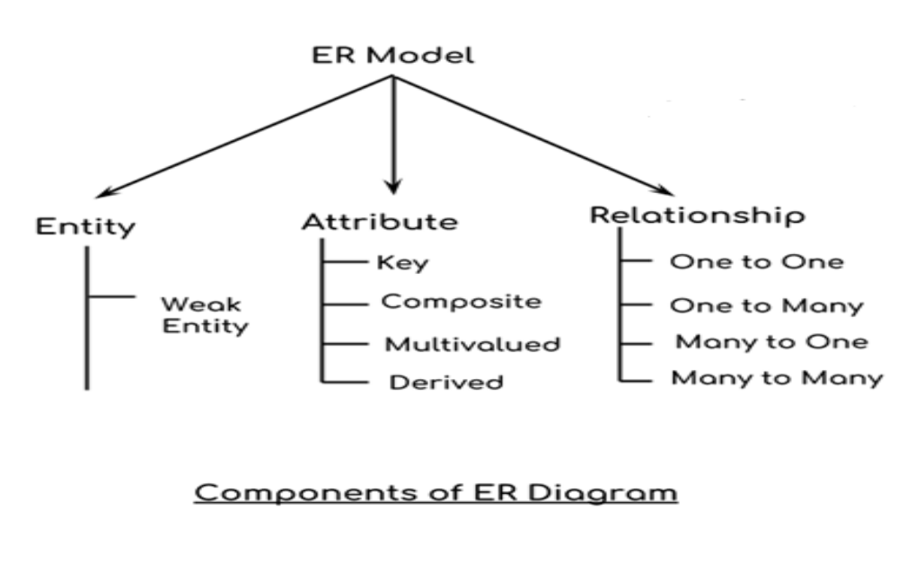
Data Model Basic Building Blocks

Slide 9
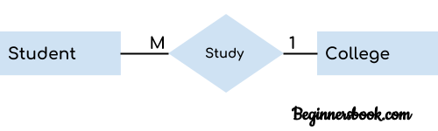
Entity
An entity is an object or component of data. An entity is represented as rectangle in an ER diagram.
In the ER diagram we have two entities Student and College and these two entities have many to one relationship as many students study in a single college.

Slide 10
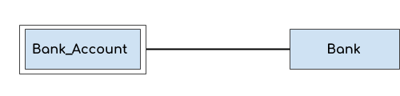
Weak Entity
An entity that cannot be uniquely identified by its own attributes and relies on the relationship with other entity is called weak entity. The weak entity is represented by a double rectangle.
A bank account cannot be uniquely identified without knowing the bank to which the account belongs, so bank account is a weak entity.

Slide 11
Attribute
An attribute describes the property of an entity. An attribute is represented as Oval in an ER diagram. There are four types of attributes:
Key attribute

Slide 12
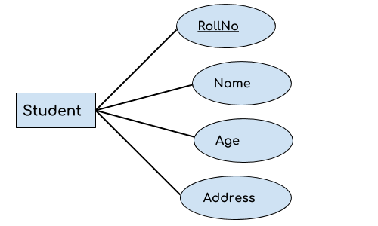
Key attribute
A key attribute can uniquely identify an entity from an entity set. For example, student roll number can uniquely identify a student from a set of students.

Slide 13
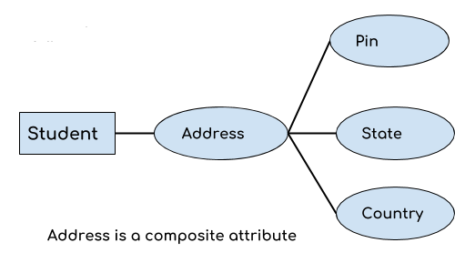
Composite attribute:
An attribute that is a combination of other attributes is known as composite attribute. For example, In student entity, the student address is a composite attribute as an address is composed of other attributes such as pin code, state, country.

Slide 14
Multivalued attribute
An attribute that can hold multiple values is known as multivalued attribute. It is represented with double ovals in an ER Diagram..

Slide 15
Derived attribute
A derived attribute is one whose value is dynamic and derived from another attribute. It is represented by dashed oval in an ER Diagram.

Slide 16
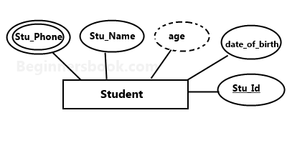
E-R diagram with multivalued and derived attributes:

Slide 17
Relationship
  A relationship is represented by diamond shape in ER diagram, it shows the relationship among entities. There are four types of relationships:
  1. One to One
  2. One to Many
  3. Many to One
  4. Many to Many

Slide 18
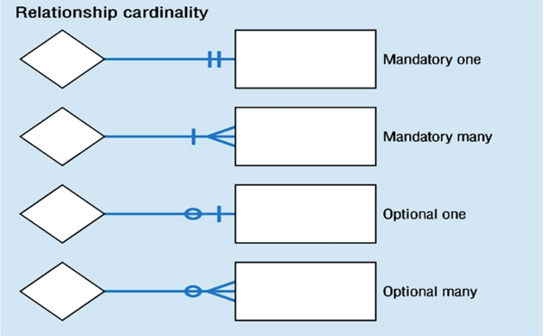
Relationship

Slide 19
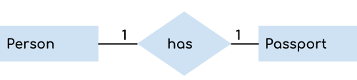
One to One Relationship
  When a single instance of an entity is associated with a single instance of another entity then it is called one to one relationship.

Slide 20
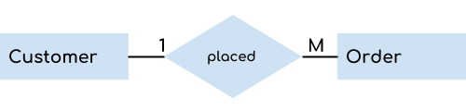
One to Many Relationship
When a single instance of an entity is associated with more than one instances of another entity then it is called one to many relationship.

Slide 21
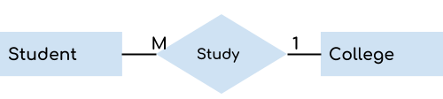
Many to One Relationship
When more than one instances of an entity is associated with a single instance of another entity then it is called many to one relationship.

Slide 22
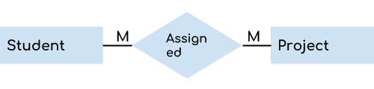
Many to Many Relationship
When more than one instances of an entity is associated with more than one instances of another entity then it is called many to many relationship.

Slide 23
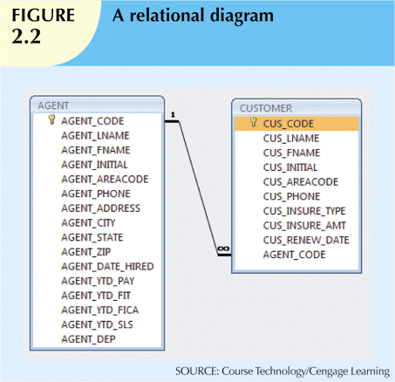

Slide 24

Steps to Create an ERD

Slide 25
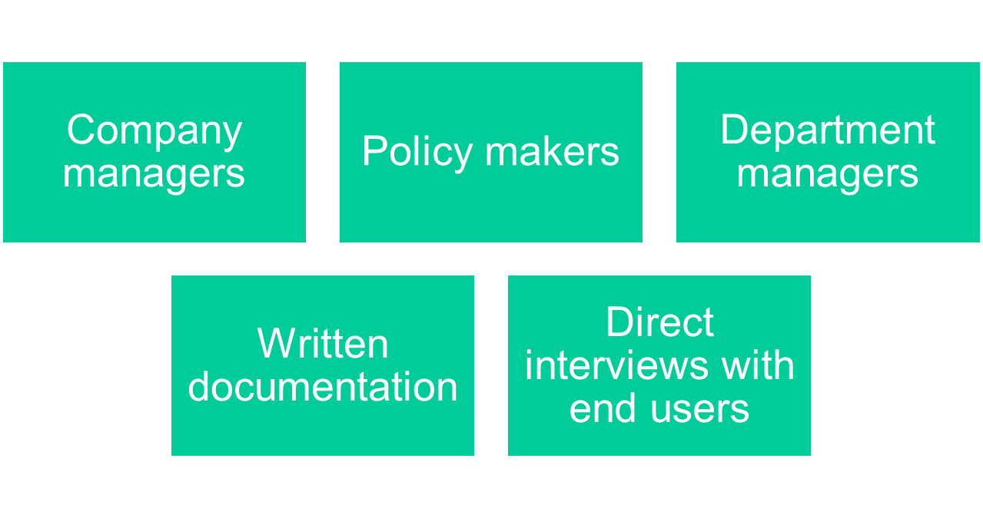
Sources of Business Rules

Slide 26
Reasons for Identifying and Documenting Business Rules
Help standardize company’s view of data
Communications tool between users and designers
Allow designer to:
  Understand the nature, role, scope of data, and business processes
  Develop appropriate relationship participation rules and constraints
  Create an accurate data model

Slide 27
Translating Business Rules into Data Model Components
Nouns translate into entities
Verbs translate into relationships among entities
Relationships are bidirectional
Questions to identify the relationship type
  How many instances of B are related to one instance of A?
  How many instances of A are related to one instance of B?

Slide 28
Naming Conventions
Entity names - Required to:
  Be descriptive of the objects in the business environment
  Use terminology that is familiar to the users
Attribute name - Required to be descriptive of the data represented by the attribute
Proper naming:
  Facilitates communication between parties
  Promotes self-documentation

Slide 29
How to Create an ERD
Example
In a university, a Student enrolls in Courses.
A student must be assigned to at least one or more Courses.
Each course is taught by a single Professor.
To maintain instruction quality, a Professor can deliver only one course

Slide 30
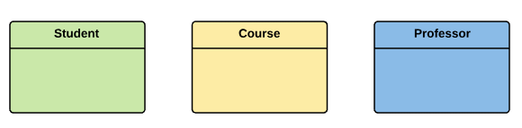
Step 1) Entity Identification
Student
Course
Professor

Slide 31
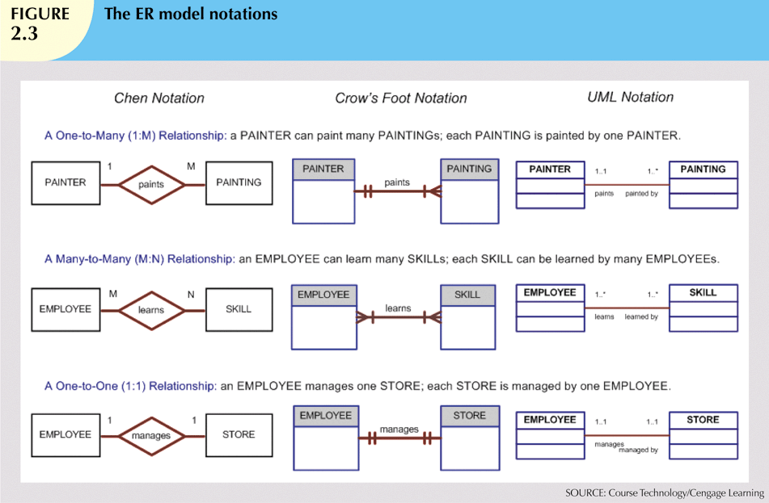

Slide 32
The Object-Oriented (OO) Model
Data and relationships are contained in a single structure known as an object
OODM (object-oriented data model) is the basis for OODBMS
  Semantic data model
An object:
  Contains operations
  Are self-contained: a basic building-block for autonomous structures
  Is an abstraction of a real-world entity

Slide 33
The Object-Oriented (OO) Model (cont’d.)
Attributes describe the properties of an object
Objects that share similar characteristics are grouped in classes
Classes are organized in a class hierarchy
Inheritance: object inherits methods and attributes of parent class
UML based on OO concepts that describe diagrams and symbols
  Used to graphically model a system

Slide 34
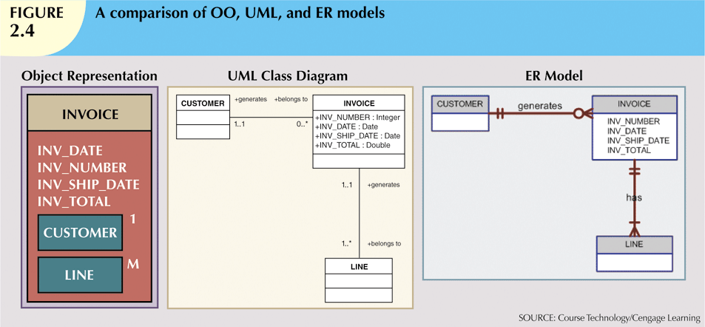

Slide 35
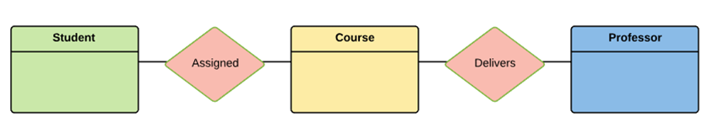
Step 2) Relationship Identification
The student is assigned a course
Professor delivers a course

Slide 36
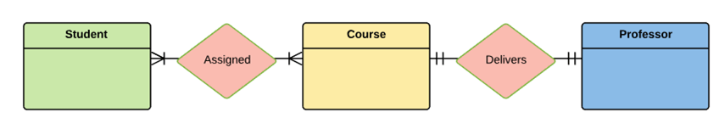
Step 3) Cardinality Identification
A student can be assigned multiple courses
A Professor can deliver only one course

Slide 37
Step 4) Identify Attributes
You need to study the files, forms, reports, data currently maintained by the organization to identify attributes. You can also conduct interviews with various stakeholders to identify entities. Initially, it's important to identify the attributes without mapping them to a particular entity.

Slide 38
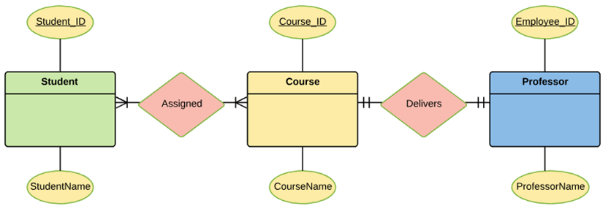

Slide 39
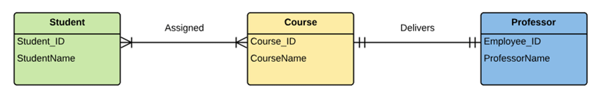
Step 5) Create the ERD

Slide 40
Assignment 1
Create the initial ER diagram for a car dealership at Bolga. The dealership sells both new and used cars,
and it operates a service facility. Base your design on the following business rules:
a. A salesperson can sell many cars but each car is sold by only one salesperson.
b. A customer can buy many cars but each car is sold to only one customer.
c. A salesperson writes a single invoice for each car sold.

Slide 41
Assignment 1(cont'd.)
d. A customer gets an invoice for each car (s)he buys.
e. A customer might come in just to have a car serviced; that is, one need not buy a car to be
classified as a customer. When a customer takes one or more cars in for repair or service, one service ticket is
written for each car.
g. The car dealership maintains a service history for each car serviced. The service records are referenced by the car's serial number.
h. A car brought in for service can be worked on by many mechanics, and each mechanic may work on many cars.

Slide 42
Assignment 1
i. A car that is serviced may or may not need parts. (For example, parts are not necessary to
adjust a carburetor or to clean a fuel injector nozzle.)

