Slide 1
E-Gadgets
Outline
Problem Statement
Aims, goals, and objectives
Scope
Background
Literature review
Requirements
Technology
System Architecture
Convenient online platform for all your electronics needs.
Group 4
Sonam Jamtsho
Jigme Dema
Ngawang Dorji
Lhaki Dema
Rigden Losel

Slide 2
Outline
Problem Statement
Aims, goals, and objectives
Scope
Background
Literature review
Requirements
Technology
System Architecture

Slide 3
Problem Statement
Rising demand for electronics in Bhutan necessitates improved accessibility and affordability.
Establishing a dedicated electronic website can address consumer dissatisfaction, reduce physical store visits, and enhance product awareness.

Slide 4
2. Aims
To create a website to promote and showcase electronic products in Bhutan.

Slide 5
Goals
Create a user-friendly website offering a diverse selection of electronic products to promote economic growth and technological advancement for Bhutanese consumers.

Slide 6
Objectives
Create an interactive and user-friendly website that includes diverse collections of electronics
Make ease for consumers to get the electronic products
Create a reliable and free accessible website

Slide 7
Scope of the project
System Scope
Admin
User
User Scope
Bhutan

Slide 8
3. Background

Slide 9
4. Literature Review
Some of the online electronic stores:
Croma Electronics
Zala.bt

Slide 10
5. Requirements
Functional Requirements
Non-Functional Requirements
User Registration
User Login
Admin login
Search products
Order products
Perform CRUD on product by admin
View post by user
Security
Responsive
Scalability
Compatibility
Performance
Usability

Slide 11
6. Technology
Front-end
Programming languages: React, HTML, CSS, JavaScript
UI frameworks: Bootstrap, Material Design, Foundation
Visual design tools: Figma
Code editors: Visual Studio Code
Back-end
Programming languages: Java, JavaScript
Databases: MySQL
Web frameworks: Spring Boot 3
Version control systems: Git, GitHub

Slide 12
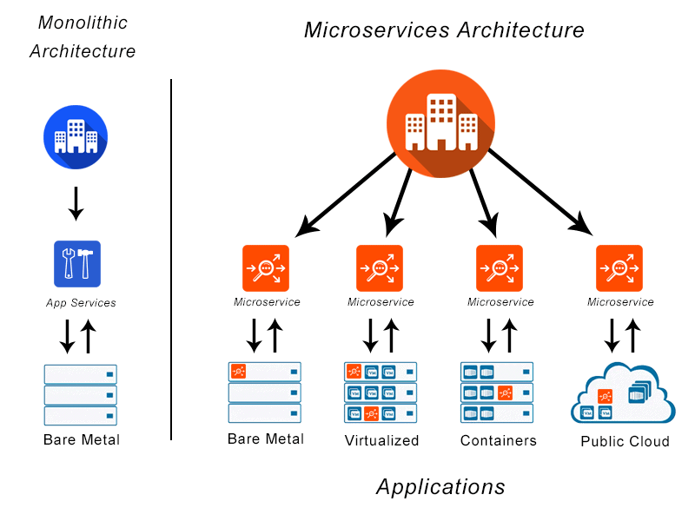
7. System Architecture
System Design

Slide 13
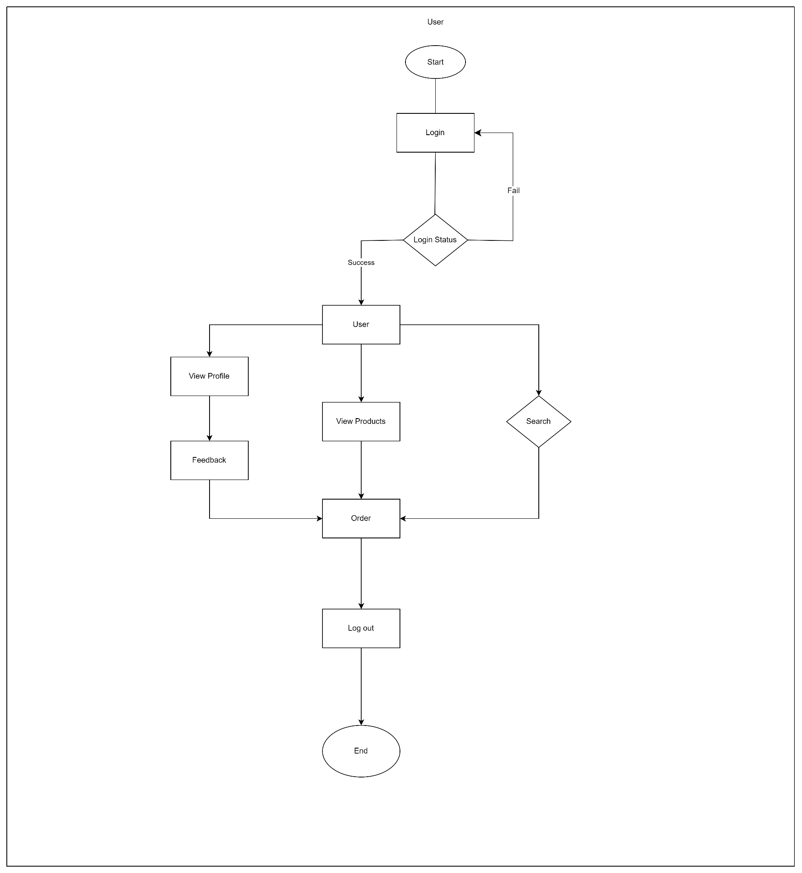
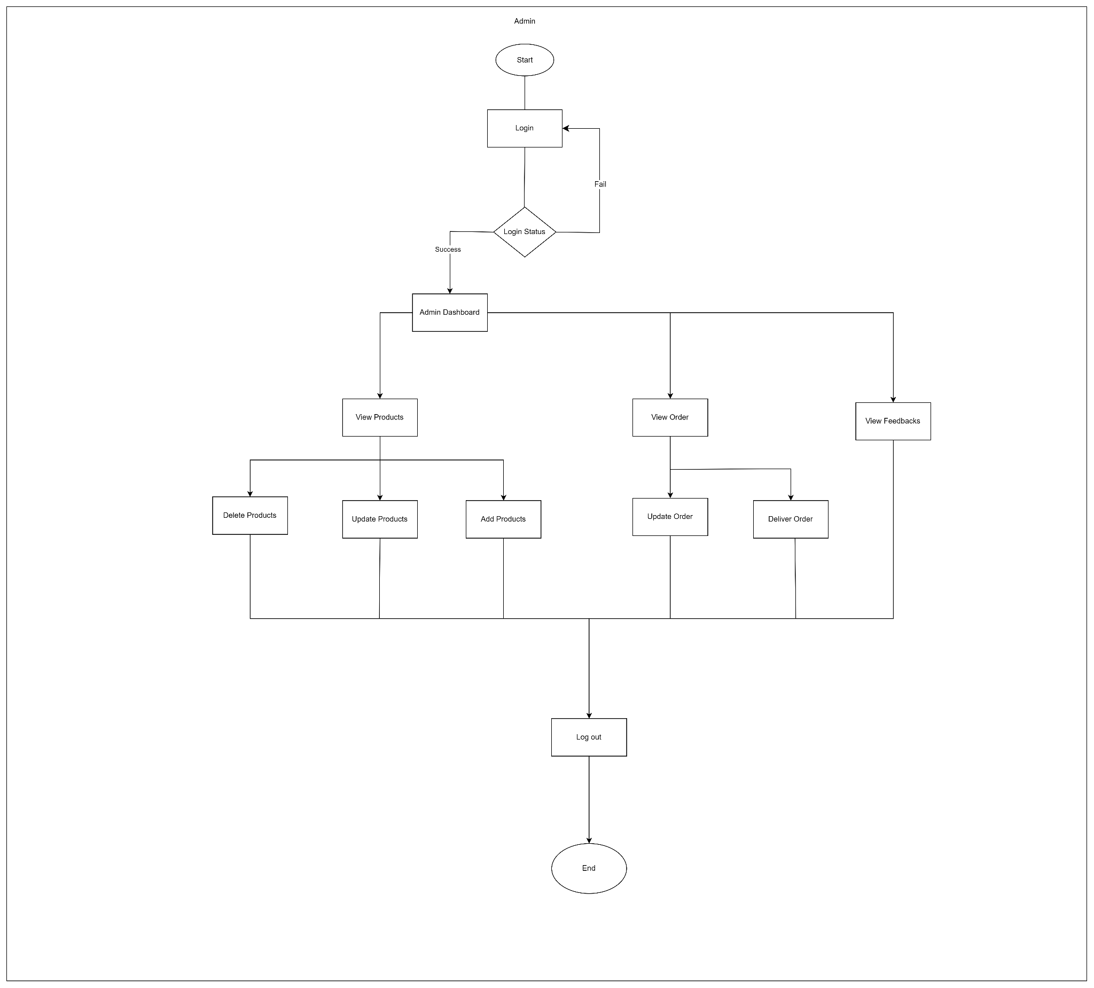
2. Workflow
User
Admin

Slide 14
Thank you

