Slide 1
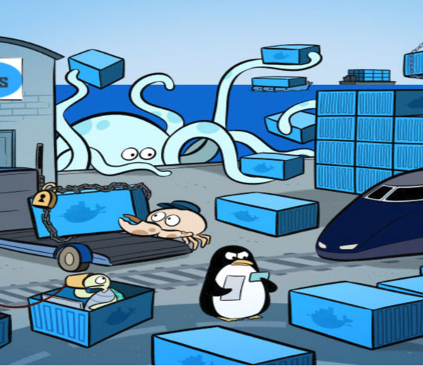
Docker Proofs of Concept
Draft Proposal

Slide 2
Why Containers Now?
We know containers are coming
People are already using them:
Big Data
Oracle
?
We want to manage one consistent platform
We want a ready answer for “how do I run a container?”

Slide 3
Three Phases
Phase One: Proofs of concept (This conversation)
Phase Two: Support of vendor applications
Phase Three: DevOps for our applications

Slide 4
The Players
Owner: Technical Architecture Group
Driver: Eric Burcham
Core Team: Eric Burcham, Dylan Clark, Mike Bollman, Lowell Roberts, Mayme Kittman, Stuart Wagner
Project Manager: TBD. Not needed for Phase One.
Stakeholders: Big Data, Desktop Support, Development Managers, eBusiness, Engineering, Network Team, NOC, Oracle Team, SCADA, Security and Compliance, Server Team
Vendors: Docker Enterprise, Red Hat OpenShift, Rancher

Slide 5
Phase One (2 Months)
Proofs of Concept, Cost Analysis, and Vendor Selection

Slide 6
Requests for Proposals with Demo POC
We’ll present identical requirements to each vendor
We want them to do the demo on our infrastructure
We want to keep the environments around for awhile
We’ll give environment access to our current container users
We’ll try to get this done for free

Slide 7
POC Scope
Automatic Scaling
Authentication / Authorization
Clustering
Copy Control
Deployment
Desktop Support
Health Monitoring
High Availability
Log Management
Management
Network Isolation for Testing
Orchestration
Resource Allocation
Security
Budgeting
Change Management
Desktop Host Management
Image Approval and Management
Licensing and Compliance
Long-term viability
Resource Planning
Security Audits
Technical Support Quality and Availability

Slide 8
Demo Requirements
We’ll provide the application
Deployment
NOC Integration
Proposals

Slide 9
Demo Requirements: The Application
We will provide a simple app to Containerize
The app will have two dependencies
Database
Messaging

Slide 10
Demo Requirements: The Deployment
The vendor will run the application on a desktop
The vendor will demonstrate solutions to our named concerns
The vendor will give us infrastructure requirements
We will provide the infrastructure
The vendor will install, configure, and demonstrate their solution
The application will must be deployed
The application must be reachable on our network
We want them to show us “the standard way” to do this, step by step
Auto-scale running containers as needed
The vendor will demonstrate rolling updates

Slide 11
Demo Requirements: NOC Operations
Demonstrate Monitoring
At the cluster level
At the host level
At the container level
* We prefer to integrate with our current NOC products
Demonstrate Escalation Plans
An application is down
Scarce resources
Demonstrate Rolling Updates
Update running containers from an old base OS image to a current one

Slide 12
Demo Requirements: The Proposal
Basic explanation of licensing
Formal pricing offers
Support details
What parts of the stack are supported
SLA
Pricing
Consulting services
Their consulting model
Availability
Costs

Slide 13
Phase Two (2 Months)
Off-The-Shelf Container Support
Notes:
These applications are provided by vendors.
They are pre-packaged to run as containers.
We deploy them manually and infrequently.
Change control is slow and carefully managed.

Slide 14
Requirements
Pilot use case
Licensing and support agreements
Budget considerations
Planning and training
Security and compliance review
Physical infrastructure
NOC integration
Potential New Roles and Responsibilites

Slide 15
Phase Three (6 Months)
Development Operations: Containers as a Service
Notes:
There will be costs
We expect to engage a vendor to do this
We want to leverage vendor time

Slide 16
Containers as a Service
Source Control
Build
Verify
Docker Hosts
Desktop
Test Env
Private
Container
Registry
UAT Env
On-Premise
Code
Debug
Run
Validate
Off-Premise
Notes:
Add detailed notes about why this takes so long.

Slide 17
Next Steps
Finalize our team
Write our RFP document
Submit RFP to vendors
Coordinate vendor presentations
Nail down estimate for phase 2

