Slide 1
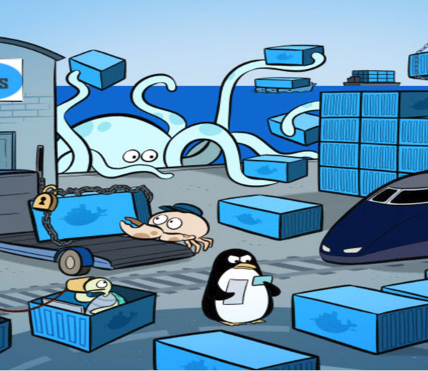
Docker Proofs of Concept
Draft Proposal

Slide 2
A Quick Refresher
More efficient usage of server resources
Rapid deployments
Simplicity around security
Rapid iteration for dev teams

Slide 3
Why Now?
We know containers are coming
We want to manage one consistent platform
We want a ready answer for people
Notes:
In fact, we have containers in house today, but we don’t have a long-term plan to manage them for everyone.

Slide 4
Three Phases
Phase One: Proofs of concept (This conversation)
Phase Two: Basic Container Support
Phase Three: DevOps Integration
Notes:
POCs – we’re really talking about making sure the vendors we’re considering are ready for prime time.

Slide 5
The Players
Owner: Technical Architecture Group
Driver: Eric Burcham
Core Team: Eric Burcham, Dylan Clark, Mike Bollman, Lowell Roberts, Mayme Kittman, Stuart Wagner
Stakeholders: Big Data, Desktop Support, Development Managers, eBusiness, Engineering, Network Team, NOC, Oracle Team, SCADA, Security and Compliance, Server Team
Vendors: Docker Enterprise, Red Hat OpenShift, Rancher
Notes:
Core Team – Will be doing or managing the work
Stakeholders – Wil be consulted during the POC planning phase for their input, and will have an opportunity to get their hands on the environments.
Vendors – Of the vendors in the market, we talked to many and think these three have the most mature offerings

Slide 6
Phase One (2 Months)
Proofs of Concept, Cost Analysis, and Vendor Selection
Notes:
I feel pretty good about this estimate.
This time should mostly be spent planning, and waiting for vendors
We have had demos with various vendors
We have expressed concerns about security, copy control, license management, etc…
Vendors have addressed those concerns verbally
We want those solutions demonstrated
We want to get our hands on the solutions
We want to get pricing
We want to get SLAs
We want to understand consulting costs

Slide 7
Proofs of Concept
Present requirements
Demonstrations
Formal pricing
Notes:
- Requirements -
For objectivity we’ll present identical requirements to each vendor
We will provide answers to questions to all vendors
We’ll provide the application so they can’t use a canned example
- Demonstrations -
We want them to do the demo on our infrastructure
We want to keep the environments around for awhile
We’ll give environment access to our current container users
We’ll try to get this done for free
- Pricing -
Application pricing
Hardware requirements

Slide 8
POC Scope (Hide in Staff Meeting)
Automatic Scaling
Authentication / Authorization
Clustering
Copy Control
Deployment
Desktop Support
Health Monitoring
High Availability
Log Management
Management
Network Isolation for Testing
Orchestration
Resource Allocation
Security
Budgeting
Change Management
Desktop Host Management
Image Approval and Management
Licensing and Compliance
Long-term viability
Resource Planning
Security Audits
Technical Support Quality and Availability

Slide 9
Demo Requirements
We’ll provide the application
Deployment
NOC Integration
Proposals

Slide 10
Phase One Outcome
We select a primary vendor
We have faith in the solution
We understand pricing and support
Notes:
We understand how our requirements our met
Our teams have had their hands on the solutions
We can better estimate phases two and three

Slide 11
Demo Requirements: The Application
We will provide a simple app to Containerize
The app will have two dependencies
Database
Messaging

Slide 12
Demo Requirements: The Deployment
The vendor will run the application on a desktop
The vendor will demonstrate solutions to our named concerns
The vendor will give us infrastructure requirements
We will provide the infrastructure
The vendor will install, configure, and demonstrate their solution
The application will must be deployed
The application must be reachable on our network
We want them to show us “the standard way” to do this, step by step
Auto-scale running containers as needed
The vendor will demonstrate rolling updates

Slide 13
Demo Requirements: NOC Operations
Demonstrate Monitoring
At the cluster level
At the host level
At the container level
* We prefer to integrate with our current NOC products
Demonstrate Escalation Plans
An application is down
Scarce resources
Demonstrate Rolling Updates
Update running containers from an old base OS image to a current one

Slide 14
Demo Requirements: The Proposal
Basic explanation of licensing
Formal pricing offers
Support details
What parts of the stack are supported
SLA
Pricing
Consulting services
Their consulting model
Availability
Costs

Slide 15
Phase Two (2 Months)
Basic Container Support
Notes:
This is a rough time estimate. We’ll tighten it up after phase one.
We can run pre-built containers provided by vendors.
We can run our own containerized applications.
Deployments and configuration handled manually.

Slide 16
Phase Two Outcome
Licensing and support agreements
We know how containers are internally paid for
Security and compliance review
Physical infrastructure is allocated
NOC integration is complete
Personnel are ready

Slide 17
Phase Three (2 – 6 Months)
DevOps Integration
Notes:
This is a VERY rough time estimate
There may be significant costs
We’re pretty busy, so we expect to engage a vendor to do this

Slide 18
Phase Three Outcome
Desktop container support
Boilerplate for common project types
Continuous integration
Automated deployments
Notes:
Push people into the pit of success

Slide 19
Containers as a Service
Source Control
Build
Verify
Docker Hosts
Desktop
Test Env
Private
Container
Registry
UAT Env
On-Premise
Code
Debug
Run
Validate
Off-Premise
Notes:
Add detailed notes about why this takes so long.

Slide 20
Next Steps
Finalize our team
Visit with all stakeholders
Write our RFP document
Submit RFP to vendors
Coordinate vendor presentations

