Slide 1
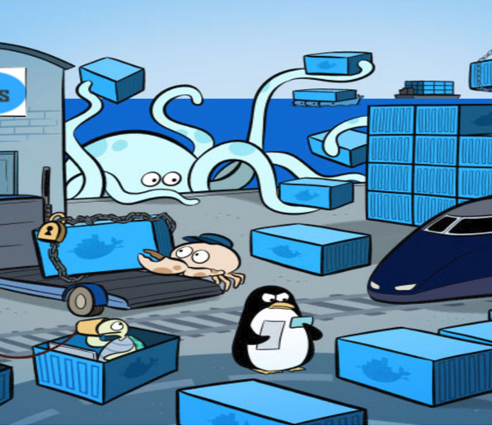
Docker Proofs of Concept
Draft Proposal

Slide 2
Introduction
Where I Tell You What I’m Going to Tell You

Slide 3
Three Phases
Phase One: Proofs of concept (This talk).
Phase Two: Support of vendor applications.
Phase Three: DevOps for our applications.

Slide 4
T-Shirt Sizes
Small: 0-2 Weeks
Medium: 2 Weeks – 2 Months
Large: 2 – 6 Months
Extra Large: More than 6 Months

Slide 5
Phase One
Proofs of Concept and Vendor Selection

Slide 6
Phase Two
Support of Vendor Applications

Slide 7
Phase Two
Support of Vendor Applications

