Slide 1
Introduction to Containers
Where I Tell You About Containers

Slide 2
Presentation Overview
Where I tell you what I’m going to tell you.

Slide 3
Presentation Overview
A Problem Statement
A Brief History Lesson
A Quick Comparison With Virtual Machines
A Quick Look at Containers
A Hard Look at Some Concerns
A Look at Next Steps
A Q&A Session

Slide 4
Beginning of a Super-Quick Demo
Show SQL Server is not installed
Use docker to configure SQL Server, no installation or admin intervention required

Slide 5
A Problem Statement
The Part Where I tell you what you already know

Slide 6
Why Do Containers Exist?
Applications are the core of modern business.
It is inefficient to deploy an operating system for each application.
It is difficult to create, deploy, run, monitor, and patch applications.

Slide 7
A Brief History Lesson
Where I Give You Some Context

Slide 8
Applications Run Businesses
Applications run businesses.
Applications run on servers.
The business needs a new application.

Slide 9
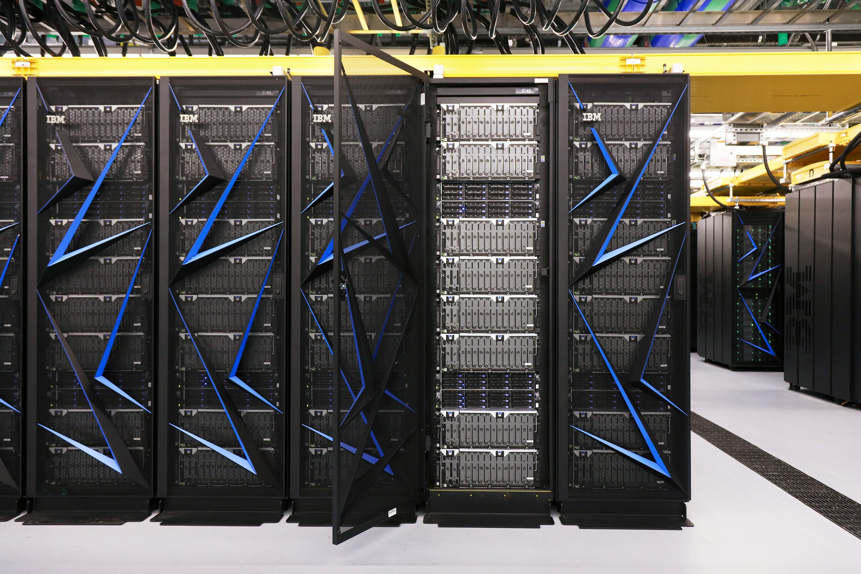
The Bad Old Days
An new application meant a new server
Procurement Lead Times
Up-front capex
Ongoing capex
Somebody asks how much power we need
Nobody knows
I.T. does the only reasonable thing
Massively overpowered servers running at 10-20%
The result was a shameful waste of company $$$$$
App

Slide 10
Hello Hypervisor!
Along came Hypervisors
We can now squeeze more out of physical servers
We can still isolate an application to an OS
Yay for VMWare!
But there are some VMWarts

Slide 11
Physical Server
App
App
App
App
Hypervisor
Notes:
We have a physical server.
We’re still running out applications on it.

Slide 12
Physical Server
App
App
App
App
VM
VM
VM
VM
Hypervisor
Notes:
Each App Gets a VM
Each VM has allocated resources
We don’t have a great way to auto-allocate, so again, we over-allocate.

Slide 13
Physical Server
App
App
App
App
OS
OS
OS
OS
OS
OS
OS
OS
VM
VM
VM
VM
Hypervisor
Notes:
Each VM has an operating system.
This is very wasteful.
Each OS steals a chunk of resources
Each OS has a license
Each OS has to be secured
Each OS has to be patched and maintained
Evolve alone has 700+ of these
This all feels like a shame
None of us are in the business of seeing how many operating systems we can manage

Slide 14
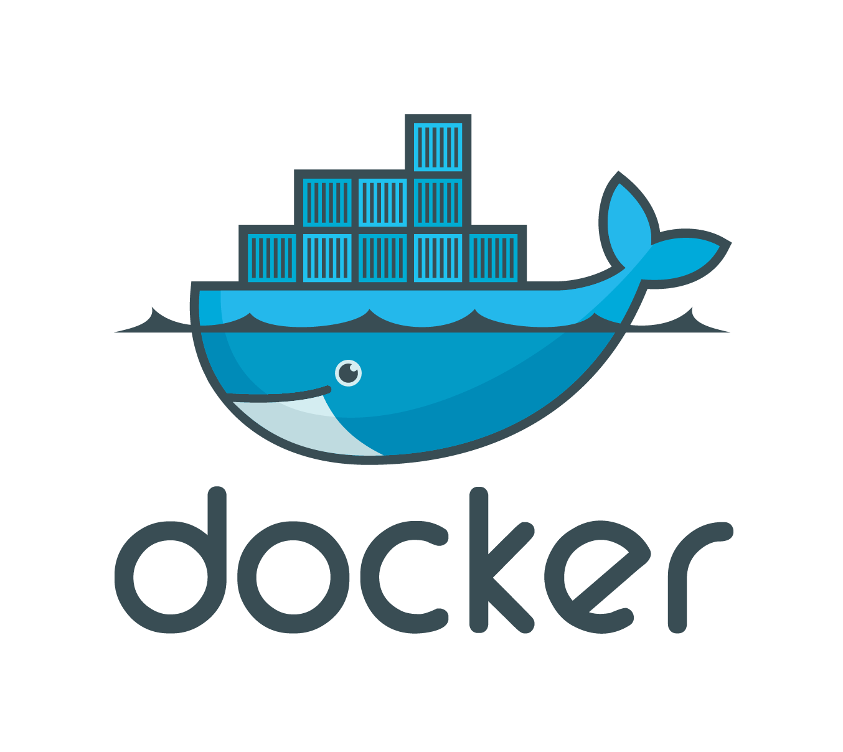
Enter Containers
A Quick Comparison With Virtual Machines

Slide 15
Physical Server
Notes:
We still have a physical server

Slide 16
Physical Server
App
App
App
App

Slide 17
Physical Server
App
App
App
App
OS

Slide 18
Physical Server
App
App
App
App
OS

Slide 19
Physical Server
App
App
App
App
OS

Slide 20
Physical Server
App
App
App
App
Savings
OS

Slide 21
Physical Server
Physical Server
App
App
App
App
Savings
App
App
App
App
OS
OS
OS
OS
OS
OS
OS
OS
VM
VM
VM
VM
OS
Hypervisor
Notes:
Each VM has an operating system.
This is very wasteful.
Each OS steals a chunk of resources
Each OS has a license
Each OS has to be secured
Each OS has to be patched and maintained
Evolve alone has 700+ of these
This all feels like a shame
None of us are in the business of seeing how many operating systems we can manage

Slide 22
A Quick Look at Containers
Where I Tell You What containers Are

Slide 23
What is a Container?
A Virtual Box That Packages Applications With Dependent Components and Services
Implements a high-level API to provide lightweight isolation
Works on the kernel’s functionality to ensure isolation of:
CPU
Memory
Block I/O
Network
More

Slide 24
What is Docker?
Little “d” docker – the container runtime and format
Big “D” Docker – the inventing and driving company
Now one of many competitors in the space

Slide 25
The Open Container Initiative
Governing body for containers
Very high-level governance
Seems to be doing it right (as opposed to the web standards, for example)
Big “D” Docker contributed the little “d” docker format
Google adopted the format and contributed Kubernetes
As a result we have many options and tools available that play nice

Slide 26
Container Advantages
True Isolation of Resources
Identical application packaging
Automated application deployment
Rapid deployment
Extremely low redundancy / Simplified portability
Minimum runtime requirements
Minimum resource requirements
Excellent management
Simplified portability

Slide 27
Containers and Development
No need to install and manage dependencies (I’ll demonstrate this)
Dependencies and their configuration are part of source code
This means everything behaves the same for everyone. This is critically important
When a developer solves a dependency problem, everyone gets it immediately
Resources for dependencies are only consumed when running the application. For example on Evolve we run:
Erlang
RabbitMQ
SQL Server

Slide 28
Containers and Development (Continued)
Provides a true “all in one” environment to the developer, without manual intervention
Resources are only consumed when running the application
The local environment can be extremely similar to downstream environments
When adding features or bugfixes, you can debug inside the container

Slide 29
Containers and Devops / Release Management
The result of our build goes in a container registry.
Deployment is extremely fast.
Startup is extremely fast.
The container is 100% consistent in all environments.
Only configuration needs to change.
This is only done when building containers from images.
Server density can be extremely high.
Reduced cost of hardware and OS licensing
Reduced maintenance burden
Much more rapid iterations

Slide 30
Containers and Operations
Reduced infrastructure cost
Tight control of container images
Security auditing
Required certification of applications
Excellent tools for automatic scaling
Reduced maintenance burden

Slide 31
A Rich Ecosystem
There is already stuff:
For configuring
For securing
For auditing
For automating
For deployment
For scaling
For NOC operations
For monitoring and visualization

Slide 32
A Hard Look at Some Concerns
Where I Tell You To BE Cautious

Slide 33
You Have An Awesome Staff!
I wanted to do a proof of concept for the developer story with docker…
These guys already know how to handle:
Application monitoring
Application isolation
License auditing and control
Patching and scheduling patches
Disaster recovery
Resource allocation
Etc…

Slide 34
Doomsday Docker Security Hole Uncovered
I’m SUPER sad about this.
One of the great fears about docker realized.
About RunC
Underlying runtime for Docker, Kubernetes, and other container-dependent programs
Created by Docker / Now an open-container initiative specification
Almost every container on earth is running on the RunC runtime
Allows a container to overwrite the host RunC binary and gain root-level execution on the host OS

Slide 35
Doomsday Docker Security Caveats
The problem highlights the newness of containers and the underlying tech. However…
The community works like it is supposed to.
A researcher found and documented the problem first
No known exploits occurred (as of this writing)
The problem was fixed in three days
Hosts runtimes were easy to patch
Fortunately, the attacker must be able to run commands within the container as root
If the host is secured, and the container is secured from malicious access, the problem is moot
This means the container must be based on a malicious root image
Lots of sysadmins are lazy and do not examine containers
If we adopt containers, we cannot be haphazard about it

Slide 36
A Quick Look at Next Steps
Where I Tell You What I Think We Should Do

Slide 37
We Need Some Proofs of Concept
We are (with some caveats) not in a hurry
We should evaluate all the offerings
We keep learning new things at every demo
We should first consider our existing Enterprise partners
We should try to avoid vendor lock-in
We should take our time and get it right
This is already being done

Slide 38
Methodically Address Our Concerns
How do we lock down public images?
How do we audit licenses?
How do we audit base images?
How do we monitor running applications?
How do we scale effectively?
How do we do disaster recovery?
How do we provide information to support teams?
How do we secure desktops for Docker?
Etc…

Slide 39
Individual Preparedness
Everybody needs to do a little work
If you are the hands-on type, get your hands dirty
Install docker somewhere
Play with it, develop and dockerize an app, build containers, smash ‘em, trash ‘em, etc…
Go through the Pluralsight courses, especially the deep dives
Take some notes
If you are not the hands-on type, do your homework
Go through one Pluralsight course: “Docker and Containers: The Big Picture” by Nigel Poulton. This is only about 4 hours.
Start talking about it with your peers and subordinates
Give some time to thinking about it

Slide 40
Organizational Preparedness
CONTAINERS ARE COMING
Acceptance is key
People are already using them
Make a formal analysis so we aren’t caught on our heels
Decide on partners and platforms
Discuss budgeting across teams
Use the Big Data / Data Science team as a launchpad
Create boilerplate so it is easy to start new applications with containers
Especially CI / CD (where appropriate)

Slide 41
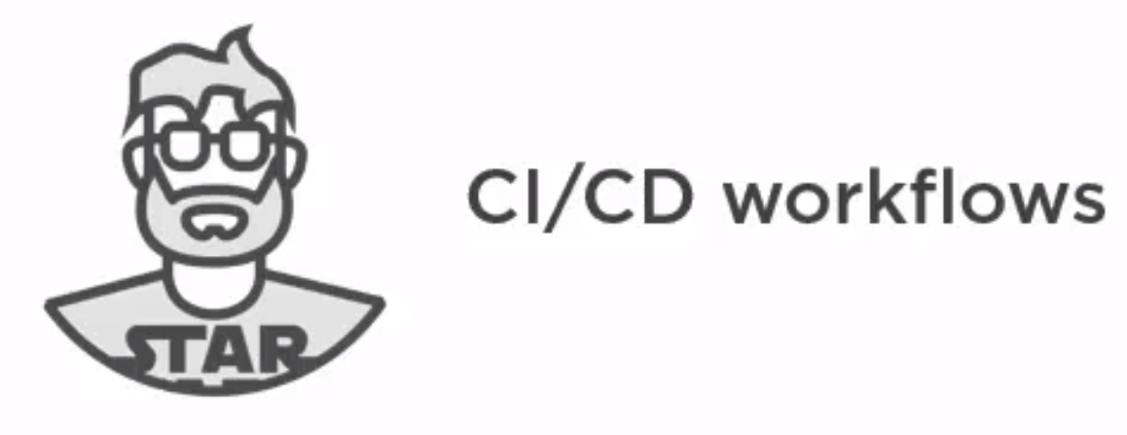

Organizational Preparedness (Continued)
Start making it official so we don’t have unsupervised pockets of adoption
Consider starting with developers and devops. This is who containers were designed for.
Ignore operations at your peril. They present many blockers to moving forward, as they should.

Slide 42
Ending of a Super-Quick Demo
Start SQL Server
Demonstrate a connection

Slide 43
A Q&A Session
Where I Expose My Ignorance

