Slide 1
Introduction to Containers
Where I tell you About Containers

Slide 2
Presentation Overview
Where I tell you what I’m going to tell you.

Slide 3
Presentation Overview
A Problem Statement
A Brief History Lesson
A Quick Comparison With Virtual Machines
A Quick Look at Containers
A Hard Look at Some Concerns
A List of Solution Partners
A Look at Next Steps

Slide 4
A Problem Statement
The Part Where I tell you what you already know

Slide 5
Why Do Containers Exist?
Applications are the core of modern business.
It is inefficient to deploy an operating system for each application.
It is difficult to create, deploy, run, monitor, and patch applications.

Slide 6
A Brief History Lesson
Where I Give You Some Context

Slide 7
Applications Run Businesses
Applications run businesses.
Applications run on servers.
The business needs a new application.

Slide 8
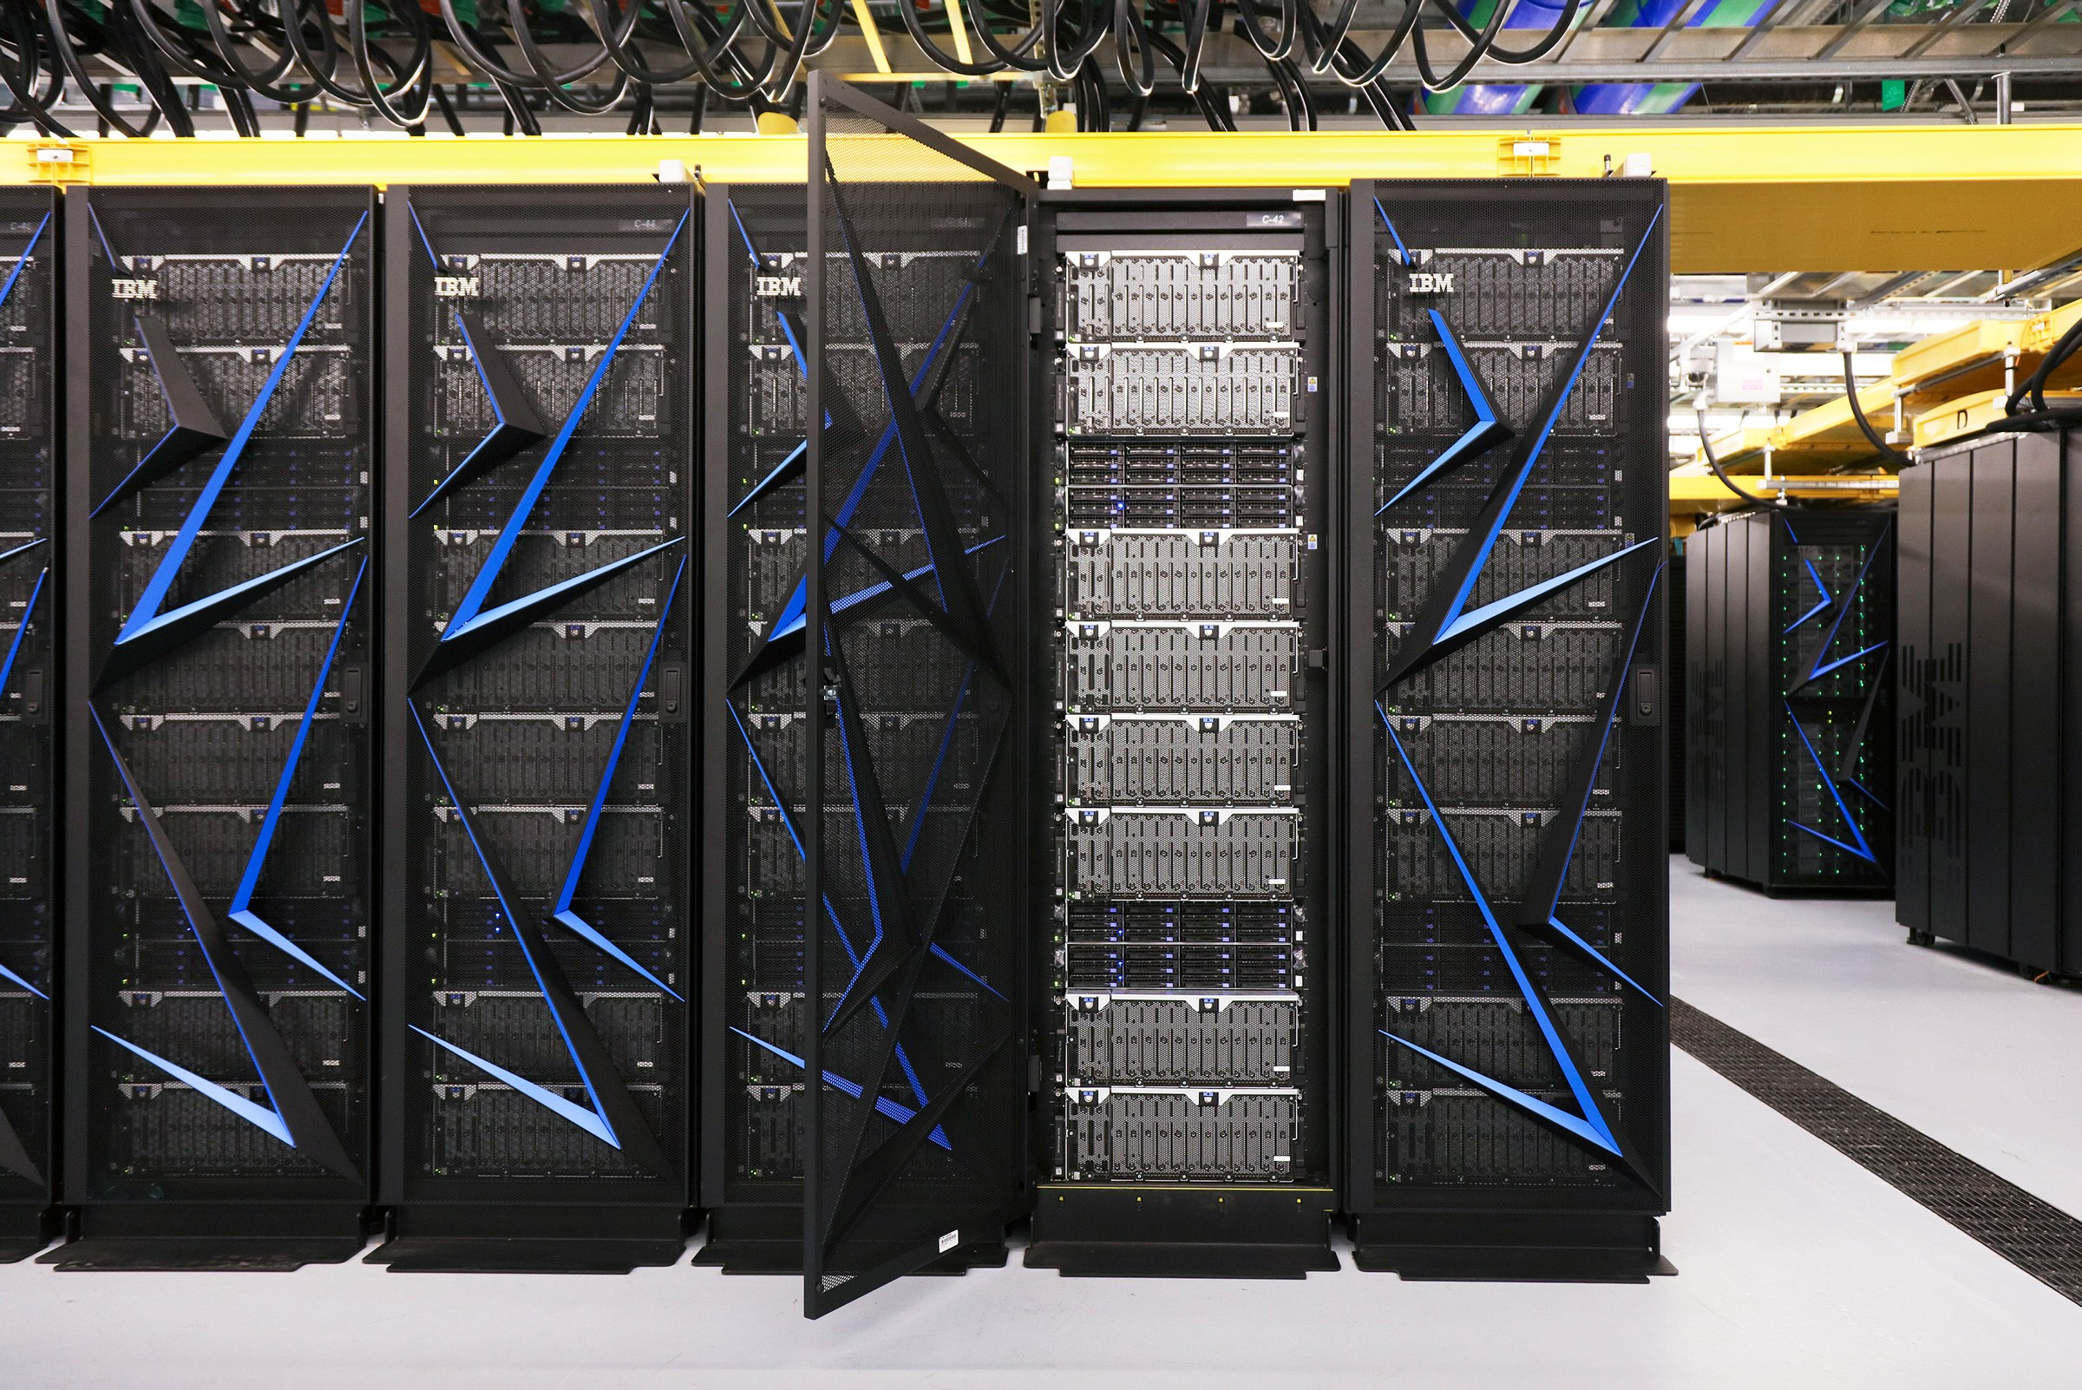
The Bad Old Days
An new application meant a new server
Procurement Lead Times
Up-front capex
Ongoing capex
Somebody asks how much power we need
Nobody knows
I.T. does the only reasonable thing
Massively overpowered servers running at 10-20%
The result was a shameful waste of company $$$$$
App

Slide 9
Hello Hypervisor!
Along came Hypervisors
We can now squeeze more out of physical servers
We can still isolate an application to an OS
Yay for VMWare!
But there are some VMWarts

Slide 10
Physical Server
App
App
App
App
Hypervisor
Notes:
We have a physical server.
We’re still running out applications on it.

Slide 11
Physical Server
App
App
App
App
VM
VM
VM
VM
Hypervisor
Notes:
Each App Gets a VM
Each VM has allocated resources
We don’t have a great way to auto-allocate, so again, we over-allocate.

Slide 12
Physical Server
App
App
App
App
OS
OS
OS
OS
OS
OS
OS
OS
VM
VM
VM
VM
Hypervisor
Notes:
Each VM has an operating system.
This is very wasteful.
Each OS steals a chunk of resources
Each OS has a license
Each OS has to be secured
Each OS has to be patched and maintained
Evolve alone has 700+ of these
This all feels like a shame
None of us are in the business of seeing how many operating systems we can manage

Slide 13
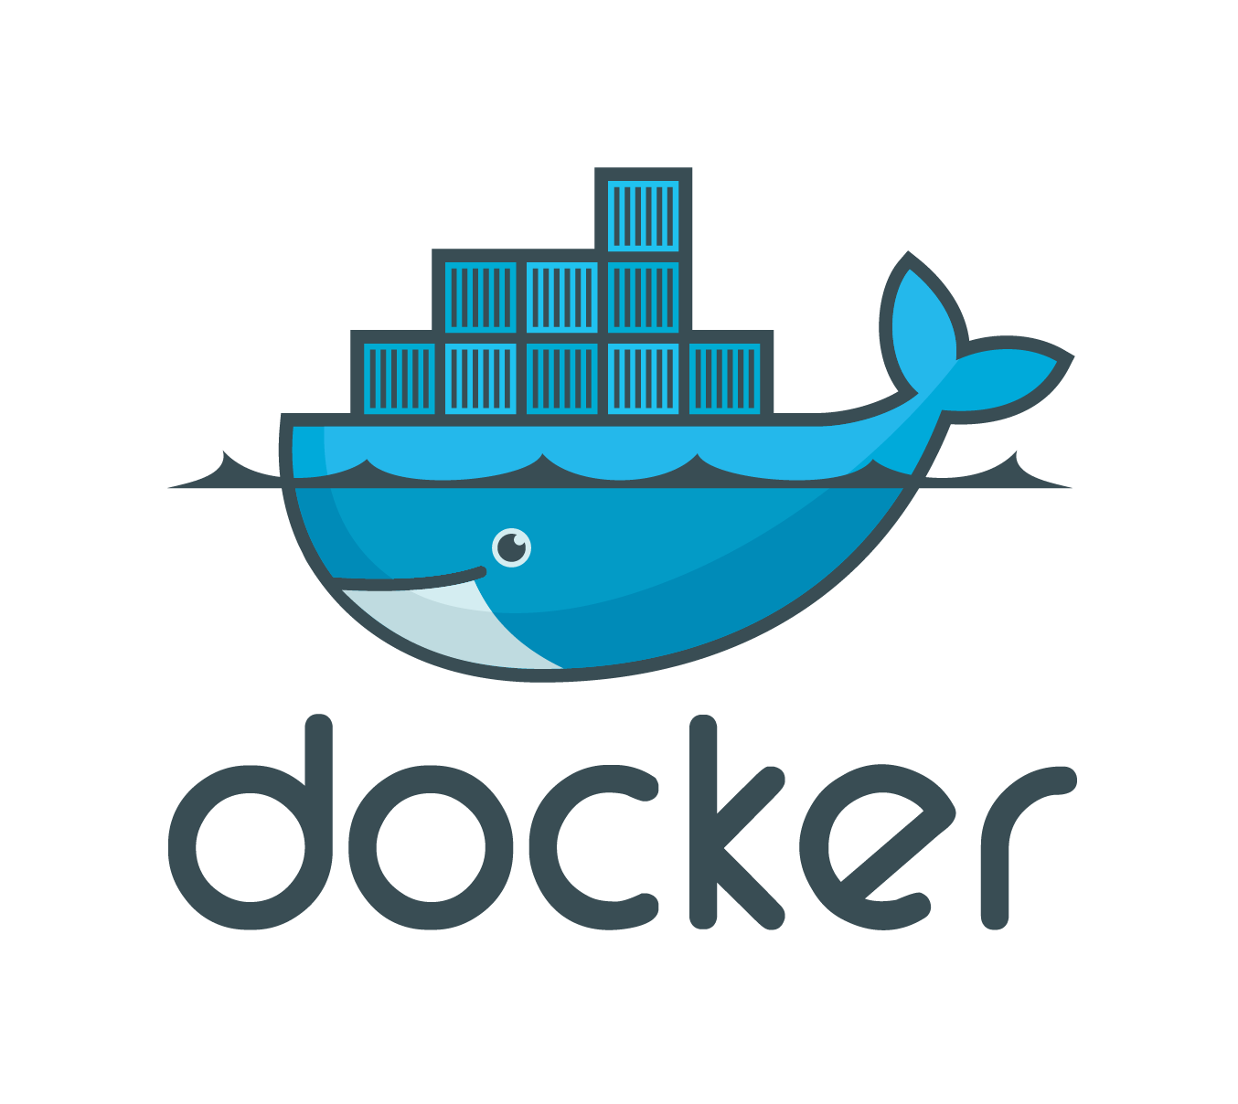
Enter Containers
A Quick Comparison with Virtual Machines

Slide 14
Physical Server
Notes:
We still have a physical server

Slide 15
Physical Server
App
App
App
App

Slide 16
Physical Server
App
App
App
App
OS

Slide 17
Physical Server
App
App
App
App
OS

Slide 18
Physical Server
App
App
App
App
OS

Slide 19
Physical Server
App
App
App
App
Savings
OS

Slide 20
Physical Server
Physical Server
App
App
App
App
Savings
App
App
App
App
OS
OS
OS
OS
OS
OS
OS
OS
VM
VM
VM
VM
OS
Hypervisor
Notes:
Each VM has an operating system.
This is very wasteful.
Each OS steals a chunk of resources
Each OS has a license
Each OS has to be secured
Each OS has to be patched and maintained
Evolve alone has 700+ of these
This all feels like a shame
None of us are in the business of seeing how many operating systems we can manage

Slide 21
A Quick Look at Containers
Where I Tell You What containers Are

Slide 22
What is a Container?
A Virtual Box That Packages Applications With Dependent Components and Services
Implements a high-level API to provide lightweight isolation
Works on the kernel’s functionality to ensure isolation of:
CPU
Memory
Block I/O
Network
More

Slide 23
Container Advantages
True Isolation of Resources
Truly identical application packaging
Automated application deployment
Rapid deployment
Extremely low redundancy / Simplified portability
Minimum runtime requirements
Minimum resource requirements
Excellent management
Simplified portability

Slide 24
Containers and Development
No need to install and manage dependencies (I’ll demonstrate this)
Dependencies and their configuration are part of source code
This means everything behaves the same for everyone. This is critically important
When a developer solves a dependency problem, everyone gets it immediately
Resources for dependencies are only consumed when running the application. For example on Evolve we run:
Erlang
RabbitMQ
SQL Server

Slide 25
Containers and Development (Continued)
Provides a true “all in one” environment to the developer, without manual intervention
The local environment can be extremely similar to downstream environments
When adding features or bugfixes, you can debug inside the containerResources are only consumed when running the application

Slide 26
Containers and Devops / Release Management
The result of our build goes in a container registry.
Deployment is extremely fast.
Startup is extremely fast.
The container is 100% consistent in all environments.
Only configuration needs to change.
This is only done when building containers from images.
Server density can be extremely high.
Reduced cost of hardware and OS licensing
Reduced maintenance burden
Much more rapid iterations

Slide 27
Containers and Operations
Reduced infrastructure cost
Tight control of container images
Security auditing
Required certification of applications
Excellent tools for automatic scaling
Reduced maintenance burden

Slide 28
A Hard Look at Some Concerns
Where I Tell You To BE Cautious

Slide 29
You Have An Awesome Staff!
I wanted to do a proof of concept for the developer story with docker…
These guys already know how to handle:
Application monitoring
Application isolation
License auditing and control
Patching and scheduling patches
Disaster recovery
Resource allocation
Etc…

