Slide 1
Learning Path 7:
Manage Exchange Hybrid Settings and Migrations

Slide 2
Learning Path Agenda
Explore Exchange Hybrid Deployment Requirements
Plan and Configure a Hybrid Deployment Using the Hybrid Configuration Wizard
Lab 7-Exercise 1 – Prepare Azure AD for a Hybrid Deployment
Plan Mailbox Migrations
Run Mailbox Migrations
Lab 7-Exercise 2 – Configure your Hybrid Deployment
Troubleshoot hybrid deployments
Lab 7-Exercise 3 – Test your Hybrid Deployment
Exercise – Planning a Mail Migration to Microsoft 365

Slide 3
Module 1: Explore Exchange Hybrid Deployment Requirements

Slide 4
Introduction
This Module examines the features, components, and requirements necessary to implement a hybrid deployment
After this Module, you’ll be able to:
Describe connection options that are available
for connecting on-premises Exchange to Microsoft 365
List and describe components of a hybrid deployment
Describe Azure Active Directory Connect
(Azure AD Connect)
Identify Microsoft 365 identity options for Exchange hybrid
Compare Exchange delegated federation vs. OAuth

Slide 5
Examine the connection options for Exchange to Microsoft 365
 | IMAP Migration | Cutover Migration | Staged Migration | Hybrid/Native
Exchange 5.5/2000 | X | - | - | -
Exchange 2003 | X | X | X | X*
Exchange 2007 | X | X | X | X*
Exchange 2010 | X | X | - | X
Exchange 2013-SE | X | X | - | X
Notes/Domino | X | - | - | -
GroupWise | X | - | - | -
GMAIL | X | - | - | X
Tenant to Tenant | - | - | - | X
Other | X | - | - | -
* Exchange 2003 or 2007 requires at least an Exchange 2010 Server for Hybrid

Slide 6
Explore the components of a hybrid deployment
On-premises organization
Exchange Online Protection (EOP
Azure Active Directory
Internet
corp.contoso.com
Domain Controllers
Azure AD Connect
Azure AD Connect server
Azure AD identity
Services
Contoso.mail.onmicrosoft.com (managed)
Contoso.com (federated)
Azure AD
authentication system
ADFS
sts.contoso.com
ADFS server
Recipient synchronization from on-premises to cloud
Internet
Recipient synchronization within Office 365 for enterprise
On-premises federation trust
Pre-defined cloud federation trust
Active Directory Federation Services trust to Microsoft Online ID from on-premises
Pre-defined ADFS trust Microsoft Online ID from cloud
Ex-MBX
mail.contoso.com
hybrid.contoso.com
Exchange server
Mail flow to and from on-premises and the Internet and secure mail flow between on-premises and Exchange Online organizations
Secure mail transport between FOP and Exchange Online
Internal mail flow between on-premises CAS and MBX servers

Slide 7
Explore Azure Active Directory Connect
The Azure AD Connect tool, formerly known as DirSync, is the directory synchronization tool for Microsoft 365
The tool enables coexistence between an organization's on-premises Active Directory Domain Services environment (AD DS) and Microsoft 365 in the cloud
Microsoft 365
Azure AD Connect
On-premises
Active Directory
Azure
Active Directory

Slide 8
Examine the Microsoft 365 identity options for a hybrid deployment
Azure Active Directory (Azure AD) is an online instance similar to on-premises Active Directory
Azure AD provides authentication and authorization for Microsoft 365 and Microsoft 365 services, such as Windows devices registered with Azure AD, Intune, and Dynamics 365
Authentication options for Microsoft 365 identities into one of three main categories:
Cloud only - the user identity only exists in the cloud, so all password management and policy control are done through Azure AD
Directory synchronization with optional Password hash synchronization - two sets of security credentials - one on-premises and one in Azure AD. These credentials are kept aligned through directory synchronization and password synchronization
Directory synchronization with Pass-through authentication (PTA) or federated with AD FS – with federation, users are redirected to the company’s sign-in page and authentication occurs using a delegated token. With PTA, there’s no redirection; instead, Azure AD validates the credentials against the company’s Active Directory
Seamless Single Sign-On (SSO) without AD FS
Seamless SSO allows domain-joined users to bypass prompts for passwords and authenticate using traditional intranet methods
User account provisioning
Companies must consider on-premises, cloud, and hybrid scenarios

Slide 9
Compare Exchange delegated federation and Open Authentication
Two federation methods in Exchange Server:
Exchange delegated federation, otherwise known as Delegated Authentication (DAuth)
Open Authentication (OAuth), which was introduced with Exchange Server 2013
DAuth
Federation trust
Federation trust
Federation trust
Federation trust
Federation trust
Azure AD authentication system
Azure AD authentication system
Azure AD authentication system
Exchange Server
Microsoft 365
Exchange Server
Exchange Server
OAuth
Exchange Server
Microsoft 365
Skype for Business server
SharePoint server

Slide 10

Knowledge Check
Test your knowledge by answering the Knowledge Check questions at the end of this Learn module

Slide 11
Summary
This Module examined the following items related to Exchange hybrid deployment requirements:
Organizations can choose one of the following migration strategies from on-premises Exchange Server to Microsoft 365:
IMAP migration Cutover migration
Staged migration Hybrid deployment
The Azure AD Connect tool, formerly known as DirSync, is the primary supported directory synchronization tool for Microsoft 365. It’s made up of three parts:
Synchronization services
An optional authentication service
Azure AD Connect Health Monitoring service
Azure AD provides authentication and authorization for Microsoft 365 and Microsoft 365 services
Two federation methods in Exchange Server:
Exchange delegated federation, otherwise known as Delegated Authentication (DAuth)
Open Authentication (OAuth), which was introduced with Exchange Server 2013

Slide 12
LAB 4 – Übung 1 – Aufgabe 1-5

Slide 13
Module 2: Plan and Configure a Hybrid Deployment Using the Hybrid Configuration Wizard

Slide 14
Introduction
This Module examines best practices for configuring an Exchange hybrid deployment, as well as all planning requirements before running the Hybrid Configuration Wizard
After this Module, you’ll be able to:
Plan for Exchange Hybrid configuration
Describe Organization Configuration Transfer
Explain Exchange Modern Hybrid and Hybrid Agent
Plan mail flow options for a hybrid deployment
Plan to run the Hybrid Configuration Wizard

Slide 15
Plan for Exchange hybrid configuration
An Exchange hybrid configuration is a connection from a single or multiple on-premises Exchange organization to a single Exchange Online organization in a Microsoft 365 tenant
Exchange hybrid is commonly used for mid-term to long-term coexistence
Mailboxes are stored in both Exchange Server and Exchange Online for compliance and security purposes
The Hybrid Configuration Wizard (HCW) is the tool that builds the hybrid deployment environment
The HCW can configure two hybrid configuration options:
Minimal hybrid configuration - provides a quick way to move to Exchange Online, and a reasonable option for both the administrator and users
Full hybrid configuration - configures the full feature set to provide the best Exchange hybrid experience for your users
When should you use minimal and full hybrid configurations?

Slide 16
Examine Organization Configuration Transfer
The Organization Configuration Transfer (OCT) is a feature of the HCW
The OCT enables a company to complete a one-time transfer of its organizational settings from its Exchange Server on-premises environment to Exchange Online
After the transfer, you must make changes in both locations to keep the objects in sync
OCT supports Exchange Server 2010 and later
OCT requires the latest cumulative update or update roll-up available for the version of Exchange that’s installed in the on-premises organization
Additional OCT considerations include:
OCT can't match all settings, so always make sure you review them
If necessary, you can revert the OCT settings using the rollback script available in the logging folder of the HCW

Slide 17
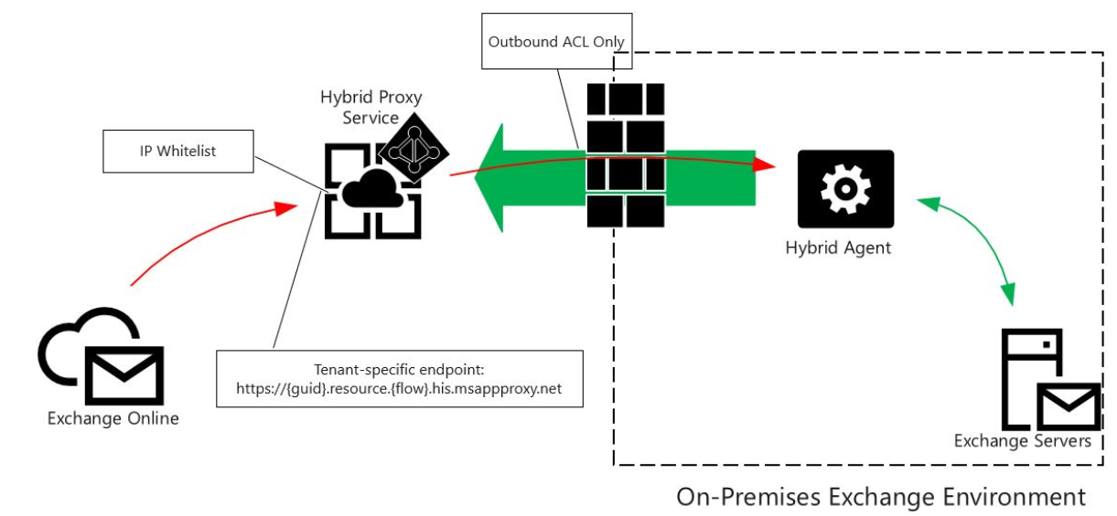
Examine Exchange Modern Hybrid and the Hybrid Agent
A core component of Exchange Modern Hybrid is the Hybrid Agent
As the hybrid agent takes over the communication between Exchange Online and your Exchange environment, it provides the following advantages:
No custom DNS changes No certificate changes
No firewall/network changes Protect your Exchange servers

Slide 18
Review mail flow options for a hybrid deployment
Inbound email flow from the Internet
Inbound to on-premises Exchange Server
Inbound to Exchange Online
Outbound email flow to the Internet
Deliver Internet-bound messages directly
Route all Internet-bound messages through your on-premises Exchange servers
Route all Internet-bound messages through Exchange Online
Email flow between Exchange Online and the Exchange Server on-premises organization

Slide 19
Prepare to run the Hybrid Configuration Wizard
Before running the HCW, ensure the prerequisites are satisfied:
Deploy Exchange Server 2010 or later
Deploy Microsoft 365 for Enterprise or Business
Register custom domains
Deploy Azure AD Connect for AD synchronization
Configure AutoDiscover DNS records in non-Modern Hybrid deployments
Install Exchange services and assign them a valid digital certificate
Ensure mail flow is configured correctly to support hybrid mail flow
Configure Edge Synchronization (for Edge Transport) when applicable
Configure Unified Messaging-enabled (UM) mailboxes when applicable
Complete the following high-level steps to configure a hybrid deployment:
Sign up for Microsoft 365
Register your custom domains with Microsoft 365
Remediate identity within Active Directory
Deploy Azure AD Connect
Ensure Exchange Server is properly deployed

Slide 20
Examine hybrid deployment best practices
Use the Hybrid Configuration Wizard (HCW) app
Understand the requirements of Minimal Hybrid, Exchange Classic, and Exchange
Modern Hybrid
Understand why your organization wants to implement a hybrid deployment
Start slowly, and then speed up when everything works
Do not change the MX resource record at first
Use multiple MRS Proxy endpoints where possible

Slide 21
Knowledge Check
Test your knowledge by answering the Knowledge Check questions at the end of this Learn module

Slide 22
Summary
This Module examined the following items related to planning and configuring a hybrid deployment using the Hybrid Configuration Wizard:
The Hybrid Configuration Wizard (HCW) is the tool used for setting up a hybrid configuration between an on-premises Exchange organization and Microsoft 365
The HCW includes a feature called Organization Configuration Transfer (OCT), which enables an organization to complete a one-time transfer of its organizational settings from its Exchange Server on-premises environment to Exchange Online
The Hybrid Agent connects to your Exchange Servers and the Hybrid Proxy Service located in your Microsoft 365 tenant
Any future requests from Exchange Online that require a connection to your Exchange Server will then be communicated using the Hybrid Agent
Complete the following high-level steps to configure a hybrid deployment:
Sign up for Microsoft 365
Register your custom domains with Microsoft 365
Remediate identity within Active Directory
Deploy Azure AD Connect
Ensure Exchange Server is properly deployed

Slide 23
Lab 7-Exercise 1 – Prepare Azure AD for a Hybrid Deployment

Slide 24
Lab exercises
Exercise 1: Prepare Azure AD for a Hybrid Deployment
Task 1
Configure your Tenant to Support Local Mail Transport
Task 2
Create a Custom Domain in Microsoft 365
Task 3
Configure the UPN Name for the Custom Domain
Task 4
Enable Exchange for the Custom Domain
Task 5
Migrate
On-premises user accounts to the Custom Domain

Slide 25
Module 3: Plan Mailbox Migrations

Slide 26
Introduction
This Module examines the importance of deciding the best migration option for your environment
After this Module, you’ll be able to:
Describe the migration and coexistence strategies with Exchange Online
Identify the factors that help determine which migration option to use
Identify when to change the DNS MS record to point to Exchange Online during a migration

Slide 27
Explore migration options to Exchange Online
Migration Approaches
Cutover Migrations
IMAP Migration
Staged Migration
PST Migrations
Minimal Hybrid Configuration/ Express Migration
Third-Party Migration
Full Hybrid Configuration

Slide 28
Determine which migration option to use
Exchange Online Migration Decision Matrix
What is the current email system
Which Exchange Server Version?
Is there any need for long term mail co-existence
Rich
Exchange
Server
Exchange 2003
or later
Yes
Hybrid Exchange/
Minimal Hybrid
Exchange 2000
or earlier
Exchange 2010
2013 or 2016
Third-party
No
How do clients connect
Is thee any need for long-term mail coexistence
How many users are there?
2,000
or over
Coexistence
IMAP
Yes
EX Version
Cross-Premises Coexistence
POP3 or
proprietary
No
Under
2,000
Simple
Can it be configured for IMAP?
How many users are there?
2,000
or over
Exchange 2003
2013 or 2007
Yes
Want more than just email folders
Under
2,000
No
Staged Exchange or
IMAP migration
Migration
Temporary
PST migration or 3rd party migration tool
IMAP migration
Cutover Exchange migration

Slide 29
Update DNS during a Microsoft 365 migration
The DNS MX record for a domain provides the main Internet SMTP message routing information and points to the target server for message delivery
You should consider multiple factors when deciding when to change your domain’s DNS MX record to point to Exchange Online in a Microsoft 365 migration
These factors are dependent on each type of migration
Cutover
Migration
Staged
Migration
Full or
Minimal Hybrid
Configuration
IMAP
Migration

Slide 30
Knowledge Check
Test your knowledge by answering the Knowledge Check questions at the end of this Learn module

Slide 31
Summary
This Module examined the following items related to planning mailbox migrations:
It’s important to understand the difference between migration and coexistence
Migration - the process of moving user data from a source messaging system to Exchange Online
Coexistence - the process of maintaining mailboxes simultaneously in both your existing on-premises Exchange Server environment and Exchange Online; coexistence is also known as a hybrid configuration
The DNS MX record for a domain provides the main Internet SMTP message routing information and points to the target server for message delivery
You should consider multiple factors when deciding when to change your domain’s DNS MX record to point to Exchange Online in a Microsoft 365 migration

Slide 32
Module 4: Run Mailbox Migrations

Slide 33
Module introduction
This Module examines how to plan for and run an IMAP migration, how to plan for a cross-tenant migration, and how to prepare source user objects for migration.
After this Module, you’ll be able to:
Describe the requirements for an IMAP migration and how it’s carried out
Move mailbox data using an IMAP migration
Plan for a cross-tenant mailbox migration
Prepare target user objects for a cross-tenant migration

Slide 34
Plan an IMAP migration
You need two things to migrate the contents of users' mailboxes from an IMAP messaging system to their Exchange Online mailboxes:
A CSV file that lists all the mailboxes to be migrated
The IMAP Migration wizard that’s located in the Exchange Admin Center
Limitations of the IMAP migration process:
You can only migrate message items in a user's mailbox; you can' migrate contacts, calendar items, or tasks
You can migrate a maximum of 500,000 mail items from a user’s mailbox
The maximum size of a single message item that can be migrated is 35 MB
The effect of an IMAP migration on users:
If you can’t access user mailboxes, you’ll have to reset your users’ passwords
Since your users won’t know the new password, they'll be unable to access their old mailboxes during the email migration

Slide 35
Run an IMAP migration
Administrator tasks
in the IMAP email system
Administrator tasks
in Microsoft 365
Administrator tasks
in domain registrar
Add users and assign licenses
1
Prepare your server and get the
information you need to migrate
Prepare: Verify your domain
2
2
Communicate changes to users
3
Set up admin credentials or get
or reset user email passwords
Create list of mailboxes to
migrate (CSV file)
4
5
Connect Microsoft 365 to
email system
6
Migrate mailboxes, then
verify the migration
7
Optimize email settings
(optional)
Configure domain to begin
routing email to Microsoft 365
8
9
Verify routing, then stop
email synchronization
10
Send a welcome letter
to users
11

Slide 36
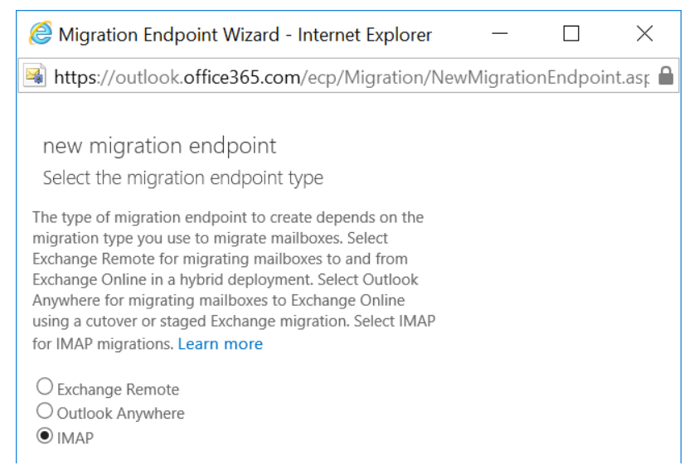
Move mailboxes using an IMAP migration
Steps for running your IMAP migration in the Exchange admin center:
Satisfy the migration prerequisites, such as:
  Register any SMTP domains in Microsoft 365
  Create all the target mailboxes in Exchange
  Online
  Create a migration endpoint to connect
  Microsoft 365 to your email system
Create an IMAP migration batch and
migrate your mailboxes
Stop the email synchronization and change
the DNS MX record of all your domains to
point to Microsoft 365
Allow either 72 hours for the final
delta-synchronization to complete or manually
start the migration batch again

Slide 37
Plan a cross-tenant migration
Cross-tenant migrations occur during mergers or divestitures when an organization must move its users' Exchange Online mailboxes into a new tenant
Cross-tenant Exchange mailbox migrations are done using Windows PowerShell
Cross-tenant migrations are started from the target tenant as migrations
Cross-tenant mailbox migration requirements:
Migrated users must be present in the target tenant's Exchange Online system as MailUsers, marked with specific attributes to enable the cross-tenant moves
You must have permissions to configure the Move Mailbox application in Azure, EXO Migration Endpoint, and the EXO Organization Relationship
At least one mail-enabled security group in the source tenant is required
Prepare the target (destination) tenant by creating the migration application and secret
Prepare the target tenant by creating the Exchange Online migration endpoint and organization relationship
Prepare the source tenant by accepting the migration application and configuring the organization relationship

Slide 38
Prepare source objects for a cross-tenant migration
Migrated users must be present in the target tenant's Exchange Online system as MailUsers, marked with specific attributes to enable the cross-tenant moves
For any mailbox moving from a source organization, you must configure a mail user object in the target organization
The system will fail moves for users that aren't properly configured in the target tenant
Users in the target organization must be licensed with appropriate Exchange Online subscriptions applicable for the organization
You may apply a license in advance of a mailbox move, but ONLY once the target MailUser is properly set up with an ExchangeGUID and proxy addresses
Applying a license before the ExchangeGUID is applied will result in a new mailbox provisioned in the target organization
You must ensure the target MailUser has no previous ExchangeGUID that doesn't match the Source ExchangeGUID
This situation can occur if the target mail end user was previously licensed for Exchange Online and provisioned a mailbox
If this situation occurs, you must clean up the cloud mail user using PowerShell to permanently clear the previous mailbox information

Slide 39
Knowledge Check
Test your knowledge by answering the Knowledge Check questions at the end of this Learn module

Slide 40
Summary
This Module examined the following items related to running mailbox migrations:
You need two things to migrate the contents of users' mailboxes from an IMAP messaging system to their Exchange Online mailboxes:
A CSV file that lists all the mailboxes to be migrated
The IMAP Migration wizard that’s located in the Exchange Admin Center
Completing an IMAP migration involves:
Satisfying the migration prerequisites
Creating an IMAP migration batch
Running the IMAP migration wizard
Cross-tenant migrations occur during mergers or divestitures when an organization must move its users' Exchange Online mailboxes into a new tenant
Cross-tenant Exchange mailbox migrations are done using Windows PowerShell

Slide 41
Lab 7-Exercise 2 – Configure your Hybrid Deployment

Slide 42
Lab exercises
Exercise 2: Configure your Hybrid Deployment
Task 1
Create Adatum’s hybrid Exchange deployment
Task 2
Configure Mail Flow settings
Task 3
Create on-premises user mailboxes for testing
Task 4
Create a new Outbound Connector

Slide 43
Module 5: Troubleshoot Hybrid Deployments

Slide 44
Module overview
This Module introduces troubleshooting techniques for hybrid deployments
After this Module, you’ll be able to troubleshoot:
Directory synchronization
Pass-Through Authentication and Single Sign-On
Transport with Exchange Online
Client Access in Coexistence
Mailbox Replication Service

Slide 45
Troubleshoot Directory Synchronization
Once an organization establishes directory synchronization, it may occasionally experience issues with the synchronization or with individual objects syncing, such as:
Sync failed completely, which can be caused by:
The synchronization service stopped
Connector credentials are invalid
Configuration is set incorrectly
Single user object didn’t sync, which can be caused by:
Duplicate objects in Azure Active Directory
The object is filtered out
Invalid characters are present on the object

Slide 46
Troubleshoot Pass-Through Authentication and Single Sign-On
Users are quick to report when Azure AD Connect pass-through authentication (PTA) or single sign-on (SSO) aren’t working or are in a degraded state
When pass-through authentication (PTA) isn’t working, users are still prompted to input their credentials, but validation will fail. Troubleshooting includes:
If no users can sign in:
Verify the Microsoft Azure Active Directory Application Proxy Connector (WAPCSvc) is running
Verify Port 443 is enabled for outbound from the PTA server to Microsoft Azure
If one user is unable to sign in:
Review the sync logs to verify whether the user account synced to Azure AD
Verify the user account is enabled and not expired and the password has also not expired
When SSO isn’t working, users must manually specify their password. Troubleshooting includes:
Verify the service URL (https://autologon.microsoftazuread-sso.com/) is defined in the Intranet zone
Verify client devices are joined and connected to the on-premises domain
Verify the SSO prerequisites are met
Verify that SSO is enabled
The Remote Connectivity Analyzer’s Microsoft 365 Single Sign-On Test tool can help organizations troubleshoot SSO

Slide 47
Troubleshoot transport with Exchange Online
Having a thorough understanding of how mail transport works in a hybrid environment
is helpful for troubleshooting
The key areas that affect transport in a hybrid environment include:
Mail flow
Connectivity
configuration
DNS
Third-party
hardware and
software

Slide 48
Troubleshoot client access in coexistence
When an organization's on-premises environment runs Hybrid coexistence, troubleshooting client connectivity becomes more complex
Not only must the organization manage its existing Exchange on-premises servers, but it must manage Exchange Online mailboxes
Verify the following items to prepare for client access in coexistence:
Firewalls – If an organization uses Modern Hybrid, firewall rules to support inbound Exchange Online connectivity aren't necessary; however, in all scenarios, outbound HTTPS connectivity from Exchange Servers is required
Certificates and DNS - If an organization uses Classic Hybrid, then it must use trusted, third-party Digital Certificates for HTTPS services, and the Digital Certificates must have Subject Alternative Names that match the configured Internal and External URLs and DNS names
Troubleshooting steps when client access issues occur in coexistence scenarios:
Run the Outlook Test Email AutoConfiguration tool
Test a new profile setup in Outlook
Run the Remote Connectivity Analyzer tool

Slide 49
Troubleshoot the Mailbox Replication Service
When you move mailboxes, public folders, and .PST files, the backend process that handles the data move is the Mailbox Replication Service (MRS)
Organizations typically troubleshoot MRS when they have moving issues, or when move performance is poor
Some indirect troubleshooting of MRS is often beneficial as well, such as collecting statistics to find information about move requests
Organizations can customize message throttling by adjusting settings in the MRS config file
Exchange Server uses dynamic message throttling, which can be disabled and replaced with customized throttling
The settings in the MRS config file are only used if dynamic throttling is disabled
If you change the settings in the MRS config file, you must restart the Microsoft Exchange Mailbox Replication service

Slide 50
Knowledge Check
Test your knowledge by answering the Knowledge Check questions at the end of this Learn module

Slide 51
Summary
This Module examined the following items related to troubleshooting hybrid deployments:
Messaging administrators must know how to troubleshoot and resolve common sync issues to maintain a healthy sync environment. Common issues include:
Sync fails completely - often the result of a backend configuration or communication problem, and less likely a problem with user or group objects
Single user object doesn’t sync - When you have a functional sync, but you have a single object that doesn’t sync, it typically means there’s a problem with that object
When pass-through authentication isn’t working, users are still prompted to input their credentials. However, there will often be a long pause during validation, and it will fail with an error message
When troubleshooting mail flow, you can start your troubleshooting at the edge (often Edge Transport servers or similar)
When an organization troubleshoots client access in coexistence, the problem is often limited to a single protocol
Organizations typically troubleshoot the Mailbox Replication Service (MRS) when they have moving issues, or when move performance is poor

Slide 52
Lab 7 – Exercises 3 – Test your Hybrid Deployment

Slide 53
Lab exercises (continued)
Exercise 3: Test your Hybrid Deployment
Task 1
Test the Hybrid Topology
Task 2
Migrate an On-Premises Mailbox to test your connectors
STOP! See note below
Task 3
Test the newly migrated mailbox
IMPORTANT: Migrating an on-premises mailbox to Microsoft 365 in Exercise 2, Task 2 can take up to an hour to complete. You cannot test the newly migrated mailbox in Task 3 until the migration is complete.
To avoid sitting around for an hour, once you finish Task 2 perform the Paper-based lab exercise outlined in the next slide while the migration runs. Once the class has finished the paper-based lab, return to Exercise 2, Task 3 to test the newly migrated mailbox.

Slide 54
Exercise – Planning a Mail Migration to Microsoft 365

Slide 55
Paper-based lab exercise
Planning a Mail Migration to Microsoft 365
Fabrikam, Inc. is moving to Microsoft 365 as its cloud solution. The Enterprise Administrator has requested that you review the company’s footprint and then develop a plan for migrating a group of on-premises mailboxes to Microsoft 365 as part of its mail migration pilot project. As part of that analysis, he has asked that you address some specific issues that concern him.
Download the planning document from GitHub – Located here
Step 1
Each student should review the information provided and answer the questions in the document
Step 2
After completing the assessment, exchange it with one of your fellow students and review each other’s assessment. Identify the key differences between your
two proposals
Step 3
Review your assessments with the class and come to a final solution
for Fabrikam
Notes:
A copy of the planning document is available in the MCT DLC for this course. The document has suggested solutions for each question. Use these suggested answers to help drive the discussion. You should allot approximately 1 hour for this exercise.

Slide 56
Learning Path Review

Slide 57
Discussion – Learning Path review
What are your key takeaways from this Learning Path, and why?
What are the key features discussed in this Learning Path that you foresee implementing at your organization?

Slide 58
Closing Slide

