Slide 1

Module 1: Managing the Transport Pipeline

Slide 2
Module Agenda
Overview of Transport Services
Configuring Message Transport
Lab 1-Exercise 1 – Create Connectors
Managing Transport Rules

Slide 3
Lesson 1: Overview of Transport Services

Slide 4

Lesson Introduction
Mail flow and message transport describe the way
in which mail is delivered from external or internal senders to a recipient in your organization
After completing this lesson, you will be able to:
Describe the transport components of Exchange
Plan an effective message routing for your organization
Modify message flow for your organization
Describe which transport agents exist and what they do

Slide 5
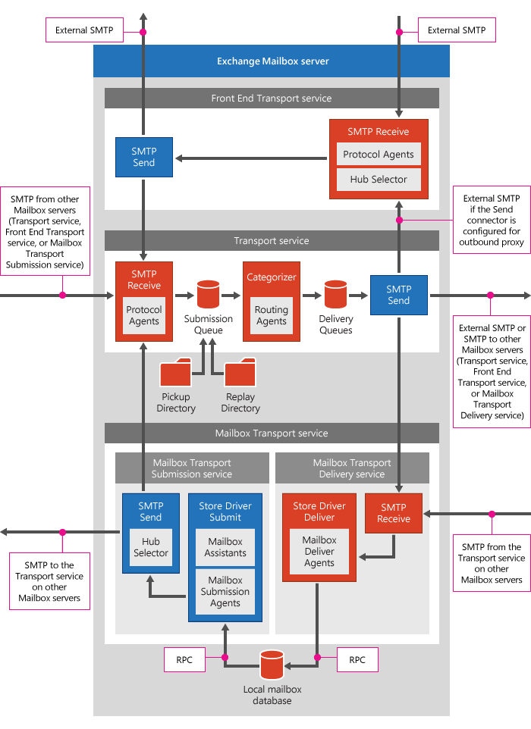
Message Transport Components
Message transport components include:
Message transport services:
  Front-End transport service
  Transport service
  Mailbox transport service
SMTP send and receive components
Pickup and replay directories
Submission queue
Categorizer
Delivery queues
Store driver

Slide 6
Message Routing
The primary task of the Transport service that exists on Mailbox servers is to route messages received from users and external sources to their final destinations
Routing destinations:
Mailbox Database
Connector
Distribution group expansion server
Delivery groups represent the collection of transport servers that are responsible for delivering messages to a specific routing destination. Each routing destination has its own delivery group
Types of delivery groups include:
Routable database availability group (DAG)
Mailbox delivery group (Exchange Server 2013, 2016, 2019)
Connector source servers
Server list
Active Directory Site

Slide 7
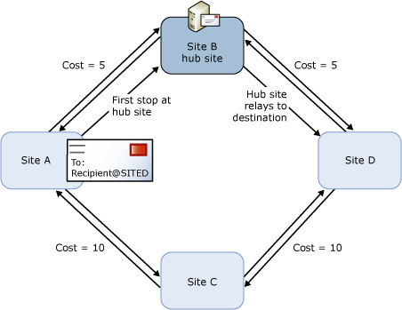
Configuring Message Transport
Logic used by Exchange to select the routing path for a message includes (in order):
Least-cost routing path
Least number of hops
Name of the AD site closest to the destination in alphanumeric order
Other considerations:
Connectors that are configured with message size limits smaller than the size of the message are eliminated from consideration
Delivery groups can span multiple Active Directory sites
If the destination on the least-cost path cannot be contacted and the next closest site on the least-cost path is not available, then the Transport service tries one hop back again
When a hub site exists along the least-cost routing path between two Mailbox servers, the messages are routed to a Mailbox server in the hub site for processing before they are relayed to the destination server

Slide 8
Transport Agents
Transport agents process email messages that pass through the transport pipeline on Transport service components
Because all messages are processed by the Transport service for delivery, you’re guaranteed that all messages are evaluated by transport agents installed on the server
Key considerations involving transport agents include:
Priority of transport agents
Built-in transport agents
Custom transport agents
Viewing enabled transport agents

Slide 9
Lesson 2: Configuring Message Transport

Slide 10
Lesson Introduction
Configuring the organizational settings for message transport includes:
Configuration of different transport options
Managing connectors and domains
Overall message moderations
After this lesson, you will be able to:
Configure the different transport options
Plan and set up domains for your organizations
Understand how receive and send connectors work
Describe how message moderation for different recipients work

Slide 11
Configuring Message Transport Options
Some transport options that are valid for entire Exchange organizations are set at the organization level
These transport settings apply only to those servers in the organization running Exchange Server
Organization-level transport settings include:
Maximum message sizes
Maximum number of recipients
Postmaster address
Shadow redundancy settings
SafetyNet settings

Slide 12
Configuring SMTP Domains
Exchange supports two types of SMTP domains:
Accepted domains – Domains from which the Exchange organization receives and processes messages
Remote domains – They don’t manage which mails are accepted or rejected in your organization; instead, they define settings for message delivery to SMTP domains that
are external to your Exchange Server organization
Three types of Accepted domains:
Authoritative domain
Internal relay domain
External relay domain

Slide 13
Configuring Connectors
Connectors are a collection of instructions that customize the way your email flows to and from your Exchange Server or Exchange Online organization
There are different connectors available in Exchange Server and Exchange Online that serve a similar purpose
Exchange Server uses connectors to enable incoming and outgoing mail flow on Exchange servers, and between services in the transport pipeline on the local Exchange server. Connectors in Exchange Server include:
Receive connector
Send connector
Delivery agents and Delivery Agent Connectors
Foreign connectors
Exchange Online uses connectors to customize the way your email flows to and from your Exchange Online organization

Slide 14
Message Moderation
Message moderation is a feature you can activate on user mailboxes and distribution groups to implement an approval workflow for messaging
Message moderation can be implemented to:
Protect large distribution groups
Require approval by a manager
Require multiple layers of approvals
Require approval based on message content

Slide 15
Lesson 3: Lab 1 – Exercise 1

Slide 16
Lab Exercise
Lab Introduction
IMPORTANT: Read through the lab introduction that appears in the student manual before you start this lab
Exercise 1: Create Connectors
Task 1
Create a Custom Receive Connector
Task 2
Create a Custom Send Connector

Slide 17
Lesson 4: Managing Transport Rules

Slide 18
Lesson Introduction
Transport rules: Powerful configuration to control the message flow in your organization
After this lesson, you will be able to:
Understand what transport rules are
Describe how transport rules are working
Configure custom transport rules
Describe how transport rules can be used
for data loss prevention

Slide 19
Overview of Transport Rules
You can use transport rules in Exchange to look for specific conditions on messages that pass through your organization and take action on them
Transport rules apply policies on messages while they’re in transit through the transport pipeline
The purpose of transport rules is to help protect corporate network resources and data by applying an action to messages meeting specified conditions
Two types of transport rules:
Transport rules on mailbox servers
Edge Transport rules on Edge Transport servers for messages sent to or received from the internet

Slide 20
How Transport Rules Work
After you create a transport rule, it gets stored in Active Directory so that all Exchange servers can access it, and any server can apply the configured rule on messages in transport
Because transport rules for Exchange mailbox servers are stored in Active Directory, Edge Transport servers that are regularly non-domain joined cannot access them:
To accommodate transport rules for inbound and outbound Internet mail flow, you can create Edge Transport rules that reside on Edge Transport servers
Transport rules consist of the following components:
Conditions
Exceptions
Actions
Properties

Slide 21
Configuring Transport Rules
Transport rules provide you with an almost limitless ability to control messaging in your Exchange Server organization
Messaging administrators must carefully plan their transport rules to ensure they behave as intended; otherwise, you could accidentally delete messages, or deliver messages to unintended recipients
Recommendations for planning transport rules:
Carefully plan conditions and exceptions
Plan for Transport rule priority and order
Use regular expressions to check message contents
Test application of transport rules
Plan for transport rule limitations on encrypted and digitally signed messages
Consider transport rule recovery

Slide 22
Lesson 5: Module Review

Slide 23

Discussion – Module Review
What are your key takeaways from this module, and why?
What are the key features discussed in this module that you foresee implementing at your organization?

Slide 24
Closing Slide

