Slide 1
Module 3: Managing Message Hygiene

Slide 2

Module Agenda
Planning for Message Hygiene
Managing Anti-Malware And Anti-Spam Policies
Lab 3-Exercise 1 – Create Hygiene Filters
Managing Advanced Threat Protection

Slide 3
Lesson 1: Planning for message hygiene

Slide 4
Lesson overview
In this lesson, you will learn about EOP features and functionality and how to plan messaging routing for this service
After this lesson, you will be able to:
Explain the use and features of Exchange Online Protection
Plan message routing for Exchange Online Protection
Investigate the different available reports and logs

Slide 5
Exchange Online Protection (EOP) overview
EOP
Corporate Network
or Exchange Online
Inbound and Outbound email filtered through EOP

Slide 6



Planning message routing for EOP
Mail flow from Microsoft 365 to your email servers
Your on-premises environment
Your Microsoft
365 environment
Internet
John@Contoso.com
Bob@Contoso.com
Sun@FabrikamInternet.com
Connector
Connector
SMTP-based email servers you manage
Firewall
Port 25 must be open
Mail flow from your email servers to Microsoft 365. Also relays Internet mail sent from your email servers
All mail flow to or from the Internet is delivered via Microsoft 365. No connector is needed

Slide 7

Monitoring and reporting
Security & Compliance Center reports
Scheduled mail protection reports
Reporting using web services
Message trace

Slide 8
Lesson 2: Managing Anti-malware and Anti-spam policies

Slide 9
Lesson overview
In this lesson, you will review the anti-malware and anti-spam protection that Exchange Server and Online Protection provide, and you will learn how to configure SPAM and malware filters, policies, and settings to provide protection for your users
After this lesson, you will be able to:
Understand the different message header fields relevant for spam and spoofing protection
Configure antispam and antimalware filters in Exchange Server
Using additional features for outbound spam filtering and quarantine
Implementing protection features against phishing and spoofing
Create transport rules for custom requirements

Slide 10
Message headers and spam confidence levels
Anti-Spam Message Headers
Spam Confidence Levels (SCL)

Slide 11

Anti-spam and Anti-malware overview
Anti-spam and anti-malware filtering in Exchange Server

Slide 12
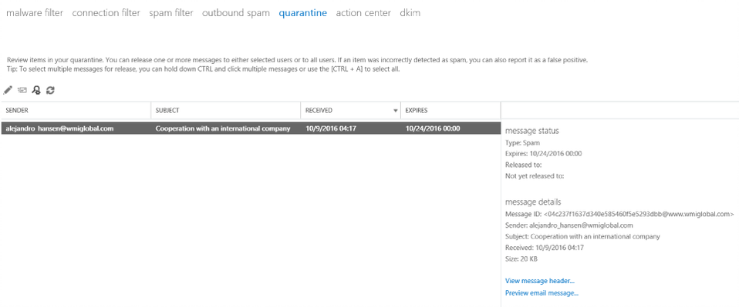
Managing anti-spam protection

Slide 13
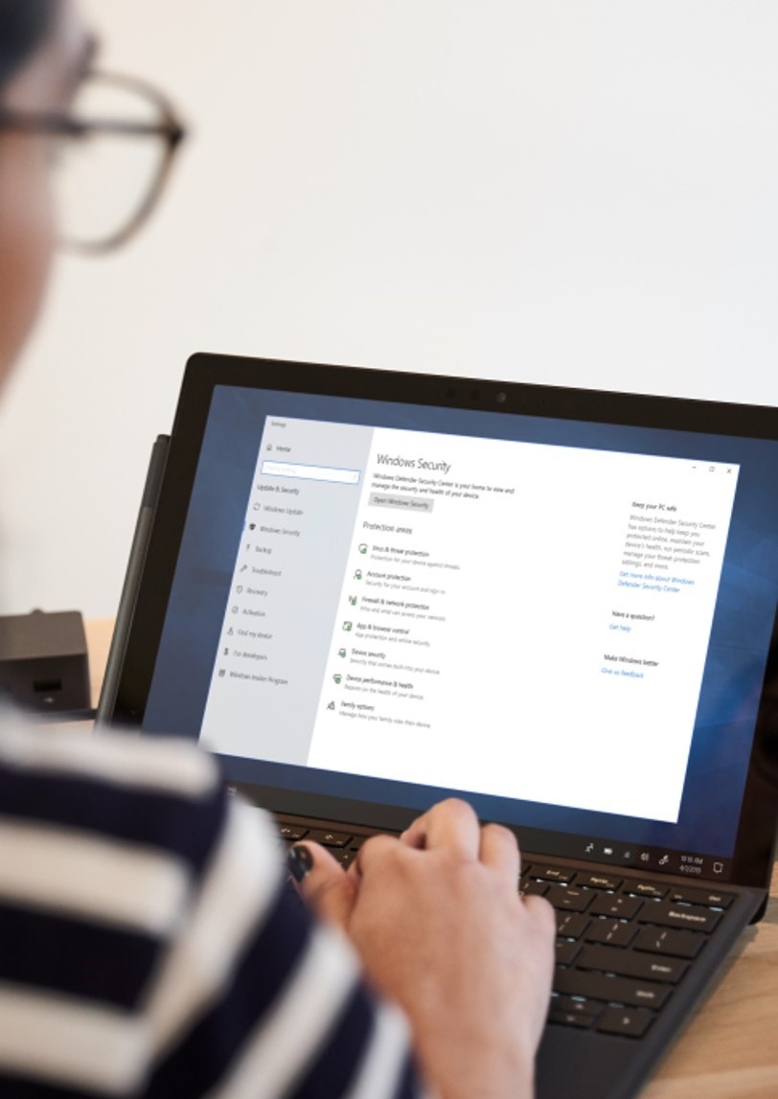
Managing anti-malware protection
Anti-malware policies
Anti-malware server settings
Anti-malware scripts

Slide 14

Using outbound spam settings, quarantine and best practices
Outbound Spam
Quarantine
Unblock users from the SCC
Best Practices for Deploying an
Anti-Spam Solution

Slide 15
Managing spoofing protection
1
SPF pass DKIM pass
2
SPF fail DKIM pass
Contoso.com
Woodgrovebank.com
Outlook.com
Mail Server
Mail Server
Mail Server
Message sent from IP address #1
Message sent from IP address #25
1
2
DKIM signature
DKIM signature

Slide 16
Managing phishing protection
Anti-phishing policies provide additional protection
Anti-phishing policies are managed in the Security & Compliance Center

Slide 17
Configuring transport rules
Bypass Spam Filtering configuration
Add Disclaimers configuration

Slide 18
Lesson 3: Lab 3 – Exercise 1

Slide 19
Lab exercises
Exercise 1: Create Hygiene Filters
Task 1
Create a Malware Filter
Task 2
Create a Connection Filter
Task 3
Create a Spam Filter

Slide 20
Lesson 4: Managing advanced threat protection

Slide 21
Lesson overview
Microsoft 365 ATP protects users from advanced threats through features such as safe attachments and safe links. ATP also generates reports which provide administrators with insight into attacks targeting their tenants through email.
After this lesson, you will be able to:
Describe the features of Advanced Threat Protection
Configure Safe Attachment policies
Create Safe Links policies
Understand the spoof intelligence features
Know how ATP anti-phishing policies work

Slide 22

Advanced threat protection overview
EOP – The sender's reputation is protected by sending messages through a “high risk” pool to ensure protection of the Organization’s reputation
Safe Attachments — protects users against exploits in email attachments
Safe Links – protects users from sites with malicious content, i.e. phishing sites
1
Microsoft 365
Sender
2
Detonation chamber (sandbox)
Behavioral analysis with machine learning
Executable?
Registry call?
Elevation?
Safe Attachments
Supported file type
Clean by AV/AS filters
Not in Reputation list
Exchange Online Protection
Multiple filters
Three antivirus engines
2
1
3
3
Safe Links
Continuously updated lists of malicious URLs
URL detonation
Unsafe
Safe
Safe Links rewrite
Recipient

Slide 23

Safe attachments
Safe Attachment Policies
Dynamic Delivery

Slide 24
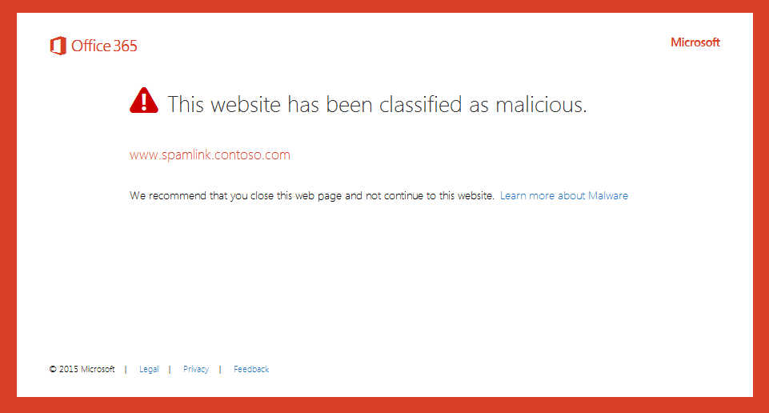
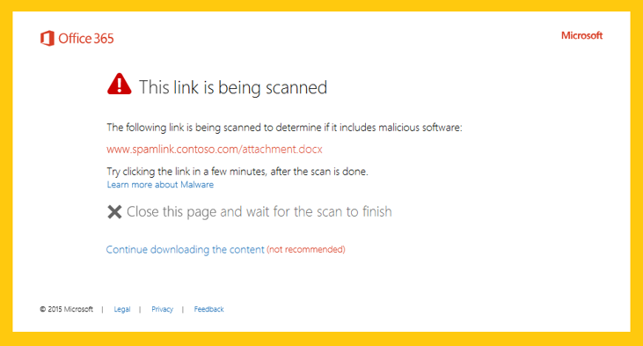
Safe links

Slide 25
Spoofing intelligence
Plan for spoof intelligence
Managing spoof intelligence

Slide 26
ATP anti-phishing
Managing ATP anti-phishing policies
ATP anti-phishing policy options

Slide 27
Lesson 5: Module Review

Slide 28
Discussion – Module Review
What are your key takeaways from this module, and why?
What are the key features discussed in this module that you foresee implementing at your organization?

Slide 29
Closing Slide

