Slide 1
Module 7:
Managing Role-Based Permissions

Slide 2
Module 3 Agenda
Managing Admin Roles
Managing User Roles
Exchange Setup – RBAC and AD Split Permission
Lab 6-Exercise 1 – Manage Roles and Permission Policies

Slide 3
Lesson 1: Managing Admin Roles

Slide 4
Lesson overview
This topic will examine the basics of admin roles that are managed through RBAC
After this lesson, you will be able to:
Describe how RBAC is used to assign roles to users
Understand what management role group for administrative tasks are
Assign the built-in management roles for administration
Create custom management roles and assign them through role assignment policies to users
Troubleshoot RBAC management roles

Slide 5
Introduction to role-based access control
Individual administrators
Role group 1
Members added to role group
Roles applied to members
Role group 2
Roles added to role group
Role 1
Role 2
Role 3
Role 4

Slide 6
Introduction to management role groups
Role Type: Help Desk
Role:
Help Desk
Role:
Seattle Help Desk
Role:
Perth Help Desk
Role:
Perth Sales
OU Help Desk
Role:
Perth Support
OU Help Desk
Role:
Perth
Junior Help Desk

Slide 7
Built-in management role groups
Exchange includes several built-in role groups, each of which provides permissions to manage specific areas in Exchange
Microsoft 365 permissions in Exchange Online

Slide 8

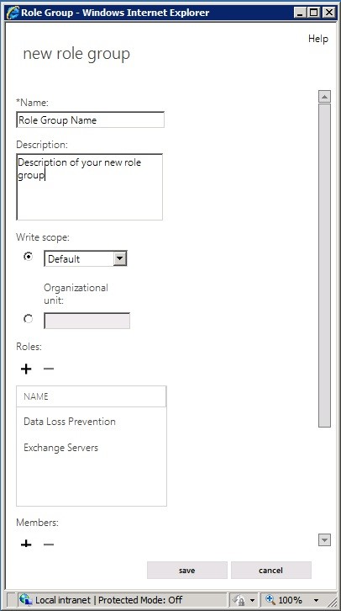
Working with admin roles for role assignment policies

Slide 9
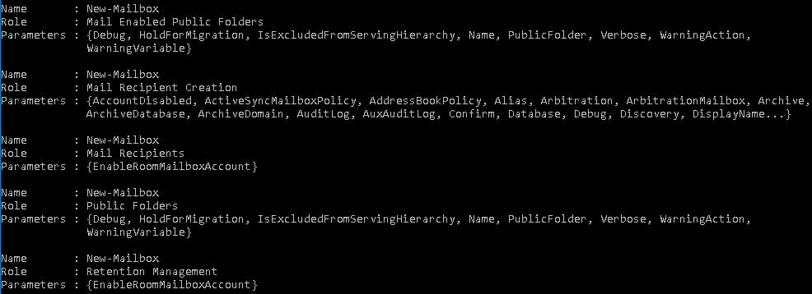
Troubleshooting RBAC

Slide 10
Lesson 2: Managing User Roles

Slide 11
Lesson overview
RBAC is primarily designed for delegating and managing administrative permissions
After this lesson, you will be able to:
Describe the built-in end-user roles
Configure role assignment policies
Create new custom roles and role assignment policies

Slide 12
Built-in role assignment policies
You can use the EAC to assign default roles to a role assignment policy
To view all user roles available in your organization, you can run
a command in the Exchange Management Shell

Slide 13
Working with management role assignment policies
A mailbox can have only one role assignment policy. All users, including administrators and specialist users are assigned one role assignment policy
You can change the management role assignment policy assigned to a mailbox
When you change a mailbox's assignment policy, the change takes effect as soon as the user refreshes the connection, such as the next time they log into their mailbox or open the mailbox options page

Slide 14
Creating new roles, role assignments, and scopes
Change a mailbox role assignment policy
Create custom role assignment policies

Slide 15
Lesson 3: Exchange Setup – RBAC and AD Split Permission

Slide 16
Lesson overview
A messaging administrator must plan and configure permissions carefully so as not to put their environment or their entire Active Directory on risk
After this lesson, you will be able to:
Understand the differences between shared permissions and split permissions
Describe multi-forest permissions
Identify the differences between the permission models

Slide 17
Introduction to split permissions
Organizations that separate the management of Exchange objects and Active Directory objects use what’s called a split permissions model
This is an important separation for many organizations because the Active Directory infrastructure often spans many locations, domains, services, applications, and even Active Directory forests
Split permissions typically make a distinction between the creation of security principals in Active Directory, such as users and security groups, and the subsequent configuration of those objects

Slide 18
Introduction to multiple-forest permissions
Exchange forest A
Exchange forest B
Organization Management
Recipient Management
Custom role group A
Mailbox Search role added
Message Tracking role added
Organization Management
Recipient Management
Custom role group A
Mailbox Search role added
Retention Management role added
Server scope A
Server scope B
Server A
Server B
Server C
Server D
Server E
Server F
Server G
Server H
Recipient scope
Mailbox 1
Mailbox 2
Mailbox 3
Mailbox 4
Mailbox 5
Mailbox 6
Mailbox 7
Mailbox 8
Mailbox 9
Mailbox 10
Forest scope A
Forest scope B

Slide 19
Differences in permissions
Configure for RBAC split permissions
Configure for Active Directory split permissions
Active Directory split permissions is a good choice for your organization
if the following are true
After you enable Active Directory split permissions, the following cmdlets are no longer available

Slide 20
Lesson 4: Lab 6 – Exercise 1

Slide 21
Lab exercises
Exercise 1: Manage Roles and Permission Policies
Task 1
Create an Admin Role
Task 2
Manage an Admin Role
Task 3
Create an Outlook Web App Policy
Task 4
Assign an Outlook Web App Policy to a user mailbox

Slide 22
Lesson 5: Module Review

Slide 23
Discussion – Module review
What are your key takeaways from this module, and why?
What are the key features discussed in this module that you foresee implementing at your organization?

Slide 24
Closing Slide

